Slide 1
Basic Battle Analysis
Battle Analysis Methodology
With
Kasserine Pass Battle Analysis

Slide 2
“Move your command, i.e. the walking boys, pop guns, Baker’s outfit and the big fellow to M, which is due north of where you are now, as soon as possible. Have your boss report to a French gentleman, whose name begins with a J, at a place which begins with D, which is five grid squares to the left of M.”
MG Lloyd Fredendall
US II Corp Commander
1943

Slide 3
Basic Battle Analysis
What is Battle Analysis?
A method used by the U.S. Army to provide a systematic approach to the study of battles, campaigns, and other operations.

Slide 4
Basic Battle Analysis
Battle Analysis Steps
Step 1: Define the Subject.
Step 2: Review the Setting (Set the Stage).
Step 3: Describe the Action.
Step 4: Assess the Significance.

Slide 5
Basic Battle Analysis
Step 1 -- Define the Subject
Identify Event (Where, Who, When)
Determine Research Material
Evaluate Material

Slide 6
Basic Battle Analysis
Step 1--Define the Subject
Identify Event (where, who, when)
Pick a subject appropriate to the level of interest.
Select a topic related to the types of lessons desired.

Slide 7
Kasserine Pass
Step 1--Define the Subject
Identify Event (where, who, when)
Kasserine Pass (Sidi-Bou-Zid)
  Leadership Lessons/Insights
  Combined Arms Example
  Changes in Doctrine
Elements of US 1st Armored Division vs. German 10th and 21st Panzer Divisions
14 & 15 Feb 1943

Slide 8
Basic Battle Analysis
Step 1--Define the Subject
Determine & Evaluate Research Material
Quantity and type of sources (books, articles, and other).
Quality of sources (content, bias, and intent).

Slide 9
Kasserine Pass
Step 1--Define the Subject
Determine & Evaluate Research Material
Books
  Kasserine Pass – Martin Blumenson
    Plus Chapter 8 “First Battles”
  Official History of the US Army in World War II
    Green Books
Articles
  Armor Magazine
    Sidi Bou Zid-A Case History of Failure
Other
  Center of Military History – Staff Ride
    Primary Sources on the WEB

Slide 10
Basic Battle Analysis
Step 2 – Review the Setting
(Set the Stage)
Strategic/Operational Overview
Study Area of Operations
Compare Antagonists
State Missions & Initial Disposition of Opposing Forces.

Slide 11
Basic Battle Analysis
Step 2--Set the Stage
Part A: Strategic/Operational Overview
Identify the War
Objective of principle Antagonists
Campaign Overview

Slide 12
Kasserine Pass
Step 2--Set the Stage
Part A: Strategic/Operational Overview
World War II : 1939 – 1945
Mediterranean Theater
Objectives:
  Allies – Invasion of North-West Africa
    Creation of a Second Allied Front – Relief for Soviet Union
    Control of the Suez Canal & Mediterranean Shipping Lane
    Attack weaker Axis Forces
  Axis – Control of North Africa to prevent Allied Goals and protect Italy/European holdings.

Slide 13
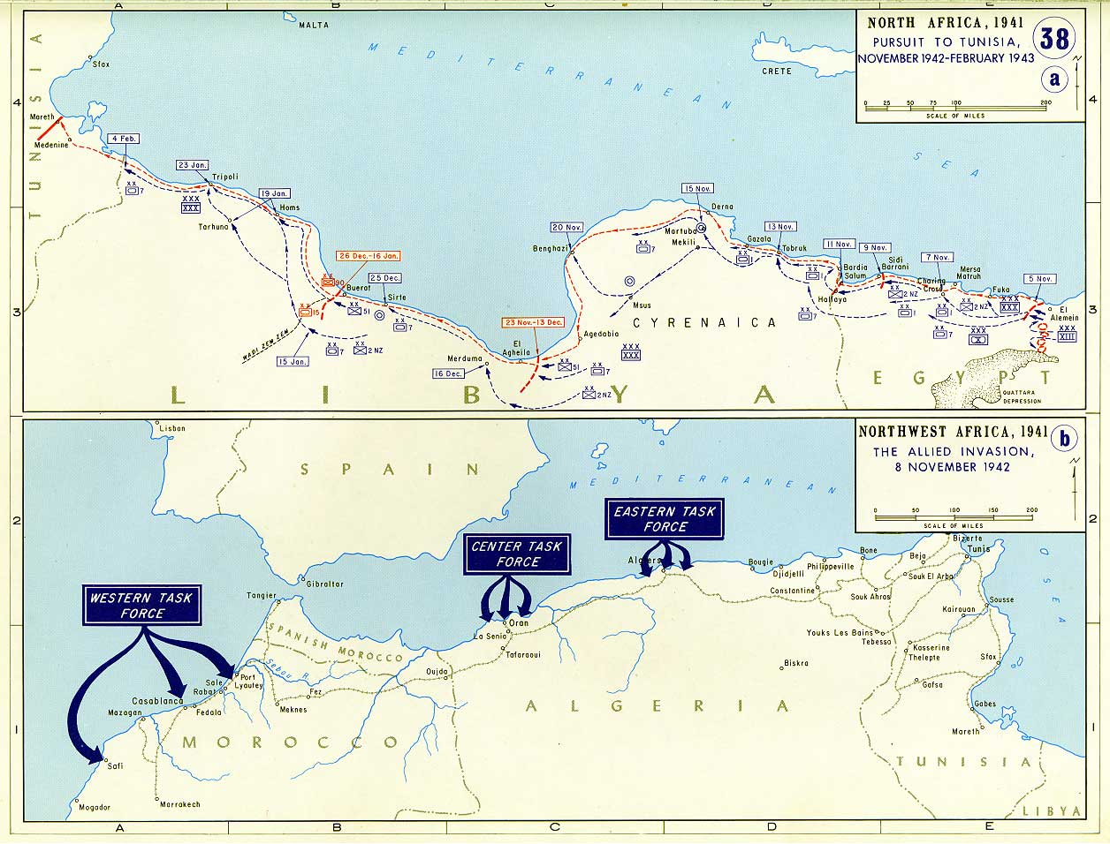
Operational Overview
xxxx
xxxx
PAA
EIGHTH

Slide 14
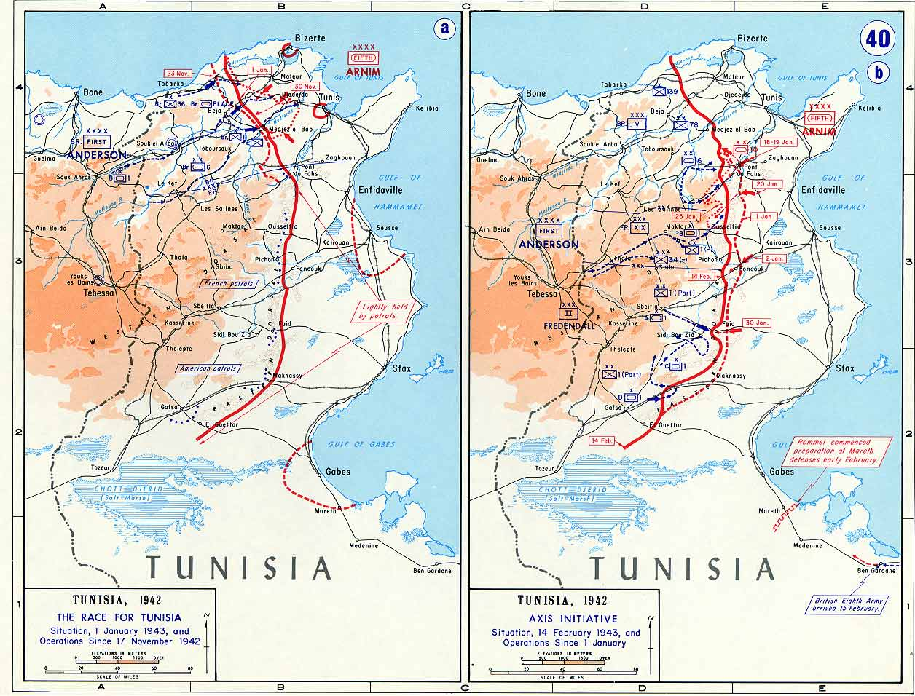
Operational Overview
x
B
1
x
C
1
x
A
1
xxxx
PAA
Notes:
By January – Axis forces won the race to secure Tunisia ports:
- Terrible weather turned terrain into quagmire
- Stiff Axis resistance
- Overextended Allied Supply Lines
Thus, the Allies decide to go on the defensive to let the weather clear, and allow supplies/more forces to catch up.
II US Corps is pushed south to protect the right flank.
BUT:
Several German Counterattacks along the Allied Defensive line reveal the French XIX Corps is very weak. Since Allied First Army (General Anderson) identified the center as the most likely area for the Germans to attack, 1/3 of the II Corps (1st Armored Division) was sent to back up the French. This spread the rest of II Corps dangerously thin.
About this time, PAA Shows up. Rommel arrived well ahead of Montgomery and was preparing a defensive line (Mareth). Seeing an opportunity to relieve pressure from his rear, he proposes an attack by forces from his army and the 5th Panzer Army on the weak Allied right flank. If successful, he would continue the attack into the Allied rear, and possibly reach the coast.

Slide 15
Basic Battle Analysis
Step 2--Set the Stage
Part B: Area of Operations
Weather
Terrain
  OAKOC

Slide 16
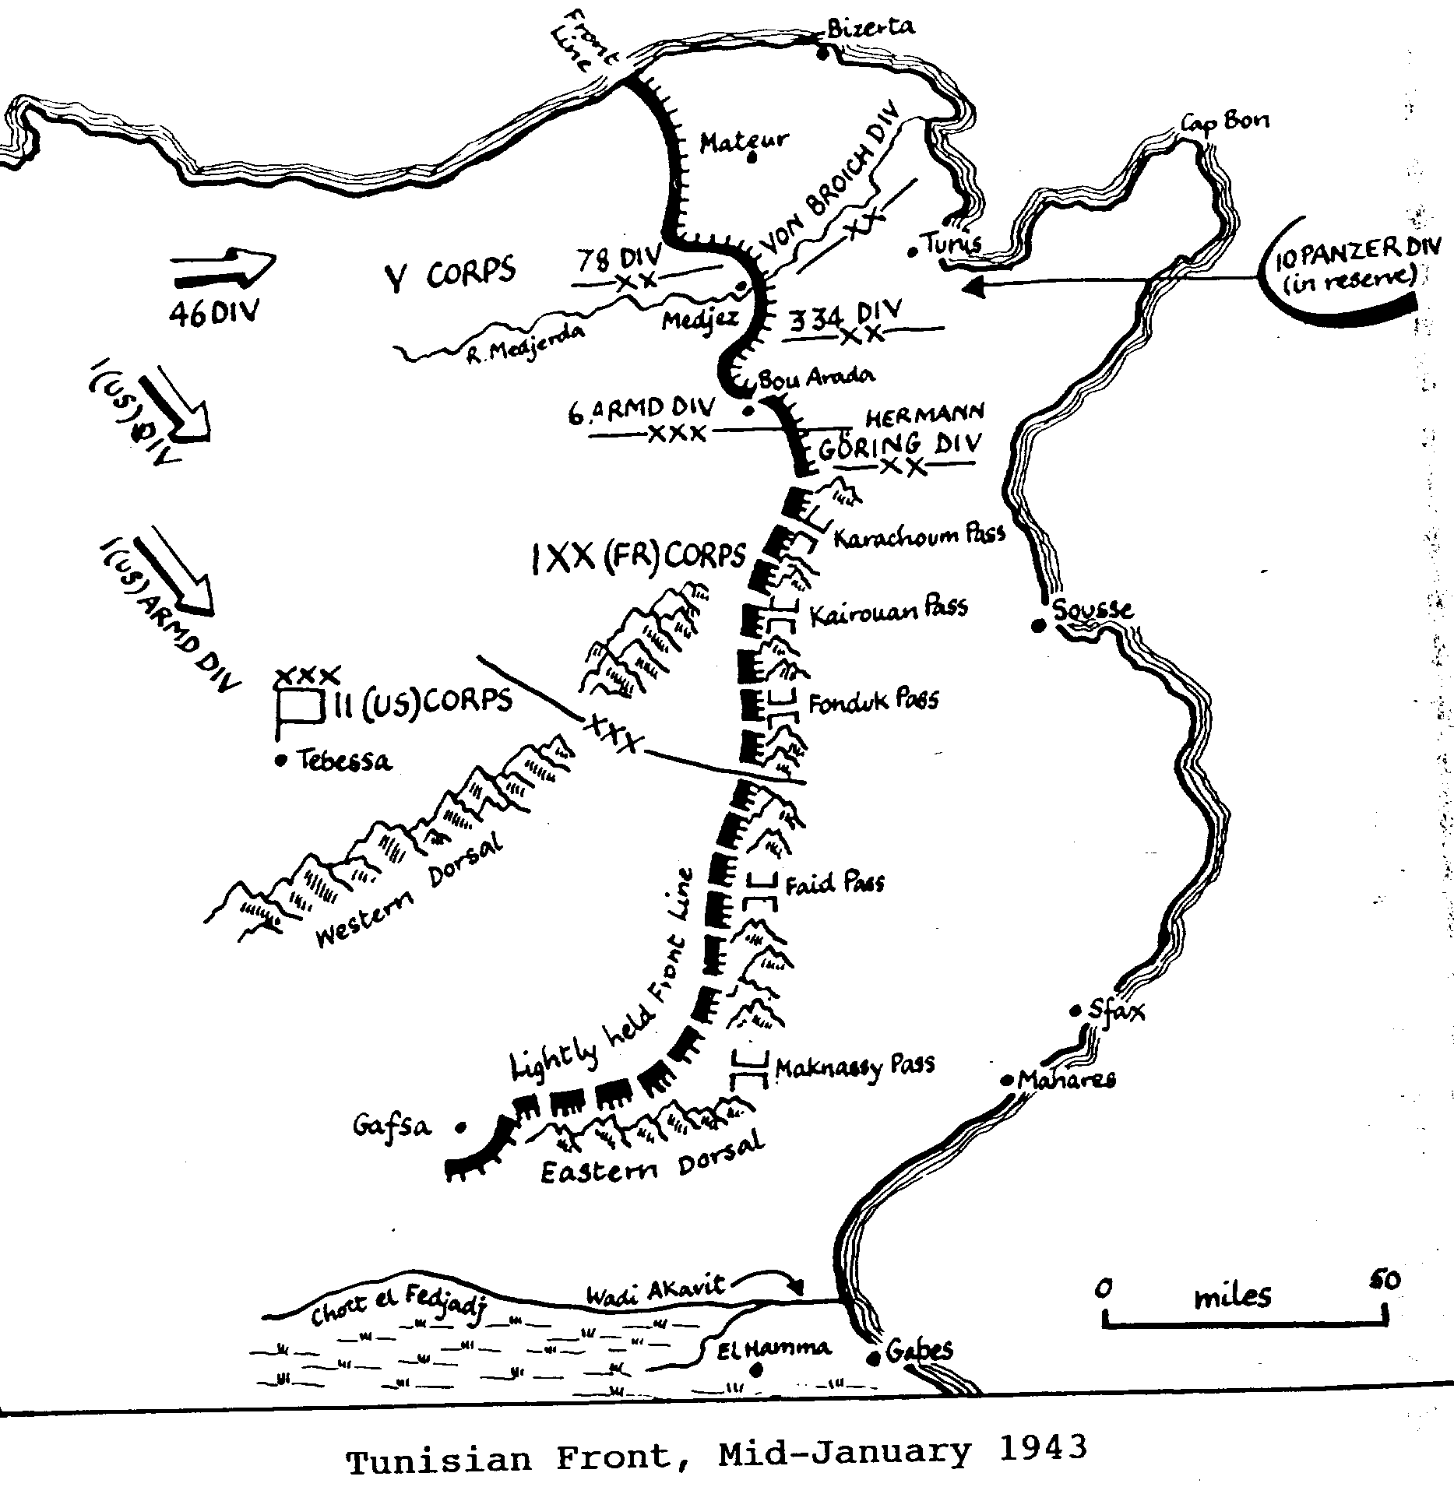
Kasserine Pass
WEATHER &
TERRAIN
x
B
1
x
C
1
x
A
1
***1st AD Disposition prior to German Offensive
Notes:
PART B of Set the Stage – Study of the Area
While the weather played little part in the events of the battle, it was significant in the events leading to the battle. As mentioned earlier, the weather was critical in slowing the Allied advance and forced them over to the defensive.
This sent the II Corp to defend the Allied Right flank vicinity the two mountain ranges that split Tunisia in half – the Western and the more dominant Eastern Dorsal. If you intend to travel either East or West, the only way to get through these ranges are through a series of passes. It was thus, these passes that the Americans placed forces to defeat any Axis forces trying to exit on the Western side.
Lets take a look at the Faid Pass, where the Battle of Sidi-Bou-Zid took place.

Slide 17
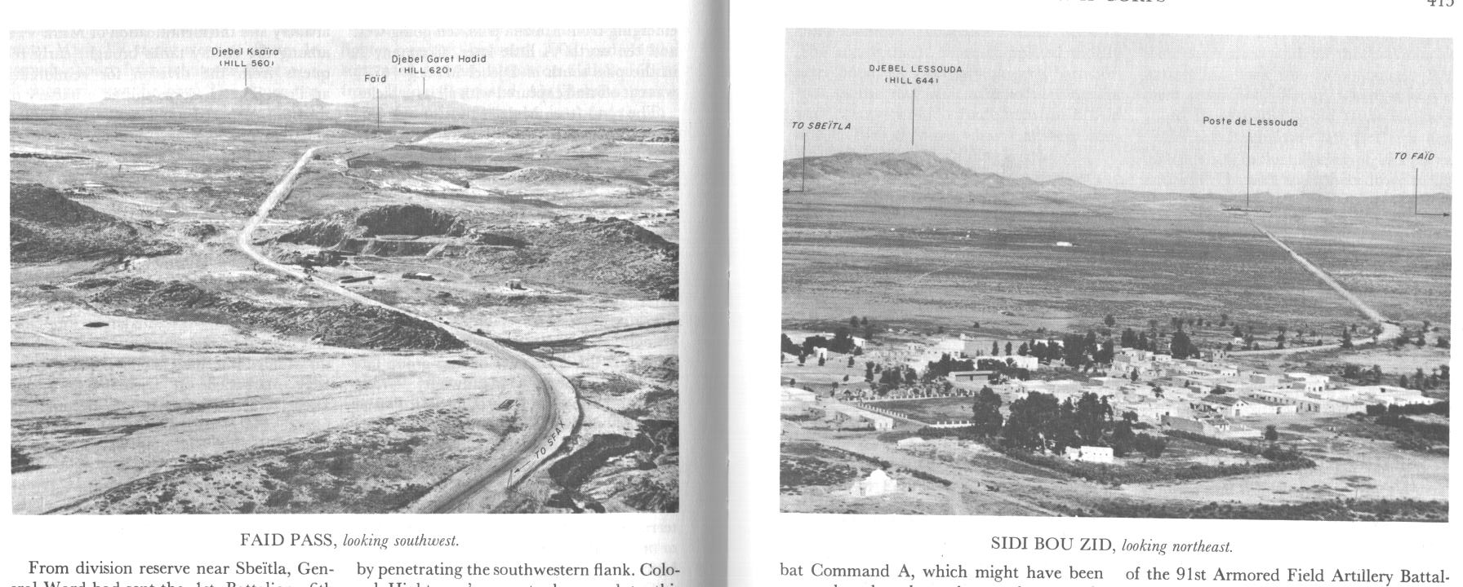
Djebel
Lassouda
Djebel
Hamra
Poste de Lessouda
Sadaguia
Sidi Salam
Faid
Sidi Bou Zid
Zaafria
El Fekka R.
Ain Rebaou
Garet
Hadid
Djebel
Ksaira
Bir el Hafa
Bir el Hafa
Terrain of
Faid Pass
&
Sidi Bou Zid Area
Maizila Pass
Notes:
High Desert. Point out the following:
Eastern Dorsal and Faid Pass and Maizila pass to the south. From the south you can enter the center plain along two routes, but both had very deep sand that would slow vehicles.
Sidi-Bou-Zid: Dominant ground around town was Djebel Lassouda, Djebel Ksaira and Garet Hadid.
Deep Wadi’s vicinity the river beds.
Show both pictures and Identify the high ground.
Sidi Bou Zid: From the US Army in World War II: “There was considerable mirage. The dips and folds of the plain were for the most part gradual, but several steep-sided deeper wadies creased it in general from north to south. Monotonous brown-grey of the landscape was marked at various points by patches of darker cactus, and the geometric figures of cultivated fields and orchards, and by small clusters of low, block shaped white buildings.”
What is the decisive terrain here?
II Corp Commander Identified the two hills as the decisive terrain based on map reconnaissance only. Hills were not in supporting distance of one another. He disregards the true decisive terrain – the pass that would have canalized the enemy.

Slide 18
Basic Battle Analysis
Step 2--Set the Stage
Part C: Compare Forces
Size & composition
Intelligence
Technology
C3
Doctrine & Training
Condition & Morale
Logistics
Leadership

Slide 19


Size & Composition
15 Feb 1943
14 Feb 1943
10TH PANZER DIVISION
Div Reserve
KG Gerhardt
CC C
1
6
DJ Lassouda
1
7
2
69
1
13
2
168
22 Pz IV
66 Pz III
2
1
C/701
KG Reimann
50 M4s
10 M4s
4 M3s
CC A Reserve
LTC Hightower
2
86
3
6
CC A
10 Tigers/10 Pzr IIIs
3 (-)
1
21st PANZER DIVISION
91(-)
40 M4s
A/701 (-)
KG Schuette
G
13
2
17
17 M4s
8 M3s
104
B/701
12 M3s
10 Pz IV
Garet Hadid
20 Pz III
DJ Ksaira
168
KG Stenkhoff
3
168
1
5
2
5
104
20 Pz IV
** Not Complete Task Organizations
40 Pz III
Notes:
At this time, a US Armored Division has 6 Battalions of Armor – two light battalions (M3 Stuarts – almost useless by this time) and 4 Medium battalions with M4 Sherman’s or M3 Lee’s. The Division has Brigade Level Headquarters called Combat Commands and can be task organized with any number of battalions the mission requires.
At Sidi Bou Zid, CCA had the following:
An attached Light Infantry Regiment with two Battalions. (A third battalion would be formed around the Regimental HQ with ad hoc elements once the battle began)
A reserve with the majority of the heavy combat power under LTC Hightower – about 50 Shermans and 12 TDs. However, one tank company and TD platoon had been detached to the 2/168th vic Lassouda.
CCA had on Artillery SP BN (105) an one Towed Artillery BN (155). Again, one battery of SP was detached to Lassouda.
About 40 miles from Sidi Bou Zid was the Division Reserve with a Mech Bn a Light Tank Bn and a TD Company
CC C was covering the pass 12-15 miles north of DJ Lassouda. This element would enter the battle on 15 Feb, with a Medium Tank Battalion from CC B attached to them just prior to the battle.
The Germans had Two Divisions, each comprising of two Kampfgruppes (each a Brigade sized element) The northern Division had about 110 tanks and the southern Division had 91.

Slide 20
Basic Battle Analysis
Step 2--Set the Stage
Part C: Compare Forces
Size & composition
Technology
Doctrine & Training
Logistics
Intelligence
Condition & Morale
C3
Leadership

Slide 21
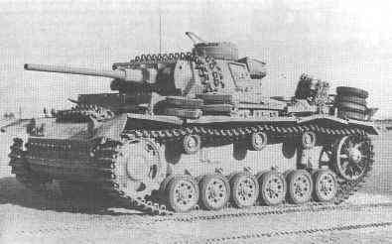
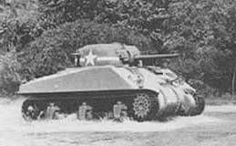
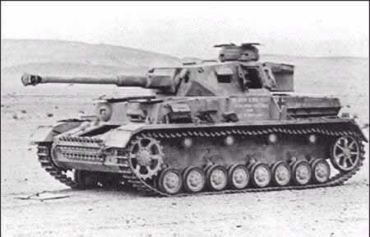
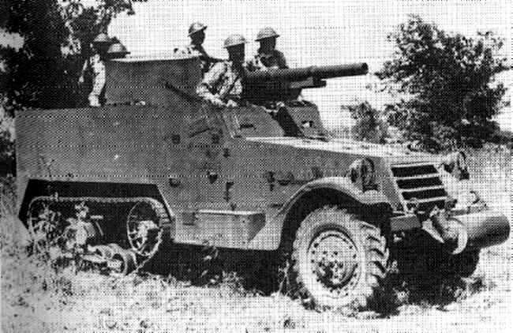
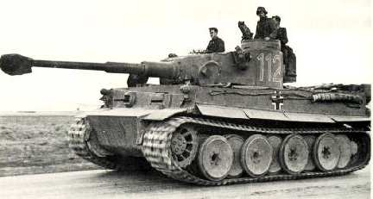
Technology
Kasserine Pass
PzKpfw III J
Weight: 22 Tons
Gun: 50 mm
Front Armor: 50 mm
Speed: 38 kph
M4 Sherman
Weight: 30 Tons
Gun: 75 mm
Front Armor: 51-76 mm
Speed: 39 kph
PzKpfw IV F2
Weight: 25 Tons
Gun: 75 mm
Front Armor: 50 mm
Speed: 38 kph
M3
Weight: 9 Tons
Gun: 75 mm
Front Armor: 6-12 mm
Speed: 64 kph
PzKpfw VI Tiger
Weight: 57 Tons
Gun: 88 mm
Front Armor: 100 mm
Speed: 38 kph
Notes:
Sherman is not a bad weapon system at this time. In British hands just prior to this battle, it is used quite effectively.
US M3 is only an interim vehicle until the M10 and M18 TDs arrive on the battlefield (similar looking to a tank, but with very light armor and an open turret). It has a similar gun to the Sherman, light armor and very good speed.
The main German Tank on the field is a Mk III. Far inferior to the M4
The second most numerous is the Mk IV, with a better 75mm gun to the Sherman, but lighter armor – thus they are almost equivalent of each other.
The least numerous is the first appearance of this vehicle on the battlefield – the Mk VI Tiger. Next slide demonstrates why it is so feared by American Tankers in WWII.

Slide 22
Maximum Penetration Comparison (In Yrds)
Front
2,600
2,100
M4
PzKpfw IV
Flank
5,000
4,600
Rear
5,000
4,200
None
Front
2,800
1,900
PzKpfw VI
Tiger
M4
Flank
5,000
1,100
Rear
5,000

Slide 23
Basic Battle Analysis
Step 2--Set the Stage
Part C: Compare Forces
Size & composition
Technology
Doctrine & Training
Logistics
Intelligence
Condition & Morale
C3
Leadership

Slide 24
Doctrine and Training
Kasserine Pass
Germans
  Doctrine well defined and soldiers battle hardened after several years of war experience.
US
  Majority of troops still relatively “green”.
  Tank Doctrine flawed:
    Tanks not intended to fight other tanks
    Cheaper Tank Destroyers were intended to defeat Armor Penetrations
General McNair (Commander-Army Ground Forces) Summer 1941:
“ Certainly it is poor economy to use a $35,000 medium tank to destroy another tank when the job can be done by a gun costing a fraction as much.”

Slide 25
Basic Battle Analysis
Step 2--Set the Stage
Part C: Compare Forces
Size & composition
Technology
Doctrine & Training
Logistics
Intelligence
Condition & Morale
C3
Leadership

Slide 26
Logistics
Kasserine Pass
Allies Strained
  Long Supply Lines
  Attempting to re-equip units with M4’s
  French poorly equipped/supplied
    Required a logistical surge to improve these units
  Result: No Additional Combat Troops Forward until Logistic Effort caught up.
Axis
  Supplied from Italy: Short Land supply lines, but challenged in Air and Sea
  Fuel Prevented long campaign, but sufficient for planned operation.

Slide 27
Basic Battle Analysis
Step 2--Set the Stage
Part C: Compare Forces
Size & composition
Technology
Doctrine & Training
Logistics
Intelligence
Condition & Morale
C3
Leadership

Slide 28
Intelligence
Kasserine Pass
Germans had correctly identified Allies were thinly deployed and struggling with logistics
Allied Intelligence failed
  1st Army incorrectly identified Germans would attack in the North.
  Anderson diverted strong Combat Command from 1st AD to back-up weak French XIX Corps. This resulted in weakness in south.

Slide 29
Basic Battle Analysis
Step 2--Set the Stage
Part C: Compare Forces
Size & composition
Technology
Doctrine & Training
Logistics
Intelligence
Condition & Morale
C3
Leadership

Slide 30
Condition and Morale
Kasserine Pass
  Morale of US troops good during Sidi Bou Zid engagement, but cases of panic increased as the battle progressed.
  Leadership attempts to correct:
    Fredendall had hands off leadership style that did little to correct dropping moral
    MG Harmon, who entered battlefield and took tactical control of II Corps at the end of the battle, used personal courage and example which seemed to improve moral overnight.

Slide 31
Basic Battle Analysis
Step 2--Set the Stage
Part C: Compare Forces
Size & composition
Technology
Doctrine & Training
Logistics
Intelligence
Condition & Morale
C3
Leadership

Slide 32
C3
Kasserine Pass
Axis Strained
  Commando Supremo in control of German troops.
  FM Kesselring considered only an Advisor to Commando Supremo, not in direct control of Panzer Army Afrika or 5th Panzer Army
  Rommel and Von Arnim considered equals: Therefore, no supreme commander on ground during campaign.
  Violation of Unity of Command
II Corps Dysfunctional
  Corp Commander Bypasses COC
  Extremely Directive Orders

Slide 33
C3
Kasserine Pass
  Corps Order:
    “DJ Ksaira on the South and DJ Lessouda on the North are the key terrain features in the defense of Faid. These two features must be strongly held, with a mobile reserve in the vicinity of Sidi Bou Zid which can rapidly launch a counter attack”
    “A Battalion of infantry should be employed for the defense of DJ Ksaira, and the bulk of a battalion of infantry together with a battery of artillery and a company of tanks for the defense of DJ Lessouda”

Slide 34
Basic Battle Analysis
Step 2--Set the Stage
Part C: Compare Forces
Size & composition
Technology
Doctrine & Training
Logistics
Intelligence
Condition & Morale
C3
Leadership

Slide 35
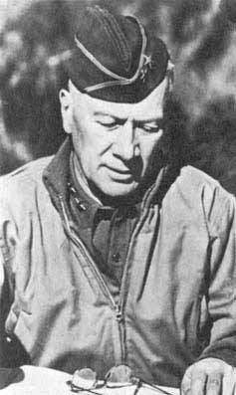
Leadership
Kasserine Pass
  MG Fredendall (II Corps Commander)
    Hands-off commander. Rarely left Command Post:
      60-70 miles from front
      Underground Bunkers
      Guarded by Ranger Company.
    Verbal orders were vague
    Often Bypassed MG Ward (1 AD Commander) and coordinated directly with combat commanders.
    Operation Order extremely directive. Not based on personal recon.
    Disregard of Subordinates

Slide 36
Basic Battle Analysis
Step 2--Set the Stage
Part D: State the Mission &
Describe Initial Disposition
Mission of each force
Objective of each force
Describe Initial Disposition of Forces

Slide 37
Kasserine Pass
Step 2--Set the Stage
Part D: State the Mission
U.S.
Mission: CCA Defends Faid and Maizila Passes
Division Objective: Protect French XIX Corps Southern Flank until 1st Army can resume offensive operations.
Mission: Elements of 5th Panzer Army Attacks Sidi Bou Zid to Destroy enemy forces and prepare for follow-on missions.
Army Group Objective: Create a buffer for Rommel’s western flank. Beyond that, Objective is never fully resolved between the two Army Commanders involved in Kasserine Pass
German

Slide 38
1
6
1
13
US Disposition
Division Reserve at Speitla, 40 Miles away
Djebel
Lessouda
Djebel
Hamra
2
168
Poste de Lessouda
Sadaguia
Sidi Salam
Faid
3
1
Sidi Bou Zid
Zaafria
91
El Fekka R.
2
17
Ain Rebaou
3
168
Garet
Hadid
168
Djebel
Ksaira
Bir el Hafa
81(-)
Maizila Pass
Notes:
Commanders on the ground were hampered by covering the two main hills with forces directed by the Corps commander. But they understood there was a gap between their forces. They therefore sent the Tank Company on a screen line during the day, and at night, it withdrew to a hiding position, and was replaced with dismounted infantry patrols. The ‘Changing of the Guard’ occurred twice a day – at Dusk, and at Dawn! Lets take a look at the German Plan. I wonder when they will attack.

Slide 39
German Plan
Djebel
Lessouda
Djebel
Hamra
x
Poste de Lessouda
Sadaguia
GERHARDT
x
10TH PANZER DIVISION
x
x
REIMANN
Faid
Sidi Salam
Sidi Bou Zid
x
x
GERHARDT
Zaafria
El Fekka R.
STENKHOFF
Ain Rebaou
SCHUETTE
REIMANN
Garet
Hadid
Djebel
Ksaira
Bir el Hafa
21st PANZER DIVISION
x
x
Maizila Pass
SCHUETTE
STENKHOFF

Slide 40
Basic Battle Analysis
Step 3--Describe the Action
Describe opening moves
Detail major phases
State outcome

Slide 41
1
6
14 FEBRUARY
Kern’s Crossroad
Djebel
Lessouda
Djebel
Hamra
2
168
x
Poste de Lessouda
Sadaguia
REIMANN
x
Sidi Salam
Faid
3
1
Sidi Bou Zid
GERHARDT
Zaafria
91
El Fekka R.
2
17
Ain Rebaou
168
3
168
Garet
Hadid
Djebel
Ksaira
Bir el Hafa
x
81(-)
x
STENKHOFF
Maizila Pass
SCHUETTE
Notes:
14 Feb German Attack
Dawn
81st Recon fell apart. Southern movement was not reported unit 0940
Germans had already moved through the pass as the tank screen was approaching their positions. Unaware of this movement, G/3/1st AR is quickly overwhelmed. One of the first tanks destroyed was the Cdrs tank that had the only radio that could communicate with HQ.
CCA gets reports of movement through pass. LTC Hightower is ordered to “Clear up the Situation” He sets up blocking psns with one tank plt north, one south and the TD Plt in btwn.
0900 – KG Gerhardt rounded Lassouda and destroyed the SP Arty Btry.
1000-1100 – the Towed Arty was beginning to move to alternate psn, but is destroyed by Aircraft and direct fire.
Tank and SP bns move back to prevent being cut off by the Germans.
Division reserve shows up and establishes defensive psn at Kerns Crossing (Bn Cdr’s name)
Noon – KG Stenkhoff begins to arrive and is met by LTC Hightower and two other tanks. His tank destroyed but he survives.
Dusk – Tank and SP bn finally exit – 7 tanks remaining.

Slide 42
15 FEBRUARY
3
6
16 FEBRUARY
2
1
Djebel
Lessouda
Djebel
Hamra
2
168
COL Stack
Poste de Lessouda
x
Sadaguia
x
GERHARDT
Sidi Salam
Faid
x
Sidi Bou Zid
REIMANN
Zaafria
x
El Fekka R.
Ain Rebaou
STENKHOFF
3
168
SCHUETTE
168
Garet
Hadid
Djebel
Ksaira
Bir el Hafa
Maizila Pass
Notes:
168IN now marooned
CCC pulled out of their defensive psn to the north and establish a “Rescue Party” along with a Tank Bn from CCB (Army Reserve)
Fredendalls Orders to Ward late on 14 Feb: “Concentrate tomorrow on clearing up the situation there and destroying the enemy”
0140, 15 Feb – Order to COL Stack of CCC from Ward: “destroy the enemy armored forces which have threatened our hold on the Sbeitla area. It will so conduct its maneuver as to aid in the withdrawal of our forces in the vicinity of Djebel Ksaira”
Col Stack positions himself on a hill overwatching the attack and places the Tank Bn Cdr, LTC Alger, in tactical control of the entire force. The CC is formed just as it is shown and moves in almost parade field accuracy. The Tank destroyers on placed on each flank of the Armor Bn.
1230 – attack begins – essentially a Mvmt to Contact due to severe lack of intel on the enemy. The formations begin to break up due to deep wadis, then they are hit by German AT fires.
Tanks from KG Gerhhardt and Stenkhoff attach LTC Alger from the North and South respectively. LTC Alger redirects his three Tank Companies to meet each attack. The Reserve Company was directed to intercept KG Gerhardt, but misses them.
By 1740, LTC Alger's Bn is destroyed. The rest of the CC withdraw in tack, but only 4 tanks from LTC Alger return.
Evening of the 15th – Lassouda attempts to withdraw – only 200 of the original 600 make it back to friendly lines.
Evening of the 16th – the rest of 168th attempt to withdraw, but due to the longer distance to travel, the are in the middle of the German forces as the sun comes up and surrender.

Slide 43
OUTCOME
15 Feb 1943
14 Feb 1943
10TH PANZER DIVISION
Div Reserve
KG Gerhardt
CC C
1
6
DJ Lassouda
1
7
2
69
1
13
2
168
22 Pz IV
66 Pz III
2
1
C/701
KG Reimann
50 M4s
10 M4s
4 M3s
CC A Reserve
LTC Hightower
2
86
3
6
CC A
10 Tigers/10 Pzr IIIs
3 (-)
1
21st PANZER DIVISION
91(-)
40 M4s
A/701 (-)
KG Schuette
G
13
2
17
17 M4s
8 M3s
104
B/701
12 M3s
10 Pz IV
Garet Hadid
20 Pz III
DJ Ksaira
168
KG Stenkhoff
3
168
1
5
2
5
104
20 Pz IV
** Not Complete Task Organizations
40 Pz III

Slide 44
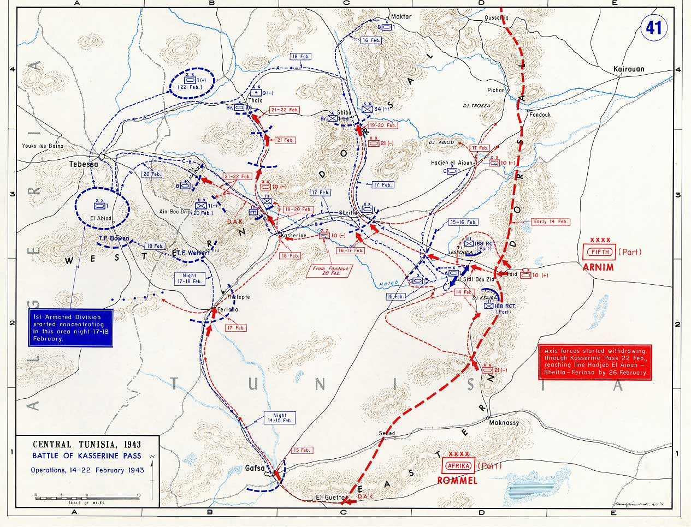

Slide 45
Basic Battle Analysis
Step 4—Assess the Significance
Cause and Effect
  Why did events turn out the way they did?
Relevance
  What is relevant about this study to current operations?

Slide 46
Basic Battle Analysis
Step 4—Assess the Significance-
Cause & Effect
Who won? Who lost?
What were the constants that affected the outcome?

Slide 47
Basic Battle Analysis
Step 4—Assess the Significance-
Relevance/Military Lessons
Principles of War
Threads Of Continuity
Warfighting Functions

Slide 48
Doctrine
Kasserine Pass
US Tank/Tank Destroyer Doctrine
US Tank/TD Reality in 1943
14 Feb
15 Feb
Notes:
Thread of Continuity – Doctrine
Cause and effect
US Doctrine designed to defeat the German Panzers that were witnessed in 1939-1941. Recon Identifies, TD destroy, Tanks exploit enemy rear.
Reality – LTC Hightower uses TD as ‘center tank company’ in stationary blocking psn. TDs too light for this mission.
Reality – LTC Alger puts TD’s on flanks – his entire force is destroyed.
In both cases – no Reconnaissance.
Insight
Is this a case of not using/understanding doctrine, or the doctrine itself being flawed. Neither Cdr followed doctrine, and worse, did not use any recon at all. The equipment was put into situations it was not designed to handle. Who’s fault. Could the doctrine have been used?
Doctrine is a living, breathing document. Only a guideline, but in this case, proved a fatal flaw. This is doctrine directing technology, but sometimes technology drives doctrine.

Slide 49
Intelligence
Kasserine Pass
Cause/Effect
1st Army ID’s Attack will be in North
II Corps Weakened
Poor Early Warning
G/3 AR Surprised and Destroyed
LTC Hightower Overwhelmed
Recon consists of “Clear up the Situation”
LTC Alger Sent into Ambush
Insight
Violation of Principle of War: Security
Notes:
Warfighting Function/Principle of War
Intelligence fails at almost EVERY level
Security: Never permit the enemy to acquire an unexpected advantage.
Note that a POW was used to reinforce a Warfighting Function.

Slide 50
COMPARISON OF MAIN DIRECT FIRE WEAPONS SYSTEMS 14 Feb ‘43
LTC Hightower
DJ Lassouda
KG Gerhardt
3 Companies M4 Shermans
1 Company M3 Tank Destroyer Half Tracks
Pzr IV Co
Similar to M4
Various AT Units
3 Pzr III Cos
Inferior to M4
KG Riemann
Tiger Co w/ spt Pzr IIIs
Superior to M4
Numbers and organization are approximations only!
Notes:
Principle of War – Mass
Concentrate the effects of combat power at the decisive place and time.
Had CCA combined the combat power of its Bn, it would have had a fighting chance – Remember the tanks in the big blue square (Mk IIIs) are inferior to the Sherman……and its not just numbers (concentrate):
“at the decisive time and place” - oriented on the pass
Utilizing engineer efforts
Coordinating with artillery fires
Infantry/Armor operations
Air
This battle was not a demonstration of the poor quality of the Sherman – next slide

Slide 51
The Destruction of LTC Alger’s 2nd Battalion, 1st Armored Regiment
50
50
NO Frontal Hits caused Tank Casualties
All Penetrations seem to be from Tank Guns
Only one penetration from a long range 88.
This is not a U.S. Technology Problem
50
50
75
50
75
75
50
Direction of Attack
75
50
50
75
50
75
75
50
50
75
50
75
50
75
88
50
75
75
75
AT Fire
75
75
50
75
50
75
75
50
50
50
75
50
50

Slide 52
Leadership
Kasserine Pass
Cause/Effect
Battlefield Math
Directive Orders
+ No Leader Recon
- Subordinate Counsel
= Conditions for Failure
Insight
Flexibility in the Plan
Faith in Subordinates
Notes:
Thread of Continuity – Leadership
End with MG Fredendall
Even if there is no leaders Recon, a more flexible plan and a trust in your subordinates could have fixed this problem.
Fredendall simply had no faith in anyone but himself
We are not here to condemn the man – he was simply the wrong man at the wrong time. But certainly we also don’t want to commit this same mistake.
These are all timeless principles and insights. We are in a very unique war right now, but we have just learned from a tank battle, lessons that are going to make our future officers think and can probably apply to any battle, at any time.
Yes I had to talk about 88’s and Halftracks, but put them in a context that is relevant today.

Slide 53
Basic Battle Analysis
Check on Learning:
Battle Analysis Methodology

Slide 54
BACKUP SLIDES

Slide 55
FM 6-22
Army Leadership
Kasserine Pass
Core Leader Competencies
The ‘Do’ of ‘Be, Know, Do’
LEADS
Leads Others
Establishes and imparts clear intent and purpose
  Empowers and delegates responsibility and authority to subordinates.
Extends Influence Beyond Chain of Command
Builds and Maintains Alliances
Leads by Example
Leads with confidence in adverse situations
  Provides leader presence at the right time and place
Seeks and is open to diverse ideas and points of view
  Explores alternative explanations and approaches for accomplishing tasks.
  Uses knowledge sources and subject matter experts.
Communicates
Conveys thoughts and ideas to ensure shared understanding.
  Expresses thoughts and ideas clearly to individuals and groups.
  Uses correct grammar and doctrinally correct phrases.
  Recognizes potential miscommunication.

Slide 56
FM 6-22
Army Leadership
Kasserine Pass
Core Leader Competencies
The ‘Do’ of ‘Be, Know, Do’
DEVELOPS
Creates a Positive Organizational Climate
Encourages subordinates to exercise initiative, accept responsibility, and take ownership
  Guides subordinate leaders in thinking through problems for themselves.
  Allocates decision making to the lowest appropriate level.
Encourages open and candid communications
  Reinforces the expression of contrary and minority viewpoints

Slide 57
FM 6-22
Army Leadership
Kasserine Pass
Core Leader Competencies
The ‘Do’ of ‘Be, Know, Do’
ACHIEVES
Gets Results
Prioritizes, organizes and coordinates taskings for teams or other organizational structures/groups
  Limits over-specification and micromanagement.
Makes feedback part of work processes
  Gives and seeks accurate and timely feedback.
  Uses feedback to modify duties, tasks, procedures, requirements, and goals when appropriate.

Slide 58
1
6
x
14 FEBRUARY
1
6
GERHARDT
Djebel
Lessouda
Djebel
Hamra
2
168
x
Poste de Lessouda
Sadaguia
3
1
x
GERHARDT
x
Sidi Salam
REIMANN
Faid
3
1
Sidi Bou Zid
GERHARDT
Zaafria
x
2
17
x
El Fekka R.
91
Ain Rebaou
168
3
168
STENKHOFF
Garet
Hadid
x
Djebel
Ksaira
REIMANN
SCHUETTE
Bir el Hafa
x
x
Maizila Pass
SCHUETTE
STENKHOFF

Slide 59
3
168
168
Djebel
Lessouda
x
Djebel
Hamra
2
168
Poste de Lessouda
GERHARDT
Sadaguia
Faid
x
Sidi Salam
Sidi Bou Zid
Zaafria
3
1
GERHARDT
x
El Fekka R.
Ain Rebaou
168
3
168
REIMANN
Garet
Hadid
Djebel
Ksaira
Bir el Hafa
x
2
168
GERHARDT
x
Faid Pass
&
Sidi Bou Zid Area
CC A
3
1
REIMANN
Maizila Pass

Slide 60
3
6
15 FEBRUARY
2
1
Djebel
Lessouda
Djebel
Hamra
2
168
Poste de Lessouda
x
Sadaguia
x
GERHARDT
Sidi Salam
Faid
x
REIMANN
Sidi Bou Zid
Zaafria
x
El Fekka R.
Ain Rebaou
STENKHOFF
3
168
SCHUETTE
168
Garet
Hadid
Djebel
Ksaira
Bir el Hafa
Maizila Pass

Slide 61
Doctrine
Kasserine Pass
US Tank/Tank Destroyer Doctrine
US Tank/TD Reality in 1943
14 Feb
15 Feb

Slide 62
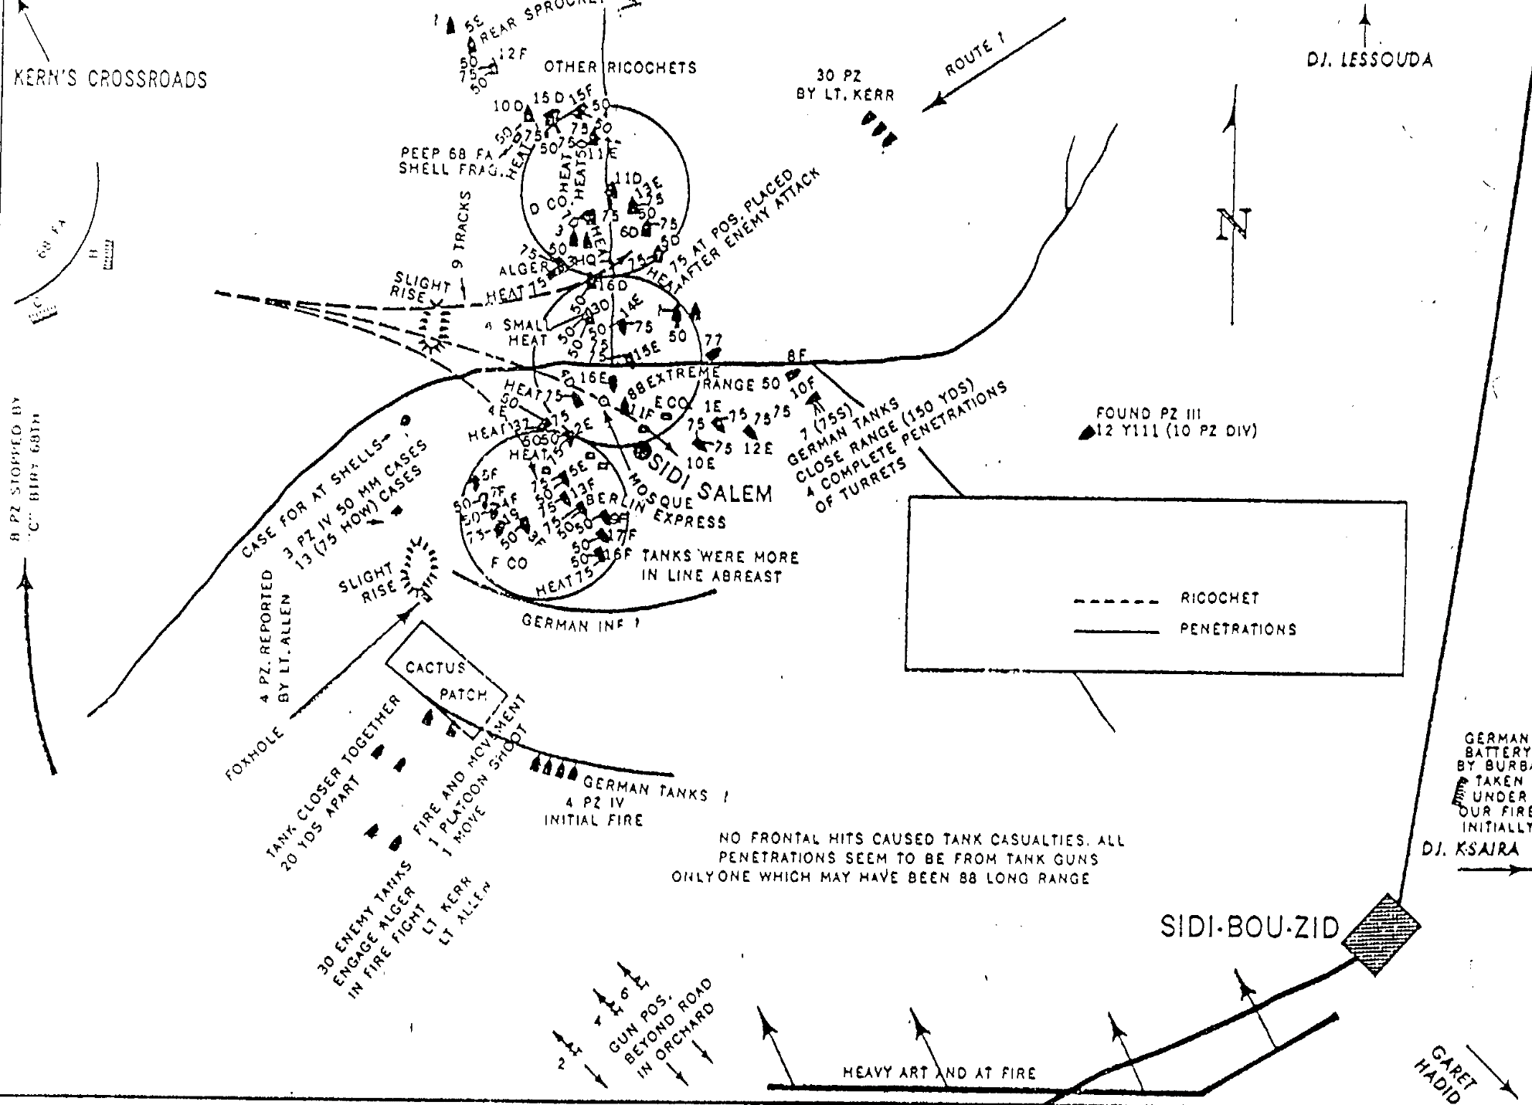
The Destruction of LTC Alger’s 2nd Battalion, 1st Armored Regiment

