Slide 1
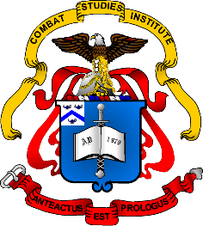
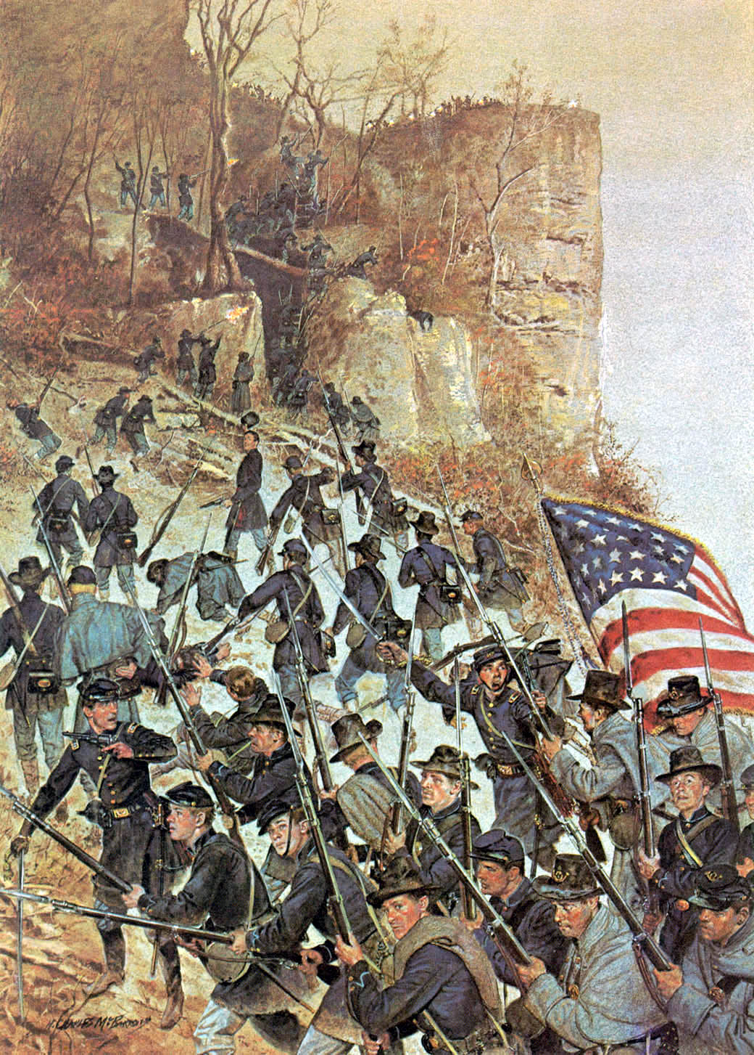
The American Civil War
Antietam
September 1862
Notes:
Instructor Note:
These slides contain animated objects. This presentation is intended to be viewed in “Slide Show”. Each click of the mouse will move an object, make an object appear/disappear or show an arrow. Each bulleted line in the Notes Pages correspond the sequential order of each “action” and describes that action.

Slide 2
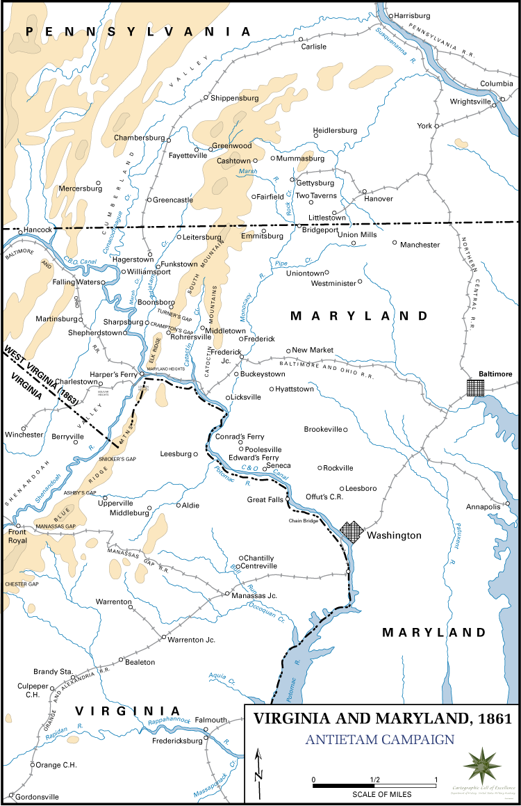

Lee
Army of Northern VA
McClellan
Army of the Potomac
VI
XII
IX
I
II
McClellan
Army of the Potomac
III
V
J
XI
Lee
Army of Northern VA
L
American Civil War
Antietam Campaign
September, 1862
Notes:
4-9 Sept – Jackson and Longstreet crossed the Potomac and concentrated at Frederick while Stuart’s Cavalry conducted a Demonstration. Stuart then crossed the Potomac to screen the army. McClellan rapidly reorganized the Army or the Potomac (AOP) into three wings: Right – Burnside (IX and I Corps), Center – Sumner (II and XII Corp) and Left – Franklin (VI Corps) and moved to intercept Lee
Lee had crossed the Potomac in the face of the AOP and needed a more secure Line of Communication: the Shenandoah Valley.
However, Halleck had ordered the garrison at Harpers Ferry to remain. This required Lee to change his plans.

Slide 3
J
H
McClellan
Army of the Potomac
Lee
Army of Northern VA
M
L
W
IX
I
XII
II
VI
III
V
XI
American Civil War
Antietam Campaign
September, 1862
Notes:
Thinking that McClellan would take a long time to reorganize and react to his invasion, Lee decided to divide his army to capture Harpers Ferry (HF).
Lee then issued Special Order 191:
Assault Force:
- Jackson with 3 divisions (Lawton, A.P.Hill, J.R. Jones) moves via Williamsport to occupy Bolivar Heights
- McLaws with 2 divisions (his and Anderson) seizes Maryland Heights
Walker seizes Loudon Heights.
Security Force:
- Longstreet with 2 divisions (Hood, D.R. Jones) screens North vic Boonsboro while D.H. Hill and Stuart defend the gaps of South Mountain.
9-13 Sept: ANV Movement
After the initial deployment of Special Order 191, Lee got false intelligence reports of Union forces to the north, so he deployed Longstreet to Hagerstown to counter that threat, further splitting the ANV.
13 Sept – McClellan moved the AOP to Frederick.

Slide 4
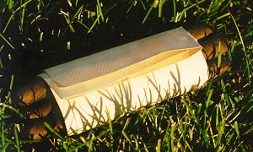
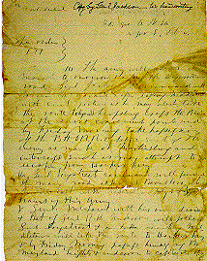
L
H
IX
McClellan
Army of the Potomac
Lee
Army of Northern VA
I
XII
II
J
M
H
W
VI
III
V
XI
American Civil War
Antietam Campaign
September, 1862
Notes:
13 Sept - At Frederick (Lee’s previous bivouac site), a soldier from XII Corps found a lost copy of Special Order 191 that detailed for McClellan the dispersion of the ANV. His concentrated army had the opportunity to destroy the ANV in detail. But he delayed movement for 7 hours and through a southern sympathizer in McClellan’s HQ’s, Lee suspected that McClellan possessed the lost order and immediately began to pull his army back together.
14 Sept – 0900: IX Corps began attacking D.H. Hill at South Mountain.
14 Sept – 1400: VI Corps, ordered to take the southern gap at South Mountain (Franklin was to move south and relieve HF) ran into Stuart’s Cavalry and McLaws Division (who left Anderson back at HF).
14 Sept – 1600: Burnside delayed his afternoon attack until I Corp could be brought up to conduct a simultaneous attack. Longstreet took advantage of the lull to reinforce Hill.
McClellan had envisioned the Right Wing quickly moving through the South Mountain Gaps and both Right and Center Wings defeating the Confederates at Boonsboro (where he thought Longstreet was). Thus the Center Wing closely followed the Right Wing, and the V Corps had been called from Washington to become the Army Reserve.
With his army divided, and the AOP reacting much faster than he expected, Lee withdrew westward and contemplated withdrawing to VA. However, he delayed that decision when Jackson assured him of the probable fall of HF. Lee finally decided to make a stand at Sharpsburg when HF fell on the 15th.
15 Sept – HF surrenders. Jackson left A.P. Hill to process the surrender and moved to join Longstreet.
15-16 Sept – McClellan gathered his force and far outnumbered the enemy. However, he spent much of this time with reconnaissance and planning while his army lay idle. (VI Corps is left at Rohrersville to cover Harpers Ferry)
16 Sept – ANV consolidated with the exception of three divisions. (Mclaws and Anderson joined the ANV in the early hours of the 17th and A.P. Hill joined the army at a critical moment the afternoon of the 17th)

Slide 5
Right
Wing
Stuart
Lawton
J.R.Jones
Hood
Jackson
Reserve
D.H. Hill
Longstreet
Walker
D.R. Jones
Left
Wing
Notes:
McClellan’s Plan. There is no written order, but from McClellan’s account after the battle:
“The design was to make the main attack upon the enemy’s left – at least to create a diversion in favor of the main attack, with the hope of something more by assailing the enemy’s right – and, as soon as one or both flank movements were fully successful, to attack their center with any reserve I might then have on hand.”
There are many flaws with this ‘after the fact’ statement, which is vague at best (which may say a lot for the actual execution of the battle)

Slide 6
Hooker I
Hooker I
Stuart
Mansfield XII
Right
Wing
J.R.Jones
Lawton
Hood
Hood
Sumner II
Jackson
D.H. Hill
Porter V
Reserve
Anderson
McLaws
Left
Wing
Longstreet
Burnside IX
Walker
D.R. Jones
Notes:
AOP’s Initial Deployment: McClellan reorganized the Army from three wings, to two, but did not keep the Wing Command structure (Each corps commander was to answer directly to him). The Right Wing was weighted with Hooker’s I Corps, Mansfield’s XII Corps, and Sumner’s II Corps. The Left Wing only had Burnside’s IX Corps. (Burnside did not want to give up his title as Wing Cdr, so he kept Cox in place as the Corps Commander, and left the unnecessary command structure between the Corps and Army Cdr) Porter’s V Corps was designated the Army Reserve and Franklin’s Corps was moving from Rohrersville on the 17th to link up with the AOP.
McLaws’ and Anderson’s divisions arrived in the early hours of the 17th and were located in the rear of Longstreet’s Corp, resting from the Harpers Ferry march.
0630: Hooker attacked through the Cornfield – Lawton’s division was forced to the rear to regroup.
0700: Hood’s division counter-attacked Hooker’s Corps and both became spent. Hooker withdrew to the north to regroup and was out of the fight.

Slide 7
Hooker I
Williams XII
Stuart
Mansfield XII
Right
Wing
J.R.Jones
Hood
Sumner II
Jackson
Hood
D.H. Hill
Porter V
Reserve
Anderson
McLaws
Left
Wing
Longstreet
Burnside IX
Walker
D.R. Jones
Notes:
D.H. Hill moved a portion of his division to support Hood’s broken line.
0800: Mansfield’s Corps entered the battle, but Mansfield was mortally wounded almost immediately (one of his division commanders, Williams, takes command). The Corps attacked the same general area as Hooker, but the two divisions became separated. One division is broken and withdraws to Hooker’s Corp. D. H. Hill fell back to a sunken road and reformed his division there (to become known as Bloody Lane) For both sides, the northern lines were broken and confused.

Slide 8
Hooker I
Williams XII
Stuart
Right
Wing
J.R.Jones
McLaws
Sumner II
Walker
Jackson
Hood
D.H. Hill
Porter V
Reserve
Anderson
McLaws
Left
Wing
Longstreet
Burnside IX
Walker
D.R. Jones
Notes:
0900: Sumner’s Corps deployed with two divisions. The lead division (Sedgwick) moved into the West Wood in a very tight formation of three Bde Lines. The following division (French), lost track of the lead division and drifted to the southwest, toward D.H. Hill’s new position.
Since the southern portion of his line was not engaged at this time, Lee shifted units north to reinforce Jackson’s broken lines. McLaws and Walkers divisions (and a portion of D.R. Jones) moved to the West Woods and were in a semi-circular ‘ambush’ position as Sedgwick’s Division emerged. They decimate his tightly packed division from the front and flank.
D. H. Hill stopped French’s Division, but needed to be reinforced by Anderson’s Division. Lee was now very low on possible reserves.
1000: Sumner’s final division, Richardson, finally arrived and extended the Union line. The Confederates were overwhelmed and fell back, but both sides were spent. Both lines were again confused and exhausted.

Slide 9
Hooker I
Williams XII
Franklin VI
Right
Wing
Stuart
J.R.Jones
McLaws
Sumner II
Walker
Jackson
Hood
D.H. Hill
Porter V
Reserve
D.R. Jones
Left
Wing
Longstreet
Burnside IX
D.R. Jones
Burnside IX
A.P. Hill
Notes:
At about 1100, Franklin’s Corps arrived from Rohrersville with its Cdr ready to go into the battle. However, the loss of three previous Corps as effective fighting forces, left Franklin the only organized force in the AOP’s Right Wing. McClellan lost his nerve and stopped Franklin from attacking the broken Confederate Left. The Northern and Center battles thus ended. The battle now shifted south.
McClellan’s plan for the IX Corp was vague, so Burnside waited for orders to attack, which finally arrived after 0900. Due to the awkward command structure, the attack was further delayed until 1100.
To even further complicate matters, Burnside concentrated all his attacks on the one bridge to his front, which the Confederates were able to defend for several hours with minimal troops. IX Corps was finally able to take the bridge at 1300. (This bridge would later be called ‘Burnside’s Bridge’.)
By 1500, IX Corps was making good progress against the remainder of the Confederate Right, when suddenly, arriving from Harpers Ferry (after a forced march starting at 0730 that morning), A.P. Hill’s division transitioned right into the attack and stopped IX Corps advance.
This action ended the fighting at Antietam, with two lines facing each other, utterly exhausted and depleted, and 20,000 Union fresh Union troops sitting idly by.

Slide 10
Right
Wing
Stuart
Lawton
J.R.Jones
Hood
Jackson
Reserve
D.H. Hill
Anderson
McLaws
Longstreet
Walker
D.R. Jones
Left
Wing
Notes:
As a comparison, this is to remind the students what the original plan was.

Slide 11
Right
Wing
Stuart
Lawton
J.R.Jones
Hood
Jackson
Reserve
D.H. Hill
Anderson
McLaws
Longstreet
Walker
D.R. Jones
Left
Wing
Notes:
In reality, the AOP attack at Antietam became three separate attacks that shifted from north to south.
This shifting battle allowed Lee to also shift his forces from south to north to meet each new threat to his line.
And finally, due to the timidity of the AOP Cdr, the decisive units that could have given the Union a stunning victory, were never utilized.

