Slide 1

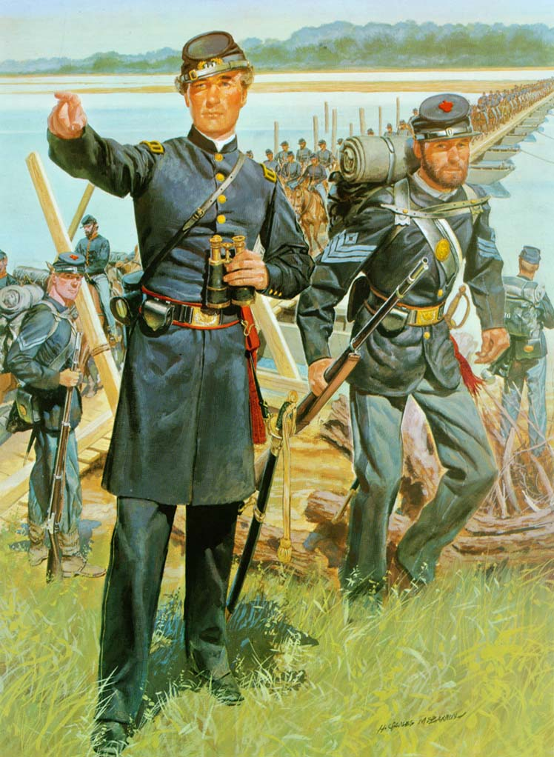
Chancellorsville
April – May 1863
Notes:
Instructor Note:
These slides contain animated objects. This presentation is intended to be viewed in “Slide Show”. Each click of the mouse will move an object, make an object appear/disappear or show an arrow. Each bulleted line in the Notes Pages correspond the sequential order of each “action” and describes that action.
Notes in red are references to the accompanying Word analysis document.

Slide 2
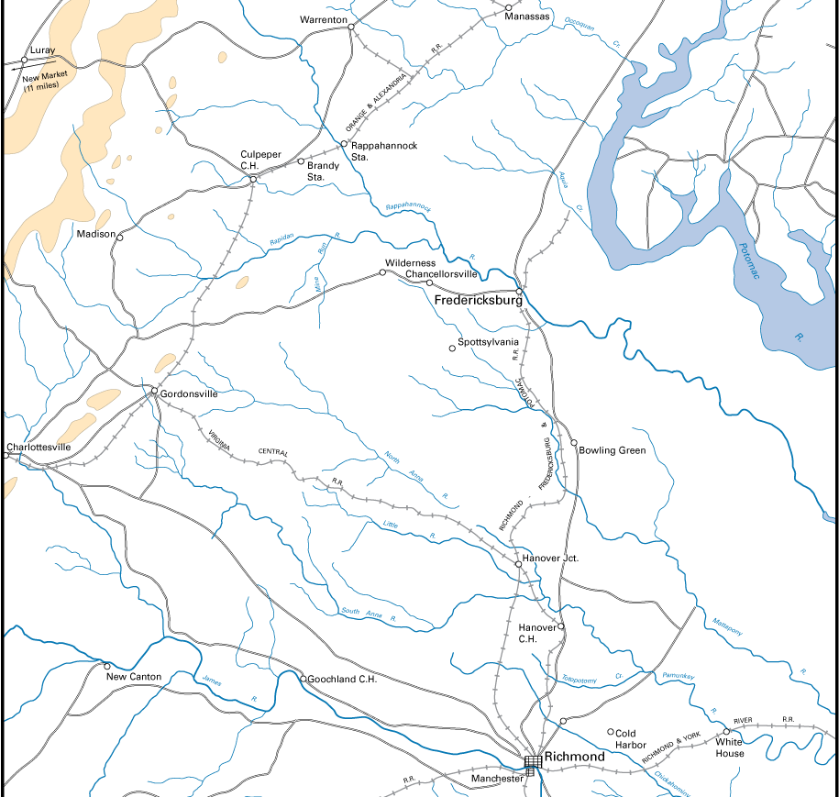

Hooker
Army of the Potomac
AOP
Lee
Army of Northern VA
ANV
American Civil War
Hooker’s Plan
“Plan B”
Notes:
After Hooker relived Burnside of the Command of the Army of the Potomac (AOP) on January 1863, he did not want to relive the horrors of the Battle of Fredericksburg the previous December. (Click twice to show that another frontal attack at Fredericksburg was not an option) He was determined to make General Lee and the Army of the Northern Virginia (ANV) pull away from their fortifications, and force Lee to attack him on ground of Hooker’s choosing (this tactical defensive concept was also probably a result of the great carnage that was demonstrated by Lee’s defensive works at Fredericksburg). Thus, Hooker planned to have his newly formed Cavalry Corps (see Chancellorsville Analysis: CV #1) swing around the ANV and cut their supply lines back to Richmond. (Click to show the Rail Line to Richmond Hooker wanted to cut, then click to show the planned movement)
This would force Lee to move back and deal with this threat to his rear
Hooker would than be able to take the initiative and find a battleground of his choosing.
13-16 April The 1st attempt by Stoneman to cross the Rappahannock failed due to heavy rains making the river unfordable.
Hooker then adjusted his plan (which was actually a much better plan). He would divide his army into two forces – A flanking force and a fixing force.
The flanking force would cross the Rappahannock to the North East, while Stoneman crossed at the same location, and continued on his original mission.
Lee would have to react to one of these two threats, and again, Hooker would be at his leisure to attack Lee at the location of his choosing.
Additionally, if Lee was to attack the flanking force, the fixing force would be able to attack Lee from his rear.

Slide 3
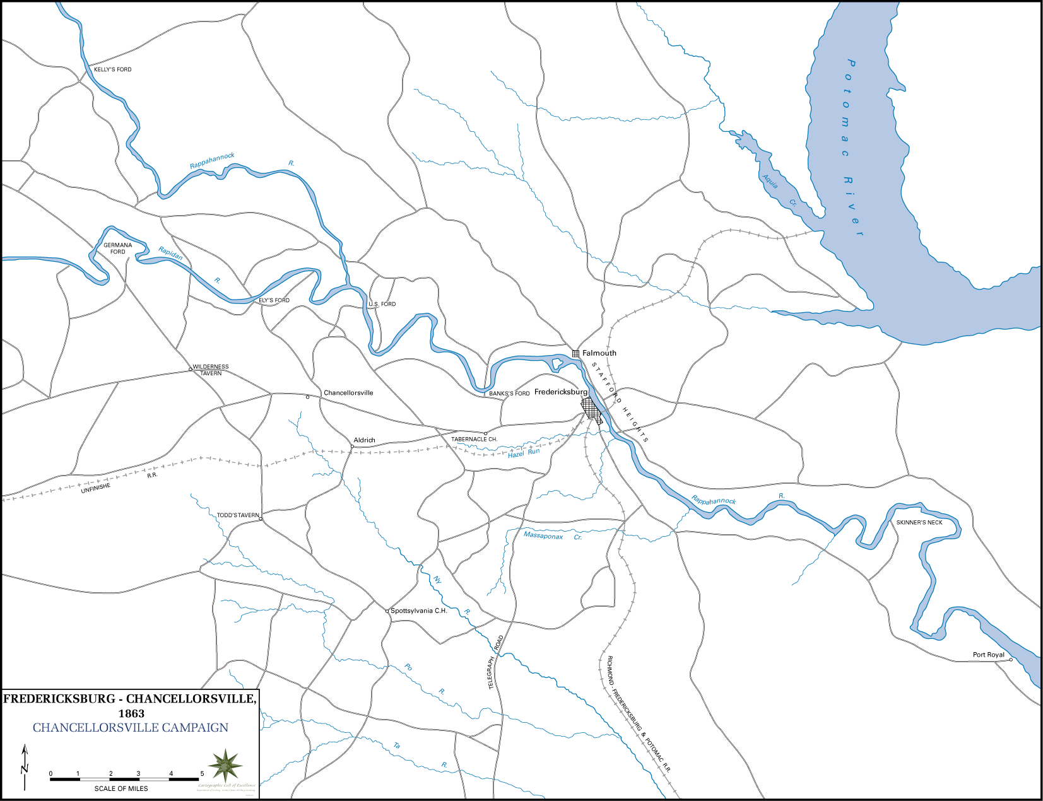
Stafford C.H.
XII
Hartwood Church
XI
III
V
II
Hooker
Army of the Potomac
I
A
M
VI
E
Lee
Army of Northern VA
R
H
C
American Civil War
Chancellorsville
Turning Movement
April 27, 1863
April 29, 1863
April 28, 1863
April 30, 1863
Notes:
27 April – Hooker’s Element began movement: V Corps (Meade), XI Corps (Howard), XII Corps (Slocum).
**Note: These Main Effort Corps were chosen because of their chance location away from the eyes of the Confederates. (XI and XII Corps were actually inexperienced, or had little success on the battlefield to date) They were able to make their initial moves without alerting the enemy to the movement – Security was all important to Hooker’s success in creating the turning movement.
***Note: For these notes, the larger, main body of the Army will be called, Hooker’s Element, and the smaller element left at Fredericksburg will be called Sedgwick’s Element. (See CV #2 Analysis for discussion on Flanking/Fixing Force and Main/Supporting Effort)
28 April – Hooker’s force crossed the Rappahannock at Kelly’s Ford. II Corps (Couch) moved to cover Banks Ford.
VI Corps (Sedgwick) & I Corps (Reynolds), supported by III Corps (Sickles) moved toward the river for Deception.
29 April. Hooker’s element continued movement. II Corps was ordered to join the flank element vic. US ford.
VI & I Corps each sent a division across the river to conduct a Demonstration.
Lee responded with Ewell’s division dug in facing the new threat, and pulling the remainder of Jackson’s Corps closer to Fredericksburg.
With reports of Union activity to his rear, Lee sent Anderson’s Division to protect that area.
**NOTE: At this time, Longstreet had been sent south with two divisions to oppose Union forces vic. Norfolk VA. Lee was in direct control of his two remaining Divisions (Anderson & McLaws), while Jackson was still in the vicinity commanding his entire 2nd Corps.
30 April – Anderson, not comfortable with his advanced position, pulled back to Tabernacle Church.
As Hooker’s Element moved east, General Stuart, commanding the Confederate Cavalry, was recalled to re-join the ANV (he had previously been covering Stoneman). He passes and identifies the Union flanking force. (Confederate Cavalry had identified the Union flanking force sooner, but as the AOP was between them and Lee’s HQ, reports of their movement were delayed).
As II Corps crossed the US Ford to join Hooker’s Element, III Corps was ordered and began movement to also join Hooker’s Element. Hooker delayed the flanking movement of the lead Corps to allow II and III Corps to close on the Main body.
Lee sent McClaws to join Anderson. (McClaws left Barksdale’s Brigade to cover Fredericksburg)
Jackson’s Corps was also ordered west to counter the AOP Main Effort. Ewell’s Division was detached from Jackson to counter Sedgwick’s Element at Fredericksburg.

Slide 4
Hooker
Army of the Potomac
Reynolds I
Couch II
Sickles III
Meade V
Sedgwick VI
Howard XI
Slocum XII
III
G
II
XI
V
V
XII
XII
M
H
M
VI
C
A
A
R
R
I
E
H
C
Lee
Army of Northern VA
Anderson (I)
McLaws(I)
Jackson – II Corp
A.P. Hill
Rodes
Colston
Early
Stuart-Cavalry
American Civil War
Chancellorsville
May 1, 1863
XI
Union
Corps
H
Confederate Division
(Jackson’s Corps)
Notes:
May 1 V Corps moved forward in two columns. 2 Division followed along the Rappahannock while one division moved along the Turnpike Road.
XII Corps proceeded forward with its two divisions along the Plank Road. II Corps was to follow and III Corps arrived that morning from US Ford.
ANV moved forward and attacked Slocum’s Corps and Meade’s southern division (Meeting Engagement)

Slide 5
Hooker
Army of the Potomac
Reynolds I
Couch II
Sickles III
Meade V
Sedgwick VI
Howard XI
Slocum XII
V
G
XI
H
C
R
III
XI
II
V
XII
M
VI
A
M
H
XII
A
R
C
I
E
Lee
Army of Northern VA
Anderson (I)
McLaws(I)
Jackson – II Corp
A.P. Hill
Rodes
Colston
Early
Stuart-Cavalry
American Civil War
Chancellorsville
May 1, 1863
May 2, 1863
XI
Union
Corps
H
Confederate Division
(Jackson’s Corps)
Notes:
These actions were indecisive and it appeared that Hooker could have used Meade’s Northern forces (that had no opposition) to conduct a decisive flanking movement. Instead, Hooker ordered a withdrawal back to their start positions at Chancellorsville. Here the Union Army built extensive log breastworks.
2 May – I Corps was ordered to join Hooker’s Element. Hooker planned to put I Corps on his right to protect his exposed right flank, but communication problems delayed the movement.
Identifying Hookers vulnerable right flank Lee planned to again divide his already divided army (it would now be three separate elements). While Early, from Jackson’s Corps continued to defend the ANV’s rear, Lee would utilize Anderson and McClaws to fix the Union Main line (from McClaw’s Division, Wilson’s Brigade was sent to cover Banks Ford).
Jackson took the rest of his 2nd Corps along a covered route to the West of the Union lines. The Union identified a portion of this move, and III Corps attacked the rear elements of Jackson’s column vic. Catherine’s Furnace. Hooker came to the conclusion that this movement represented a general Confederate withdrawal back to Richmond (see CV #3)).
Jackson formed his three divisions to mass on and roll up the XI Corps’ flank. Rodes’ division was in the lead for the initial assault. Colston followed in support, and Hill’s Division was in the rear. Each in turn would become the main effort as the lead division culminated.
Late that afternoon (about 1700), Jackson attacked and broke the XI Corps, which hastily retreated to the V Corps position.
Jackson’s next division then struck the XII Corps. (At Dusk, Jackson was mortally wounded by his own troops while he was reconnoitering his confused front lines). Late that evening, III Corps conducted an inconclusive night attack.

Slide 6
Hooker
Army of the Potomac
Reynolds I
Couch II
Sickles III
Meade V
Sedgwick VI
Howard XI
Slocum XII
I
I
V
XI
G
V
XI
III
II
A
VI
H
XII
R
C
III
M
E
VI
M
A
VI
A
E
Lee
Army of Northern VA
Anderson (I)
McLaws(I)
Jackson – II Corp
A.P. Hill
Rodes
Colston
Early
Stuart-Cavalry
American Civil War
E
Chancellorsville
May 2, 1863
May 4, 1863
May 3, 1863
May 6, 1863
XI
Union
Corps
H
Confederate Division
(Jackson’s Corps)
Notes:
3 May – Hooker reconfigured his lines with V & I Corps protecting the right flank. However, he also moved his III Corps out of Hazel Grove, fearing they would be cut off. This move gave up key terrain (high ground) to the Confederates who rapidly occupied and massed artillery there.
That morning, the Confederate 2nd Corps (now commanded by General Stuart) renewed their attack of the previous day, with Anderson and McClaws also attacking. Lee was attempting to re-unite the two separated elements of his Main Effort forces.
Simultaneous with this attack, Sedgwick, who was slow to act (CV #4) finally began to attack Early’s position. General Gibbon’s Division, detached from II Corps, (part of original deception plan) takes part in the attack, but he was never officially attached to Sedgwick (unity of effort).
Early had estimated that Sedgwick would attack his right. When Sedgwick instead attacked his weaker left and broke through to Marye’s Heights, Early was forced to withdraw to the south-west. Winslow’s Brigade (originally covering Banks ford), rapidly moved to Salem’s Church to establish a delaying position.
Hooker, under pressure from growing Confederate Artillery, decided to pull his embattled center Corps back to a less exposed position. Here the Union army would be well entrenched with both flanks secured on the Rapidan and Rappahannock Rivers. He would now wait for Lee to attack this solid defense and destroy him, while Sedgwick moved forward into Lee’s rear.
This action, however, allowed Lee to finally re-link his two main effort elements.
Additionally it allowed Lee to keep the initiative (Offensive-See CV #5). Lee was now able to shift his main effort to attack Sedgwick’s force, and keep Hooker’s Element in check. He therefore sent McLaws back East to support Wilcox at Salem Church.
Sedgwick did not expect much resistance as he slowly moved west. His lead Brigade was stopped by McLaws division. (Gibbon had been left behind to protect Fredericksburg)
Sedgwick feared the loss of his lines of communication with Fredericksburg (with Early threatening to his south). VI Corp thus fell back and established defensive positions and an escape route at Scott’s Ford.
4 May Lee moved Anderson and Early to attack the Union VI Corps.
The attack is repulsed, but Sedgwick decides to evacuate that night.
Hooker withdraws the Main Element the morning of 6 May.

