Slide 1

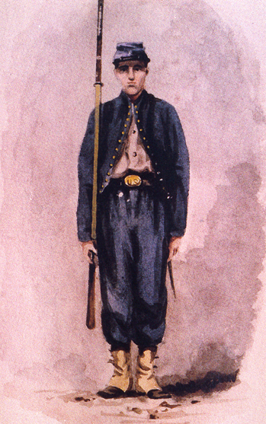
The American Civil War
Prelude
Notes:
Instructor Note:
These slides contain animated objects. This presentation is intended to be viewed in “Slide Show”. Each click of the mouse will move an object, make an object appear/disappear or show an arrow. Each bulleted line in the Notes Pages correspond the sequential order of each “action” and describes that action.
Notes in red are references to the accompanying Word analysis document.

Slide 2


Battle of Wilson Creek
(10 Aug 1861)
Battle of Pea Ridge
(6-8 March 1862)
Fort Sumter
(12 April 1861)
Initial Secession
Final Secession
Border States
17 April – 8 June 1861
20 Dec 1860 – 23 Feb 1861
Notes:
Seceded Before Ft. Sumter (7 states) (See Analysis for details – Prelude #1)
Ft. Sumter attacked, April 12, 1861
Seceded After Ft. Sumter (4 states)
The Border States (See Analysis for details – Prelude #2) These states or territories were all slave holders who could have also seceded from the Union.
Delaware: High percentage of the population were Union, so State quickly sided with the Union.
Maryland: Occupied State – Little choice but to stay with the Union
Kentucky:
Strong Union forces were poised in Illinois to occupy critical rail/river junctions in KY.
Confederate Forces under General Polk moved to occupy those same critical areas before the Union could execute. However, this aggressive action turned the neutral KY government toward the Union cause.
Significance: Had KY gone to the Confederate side, the confederacy would have gained an important natural defensive line: the Ohio River.
Instead, the Union gained a gateway to the south: the Cumberland and Tennessee Rivers. The Union now had natural supply routes that were aimed right into the center of the Confederacy.
Union forces under General Grant quickly seized positions that would be the start point of the major thrust into Tennessee.
Missouri: Two battles occurred that eventually turned a divided state toward the Union:
Wilson Creek – Confederate Victory
Pea Ridge – Union Victory
West Virginia: Not a state prior to the Civil War, this was a portion of Virginia that contained a pro-Union population and a length of critical Union rail lines. Several quick victories by Union forces under General McClellan allowed for this territory to eventually become a Union State.

Slide 3
Population
(Millions)
Manufacturing
Establishments
(1,000)
Pig Iron
(1,000 tons)
Warships
(x10)
20
600
100
500
15
400
10
300
50
200
5
100
USA
CSA
CSA
USA
CSA
USA
CSA
PA
North
Vs.
South
1860
Notes:
Comparative Advantages (See Analysis – Prelude #3)
Population (Red Hash marks represent slaves)
Manufacturing Establishments
Pig Iron production (Note the Union figure is Pennsylvania ONLY)
Warships

Slide 4
Rail (1,000 Miles)
20
15
10
5
USA
CSA
North
Vs.
South
Notes:
Railroad Comparison (See Analysis-Prelude #4)
Total mileage at the beginning of the war.
The only continuous East-West Confederate Line traveled through VA, TN,LS and MS. The southern E-W line was never fully connected (Gaps in Alabama)
This demonstrates the importance of Chattanooga to the Confederate war effort. If lost, they had to relay on the few north/south connections to move men/material (but on a longer route) Further complications (not shown) were the different gages (width) of certain rail lines which forced multiple transfers between the trains that could travel on that gage.
This arrow represents the Union Central Thrust toward Atlanta. This demonstrates the importance of this attack and the effect it had on the Confederate’s ability to wage war.

Slide 5
COA’s - South
Attack
Passive Defense
Active Defense
Notes:
Confederate COA’s (See Analysis Prelude #5) (Instructors Note: these are possible COA’s created by the author and not all-inclusive)
COA 1 – Attack into the Northern Territory
COA 2 – Passive Defense: Allow Union Forces to attack into the south
– Form guerilla bands or small mobile units and destroy the Union Army’s ability to survive in the South
COA 3 – Active Defense: Identify major Union attacks
– Consolidate forces and counterattack these thrusts.

Slide 6
COA’s - North
Attrition
(Anaconda Plan)
Both
Attack
Notes:
Union COA’s (See Analysis Prelude #6) (Instructors Note: these are possible COA’s created by the author and not all-inclusive)
COA 1 – Anaconda Plan (Attrition): Establish Land and Naval Blockade
– Seize the Mississippi
COA 2 – Attack
COA 3 – Combination of COA 1 & 2

