Slide 1

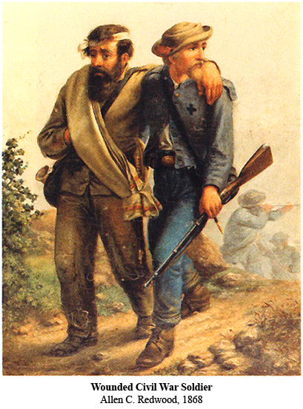
The American Civil War
Eastern Theater
1862
Notes:
Instructor Note:
These slides contain animated objects. This presentation is intended to be viewed in “Slide Show”. Each click of the mouse will move an object, make an object appear/disappear or show an arrow. Each bulleted line in the Notes Pages correspond the sequential order of each “action” and describes that action.
Lines in Green are planned movements or do not have any action.
Lines in Red are analysis or refer to the accompanying Word analysis document.

Slide 2
Banks
Fremont
Jackson
McClellan
J. Johnston
McClellan’s Plan
1862
Notes:
McClellan’s Proposed Plan to defeat Confederate Army:
Move by sea (undetected) to Urbana on the Rappahannock. This would put the Union Army closer to Richmond than the Confederate Army.
Conduct a rapid march to Richmond. This would hurt Confederate morale and force the Confederate army to attack him on Union terms.

Slide 3
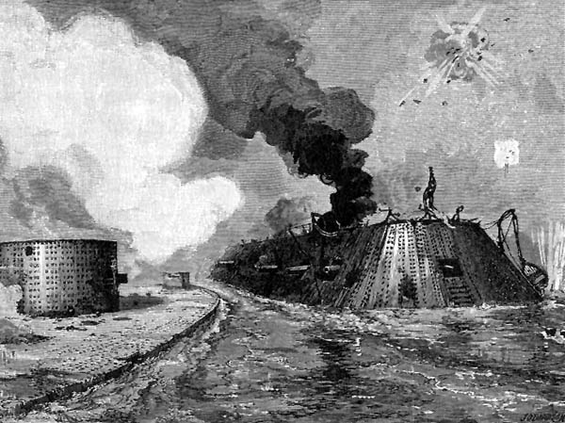
Banks
B
Fremont
J
S
Jackson
McClellan
Army of the Potomac
McDowell
J. Johnston
Jackson
155,000
Troop Strength
(Thousands)
100
Ewell
90
E. Johnson
E
80
70
60
50
J. Johnston
40
McClellan
Army of the Potomac
30
20
Jackson’s Valley
&
Peninsular Campaigns
10
U.S.
C.S.
Notes:
Confederate disposition: BG E. Johnson positioned to block any movement by Fremont toward Tennessee or Staunton. Jackson was at Winchester to defend this important supply base and prevent Union movement into the Shenandoah Valley. J. Johnston had the majority of the Army(40,000) positioned on the most likely Union avenue of approach to Richmond.
McClellan applied his superior administrative skills to train and organize a greatly increased Union troop strength of 155,000 in the Washington area.
Johnston had intelligence that told him of Union intentions of moving to the south by sea. He therefore fell back behind the Rappahannock. This move placed him closer to Richmond, thus negating the Union advantage of landing at Urbana.
Undeterred, McClellan moved the landing site to Fort Monroe, which was a secure site in Union hands.
In March, the Confederate Navy presented a threat to the landing site: CSS Virginia – A new ironclad based on the hull of the Union ship Merrimack (burned to the waterline when Norfolk was evacuated)
8 March – CSS Virginia destroyed two Union Blockade ships: USS Cumberland and USS Congress.
9 March – USS Monitor (built to counter Conf. ironclads) arrived and battled CSS Virginia. While the battle was essentially a draw, the Monitor successfully neutralized the CSS Virginia threat to the blockade and the Fort Monroe landing site.
CSS Virginia was eventually scuttled May 10 when Norfolk was abandoned due to Union advances.
Jackson’s Valley Campaign – Confederate forces varied (About 4,000-16,000) throughout the campaign. Jackson’s purpose was to observe the enemy, keep them occupied (prevent Union from reinforcing their main forces to the east) and be prepared to reinforce the Confederate main effort.
March 11-17 After Johnston’s move south to the Rappahannock, Jackson withdrew from his exposed psn to Strasburg. MG Banks crossed the Potomac with his Corps and occupied Winchester shortly after Jackson evacuated it.
Under pressure, Jackson continued south to Mt. Jackson. Banks sent a Division (BG James Shields) in pursuit.
March 19 – McClellan began his seaborne movement to Fortress Monroe. (Also, prior to movement, McClellan had been relieved of the duty of General in Chief of all Union forces – no replacement was named – Lincoln and Secretary of War Stanton took on the duties of overall coordination)
March 19 – Shields incorrectly identified that Jackson was leaving the valley. He returned to Winchester and reported this to Banks. Banks began to send the majority of his forces toward Washington. His units were to defend the capital, releasing McDowell to conduct operations with the Army of the Potomac (AOP).
Jackson identified the Union movement. To accomplish one of his missions (prevent Banks from reinforcing McClellan), Jackson attacked Shields even though he was heavily outnumbered.
March 23 – At the Battle of Kernstown, Shields defeated Jackson, who fell back to the south. Jackson was despondent because he felt that he had failed.
In fact, Jackson was quite successful strategically. Believing Jackson’s attack was a forerunner of greater attacks in the Shenandoah, Banks returned to the Valley.
Also, to assist Fremont in W.VA territory against this threat, Lincoln diverted a division (10,000) from McClellan’s force.
Worse still, while McClellan was in the middle of moving his army south, McDowell’s Corps, which was to be moved by sea, was instead held in the Washington area to protect the capital.
This diversion of forces reduced McClellan’s force to 92,000 available for the Peninsula. While the Union Army still overwhelmingly outnumbered Johnston’s main force, McClellan’s constant overestimation of Confederate forces opposing him, combined with this reduction, created a paralysis in the Union commander’s ability to act decisively.
As McClellan was transferring his troops by sea, Johnston was also moving his main army south toward the Peninsula, dropping Ewell’s division at Gordonsville to support Jackson.
The original plan was to send overwhelming force up the peninsula to take Richmond and destroy the main Confederate Army.
However, Jackson’s aggressive actions with his a small Confederate force had resulted in much larger Union forces becoming fixed away from the main effort.

Slide 4
B
Banks
Fremont
B
F
McDowell
B
J
Jackson
S
Troop Strength
(Thousands)
McDowell
100
Jackson
Ewell
90
E
E. Johnson
80
Battle of Seven Pines
(31 May-1 June 1862)
70
McClellan
Army of the Potomac
60
Lee
50
J. Johnston
J. Johnston
40
McClellan
Army of the Potomac
30
20
Jackson’s Valley
&
Peninsular Campaigns
10
U.S.
C.S.
Notes:
4 April. McClellan began initial movement with two corps. On 5 April, McClellan came in contact with Confederate fortifications commanded by MG John Magruder and was informed of McDowell’s Corp being held at Washington.
McClellan decided to await reinforcements and siege artillery to breach the Confederate line which took all of April to accomplish, thus allowing Johnston time to consolidate his forces.
While McClellan waited at Yorktown, Jackson withdrew south to Harrisonburg. He then shifted East so he would not be cut off from Ewell, and at the same time, threaten the Union flank if they attempted to move south.
Jackson’s plan to deal with Fremont and Banks with his limited resources:
Phase I – Join with E. Johnson and drive Fremont’s southern wing back at McDowell, (which was threatening Jackson’s rear)
Phase II – Turn on Banks with Ewell and drive him out of Shenandoah Valley.
Prior to this happening, Johnston decided he could not compete with McClellan’s planned attack of 5 May and withdrew from Yorktown on 3 May. Both armies proceeded slowly up the Peninsula until they faced each other in front of Richmond on 24 May.
During this shift in location of the main armies, Jackson executed his plan:
30 April – Jackson took an indirect route (deception) to join with E. Johnson vic. Staunton. Simultaneously, Ewell occupied the area Jackson just vacated to threaten Bank’s flanks if the Union attempted to pursue Jackson.
7 May – After linking up with Johnson, Jackson skirmished with Union Bde at McDowell, which fell back to Franklin.
Jackson pursued to Franklin, but turned back to McDowell (12 May) when the Bde was reinforced from the north.
Banks is ordered to send Shield’s division to support McDowell’s Corps. With this loss of strength, Banks withdrew north, down the Valley to defend Strasburg (with a garrison of 1,000 at Front Royal).
20 May, Jackson reached New Market, crossed the Gap at Luray to join with Ewell and together they overwhelmed the Front Royal Garrison (23 May).
Banks withdrew north to make a stand at Winchester.
As mentioned earlier, this is the time that the main Union/Confederate Forces were closing on Richmond (24 May). McClellan reorganized his army into 5 corps with three north of the Chickahominy River, and two south of it.
To support the AOP, McDowell had been ordered to move south over land and join with the main army against Lee. (the move was to be made on 26 May).
However, Jackson defeated Banks at Winchester (25 May) who withdrew across the Potomac.
Lincoln, identifying the possibility to cut Jackson off in his northern exposed position, ordered Fremont to move East and re-directed McDowell to move West and trap the Confederates north of Strasburg. (once again, Jackson’s small force redirected decisive Union forces away from the main effort)
30 May – Union forces were in position to close the trap (See Analysis: East #1). Jackson had been rapidly moving south once he discovered the Union movement.
Jackson sent cavalry and one Infantry brigade fwd to delay the Union pincers.
Ewell supported the cavalry to delay Fremont, then turned to repulse Shield’s division in the East. Jackson evaded the trap.
31 May - 1 June – Johnston attacked McClellan in the Battle of Seven Pines (Fair Oaks).
Although the battle was inconclusive, Johnston was wounded and replaced by Lee.
Jackson’s Cavalry blocked Shields in his attempts to cut off Jackson at Luray Gap and South Fork. Jackson arrived at Cross Keys by 7 June.
8 June – Ewell defeated an attack by Fremont at Cross Keys then joined Jackson to defeat Shields at Port Republic on 9 June. Jackson withdrew to Brown’s Gap on 17 June.
12-15 June – Stuart’s ride around the AOP.

Slide 5
Banks
Fremont
B
Second Bull Run
(29-30 Aug 1862)
Banks
Pope
Army of Virginia
McClellan
Army of the Potomac
VI
III
Fremont
Lee
Army of Northern VA
Sigel
Banks
McDowell
P
V
Troop Strength
(Thousands)
II
Cedar Mountain
(9 August 1862)
IX
McDowell
F
Pope
Army of Virginia
Burnside
S
100
Jackson
Ewell
90
J
J
L
80
Jackson
Seven Days Battles
(26 June - 1 July 1862)
70
Lee
Army of Northern VA
McClellan
Army of the Potomac
60
Longstreet
50
Lee
40
30
Burnside
20
Jackson’s Valley
&
Peninsular Campaigns
2nd Bull Run
10
U.S.
C.S.
Notes:
Union dispositions following Jackson’s Valley Campaign and Battle of Seven Pines: Fremont & Banks consolidate vic. Strasburg. McClellan has moved all but one Corps (Porter’s V Corp) south of the Chickahominy River. Lee plans to attack this exposed corps and cut off McClellan’s supply line to White House (which connected him to the York River)
24-25 June – Jackson moved to reinforce Lee’s Attack. The following attack resulted in continuous battle over the next 7 days.
26-27 June – Battles of Mechanicsville and Gaines Mill. Lee massed 65,000 against Porter’s 30,000. McClellan shifted his supply lines to the James River.
28 June-1July - McClellan withdrew south on his new supply line. The AOP made a stand at Malvern Hill on 1 July, the last major action of the Peninsula Champaign.
26 June – General Pope was transferred from the western theater to organize and command the three Northern corps from Jackson’s Valley Campaign (Army of Virginia). Halleck was also pulled from the West to become the General in Chief (11 July). (Halleck will eventually order McClellan to return by sea to Washington(3 August) and unite with Pope. See Analysis: East #2)
Banks and Sigel (Fremont resigned in protest of the junior Pope commanding) moved out of the Shenandoah, east of the Blue Ridge Mountains.
12 July - Lee sent Jackson to Gordonsville to defend against the Army of Virginia (AV).
5 Aug - Burnside, who arrived at Fort Monroe to support the AOP after his N. Carolina expedition, was now sent to Fredericksburg to support Pope (a portion of his Corps, commanded by Reno, will eventually join Pope – not shown)
Both sides now participated in a race against shifting forces. Halleck wanted Pope to consolidate and move south to delay Lee while McClellan withdrew by sea to Washington. Lee wanted to destroy the AV before the AOP could join it, but could not leave Richmond unguarded with McClellan still occupying Malvern Hill. Jackson wanted to attack each AV corps separately before it could unite. The result was the battle of Cedar Mountain on 9 August. (See Analysis: East #3)
This was an indecisive battle between Jackson and Banks’ Corp, but convinced Lee he must unite his army to destroy Pope. Jackson withdrew to Gordonsville and Pope united his Army.
13-17 Aug – With credible intelligence that McClellan would withdraw soon (he began 14 Aug), Lee sent Longstreet to join Jackson and united the Army of Northern Virginia (ANV) with the intent of defeating Pope before the arrival of the AOP.
22 Aug – Porter’s (V) and Heintzelman’s (III) Corps arrived at Alexandria and Aquia Landing and linked up with Pope.
25-26 Aug – Jackson, followed by Longstreet moved to cut off Pope’s Lines of Communication (and force Pope to react).
27 Aug – Franklin’s (VI) and Sumner’s (II) Corps disembarked.
29 Aug – After extensive maneuvering by both Pope and Jackson, Pope finally located Jackson and attacked him.
30 Aug – Before II or VI Corps could link up with Pope, Longstreet attacked Pope’s flank.
Defeated, Pope’s forces withdrew back to Washington in great disarray (Closed on Washington by 3 Sept)
Lincoln, searching desperately for a commander to successfully lead the Union Army, but facing a Confederate Army sitting at Washington’s doorstep, was again forced to turn to McClellan to revitalize a disorganized and demoralized Union Army.
While McClellan was reorganizing his army, Lee turned his sights on invading the North. This Campaign would result in the Battle of Antietam. (See Separate Antietam Slide Show)

