Slide 1
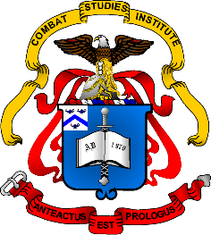
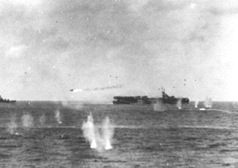
World War II
Leyte Gulf/Luzon
October 44 – April 45
Notes:
Instructor Note:
These slides contain animated objects. This presentation is intended to be viewed in “Slide Show”. Each click of the mouse will move an object, make an object appear/disappear or show an arrow. Each bulleted line in the Notes Pages correspond the sequential order of each “action” and describes that action.

Slide 2
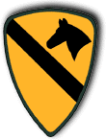

TF 38
Second Striking Force
Carrier (Decoy) Force
Wasp
18
TG 38.1
Hornet
12
Monterey
26
Cowpens
25
TG 38.2
Intrepid
11
Hancock
19
22
Cabot
28
Independence
TG 38.3
Essex
9
TG 38.3
Lexington
16
Princeton
23
Langley
27
TG 38.2
TG 38.4
Enterprise
6
Franklin
13
Belleau Wood
6th Army
24
San Jacinto
30
TG 38.4
X Corps
Landing
Area
XIV Corps
TG 38.1
TG 77.3
Force A
Taffy 1
Taffy 2
Force C
Taffy 3
First Striking Force
Notes:
20 Oct 44: 6th Army landed at Leyte Gulf. This force contained an immense amount of vulnerable landing craft, troop and supply ships. The 7th Fleet, using pre-war battleships and 18 Escort Carriers, provided direct combat support to the landing.
Halsey’s TF 38, which consisted of all the Fast Carriers, Light Carriers and new fast Battleships were in general support of the landing, isolating the landing area with areal raids and prepared to attack and destroy the Japanese Navy.
The Japanese Navy intended to contest the landings. The plan (Sho-1):
A Carrier Strike Force (Northern Force) under Ozawa, would attempt to draw as much of the American combat power away from their landing area, particularly the fast carriers of TF 38.
Surface ships would then attack with the remainder of the Japanese Fleet (Two super battleships, five Battleships and many heavy cruisers). The First Strike Force, based out of Borneo, would be broken into two: Force A (Center Force) under the overall commander, Kurita, would travel through the San Bernardino Straight and Force C (Southern Force) under Nishimura would travel through the Surigao Straight. A smaller force from Japan, the Second Strike Force under Shima, was sent to be the rear of the Southern force. The Center and Southern Forces would act as a pincer to destroy the vulnerable ships in the landing area.

Slide 3
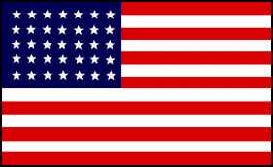
Center Force
First Striking Force (Force A)
Carrier (Decoy) Force
TF 38
TG 38.1
Wasp
18
Hornet
12
Monterey
26
Cowpens
25
TG 38.2
Intrepid
11
Hancock
19
22
Cabot
28
Independence
TG 38.3
Essex
9
TG 38.3
Lexington
16
Princeton
23
Langley
27
TF 38
Enterprise
TG 38.2
TG 38.4
6
Franklin
13
Belleau Wood
24
San Jacinto
30
TG 38.4
Taffy 3
Landing
Area
77.3
“TF 34”
TG 77.3
Southern Force (Van)
First Striking Force (Force C)
Southern Force (Rear)
Second Striking Force
First Striking Force
Notes:
22 Oct 44: TG 38.1 & USS Hancock was detached to Rearm/Reprovision/Rest at Ulithi.
22 Oct 44: 1st Strike Force sailed from Borneo. 23 Oct: The Center Force is discovered and attacked by two US Submarines (Darter and Dace). Two Cruisers (Atago and Maya) are sunk and a third Cruiser (Takao) is damaged and returned to port.
241000 Oct 44: Relative positions of Northern (Decoy), Center and Southern Attack Forces. The Carrier Force consisted of the Zuikaku (the last veteran of Pearl Harbor), three light carriers and two battleships that had been converted to ½ Battleship & ½ Seaplane Carrier.
24 Oct 44: Japanese land based planes attacked TG 38.3 and sunk the Light Carrier Princeton.
24 Oct 44: US Reconnaissance planes spotted the Center Force and US Carrier planes attacked and sunk the Super Battleship Musashi and damaged the Heavy Cruiser Myoko (returned to port). Kurita decided to turn back.
Halsey, thinking he had defeated the Center Force, now turns his attention to the Northern force (recently spotted) and the Southern Force.
TG 77.3 (from Kinkaid’s 7th Fleet) was tasked to defeat the Southern Force in the Surigau Strait.
The three remaining fast carrier Task Groups assembled to steam north and destroy the Japanese Northern force.
Halsey had transmitted radio traffic announcing a planned formation of TF 34 which would have contained all the fast battleships to defend the San Bernardino Strait.
However, when he traveled north, he kept all the Battleships task organized with the three Carrier Task Groups. Higher HQ and Kinkaid assumed the battleships had been left behind as TF 34 (which never formed).
Unknown to the US, Kurita again turned his force around in the cover of darkness and was headed toward an unguarded landing area.
250400 Oct 44: Van of the southern force was destroyed by the veteran battleships of Pearl Harbor. The rear of the southern force withdrew with one cruiser damaged.
250600 Oct 44: The Center Force arrived to the north of the Landing Force. They encountered a very surprised Escort Carrier detachment – Taffy 3 (one of three groups of 6 Escort Carriers assigned and armed to support ground troops, not engage battleships).
In a running battle, the Escort Carriers and their 5 Destroyer/Destroyer Escorts trying to buy time, sunk 3 Cruisers and damaged a 4th.
The Japanese sunk three US Destroyers/Destroyer Escorts and an Escort Carrier: Gambier Bay.
25 Oct: Halsey destroyed all 4 Japanese carriers. The two converted battleships escaped.
25 Oct: Kurita, whose ships had been dispersed and damaged, withdrew as Taffy 2 approached. He missed a great opportunity to destroy a portion of the vulnerable US landing force. US Fast Battleships finally returned to Leyte, but too late to engage Kurita’s withdrawing force.
As the Japanese surface fleet retreated, the first organized Japanese Kamikazes attacked the hapless Taffy 3 and sunk the Escort Carrier St. Lo.
With no Japanese naval or effective air threat to contend with, the US Army defeated the ground forces on Leyte Island by 25 December.
US Battleships in TG 77.3
West Virginia
California
Maryland
Tennessee
Pennsylvania
Mississippi *
*The only BB not at Pearl Harbor on 7 Dec 41
US Battleships in TF 38
Iowa**
New Jersey**
S. Dakota
Massachusetts
Alabama
Washington
**Newest BB’s of the Fleet – comparable to the Japanese Super Battleships

Slide 4
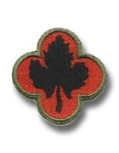


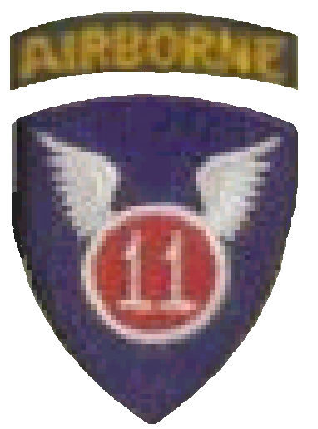
TF 38
Wasp
18
TG 38.1
Hornet
12
6th Army
I Corps
Yorktown
10
Follow Up
Monterey
26
Cowpens
25
DAMAGED
Intrepid
11
TG 38.2
11
XIV Corps
Hancock
19
22
Cabot
28
Independence
DAMAGED
Essex
9
TF 38
9
TG 38.3
DAMAGED
Lexington
16
8th Army
16
Ticonderoga
14
Langley
27
14
Enterprise
6
10
TG 38.4
DAMAGED
Franklin
13
13
6th Army
Belleau Wood
24
San Jacinto
30
X Corps
XIV Corps
Notes:
Nov 44: While the 6th Army was clearing Leyte Island, TF 38 was preparing for the next major amphibious operation, the invasion of Luzon. (Yorktown returned to and Ticonderoga entered the fleet)
However, just after Franklin suffered severe damage by a Kamikaze off of Samar, TF 38 suffered the temporary loss of three more carriers to a Kamikaze campaign off of Luzon (Lexington, Intrepid and Essex)
15 Dec 44: Mindoro was invaded by elements of the 24th ID to establish airfields which supported the next amphibious landing at Luzon.
9 Jan 45: 6th Army invaded Luzon vic. Lingayen Bay (where the Japanese had landed in Dec 41 and the US had landed in 1899) With Follow on forces, the 6th Army continued the drive south while secondary amphibious landings on the west coast were made by elements of the 8th Army to assist in the capture of the Bataan peninsula and Manila. (Luzon was cleared by April)

