Slide 1
The Principles of War

Slide 2
The Principles of War
“The nine principles of war provide general guidance for conducting war and military operations other than war....The Principles are the enduring bedrock of Army doctrine.”
FM 3-0, 2001

Slide 3
The Principles of War
BACKGROUND
Sun Tzu, Miltiades, Antoine Henri Jomini
  Exploring early principles in theory and practice
J.F.C. Fuller
  First detailed enumeration of principles of war in 1916
Nine American principles of war
  First published and outlined in 1921 Training Regulations No. 10-5
  First clarified in 1923 Infantry Journal articles
  First officially defined in 1949 FM 100-5
  Placed in FM 3-0
  Continuing foundation of Army doctrine

Slide 4
The Principles of War
1. OBJECTIVE
2. OFFENSIVE
3. MASS
4. ECONOMY OF FORCE
5. MANEUVER
6. UNITY OF COMMAND
7. SECURITY
8. SURPRISE
9. SIMPLICITY

Slide 5
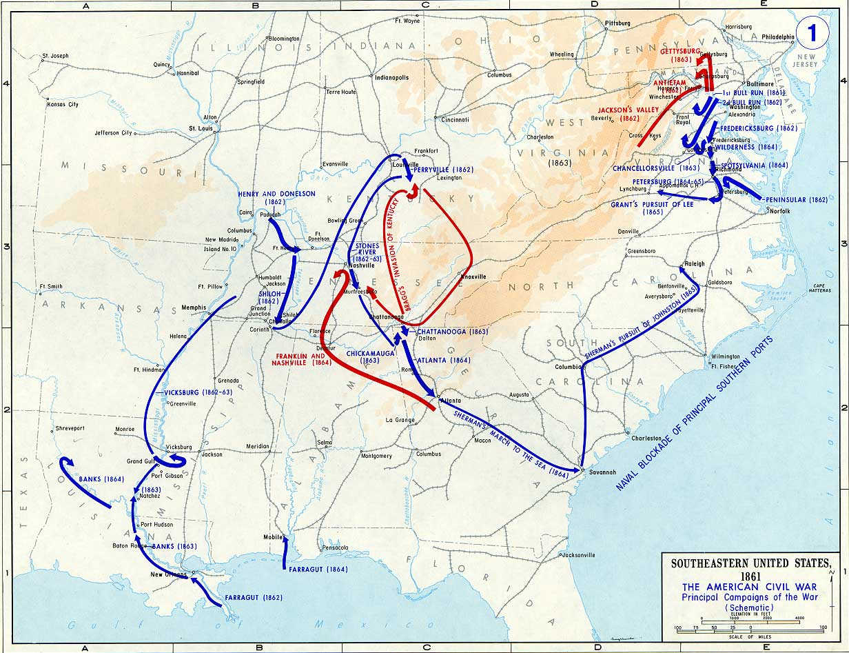
END 1862: STRATEGIC SITUATION

Slide 6
CHANCELLORSVILLE
BACKGROUND
1862 ENDS POORLY FOR THE UNION:
  3 OPERATIONS INITIATED AFTER BATTLE OF ANTIETAM
  ALL 3 OPERATIONS STALLED BY END OF DECEMBER
VICKSBURG AND CHATTANOOGA STILL IN CONFEDERATE HANDS
ARMY OF NORTHERN VIRGINIA STILL EFFECTIVE
  BATTLE OF FREDRICKSBURG IS THE WORST UNION DEFEAT TO DATE
  BURNSIDE’S VAGUE PLAN AND POOR EXECUTION RESULTS IN DISASTER
  PRESIDENT LINCOLN REPLACES BURNSIDE WITH “FIGHTING JOE” HOOKER

Slide 7
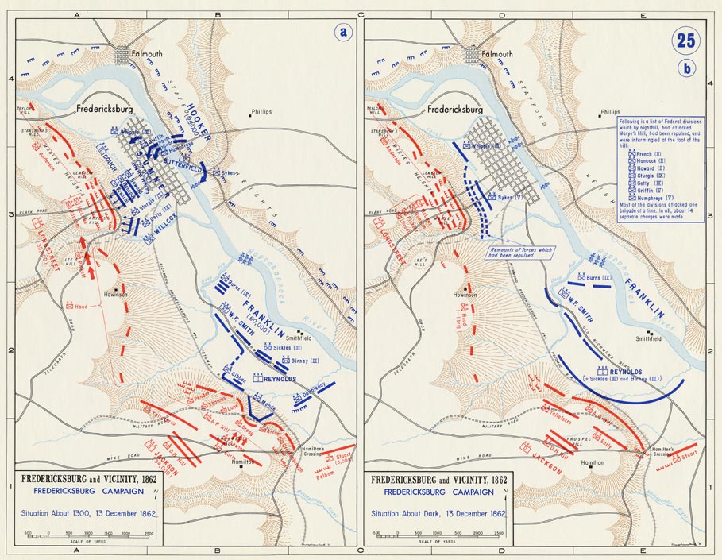
FREDRICKSBURG
Failure of the Grand Divisions

Slide 8
DOCTRINE
UNITY OF COMMAND:
For every objective, ensure unity of effort under one responsible commander.
A single commander directs all actions of all forces toward a common objective
Absence of Command Authority requires unity of effort
  Joint, Multi-national, interagency

Slide 9
CHANCELLORSVILLE
UNITY OF COMMAND
ARMY OF THE POTOMAC STRUCTURE
FREDRICKSBURG vs CHANCELLORSVILLE
XXXX
XXXX
BURNSIDES
HOOKER
XXX
CORPS
XXX+
XXX+
XXX+
GRAND DIVISION
GRAND DIVISION
GRAND DIVISION
XXX
XXX
XXX
XXX
CORPS
CORPS
CORPS
CORPS
XXX
XXX
XXX
XXX
XXX
XXX
XXX
XXX
XXX
CORPS
CORPS
CORPS
CORPS
CORPS
CORPS
CORPS
CORPS
CORPS

Slide 10
DOCTRINE
SECURITY:
Never permit the enemy to acquire an unexpected advantage.
Protect and preserve combat force
Take necessary, calculated risks
Deception enhances Security

Slide 11
CHANCELLORSVILLE
SECURITY:
Hooker implements intelligence / counterintelligence measures
  Military Intelligence Bureau
  Newspaper Censoring
  Deception Operations

Slide 12
DOCTRINE
OBJECTIVE:
Direct every military operation toward a clearly defined, decisive, and attainable objective.
Operational and Tactical Level
    All actions contribute to higher commander’s goals
Strategic Level
    Clear vision of the end-state
Restraint and Legitimacy

Slide 13
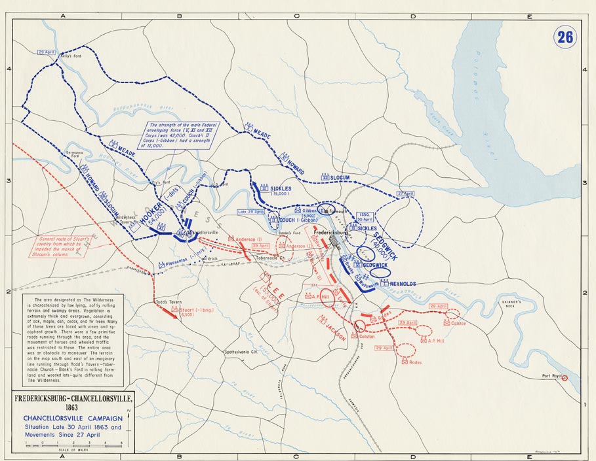
OBJECTIVE
CHANCELLORSVILLE
ADVANCE MOVEMENTS
Turning Force
Reserve
Fixing/Demonstration
Turning Force
(Main Body)
Raiding Force

Slide 14
DOCTRINE
MANEUVER:
Place the enemy in a disadvantageous position through the flexible application of combat power.
Concentrates and disperses combat power
Keeps enemy off balance and reduces cost
Flexibility

Slide 15
MANEUVER
CHANCELLORSVILLE
ADVANCE MOVEMENTS
3
2
1

Slide 16
DOCTRINE
OFFENSIVE:
Seize, retain, and exploit the initiative.
Offensive actions:
  Dictate the nature, scope and tempo
  Force the enemy to react
Essential to retain freedom of action

Slide 17
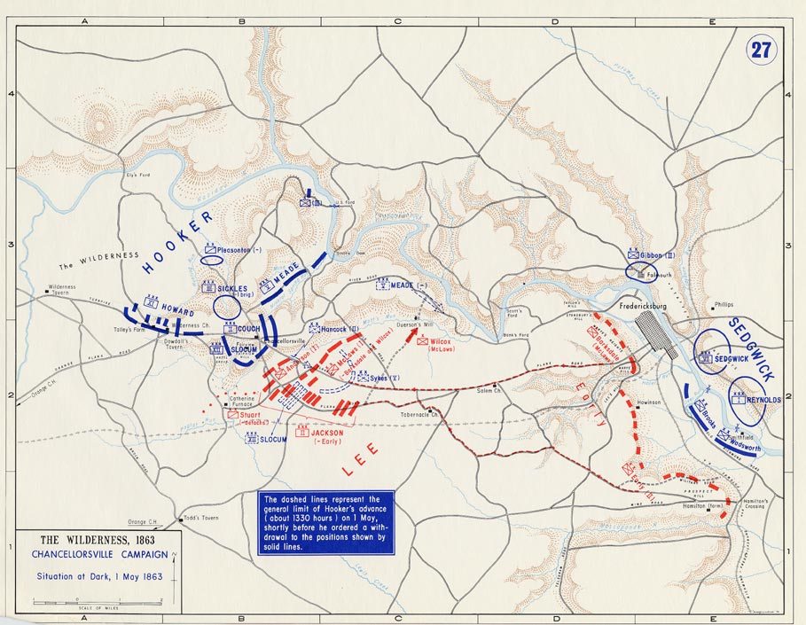
OFFENSIVE
CHANCELLORSVILLE

Slide 18
DOCTRINE
SIMPLICITY:
Prepare clear, uncomplicated plans and clear, concise orders to ensure thorough understanding.
Reduce misunderstanding and confusion
METT-TC will determine degree of simplicity
Simple plan on time vs. detailed plan executed late

Slide 19
DOCTRINE
MASS:
Concentrate the effects of combat power at the decisive place and time.
Mass in time = applying combat power against multiple target simultaneously
Mass in space = concentrate different elements of combat power against a single target
Both can overwhelm and enemy or dominate a situation

Slide 20
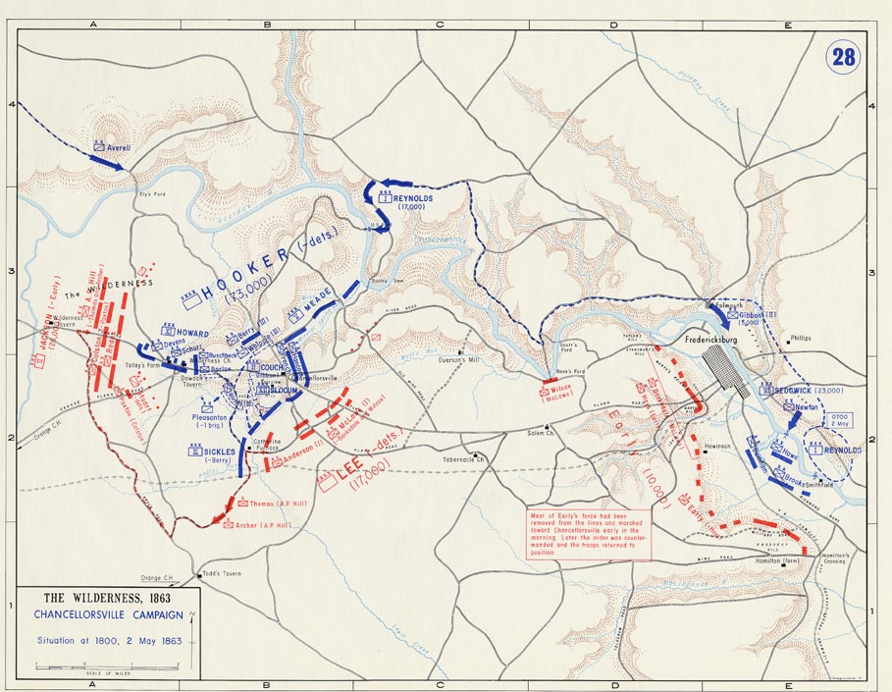
SIMPLICITY/ MASS
CHANCELLORSVILLE

Slide 21
DOCTRINE
SURPRISE:
Strike the enemy at a time or place or in a manner for which he is unprepared.
Major contributor to achieving Shock
Powerful but Temporary
Contributing factors: Speed, Operations Security, Asymmetric capabilities

Slide 22
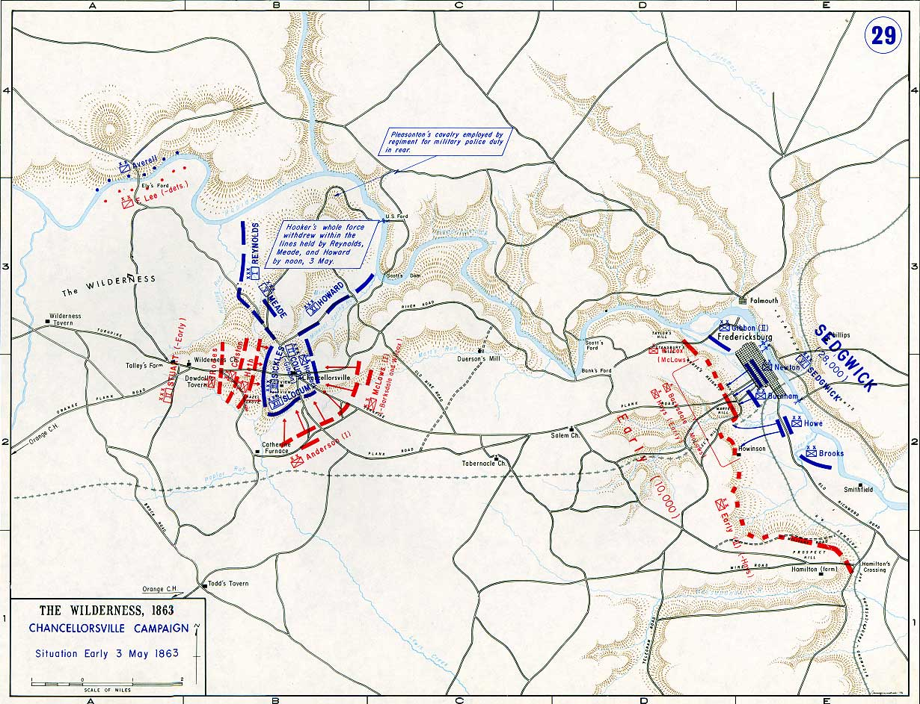
SUPRISE
CHANCELLORSVILLE

Slide 23
DOCTRINE
ECONOMY OF FORCE:
Allocate minimum essential combat power to secondary efforts.
Discriminating employment and distribution of forces
Accepting risk in selected areas to achieve overwhelming effects in decisive operations.

Slide 24
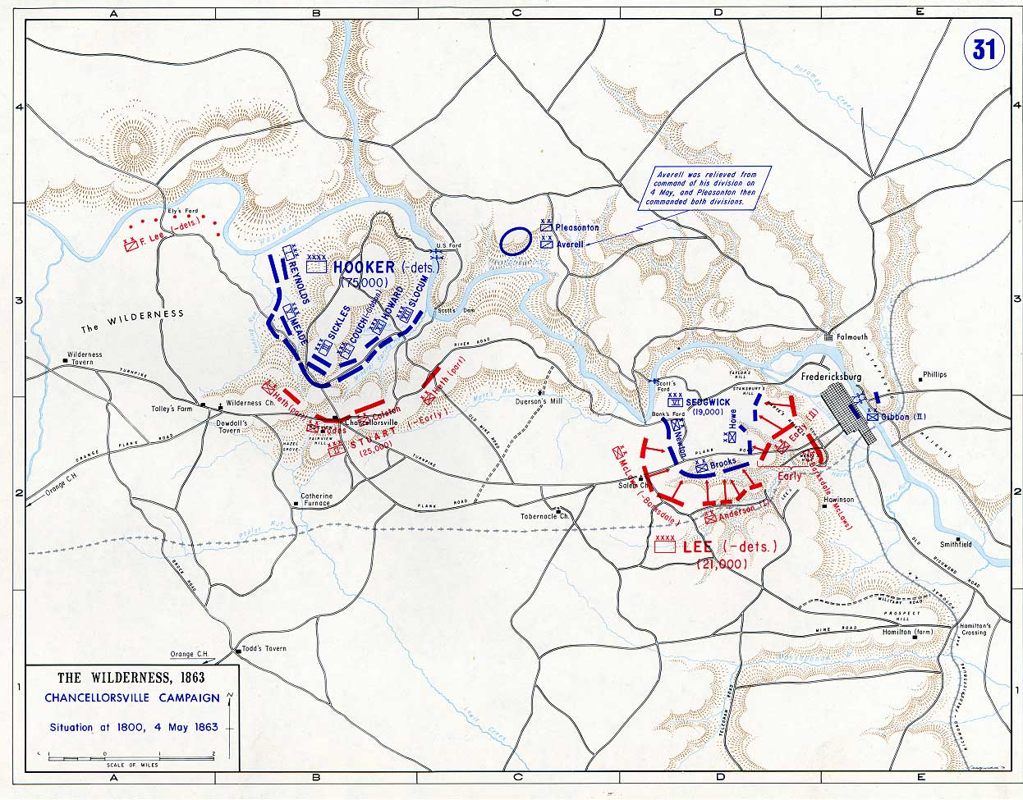
ECONOMY
OF FORCE
CHANCELLORSVILLE

Slide 25
LIMITATIONS OF THE PRINCIPLES OF WAR:
Not prescription, formula, recipe, or checklist!
May be followed or violated and either win or lose!
Guidelines and tool for analysis only!

Slide 26
BACKUP SLIDES

Slide 27
Doctrinal Terms
Forms of Maneuver

Slide 28
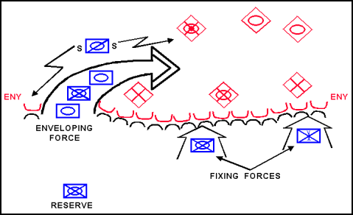
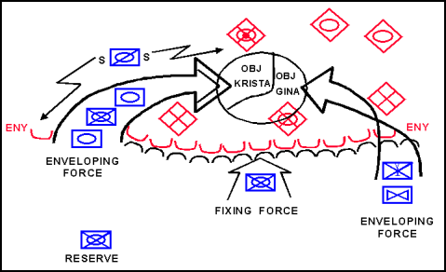
Envelopment
Double
Single

Slide 29
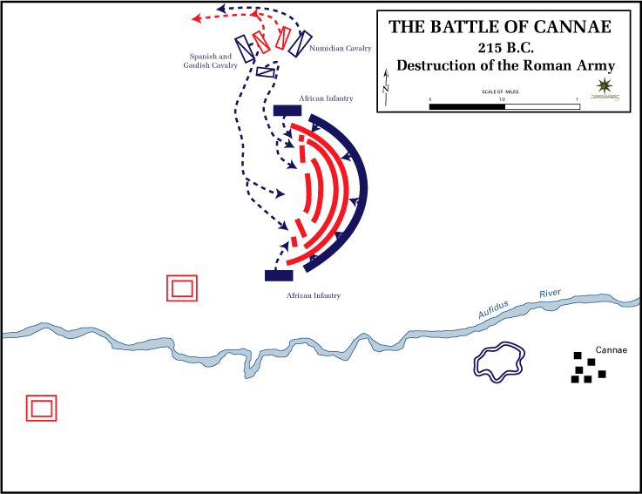

Slide 30
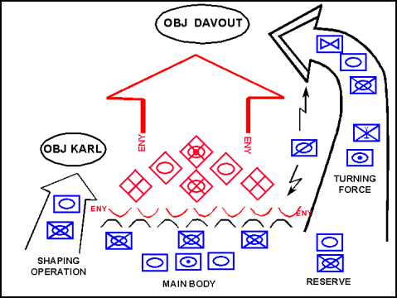
Turning Movement

Slide 32
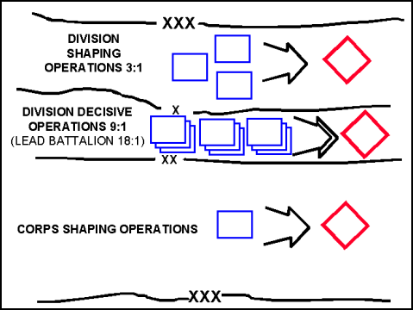
Penetration

Slide 33
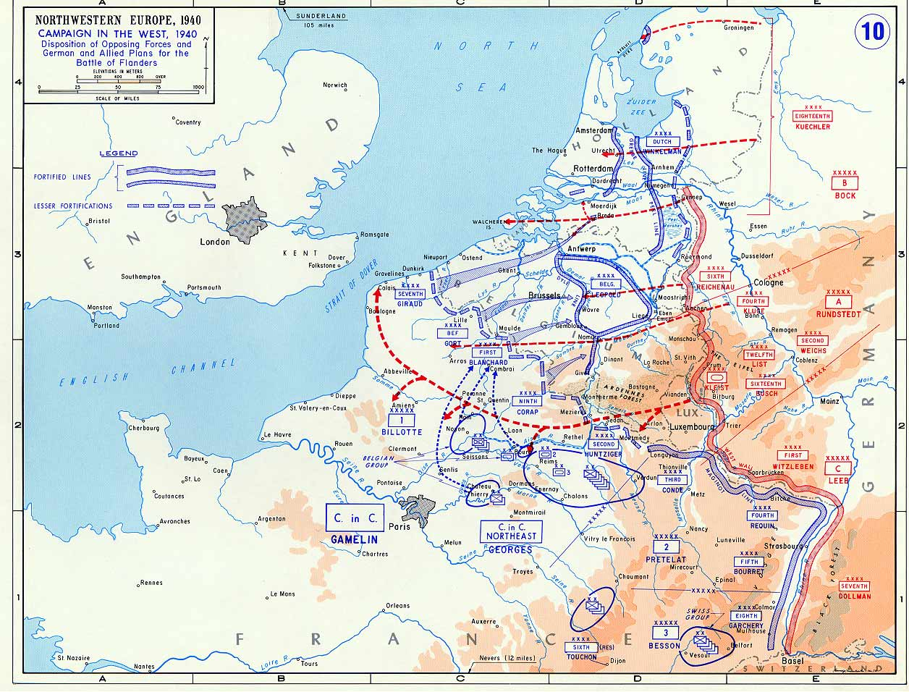

Slide 34
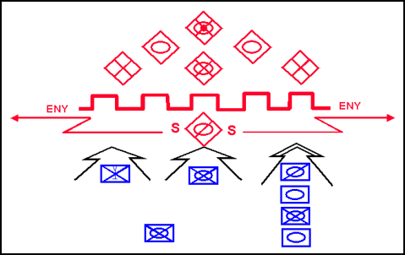
Frontal Attack

Slide 36
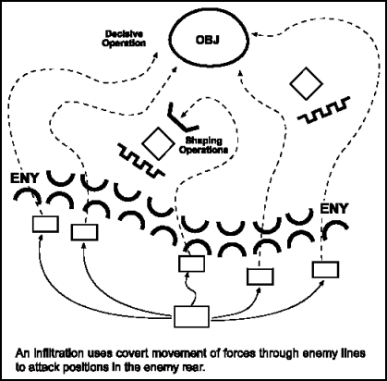
Infiltration

Slide 37
