Slide 1
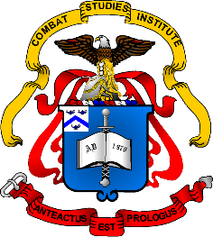
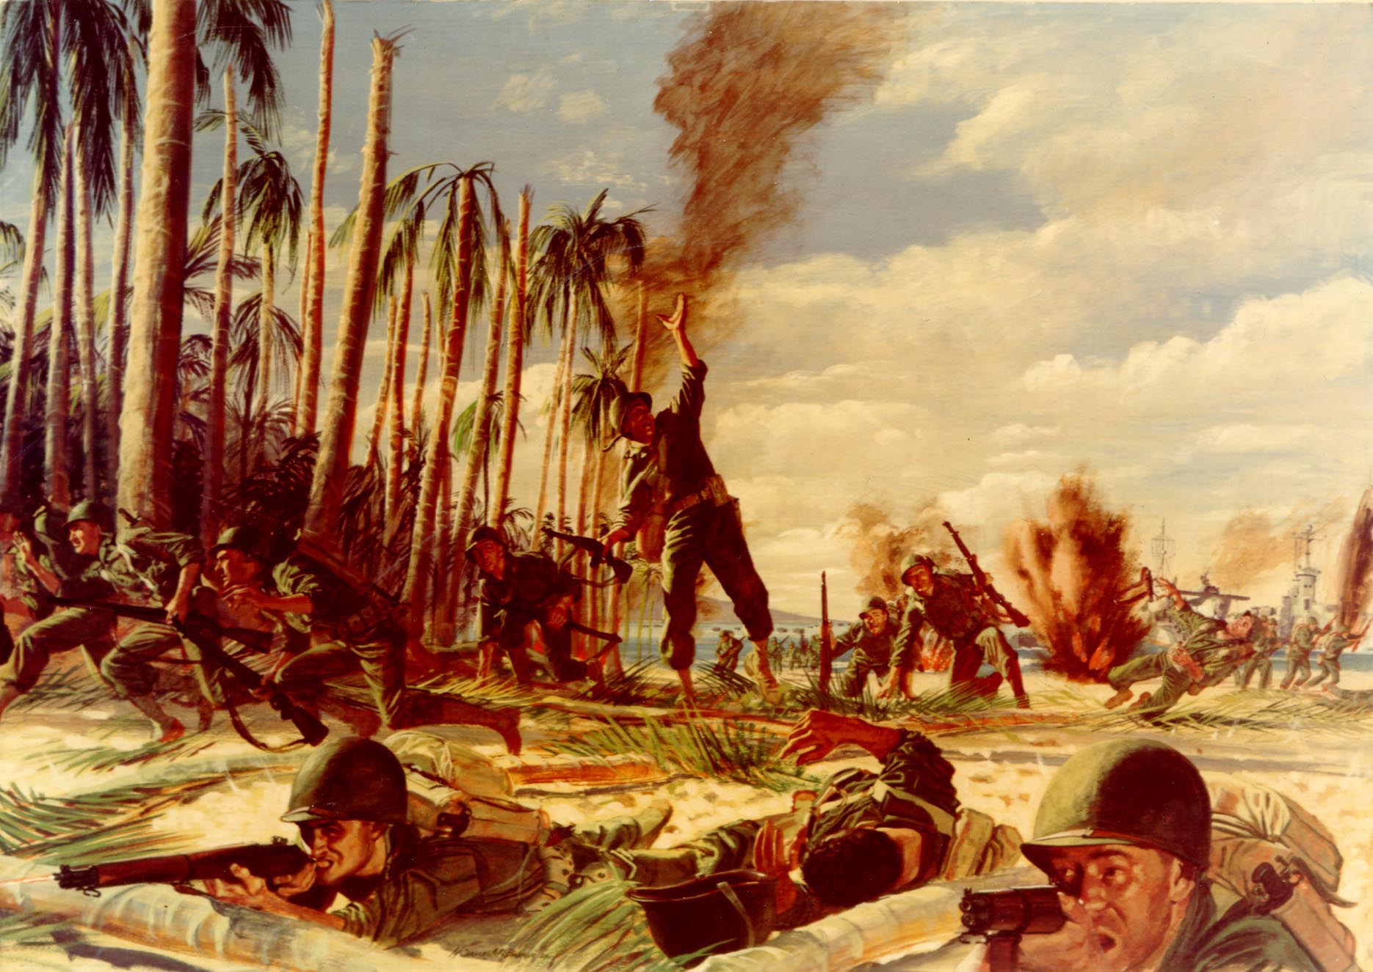
World War II
Pacific Theater
July 1942-August 1945
Notes:
Instructor Note:
These slides contain animated objects. This presentation is intended to be viewed in “Slide Show”. Each click of the mouse will move an object, make an object appear/disappear or show an arrow. Each bulleted line in the Notes Pages correspond the sequential order of each “action” and describes that action.
On some Notes Pages: Lines in blue represent US Central or South Pacific Actions/Movements and lines in green represent US South West Pacific Actions/Movements. Words in red are major events.

Slide 2
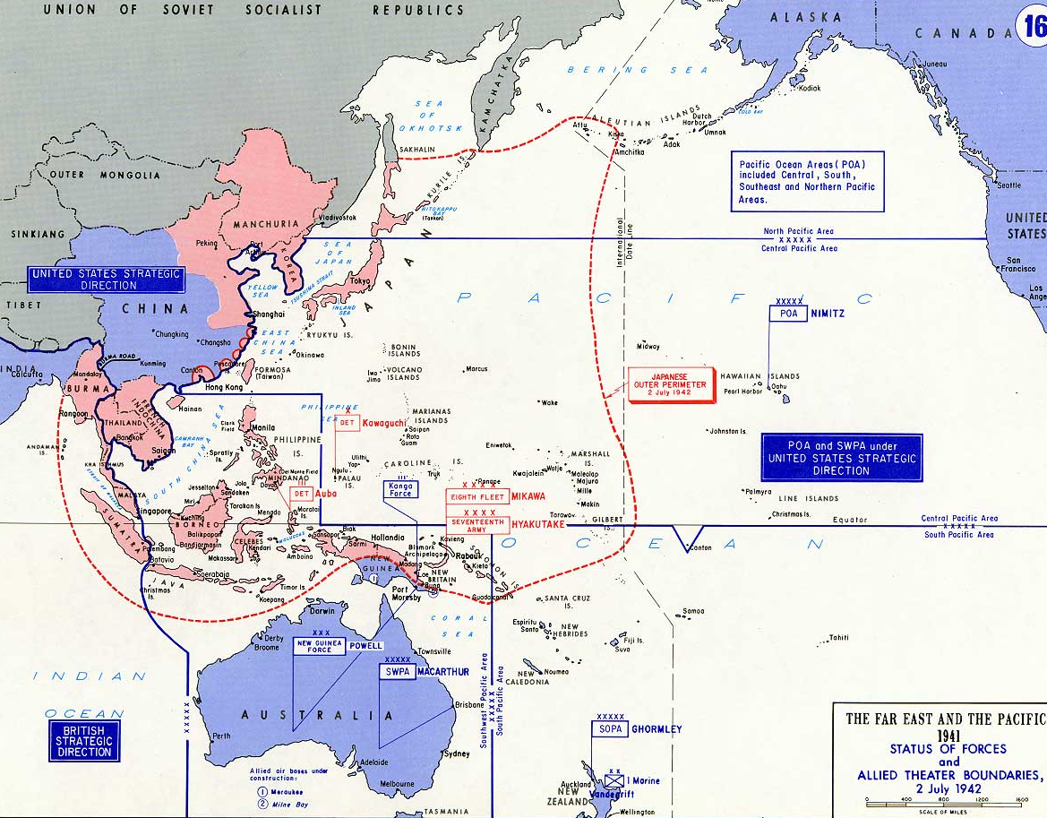
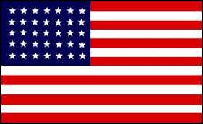
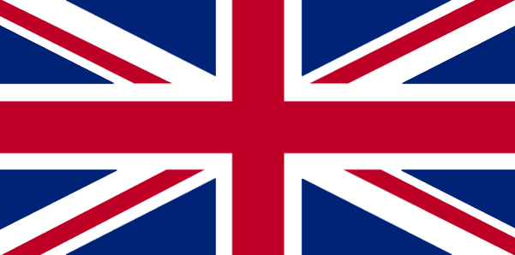
US Division of Command and Initial Offensive Plan
Task 1 – Navy Command
Task 2 – Army Command
Task 3 – Army Command
Nimitz
Ghormley
MacArthur
Notes:
Initial Strategy
April 18 1942 – The US Joint Chiefs devided the Pacific theater into several areas:
The Pacific Ocean Area had 3 subordinate areas: North Pacific, Central Pacific, and South Pacific which all fell under the command of Admiral Nimitz.
The 4th US area was the Southwest Pacific Area under General MacArthur. (MacArthur, being a famous and the most senior officer in the army, needed a command). However, since the Navy did not trust him with their capital ships (Aircraft Carriers), Nimitz would be in direct control of this precious asset even if they operated in the SW Pacific. With Nimitz and MacArthur being of equal rank, both answered directly to the JCS: Nimitz to King, and MacArthur to Marshall. With this unique command structure, there was no overall supreme commander in the Pacific, which in turn drove a rather unique duel drive strategy that formed in 1943.
The British would provide strategic direction of the operations in India and Burma
China remained under the direct control of Generalissimo Chiang Kai-Shek and thus technically answer to no one. But as he was dependant on Allied Aid to survive, LTG Joseph Stillwell served as the Chief of Chiang’s Joint Staff.
The most immediate goal of the US after Midway was to blunt the Japanese drive that had been underway since the Battle of Coral Sea: Stop the Japanese push on the Eastern Solomon Islands. To complete this, the JCS devised a 3 Task operation that would finally put the US on the offensive. July 2 1942, the JCS ordered the following:
Task 1 – Navy Command – Seize Tulagi Harbor, Santa Cruz Island and other nearby areas. Vice Admiral Ghormley, Commander of the South Pacific Area, would control this operation. Simultaneously, Macarthur’s SW Pacific Area would support the Navy’s effort and build up forces in New Guinea.
Task 2 – Army Command – After gaining two footholds from Task 1, two simultaneous drives would seize the Solomon’s and strategic points along the New Guinea Coast. MacArthur would have strategic direction over the entire operation, but the Solomon’s operation, which was primarily a Naval command, would still answer directly to Nimitz.
Task 3 – Army Command – Seize the Japanese stronghold of Rabaul – the ultimate objective of the Allied offensive.

Slide 3
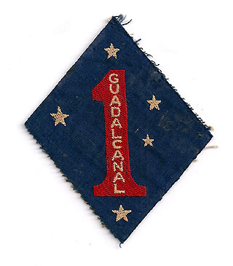
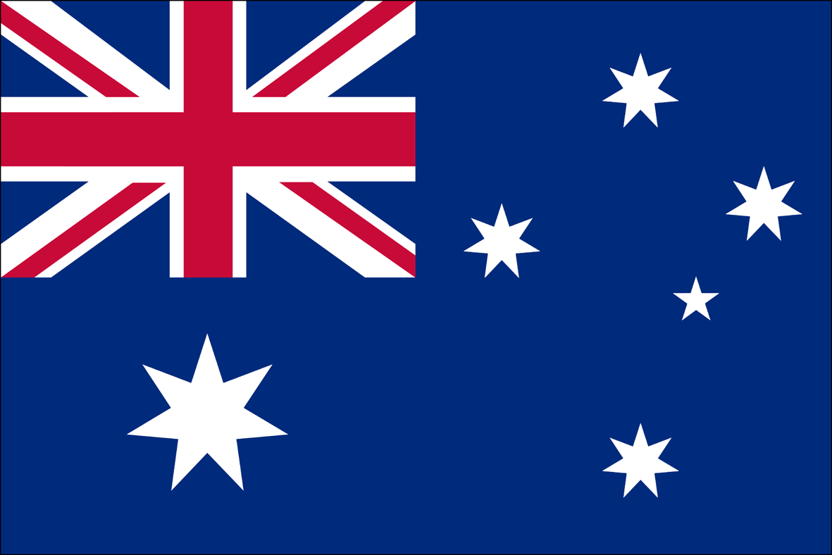

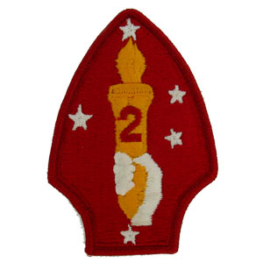
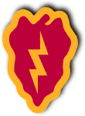
Japanese Carriers
US Carriers
DAMAGED
Shokaku
DAMAGED
Saratoga
3
3
Zuikaku
DAMAGED
Enterprise
6
6
SUNK
Hornet
8
REFIT
8
8
‘Medium’ Carriers
SUNK
Wasp
7
7
Junyo
Hiyo
Mechanical
H
Z
J
S
Nimitz
8
6
7
3
US Ground Forces
(New Guinea)
US Ground Forces
(Solomons)
Halsey
MacArthur
Ghormley
Notes:
Guadalcanal Campaign
21/22 July 42 : After the loss of a large portion of their Combined Fleet at Midway, the Japanese cancel the New Caledonia/Fiji operation that had been started at Coral Sea, but still wanted to complete the occupation of New Guinea by taking Port Moresby. With no naval support to conduct an amphibious operation, the Japanese attempt an overland attack, but are finally repulsed by primarily Australian Troops on 26 Sept.
7 August 42: Invasion of Guadalcanal (Operation Watchtower – Task 1) with the 1st Marine Division (MAR Div), supported by the Saratoga, Enterprise and Wasp.
24 August 42 : Japanese reinforce their troops on Guadalcanal with support from their Combined Fleet (Zuikaku and Shokaku) which produced another clash of carriers – The Battle of East Solomon’s.
The Result: Enterprise Damaged and the loss of a Japanese light carrier (Ryujo). The Combined Fleet withdraws back to Truk (The two main Japanese strongholds in the Pacific were Truk and Rabaul – both focal points for US strategy)
31 August 42: Saratoga was damaged by Japanese submarine but is replaced by Hornet.
16 Sept 42 : Wasp is sunk by a Japanese Submarine. A repaired Enterprise returned to station and on 18 October, Vice Admiral Halsey replaced Ghormley (lack of aggression).
23-25 Oct 42: After a sufficient build up of troops, the Japanese conducted a furious, but ill-coordinated and unsuccessful attack on American positions. Once again, supporting Japanese Carriers clashed with the American supporting fleet on 26 October – the Battle of Santa Cruz.
Results: Hornet was sunk and Enterprise damaged. Japanese Shokaku was heavily damaged and once again the Combined fleet withdraws to Truk, suffering great loss in aircraft/crews.
Sept– Dec 42: Australian forces and 32 Infantry Division (ID) advance over Owen-Stanley Mountains and seize Buna.
Dec 42-Jan 43: XIV Corps (Americal Division/2nd MAR Div/25 ID) replaces 1st MAR Div. Overwhelming US numbers force the Japanese to withdraw from Guadalcanal in February.
The United States now shifted to Task 2 – the Duel Drive up New Guinea and the Solomon’s: Operation Cartwheel. The 1st Half of 1943 was spent building up and preparing to execute this operation.

Slide 4
Japanese Carriers
US Carriers
DAMAGED
Shokaku
DAMAGED
Saratoga
3
3
Zuikaku
DAMAGED
OVERHAUL
Enterprise
6
6
6
SUNK
8
‘Medium’ Carriers
SUNK
7
Junyo
Aircraft Losses
Hiyo
Aircraft Losses
Mechanical
Nimitz
3
H
J
Z
S
US Ground Forces
MacArthur
Halsey
6
Notes:
1st Half of 1943(US preparations for Cartwheel)
Saratoga (Dec 42) and Enterprise (Feb 43) were repaired and return to station to support Solomon’s operations.
Spring 44: While the US is preparing for Operation Cartwheel, the Japanese executed an air offensive. To support this, the Japanese Navy shifted aircraft from their 3rd Fleet to Rabaul: Operation I-Go. In the air battles that followed,(1-14 April) the US successfully countered the Japanese and were not delayed in their preparations.
The Japanese, on the other hand, lost aircraft/crews they could ill afford to lose. The 3rd Fleet was now incapable of operations until they could replace these losses.
18 April: Flying to congratulate his troops and improve moral, Yamamoto fly’s to Bouganville. Radio intercepts allow for US P-38’s to intercept his airplane and shoot it down. Yamamoto is killed and replaced as Combined Fleet Commander by Admiral Koga. (Admiral Toyoda would become the last Combined Fleet Cdr when Koga’s airplane crashed in March ’44). Enterprise was sent back to the US for Overhaul (May).

Slide 5
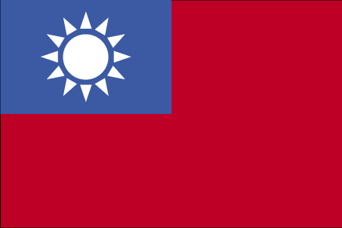

Japanese Carriers
US Carriers
DAMAGED
Shokaku
Saratoga
3
Zuikaku
DAMAGED
OVERHAUL
Enterprise
6
6
Allied Strategic Concept
6
‘Medium’ Carriers
Junyo
Aircraft Losses
Hiyo
Aircraft Losses
Mechanical
Nimitz
H
7
J
5
Spruance
Z
S
5
13
7
Kinkaid
3
Halsey
3
US Ground Forces
MacArthur
Halsey
Notes:
US Strategic Plan
April 43: Joint US Strategic Committee Presents: “The Strategic Plan for the Defeat of Japan”. Assumptions:
-Unconditional Surrender is ultimate goal
-A devastating areal bombardment would be needed prior to invasion of Japan.
China (Hong Kong) was therefore identified as the best location to stage such an aerial campaign.
To obtain this objective, the Americans devised the following strategy:
While MacArthur and Halsey were neutralizing Rabaul, another force under Vice Admiral Spruance (5th Fleet) would gather to conduct a drive through the central pacific.
MacArthur would then conduct a simultaneous and supporting effort in the SW Pacific area.** These duel drives would not only result in control of the South China Sea (needed to supply Hong Kong) but also reoccupy the Philippines and cut off the Japanese from their resources to the south.
The British Forces in India would reopen the Burma Road to supply the Chinese Army, which would in turn attack and recapture Hong Kong from the Japanese.
Once all these tasks were complete, a Strategic Bombing Campaign would begin that would establish the conditions for an eventual seizure of the Japanese Home Islands.
**In reality, due to the magnitude of both efforts, neither drive became a ‘main effort’. Devised from the need to give MacArthur a command, this duel drive concept, with no supreme commander or ability to properly direct resources or a unified strategic direction, seemed to be a recipe for disaster. However, due to the immense capability of the US to supply the men and materiel for both drives, and given the competitive nature of the two services/command personalities, the two drives were fed by the desire to ‘get there first’ and literally overwhelmed the already disjointed and under strength Japanese effort to stop either one.

Slide 6
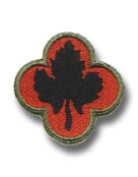


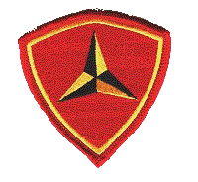
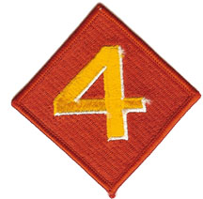
Japanese Carriers
11
US Carriers
Shokaku
Aircraft Losses
Support Duty
OVERHAUL
Saratoga
3
3
3
Zuikaku
Aircraft Losses
OVERHAUL
Enterprise
6
6
Taiho
OVERHAUL
Essex
9
9
‘Medium’ Carriers
DAMAGED
Lexington
16
16
Junyo
Yorktown
10
Aircraft Losses
Hiyo
Bunker Hill
17
Aircraft Losses
DAMAGED
Intrepid
11
11
Hornet
12
T
Nimitz
9
16
10
7
17
H
5
Spruance
J
TF 58
6
12
Z
11
S
16
5
3
7
Kinkaid
13
3
Halsey
US Ground Forces
MacArthur
Notes:
Operation Cartwheel & Beginning the Central Drive:
2/3 July 43: 43 ID invaded New Georgia, but got bogged down.
5 August 43: After XIV Corps reinforced the effort with the 37ID and 25ID (-), the critical airfield of Munda fell (this airfield would support the next effort to seize Bouganville – this would be a major theme throughout the Pacific – Objectives were determined by aircraft range and terrain suitability to build or capture airfields)
2 July – 16 Sept 43: Primarily Australian forces attacked and seized Lae-Salamaua.
May-Aug 43: US Recaptured Attu and Kiska with the 7ID, 11Air Force, and a small surface fleet under Kinkaid. Kinkaid was then promoted to Vice Admiral and received command of the 7th Fleet which supported MacArthur for the rest of the war.
Aug-Oct 43: The first of the Essex carries arrived in the Pacific. Much like the pre-war carriers of early 42, these carriers conducted a series of raids on Marcus, Wake and the Gilbert Islands to train their aircrews.
12 Oct 43: 5th AF conducted a massive 349 plane raid on Rabaul.
Japanese responded to this raid by again stripping the Combined Fleet at Truk of aircraft – 173 planes were sent to Rabaul.
5 & 11 Nov 43: in two separate raids on Rabaul (Saratoga, then Essex & Bunker Hill borrowed from the 5th Fleet) Halsey crippled the Japanese Combined Fleet’s ability to act due to aircraft losses.
1 Nov: While Japanese airpower was being neutralized, the 3rd MAR Div and 37 ID invaded Bouganville.
After Bouganville fell, bypassed Islands to the east had to be evacuated by the Japanese.
Beginning of Central Drive: Instead of a direct assault on the Marshals, the 5th Fleet attacked the Gilberts for the following reasons:
1. Only one Marine Division was needed (freeing up 1st MAR Div for MacArthur)
2. Bases from the Gilberts would allow for a bombing/Reconnaissance campaign on the Marshalls. Thus bases were established vic. the Ellice Islands to conduct Bombing/Reconnaissance on the Gilberts.
20-23 Nov 43: Spruance attacks the Gilberts (Operation Galvanic) with the 5th Fleet Carriers (Grouped into Task Force 58), the 2nd MAR Div on Tarawa and the 27 ID on Makin.
Dec 43 : 1st MAR Div lands on New Britain.
The Japanese Combined Fleet withdraws from Truk to bases in the Carolinas and Indonesia. With Rabaul untenable, the US Fleet threatening the Marshalls and the loss of aircraft, the Japanese fleet is positioned in a safe location to rebuild. A fifth carrier is commissioned in March 44 (Taiho).
Jan 44: 7th AF Raids/Recon of the Marshall Islands.
Feb 44: 4th MAR Div & 7th ID seize Kwajalein Atoll on 1/2 Feb 44 and Eniwetok on 17-22 Feb. Nimitz’s decision to attack these central, less defended islands proved correct as the eastern, well fortified islands were cut off and isolated from Japan.
16/17 Feb 44: TF 58 conducted a surprise attack on Truk destroying over 250 Japanese aircraft
29 Feb 44: 1st Cavalry Division invaded the Admiralty Islands – with this capture, Rabaul was completely isolated. Task 3, to seize Rabaul, was no longer needed.

Slide 7

Japanese Carriers
11
US Carriers
Shokaku
Aircraft Losses
Support Duty
OVERHAUL
Saratoga
3
3
3
Zuikaku
Aircraft Losses
Enterprise
6
Taiho
OVERHAUL
Essex
9
9
‘Medium’ Carriers
Lexington
16
Junyo
Yorktown
10
Aircraft Losses
Hiyo
Bunker Hill
17
Aircraft Losses
DAMAGED
Intrepid
11
11
Hornet
12
T
Nimitz
7
5
Spruance
H
7
17
J
5
Spruance
Z
TF 58
6
12
S
Nimitz
11
16
3
Halsey
5
13
FEAF
7
Kinkaid
US Ground Forces
(New Guinea)
7
Kinkaid
3
Halsey
US Ground Forces
MacArthur
Notes:
Strategic Adjustment
With Nimitz pushing hard in the Central Pacific, Macarthur looked at making a long jump to Hollandia. This would bypass and cut off a great many Japanese troops.
30 Mar-3 Apr 44: To support this mission, two air operations occured: TF 58 was temporarily diverted to raid and isolate Palau while the 5th AF destroyed much of the Japanese Air Force in New Guinea.
April/June 44: With TF 58 covering the assault (which proved unnecessary due to the 5th AF almost complete destruction of the Japanese air force in the area), the I Corp (41 ID, 24 ID, 32 ID) seized Hollandia. TF 58 again raided Truk on their return to the 5th Fleet (29-30 April).
May/August 44: MacArthur made another long jump, this time to Biak, again cutting off Japanese forces.
After Biak, some Command restructure occurred. With the Solomon’s captured and Task 1 & 2 complete, Halsey and the 3rd Fleet was freed up for future operations. This would begin a new and unique command structure for the rest of the war. The Navy’s central drive force would essentially have two higher commands. While Spruance and his staff were in command and fighting the Japanese, the Fleet would be called the 5th (and the Fast Carrier force consolidated as TF 58). Then, once the planned operation was complete, Halsey and his staff would take over, freeing up Spruance to rest and plan for the next operation. With Halsey in charge, the same organization would be renamed the 3rd Fleet (with the carriers becoming TF 38). The result was well planned operations with fresh commanders executing a plan that could be immediately executed. This was yet another example of the US ability to overwhelm the Japanese war effort. Additionally, the 5th and 13th AF were consolidating into the Far East Air Force (the 7th AF would later be consolidated under this organization) and MacArthur would receive Halsey’s XIV Army Corps. MacArthur then activated the 8th Army under Eichelberger in September (the 6th Army under Kruger was already activated)
Strategic Decision in the Central Pacific: After taking the Marshalls, the US central drive could have either taken Truk or bypassed it to the north in the Marianas. With the war in China going poorly (it was doubted the Chinese Army could take the necessary airfields) the Army Air Force tipped the scales to invade the Marianas by identifying those as air bases that their new long range B-29s could operate from.

Slide 8
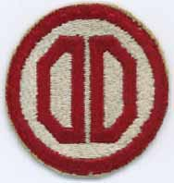

Japanese Carriers
11
US Carriers
SUNK
Shokaku
Aircraft Losses
Support Duty
OVERHAUL
Saratoga
3
3
3
SUNK
Zuikaku
Aircraft Losses
OVERHAUL
Enterprise
6
SUNK
6
Taiho
OVERHAUL
Essex
9
9
‘Medium’ Carriers
Lexington
16
DAMAGED
OVERHAUL
Junyo
Yorktown
10
Aircraft Losses
10
OVERHAUL
Bunker Hill
17
SUNK
17
Hiyo
Aircraft Losses
Intrepid
DAMAGED
11
11
Hornet
12
T
Wasp
20
18
DAMAGED
Franklin
13
13
10
Hancock
19
14
DAMAGED
Ticonderoga
14
14
9
7
18
5
Spruance
13
H
TF 38
19
3
Halsey
20
TF 58
J
Z
MacArthur
S
Nimitz
5
Spruance
3
Halsey
FEAF
7
Kinkaid
US Ground Forces
FEAF
US Ground Forces
(Peleliu)
US Ground Forces
(Morotai)
7
Kinkaid
US Ground Forces
6th Army
Kruger
MacArthur
Notes:
Marianas and Leyte
Early June 44 – As Essex returned and Wasp joined the Fleet, the Japanese Mobile fleet gathered at Tawi Tawi to counter TF 58 (under VAdm Mitscher) and destroy them in a decisive engagement. However, MacArthur’s drive to Biak forced the Japanese to divert some of their surface fleet to counter it. They conducted three aborted attempts to stop MacArthur’s Drive (Kon 1-3) until US actions again forced the Japanese to react.
15 June 44: After a Bombing campaign on several bases in the Carolinas by the Far East and 7th Air Forces, including Truk, to neutralize Japanese air assets, the 5th Fleet invaded the Marianas (Saipan & Tinian) in Operation Forager with the 4th & 2nd MAR Divs and the 27th ID.
19 June 44: Battle of the Philippine Sea. The Japanese redirect their fleet to conduct Operation A-Go and destroy TF 58. The Japanese launched over 430 planes but were intercepted by American fighters and an anti-aircraft screen. The Japanese lost 330 planes in what became known as ‘The Great Mariana’s Turkey Shoot’.
At the same time as this air battle, two US submarines sunk the Shokaku and the Taiho.
20 June 44: As the Japanese fleet attempted to escape, US planes sunk the Hiyo. The Japanese finally lost their naval air capability. They had to rely on land based aircraft for the rest of the war.
21 July 44: Franklin joined TF 58 and Guam was invaded with the 3rd MAR Div and the 77th ID. The Marianas are secured by August.
Prior to the Marianas, the US had conducted a limited bombing campaign that had been established vic. of Chungking by the 20th AF. Supported by the 10th AF, transport planes supplied both the 20th AF and the 14th AF (formally the Flying Tigers, who directly supported the Chinese Army).
At the end of this long and divided air-supply line, B-29s flying at extreme range, had a very limited effect.
The Marianas, which were within range of the major cities of Japan and were supplied by an almost inexhaustible naval supply line, were a much better option for the American Air Campaign that began in November.
Thus the 20th AF assets in China were eventually transferred to the Marianas. This shift also made Hong Kong less important as a final objective and was eventually dropped.
The US, however, continued to orient on the Philippines. The two drives were about to merge and were poised to establish jumping off points to invade the archipelago as one unified effort. Halsey now commanded the Central Pacific forces and Spruance was in the rear to plan the next operation: Iwo Jima/Okinawa.
15 Sept 44: TF 38 now supported both drives as they seized their final objectives prior to the Philippines. Halsey’s forces took Peleliu. This has often been considered a needless and costly attack as it did not contribute much to the taking of the Philippines (however, the bloodless capture of Ulithi to the North East proved to be a huge asset as a forward base for the fleet). MacArthur took Morotai which became an air base that covered the American left flank.
Prior to the invasion of Peleliu and Morotai, Halsey had made some initial raids on the Central Philippines to protect these two attacks. His success in destroying a great number of Japanese aircraft and the overall lack of resistance in this area, led him to suggest dropping many of the planned invasions of Central Pacific Islands, as well as MacArthur’s planned invasion of Southern Philippines: Mindanao. Halsey now suggested, and the JCS accepted, an attack into the Central Philippines – Leyte Island.
As Hancock joined the Fleet, TF 58 covered the northern approaches to the Philippines (by conducting raids on Luzon, Formosa and Okinawa) while the FEAD protected the left flank and isolated Leyte. A raid on Formosa (12-14 Oct) resulted in the loss of 500 Japanese Aircraft – stripping the Japanese Navy of many of the newly trained pilots being prepared to defend the Philippines.
20 Oct 44: Vice Admiral Kinkaid and the 7th Fleet, combined with the amphibious assets from the 3rd Fleet, conducted the invasion of Leyte with the 6th Army (Lt. Gen. Kruger). The overall operation was under MacArthur, although 3rd Fleet’s fast carriers and battleships, tasked with general support and the on-call mission to destroy the Japanese fleet should it arrive, still answered directly to Nimitz.
23-25 Oct 44: Battle of Leyte Gulf (See more detailed Leyte Gulf/Luzon Battle-Map for full details of this battle). The Japanese attempted to destroy the US landing operation by drawing off Halsey’s 3rd Fleet with a decoy force of their most expendable carriers (which had very few defensive planes on them). While this succeeded, the follow on Japanese surface fleet failed with great loss and allowed the US Army to take Leyte and also Luzon which began on 9 Jan 44. TF 38 then entered the South China Sea and conducted very destructive raids on Japanese shipping.
Japan was now cut off from its southern assets/resources and without a Navy to contest the US fleet in any way. The US was set to conduct final operations to defeat the Japanese: retaking the occupied areas to the south, and more importantly, the invasion of the Japanese Home Islands to the north.

Slide 9

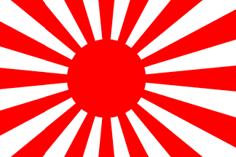

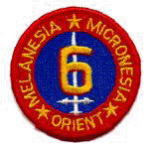
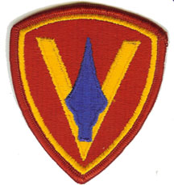


11
US Carriers
Support Duty
Saratoga
3
3
DAMAGED
Enterprise
6
6
Essex
9
OVERHAUL
Lexington
16
16
Yorktown
10
DAMAGED
Bunker Hill
17
17
DAMAGED
DAMAGED
Intrepid
11
11
11
OVERHAUL
Hornet
12
12
Operation Downfall
DAMAGED
Wasp
18
18
MacArthur
DAMAGED
DAMAGED
TF 38
Franklin
13
13
3
Halsey
13
DAMAGED
Hancock
19
19
TF 58
DAMAGED
Ticonderoga
14
14
10
14
Bennington
20
Randolph
15
38
5
Spruance
31
Shangri-La
38
20
15
3
Halsey
Bon Homme Richard
20
31
MacArthur
Nimitz
5
Spruance
3
Halsey
US Ground Forces
(Iwo Jima)
US Ground Forces
(Okinawa)
US Ground Forces
(Philippines)
8th Army
Eichelberger
Notes:
Final Steps
To begin the attack toward the Japanese Home Islands, Admiral Spruance once again took command (and the fleet once again became the 5th) and USS Bennington and Randolph joined TF 58. MacArthur remained with the 8th Army to the south which would clear the rest of the Philippines.
The first objective for Spruance was Iwo Jima to satisfy the following goals: 1. Destroy the Japanese radar/early warning station; 2. Create a ‘life boat’ for B-29s with damage or mechanical failure; 3. Create a base from which fighter planes could escort the B-29s to their targets and provide protection.
Feb 45: In preparation for the invasion, TF 58 conducted raids on Tokyo and Iwo Jima.
15 Feb 45: Iwo Jima invaded with 5th and 4th MAR Divs (3rd MAR Div in reserve). The island was cleared by 26 March.
Spring/Summer 45: With Iwo Jima cleared, the strategic bombing campaign was increased and culminated with firebombing of Japan’s major cities, which destroyed large percentages of them.
Feb-July 45: 8th Army conducted 52 separate amphibious assaults to clear the rest of the Philippines. Australians, who had been previously conducting mop up operations in the Solomon Islands, seize portions of Borneo in July.
Feb-August 45: Much of Burma is recaptured by UK/Chinese/US forces.
March-April 45: With Intrepid and Franklin returning to the fleet (and Lexington sent back for Overhaul) TF 58 conducted raids on the Home Islands to isolate the assault on Okinawa and then supported the invasion which occurred on 1 April (Operation Iceberg) with the 10th Army: III Amphibious Corp (6th and 1st MAR Divs) and XXIV Corps (7 ID & 96 ID) (77ID, 27 ID and 2nd MAR Div were in reserve)
April-May 45: Japanese conducted a massive air and Kamikaze offensive resulting in great loss for the Navy (to include heavy damage to 6 carriers)
21 June 45: Okinawa is finally cleared.
June/July/Aug 45: TF 38 (Halsey was again at the helm of the 3rd Fleet), with several carriers repaired and USS Shangri-La and Bon Homme Richard joining the fleet, began raids on the Japanese Home Islands. MacArthur prepared to invade the Japanese main land.
6 & 9 August 45: US drops Atomic Bombs on Hiroshima and Nagasaki.
9 August 45: The Soviet Union invaded Manchuria and move troops as far as North Korea.
The Japanese government now faced:
Constant, very destructive bombing by the 20th AF that now possessed the Atomic Bomb.
Unopposed raids by TF 38 (which had 11 operational carriers – with more being built/repaired) that could travel on the Japanese coast at will.
Huge Soviet forces that were easily overrunning the much inferior Japanese Army in China.
A planned US invasion of three Armies (that was receiving men and equipment from the now complete European theater).
The Japanese surrendered on 14 August 45. The sun finally set on the Japanese Empire.

