Slide 1

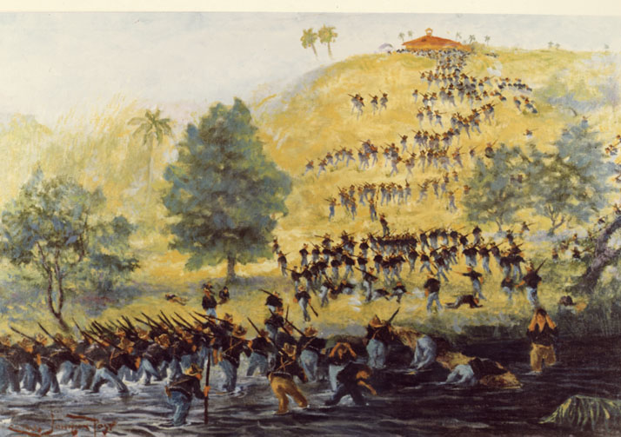
The Spanish-American War
&
The Philippine War
1898-1902
Notes:
Instructor Note:
These slides contain animated objects. This presentation is intended to be viewed in “Slide Show”. Each click of the mouse will move an object, make an object appear/disappear or show an arrow. Each bulleted line in the Notes Pages correspond the sequential order of each “action” and describes that action.
Lines without bullets and in blue are simply further analysis that have no action.
Notes in red are references to the accompanying Word analysis document.

Slide 2
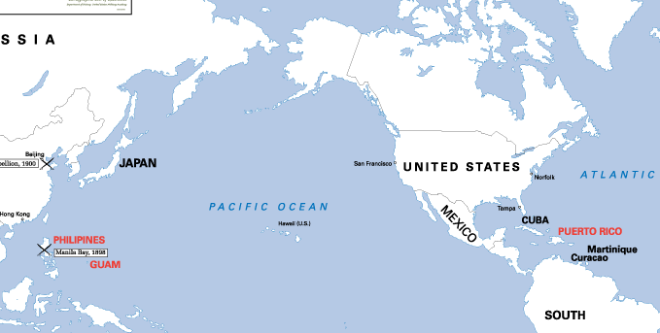
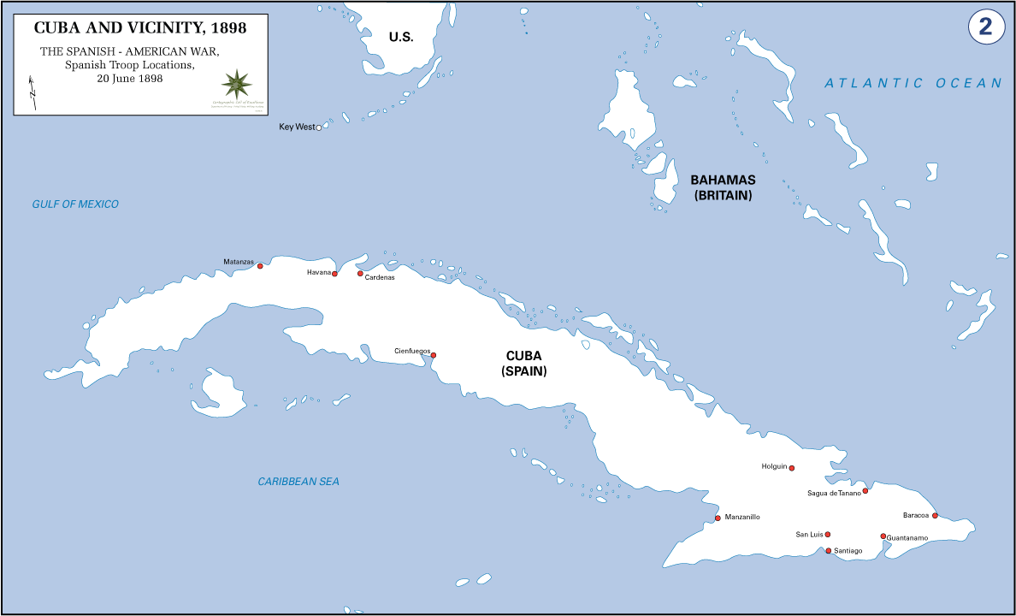

North Atlantic Squadron
Sampson
USS New York
Six 8” Guns
USS Iowa
Four 12” Guns
Asiatic Squadron
Dewey
USS Indiana
Four 13” Guns
Spanish Squadron
Cervera
Spanish Squadron
Montojo
USS Olympia
Four 8” Guns
USS Oregon
Four 13” Guns
Infanta Marida Teresa
Two 11” Guns
Flying Squadron
Schley
Reina Cristina
Six 6.2” Guns
USS Baltimore
Four 8” Guns
Almirante Oquendo
Two 11” Guns
Castilla
Four 5” Guns
USS Brooklyn
Eight 8” Guns
USS Raleigh
One 6” Gun/Ten 5” Guns
Viscaya
Two 11” Guns
Isla de Cuba
Four 4.7” Guns
USS Massachusetts
Four 13” Guns
Critobal Colon
Ten 6” Guns
USS Boston
Two 8” Guns/Six 6” Guns
Isla de Luzon
Four 4.7” Guns
USS Concord
Six 6” Guns
Don Antonio de Ulloa
Four 4.7” Guns
USS Texas
Two 12” Guns
Pluton & Furor
Two 14 Pounders
Don Juan de Austria
Four 4.7” Guns
Spanish American War
USS Petrel
Four 6” Guns
Naval Force Comparison
Marques del Duero
One 6.2” Gun/Two 4.7” Guns
US Plan
Notes:
US PLAN: The US Strategic plan was to concentrate on the Spanish Colonies and only attack the Spanish mainland as a last resort. To accomplish this, the US would rely on its strength: the Navy. It was envisioned that the Navy could control the Spanish possessions through the destruction of their squadrons and merchant ships. This action would cut the colonial land forces from Spain and they would eventually be forced to capitulate. Thus the only need for the U.S. Army would be as occupation forces. (See Analysis: Spanish-American War #1)
The Primary US Objective was to Blockade and thus eventually control Cuba.
Secondary Objectives were the Spanish possessions of the Philippines and Puerto Rico.
The US had two Naval Squadrons to effect these objectives (there were several secondary forces, but those were used for coastal defense):
In the Pacific, stationed at Hong Kong prior to the declaration of war, the US had the Asiatic Squadron under Commodore Dewey. His flagship, the USS Olympia, far out-powered anything the Spanish had in the Philippines (it was the only fully turreted ship for either side)
Three lesser cruisers, a bit antiquated for the period, all outclassed even the best Spanish opponent.
Two unarmored gunboats, intended for inland water operations and blockading, were still heavily armed and able to compete with the enemy ships.
The Spanish squadron, Commanded by Admiral Montojo, had only one cruiser (his flagship) of a class that was competitive with the American cruisers (with the exception of the Olympia). However, even so, she was under-gunned and under-armored compared to the Americans.
The second best Spanish Cruiser was similarly under-gunned, and further hampered by engine problems that left her stationary. She had to be towed to the Spanish anchorage at Cavite.
The rest of the Spanish Squadron of small cruisers and gunboats could not even compete with the American gunboats. All were in poor mechanical condition, poorly armored, and several of the guns had been removed for use on shore batteries.
For the Cuban theater, the US had a relatively modern fleet.
The North Atlantic Squadron contained two very successful cruisers that were designated as flagships.
The USS Iowa, the newest ship in the fleet (only one year old from commissioning), had smaller main guns than the previous Indiana Class, but better sea-going capabilities and could fight better in heavy seas.
Three sea going coastline battleships of the Indiana Class (also fairly new with 1895-96 commissioning) were powerfully armed and armored.
2nd Class Battleship Texas (the first bonafide US Battleship) was very similar to the USS Maine. Its design was clearly outmoded by the two new classes.
While the US Navy understood its’ superiority in ships, the American public did not. With the public fearing an attack on the coast, the Navy was forced to divide its capital ships into two squadrons: The Main Squadron under Rear Admiral Sampson was to conduct a blockade of Cuba from Key West and a “Flying Squadron” under Commodore Schley was positioned at Norfolk to either react to any attack on the American coast, or reinforce Sampson as needed.
The Spanish Atlantic Fleet consisted of one battleship (Pelato) and six cruisers. The Pelato and two cruisers were allocated to protect the Spanish coast (the Pelato and one cruiser were later sent to defeat Dewey after the Battle of Manila Bay, but were recalled at the Suez Canal as the war ended).
The remaining four cruisers, commanded by Admiral Cervera, were sent to relieve Cuba from the US Blockade, or at least protect Puerto Rico. Three cruisers had two 11 inch guns (one each in two armored turrets), while the fourth (the Crystobal Colon) had mountings for two 10 inch guns that were not installed.
Two Torpedo-Destroyers – These mounted newly developed motorized torpedoes. The Americans had no equivalent, so this unknown capability was a concern for the US.
The Spanish had built a light, fast fleet to control her distant and weakening imperial possession (as opposed to the Americans who built large powerful battleships to protect the Coast). Consequently, as with the Pacific theater, the Spanish were heavily out-classed. To make matters worse, the maintenance of the ships and the training of their crews were also lagging far behind the Americans. (See Analysis: Spanish-American War #2)

Slide 3
Spanish American War
30 April – 10 December 1898
Notes:
1898
30 April-1 May: Dewey’s Asiatic Squadron sailed from Hong Kong bay and defeated the Spanish Squadron. The Spanish, knowing that they were out-classed, had anchored their ships close to shore batteries located on a peninsula (to act as a continuation of those batteries and provide mutual support). It was no use: The well-trained American gunners outscored their Spanish counterparts with 170 hits to 15. By the end of the day, the Spanish lost or abandoned all of their ships. Consequently, losing their connection with the Spanish mainland, the Spanish consolidated into a few coastal ports, primarily Manila, and were in turn quickly surrounded by Filipino rebels who established trench lines all around the city (Green Semi-circle).
3-12 May – Learning that Cervera’s Squadron had sortied on 29 April from the Cape Verde Islands (just off the west coast of Africa), Sampson sailed to Puerto Rico to intercept him (Sampson believed Cervera would refill his coal supply at the strong Spanish port of San Juan after their Atlantic trek).
12 May – Cervera had anticipated Sampson’s move and chose to coal at Curacau (Dutch Colony – The French at Martinique refused his request for coal)
12-18 May – Finding no Spanish ships at San Juan, Sampson returned to Key West to Link up with the Flying Squadron.
19 May – With the Americans maneuvering near Havana to blockade that main effort, Cervera slipped into Santiago Harbor. At this point, he had no follow on course of action other than being a threat to further American operations.
18 May – 1 June – Still thinking Havana Harbor to be the eventual Spanish objective, Sampson again split his forces between Havana (himself) and Cienfuegos (Schley) which was linked to Havana by rail. Still finding no Spanish activity, the Americans, with the aid of Cuban intelligence, finally located the Spanish Squadron and blockaded them in the Santiago Harbor. Unable to enter the Harbor due to mines and strong shore batteries, (and since the Spanish were too weak to confront the US Squadron in open waters) a stalemate ensued.
14 June – 1 July - To break the stalemate, the Navy called on the Army to capture the batteries. The US 5th Corp under MG William Shafter deployed to Santiago(14-20 June), disembarked east of the city (22-24 June) and attacked both El Caney and the city itself (1 July) and began a siege. (even though the Navy desired for Shafter to attack the fortifications covering the harbor – See Analysis: Spanish-American War #3).
3 July - Concerned that Santiago was about to fall to the Americans, Cervera attempted to make a run out of the Harbor. However, much like the battle of Manila Bay, the American superiority in gunnery and guns resulted in every Spanish ship either sunk or beached.
End of June – End of July – US VIII Corps (in three separate expeditions, under MG Wesley Merritt.) traveled from San Francisco to the Philippines, and deployed in the southern portion of the Filipino lines around Manila.
21-25 July – General Miles lead an expedition from Guantanamo Bay to Puerto Rico.
Aug 13 – 1st Battle of Manila. In a ‘pre-arranged’ battle, the Americans and Spanish conducted a half-hearted fight. The Americans agreed to not use naval bombardment and keep the Filipinos out of the city in exchange for the quick capitulation by the Spanish.
10 Dec – Treaty of Paris signed:
Spanish relinquish control of Cuba, which becomes an independent State
Spain ceded Puerto Rico, Guam and the Philippines to the US
Since Manila fell after the initial peace protocol had been signed on 12 August, the US paid Spain $20 million for the Philippines.

Slide 4
Notes:
1899
With Treaty of Paris, essentially one occupier exchanged places with another occupier. Now the US 8th Corps under MG Elwell Otis (who assumed command from Merritt on 29 AUG 1898) occupied Manila and was surrounded by a Filipino Army that desired independence. The US, however, opted to annex the Philippines from the Spanish rather than grant independence.
23 JAN: The Filipino leader Emilio Aguinaldo, established a government at Malolos (Green Circle) and decided to counter the Americans in a conventional manner with the Army of Liberation (AOL). He also called for insurrection within the city of Manila.
4-23 FEB: 2nd Battle of Manila. The Filipino trenches were broken and the AOL withdrew north. The US 2nd Division under MG Arthur MacArthur unsuccessfully attempted to cut off the AOL and destroy it, but did capture Caloocan. An uprising by Filipinos in Manila was also repressed.
11 February – Early March – The City of Illoilo fell. Bacolod and Cebu City were occupied shortly after in an attempt to control the Eastern Visayas – insufficient troops precluded this.
12-17March - With the Capital/President/and the majority of the AOL all located north of Manila, Otis planned a Spring Offensive into Northern Luzon with the ultimate objective of capturing the capital and destroying the AOL in a decisive battle. However, prior to this offensive an expedition under BG Loyd Wheaton moved East to cut the Filipino forces in half and secure the US southern flank. (NOTE: The blue shaded area represent expanded occupation of the islands by US forces, but not necessarily full control of that area)
25-31 March – Phase I - Malolos Campaign – While the 1st Division (MG Henry Lawton) held the southern line, MacArthur’s 2nd Division attacked and captured Malolos. However, attempts to cut off and destroy the AOL failed, and the AOL escapes to the north. Aguinaldo moved his government to San Isidro.
April – May: Phase II of the Spring Offensive was to push into the Bulacan and Pampanga provinces while Otis still had State Volunteers (the U.S. government was calling for their return).
23-26 April – MacArthur attacked the fortifications at Calumpit, but once again the AOL escaped. Simultaneously, 22 April-2 May, Lawton’s 1st Division attacked to Baliuag.
4-5 May – MacArthur continued to push along the N/S Railroad, but stalled at San Fernanado.
11-17 May – With MacArthur unable to continue the offensive, Lawton proposed and executed an offensive north around the Candaba Swamp to catch the AOL between the two division. Once Lawton reached San Isidro (which prompted Aguinaldo to move his capital again, this time to Tarlac) 1st Division also lost momentum due to severe logistical problems and exhaustion. Lawton fell back to the US lines, along the Rio Grande route, without keeping control of the areas he attacked through. The Spring Offensive ended, with the majority of the 8th Corps defending the rail line from Manila to San Fernando.
June-September – During the Monsoon Season, Otis prepared for the fall offensive, sent back the State Volunteer Regiments (to be replaced by US Volunteers in the fall) and strengthened his position around Manila to the west and to the south:
3-4 June – Expedition that pushed west then South to capture Morong (and trapped insurgents in that peninsula).
10-19 June – Two pronged attack on the Coasts of Manila Bay and Laguna de Bay to take those supply points away from the insurgents.
Fall Campaign: In order to capture the AOL and prevent it from dispersing into the surrounding mountains, Otis devised a three column attack:
Lawton’s 1st Division would advance up the Rio Grande and block escape routes into the mountains to the east, and eventually link up with an amphibious expedition under Wheaton which was to block the coast road leading into Northern Luzon.
Finally, MacArthur’s 2nd Division was to continue its push up the North/South Railroad and destroy the AOL against the pocket created by Lawton and Wheaton.
9-31 OCT – Lawton attacked to Cabanatuan
5-8 NOV – Wheaton sailed from Manila (6 Nov) while Macarthur advanced to Mabalacat. Wheaton began to land on 7 Nov. but did not complete the operation until after 12 Nov due to bad weather and rough seas. Aguinaldo again moved his capital, this time to Bayambang.
30 OCT-13 NOV – With a ½ dismounted Cav Squadron (BG Young) in the lead, Lawton’s force drove north to link up with Wheaton. Since Wheaton did not push out from the Coast with vigor, Aguinaldo, who called for a dispersal of the AOL and a shift to guerilla warfare, narrowly escaped to Northern Luzon.
8 NOV – DEC – 20-26 NOV: MacArthur reached Dagupan, the end of the rail line to Manila and linked up with Wheaton’s forces. 8th Corps then proceeded to occupy the rest of Northern Luzon.
NOV-DEC – West Visayas – As North Luzon was being occupied, the West Visayas finally received the necessary reinforcements to fully occupy the islands.
1900
4-10 JAN – Otis turned to occupy Southern Luzon. Again using separate columns, Otis sent one to cordon off the enemy from the west and the other to attack from the north to destroy him. The 8th Corps was again disappointed since there was no climactic or decisive battle. The remnants of the AOL simply disappeared into the countryside. The 8th Corps was then able to occupy the most rebellious region of the Philippines rather rapidly.

Slide 5
OCCUPATION PHASE
1900-1902
Department of Northern Luzon
BENEVOLENT ASSIMILATION
Road Construction
  Aug 1900 – 1000 Miles Built or Improved
Telegraph Lines
  June 99 – 139 Miles
  June 00 – 3,000 Miles
  July 02 – 10,000 Miles
Education
Government - Native Control
Department of Southern Luzon
Department of Visayas
PUNITIVE MEASURES
Crop & Property Destruction
  “Burning”
Continuous Sweeps
  “Hikes”
Protected Zones
Filipino Police
Prisoners
  Imprisonment
  Torture
  Execution
Department of Mindanao-Jolo
Notes:
1900
JAN-FEB - As maneuver operations were coming to a close, Washington ordered Otis to occupy the Hemp ports to insure a return of the best cordage in the world. Twine and rope sales had increased considerably and the US economy was calling for a relief. Additionally, the southern islands of Mindanao had to be occupied IAW a treaty with the Sultan of Sulu which had been signed in AUG 99 (these islands would accept US Sovereignty in return for protection and free trade). The result was a scattering of forces prior to each island being brought to complete pacification in a more systematic fashion. Some ports fell quickly, while others resulted in minor battles.
MARCH – Four Departments were created with parallel duties – Each Commander, and their subordinates, were to (1) Coordinate operations to defeat opposition and (2) establish government/infrastructure/education/etc.
With the restructuring of the 8th Corp to 4 geographical departments, the troops were dispersed into garrisons that rapidly expanded to occupy the entire archipelago: 1 NOV 99 – 53 Stations / 1 Oct 00 – 413 Stations / Mar 1901 – 502 stations / Dec 1901 – 639 Stations
During the early months of occupation, Otis’ emphasis was on benevolent assimilation and much was built to make American sovereignty look appealing. (See Analysis: Philippine War #1)
MacArthur, who took command from Otis in May, shifted emphasis to increased punitive measures as insurgent activities increased (See Analysis: Philippine War #2)
SEPT – Aguinaldo established a HQ in the remote town of Palanan, but had little control over the insurgency. The insurgent strategy during the occupation was to only attack American weakness and attempt to wear down American will. Unfortunately for the insurgents, they had tied this long term strategy to a short term goal: attempting to convince America to vote for the anti – imperialist candidate – William Jennings Bryan – in the November 1900 elections. While this goal momentarily united the insurgent effort, when McKinley was re-elected, the effect on insurgent moral was devastating.
Early 1901 – The majority of the insurgent leadership capitulates:
March – Marioano Trias of Southern Luzon and all major Jefes of Panay and Northern Mindenao.
April – Aquinaldo captured in a US Raid.
By June, the only holdouts are Miguel Malvar in Batangas and Vicente Lukban on Samar.
July 1901 – Command Split – The duel command structure was finally dissolved with William Taft taking the responsibilities of the Office of the Military Governor, and MG Adna Chaffee becoming the Commanding General, both replacing MacArthur.
With the island of Samar and the province of Batangas still in rebellion, Chaffee placed very aggressive commanders in these areas: BG Jacob Smith in the first and BG Franklin Bell in the second, who with punitive expeditions, pacify both areas by 1902. (See Analysis: Philippine War #3)

