Slide 1

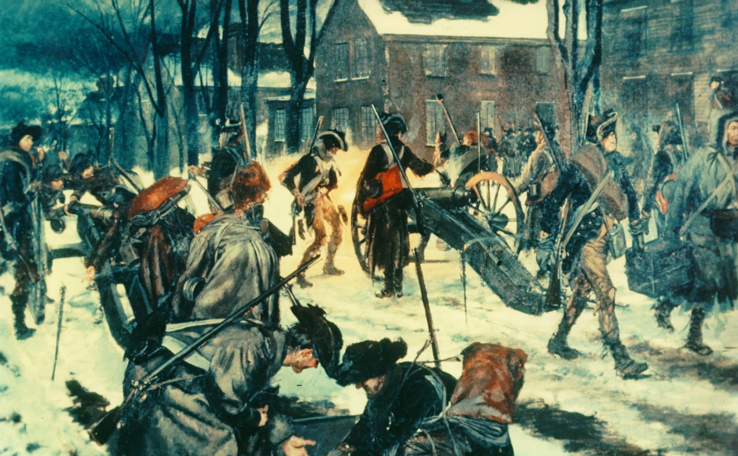
The American Revolution
1776
Notes:
Instructor Note:
These slides contain animated objects. This presentation is intended to be viewed in “Slide Show”. Each click of the mouse will move an object, make an object appear/disappear or show an arrow. Each bulleted line in the Notes Pages correspond the sequential order of each “action” and describes that action.
The accompanying Word analysis document has analysis for each slide.

Slide 2
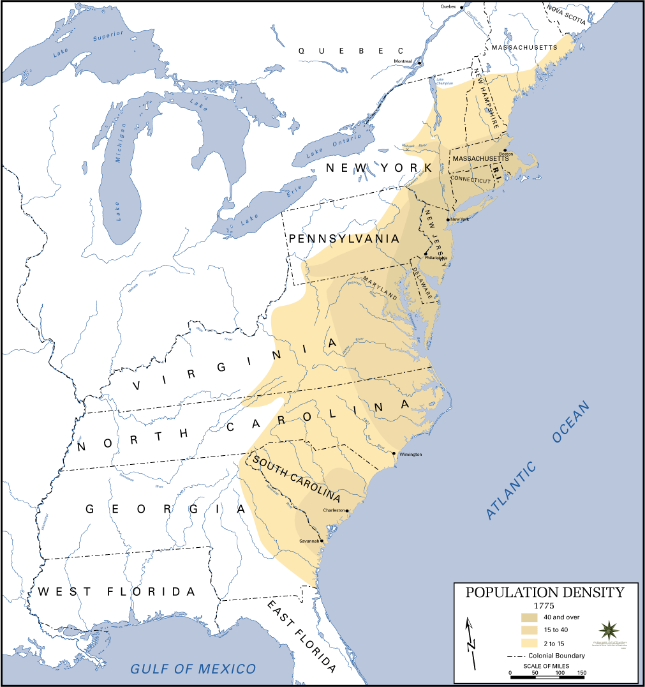
1776:
British Options
Notes:
COA 1: invade the colonies in the south.
COA 2: invade the Mid-Atlantic Colonies through either the Delaware or Chesapeake Bays
COA 3: invade New York.

Slide 3
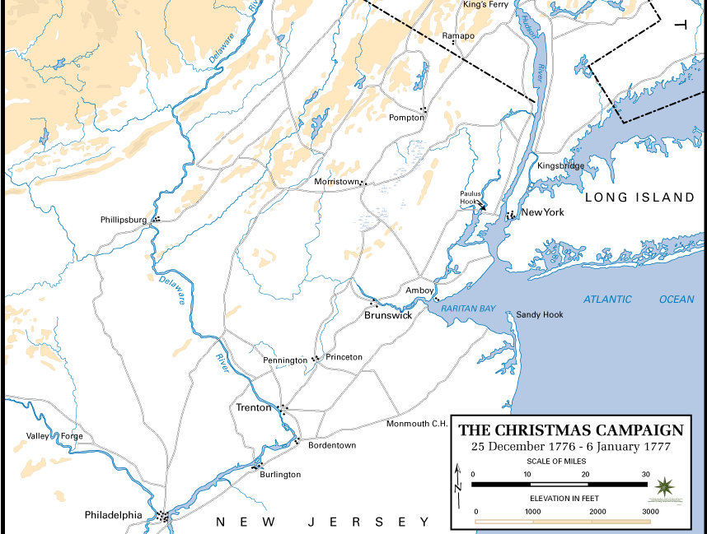
xxxx
The Invasion of New York
22 August 1776 –
25 January 1777
xxxx
Notes:
Late June – July: General Howe assembles 32,000 troops on Staten Island
American Distribution:
3 Divisions in Southern Manhattan
1 Division at Northern Tip of Manhattan (Fort Washington)
(Arrows) Washington recognizes that Brooklyn Heights dominate his main forces on Manhattan therefore:
1 Division (under Putnam) placed on Long Island to deny the British access to these Heights

Slide 4
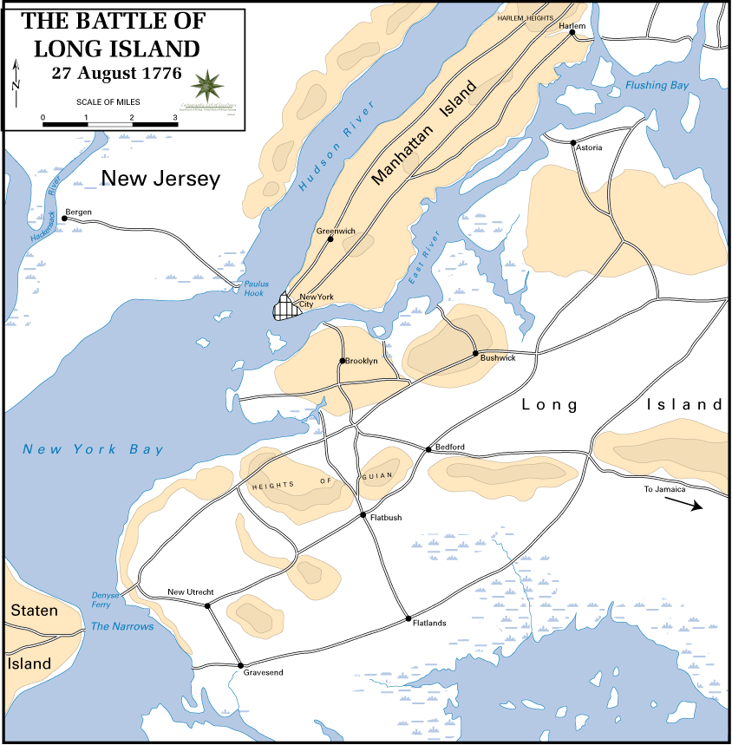
Notes:
Putnam’s Disposition of Forces. Takes advantage of protective terrain formed by Heights of Guian and fortifies the gaps with his troops:
To the West, at Gowanus Road – Lord Sterling with 1,600 troops
In the center at Flatbush and Bedford Passes – Sullivan with 1,500 troops
Putnam leaves the Jamaica Pass to the West unguarded.
22 August – Howe lands 15,000 troops near Gravesend Bay
British conduct a demonstration at Flatbush Gap
26 August – MG Grant attacks Lord Sterling along the Gowanus Pass with 5,000 troops – he does not press his attack – his intent is to keep the American Right flank fixed.
Howe maneuvers the British Main Body(10,000) around the American left flank, through the unguarded Jamaica Gap. Sullivan is forced to withdraw from his fortifications and try to stop the British envelopment.
Greatly outnumbered, Sullivan’s forces break and withdraw back to fortifications at Brooklyn Heights.
Howe completes the trap with Sterling’s forces who capitulate.
Washington personally takes over the Americans at Brooklyn Heights and reinforces the Americans to 9,500 (still ½ of the British Forces).
Howe constructs siege lines (normal for this period to attack enemy fortifications this way)
August 29 – Washington identifies the futility of his position and evacuates the night of 29 August. For the Long Island Campaign:
American Losses: 1,012
British Losses: 392
Howe offers Washington a peace proposal from London. Washington refuses.

Slide 5
The Invasion of New York
22 August 1776 –
25 January 1777
Notes:
15 September – Howe Lands troops at Kips Bay to cut off Putnam’s Southern troops
Putnam abandons NYC and occupies Harlem Heights
16 September – Pursuing British troops repulsed at Harlem Heights
18 October – Howe attempts to outmaneuver Washington and lands troops at Pell’s Point
Washington had already decided to abandon Manhattan and fell back to White Plains. He left 2,800 (Col McGraw) at Fort Washington and 3,000 (General Greene) at Fort Lee on the West side of the Hudson. The intent was to attempt to disrupt British attempts to use the Hudson.
28 October – Howe defeats Washington at White Plains
Washington force to withdraw – Positions 6,000 troops (General Lee) at Castle Hill to prevent further British movement north. Washington takes the remainder of the Army to Peekskill.
10 November – Washington crosses the Hudson and moves south. Howe decides not to pursue and instead moves south and captures Fort Washington (loss of 2,800 American Troops)
20 November – Greene joins Washington’s force just as General Cornwallis (sent by Howe) moves to take Fort Lee. At this point, Washington is down to 3,500 effectives (he lost 2,000 to expiring enlistments).
Washington retreats to the safety of the West side of the Delaware River. Cornwallis pursues him all the way, with 10,000 troops. The two forces face each other on 8 December at Trenton, Washington protected by a still unfrozen Delaware River.
Howe is satisfied with the campaign and moves his troops into winter quarters on 14 December. The British establish garrisons from Trenton all the way back to NY. Howe Returns to NYC and Cornwallis prepares to return to England on leave.

Slide 6
The Invasion of New York
22 August 1776 –
25 January 1777
Notes:
25 Dec – Washington crosses the Delaware with 2,400 men. He attacks the Hessian Garrison at Trenton with the following result:
4 Americans Killed
Hessians: 22 Killed/918 Captured/500 escape
Cornwallis gathers 8,000 troops to attack Washington (he leaves 1,200 troops at Princeton and another 1,200 to his immediate rear) and enters Trenton on 1 January. He faces dug in Americans to the South East of the City.
Washington slips away that night and moves to the North East. He defeats the British Rear Guard at Princeton. The final casualty figures for Princeton action:
Americans: 23 Killed
British: 28 Killed/58 wounded/323 captured
With exhausted troops, Washington finally moves into winter quarters at Morristown
With Washington in a threatening position to cut off the New Jersey outposts – Howe is forced to withdraw his garrisons from New Jersey and return to NY.

