Slide 1

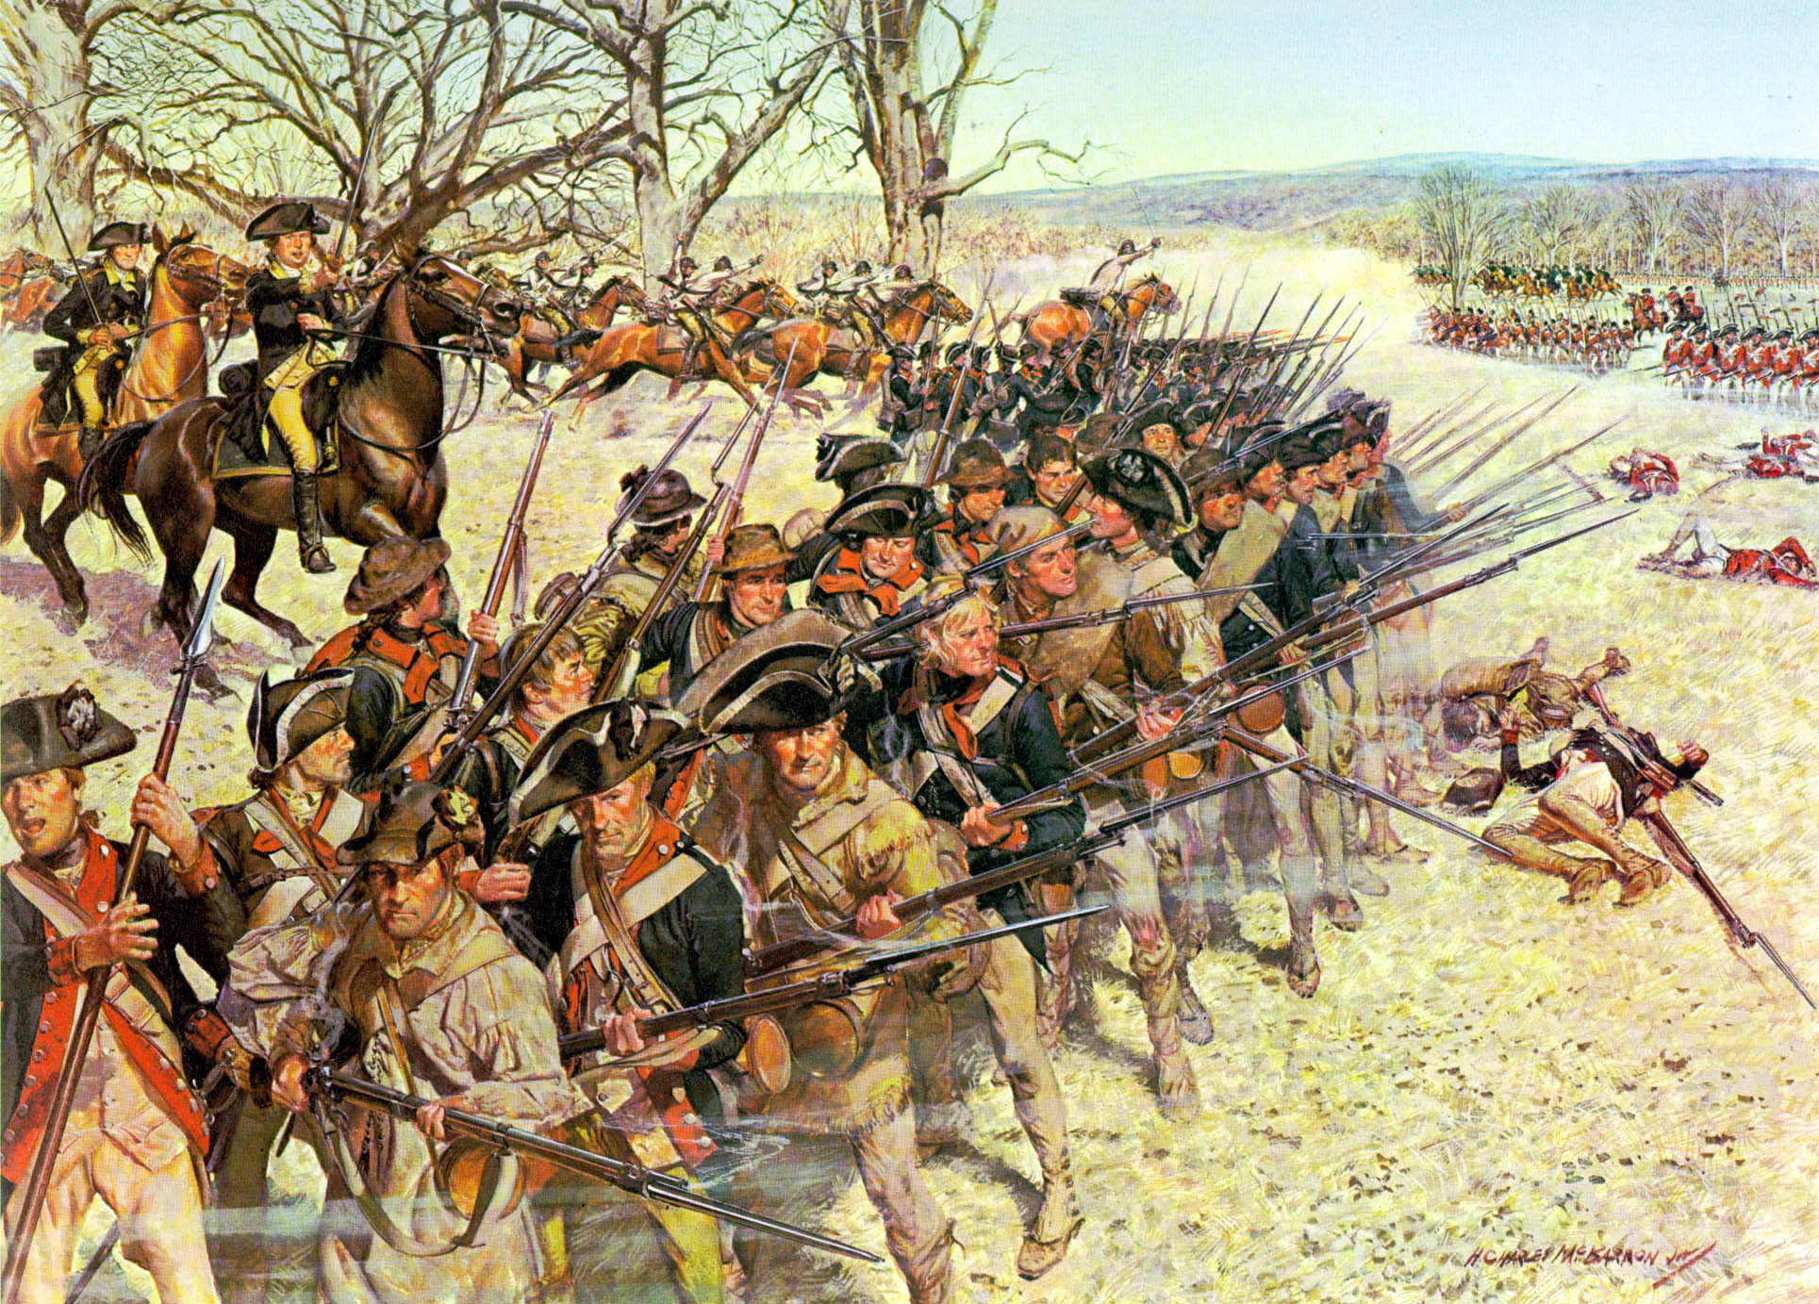
The American Revolution
Southern Campaign – 1780-1781
Notes:
Instructor Note:
These slides contain animated objects. This presentation is intended to be viewed in “Slide Show”. Each click of the mouse will move an object, make an object appear/disappear or show an arrow. Each bulleted line in the Notes Pages correspond the sequential order of each “action” and describes that action.
The accompanying Word analysis document has analysis for each slide.

Slide 2


Notes:
-April 1780 – Clinton lays siege to American Forces under General Benjamin Lincoln in Charleston. The city falls 12 May with the loss of 5,000 troops.
The British establish a series of outposts to control South Carolina
Congress (w/o consulting Washington) appointed Gates (‘Hero’ of Saratoga) to take command of the Southern Troops. His campaign results in the Battle of Camden (16 Aug) The American Army is destroyed (Greatest American Defeat of the war on the heels of their greatest loss in troops – Charleston)
7 October 1780 – Kings Mountain. Cornwallis initially plans a 3 prong advance into NC. However, his left wing under Major Patrick Ferguson is destroyed by a hastily assembled force of various Militia. Cornwallis is forced to consolidate his forces vicinity of Winnsboro.
Washington appoints Nathanael Greene as the new Southern Cdr. With very few troops, he divides his forces. He controls the main force at Cheraw Hill and sends the remainder to Cowpens under the Cmd of Daniel Morgan.
With this risky deployment, the British cannot attack one force w/o allowing the other to get into the British rear. Cornwallis therefore decides to split his forces into three elements. One force to move vic. Camden to hold Greene, one force under LTC Tarleton to attack Morgan and Cornwallis commanded the main force which moved into North Carolina between the two forces. His plan was to defeat Morgan at Cowpens with Tarleton, and destroy the retreating Americans with his main force. He would then turn on Greene.

Slide 3
Washington
Morgan
Hill
N
Coulter’s Ferry Road
Militia
Reforming
The Swale
VaM
17
VaST
Howard
Triplett
Hammond
North Head
NCST
VaLt
1Md
2Md
Del
3Md
Legion
7
Suck Creek
McDowell
Legion
Light
71
McDowell
Roebuck
Thomas
Hayes
Brandon
South Head
Legion
Hammond
71(-)
Maple
Swamp
1
Green River Road
Hayes
Rise
West Ravine
McDowell
Hammond
Rising
Ground
Legion
7
17
3
The Rivulet
Legion
Light
1
71
120 meters
Notes:
-Morgan’s plan – 3 lines of defense. The first line (Militia) were sharpshooters who will fire and force the British to deploy. They will fall back to the second line (Militia). This line will also fire two shots at the approaching British. They were to then retire behind the main American line (that was anchored in the center by the Continental troops). The small American Cavalry under Washington was to be the reserve.
The British deploy with artillery in the center, with infantry on each side. The flanks were covered by mounted units. There were also 200 Legion Dragoons in the British rear, but these would never enter the battle.
Skirmishers conduct a fighting withdrawal as the British advance and fall back to the flanks of the second line.
The British pursue and are met with two volleys from the second line. Estimated 60% of the officers are hit.
The Militia fall back behind the American third line and begin to reform.
The British pursue an attack the 3rd line. The Legion Dragoons and a company from 1-71st attack McDowell’s Militia on the flank, while the 17th Light Dragoons attempted to pursue the American Militia in the rear of the third line.
Washington counters this move and the 17th Light Dragoons withdraw.
McDowell’s militia breaks and falls back. The Legion Dragoons then attack the American Right Flank and the North Carolina Militia break and fall back.
The VA Continentals have been given the order to refuse the right, but confuse the order and begin to fall back. The rest of the American line follows suit, in good order.

Slide 4
VaLt
VaST
Morgan
Hill
VaM
N
Coulter’s Ferry Road
Howard
Militia
Reforming
1
71
1Md
2Md
Del
3Md
Washington
7
The Swale
Triplett
Hammond
North Head
Legion
Legion
Light
7
Legion
Light
Suck Creek
71
South Head
71(-)
Maple
Swamp
1
Green River Road
Hayes
Rise
West Ravine
Rising
Ground
4
The Rivulet
120 meters
Notes:
On orders from LTC John Howard, the American line turns and fires into the pursuing British Troops. The British were stunned by this action (they were under the misunderstanding that the Americans had broken and were in retreat).
The Results:
Washington’s Cavalry Stops the Legion Cav and Envelops the British left.
The 1-71st withdraw and finally surrender. The artillery is also captured.
The 7th foot and the right side of the British line withdraw from the field.
****NOTE: Events of Washington’s Dragoons and the Militia’s Actions at the end of the battle are based on the most recent study of the battle (A Devil of a Whipping, Lawrence Babits)

Slide 5
1781
Notes:
Although Morgan has defeated Tarleton, the Americans are still not strong enough to defeat the main British force. They therefore fall back into North Carolina and rejoin at Guilford Courthouse. After some further maneuver and gathering of more forces, Green establishes a triple defense line similar to Cowpens which Cornwallis attacks on March 15 1781.
While Greene was driven from the field, Cornwallis suffered 30% casualties. Since he also had burned his supplies to try to catch Morgan, he withdrew to Wilmington to get re-supplied by sea. Greene initially followed, but then diverted south back into South Carolina. The British Commander in South Carolina, General Rawdon, had 8,000 troops, but they were dispersed throughout the countryside(25,000 square miles to control). The largest (900) was in the vicinity of Camden, and Greene attacked that force at Hobkirk’s Hill on April 25. Although Rawdon defeated Greene, Greene’s Army was still in tact.
Knowing he would not have been able to withstand another attack from Greene, and knowing his outposts were vulnerable, Rawdon called for a general withdrawal back to Charleston while Cornwallis headed into Virginia.
British units then either withdrew from their outposts, or were besieged and fell to American patriots.
The final British outpost at Ninety-Six required Greene to conduct a siege with his force. However, Rawdon rescued the outpost with a relief force.
Greene again attacked the British main force located at Eutaw springs in September 8, and once again, lost. But the British were once again forced to withdraw to Charleston and Savannah. Greene was to never win a battle, but, with his forces in tact, drove the British from the Carolina’s.

Slide 6
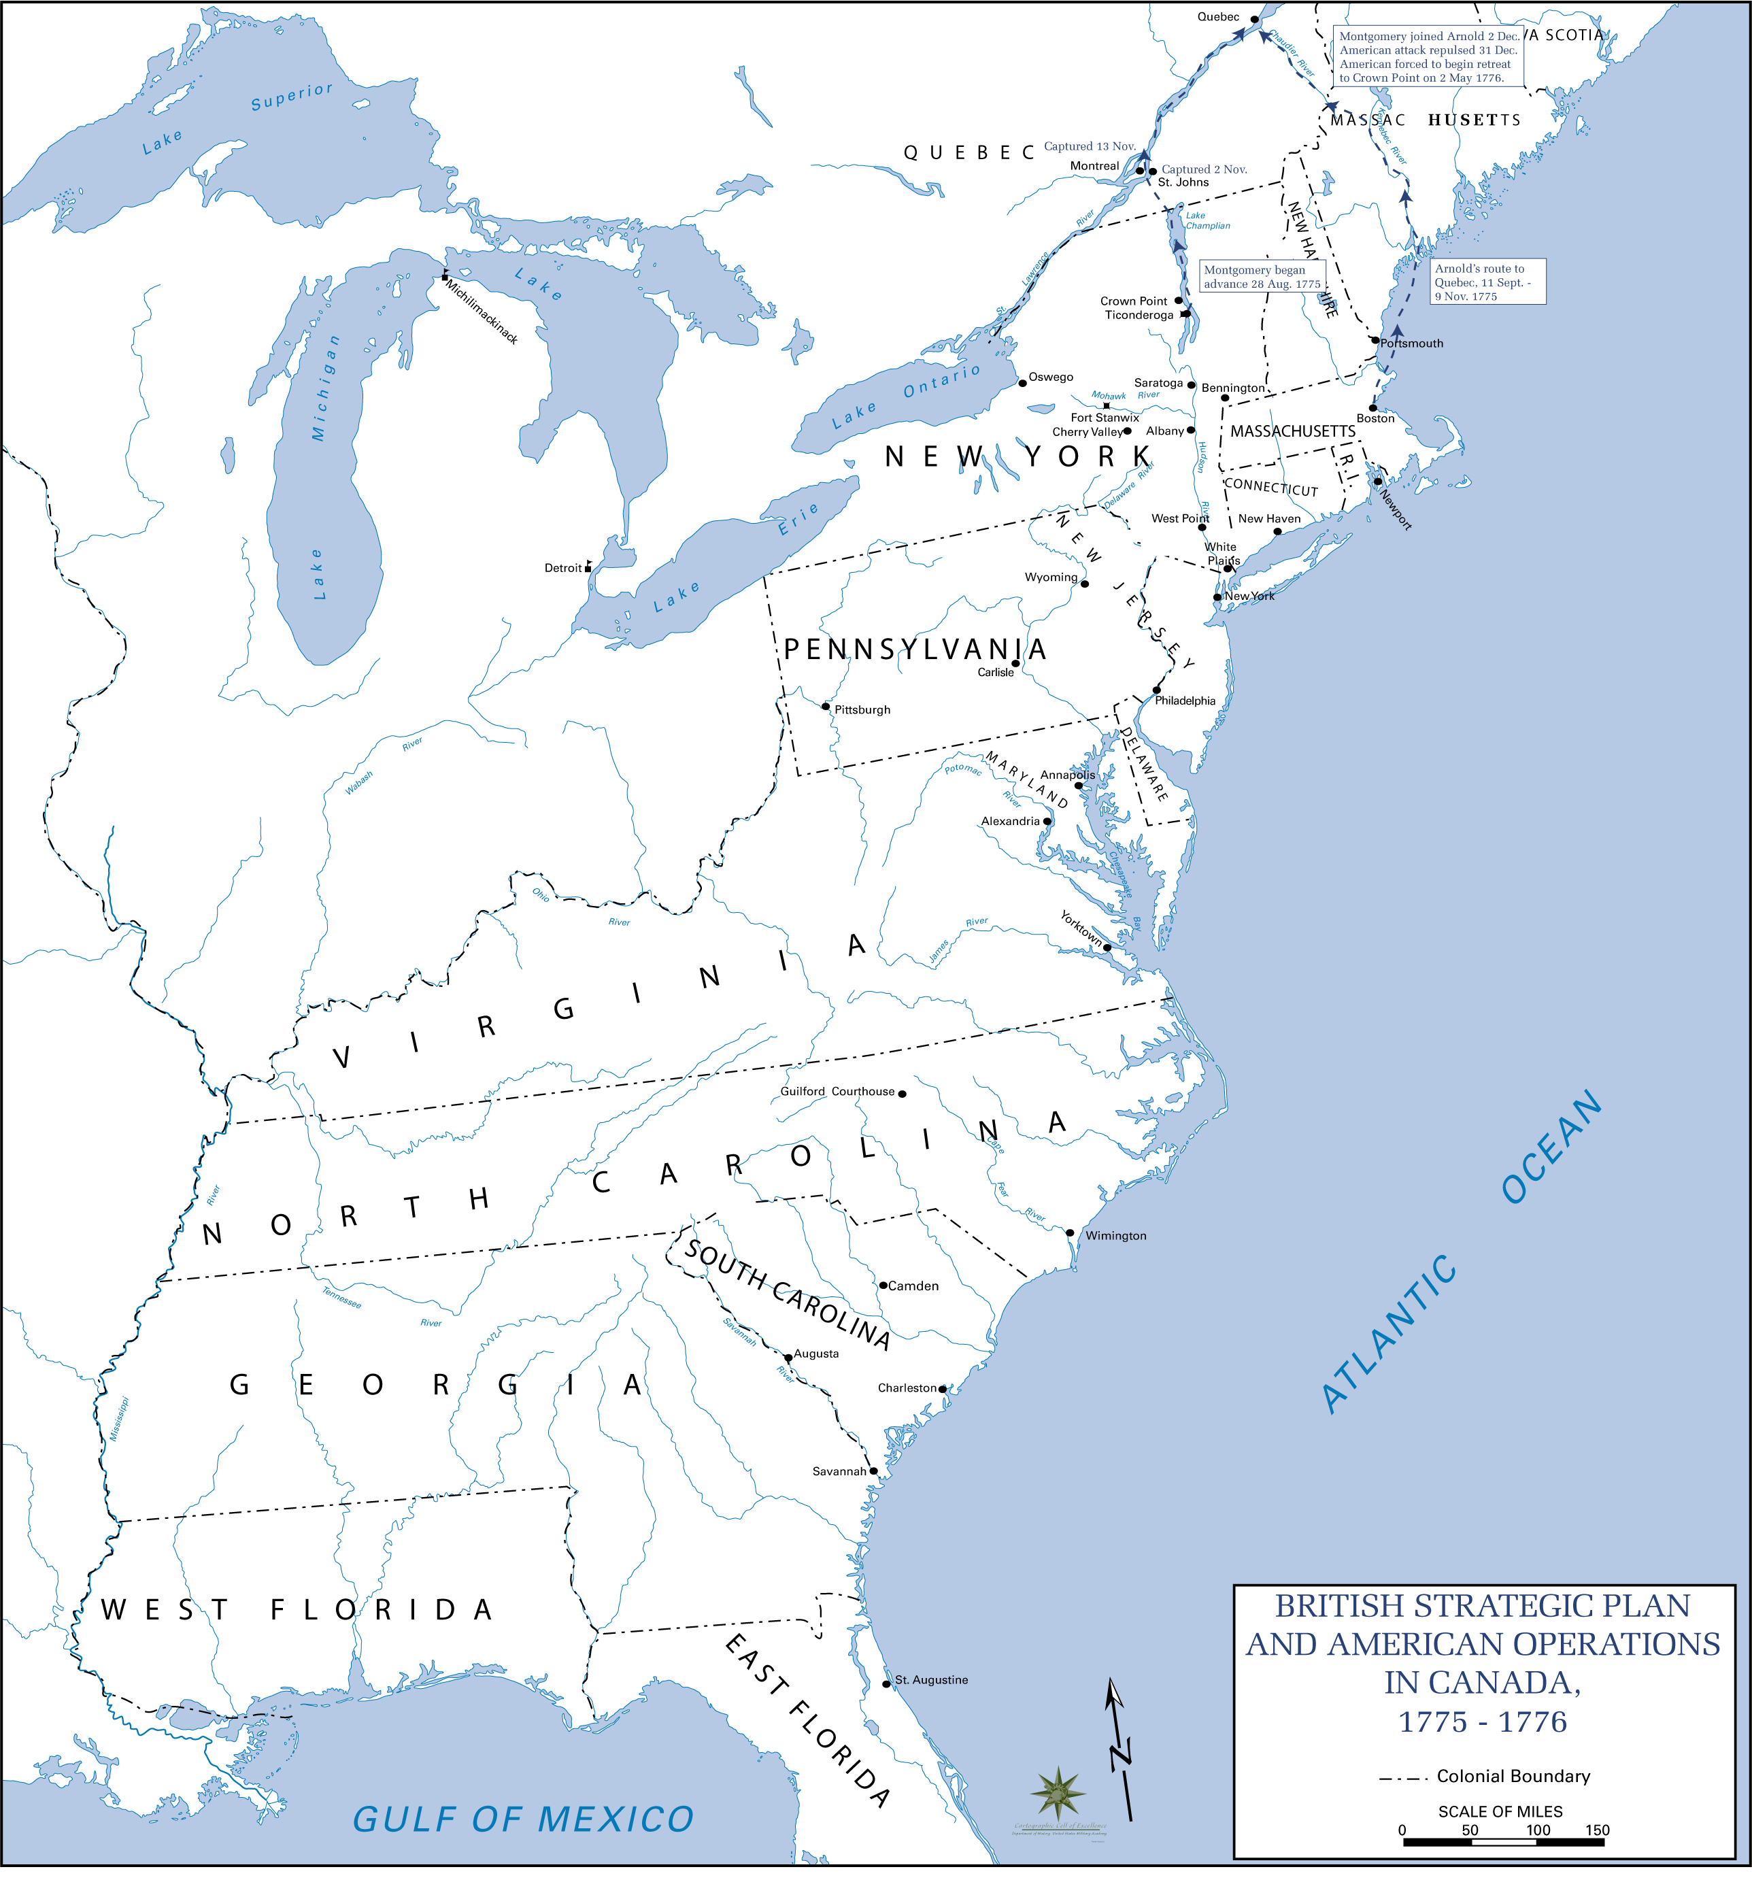
R
W
CL
L
CW
The Road to Yorktown
May 1779-
September 1781
Notes:
1779-1781 – Cornwallis is convinced VA is the key to the south and convinces Clinton to send an expedition to VA. British forces (to include a force under the American traitor, Arnold) wreck havoc in VA.
March 1781 - Washington sends a small force under Lafayette to attempt to check the destruction (and possibly capture Arnold).
May 1781 – Cornwallis arrives in VA from his campaign in the Carolinas
Summer of 1781 – French Army under Rochambeau arrives in Newport, RI (4,000). The French also promise the use of their fleet to conduct and all out effort in 1781. July 1781- Rochambeau moves to mass forces with Washing in NY. Both Washington and Clinton envision a large battle in New York/ Pennsylvania area. However, DeGrasse, the Admiral of the main French Fleet, informs Washington he will move only as far north as the Chesapeake Bay, and will leave prior to October (Hurricane Season)
Aug-Sept 81 – Washington leaves a small force to cover NYC, conducts deception operations and moves his combined American/French Army to VA to trap Cornwallis.
British Admiral Hood, departing the Caribbean, and looking for Degrasse’s Fleet, arrives at Chesapeake bay first, found an empty bay, and moved on to New York.
Since he had stopped in Havana, Degrasse’s fleet was 5 days behind Hood, and by luck, arrived in the empty Chesapeake Bay on 30 August. Degrasse delivers 3,000 troops.
Admiral Graves, with Hood’s fleet, moved back to the Chesapeake Bay and attacked the French Fleet in the inconclusive Battle of Virginia Capes. (Sept 5)
A French Squadron slips into Chesapeake Bay during a lull in the naval battle to deliver siege cannon.
The combined French fleet numbered 35 vs. the 19 English Ships, who thus depart back to NY. Cornwallis is trapped by land and by sea.

Slide 7
