Slide 1

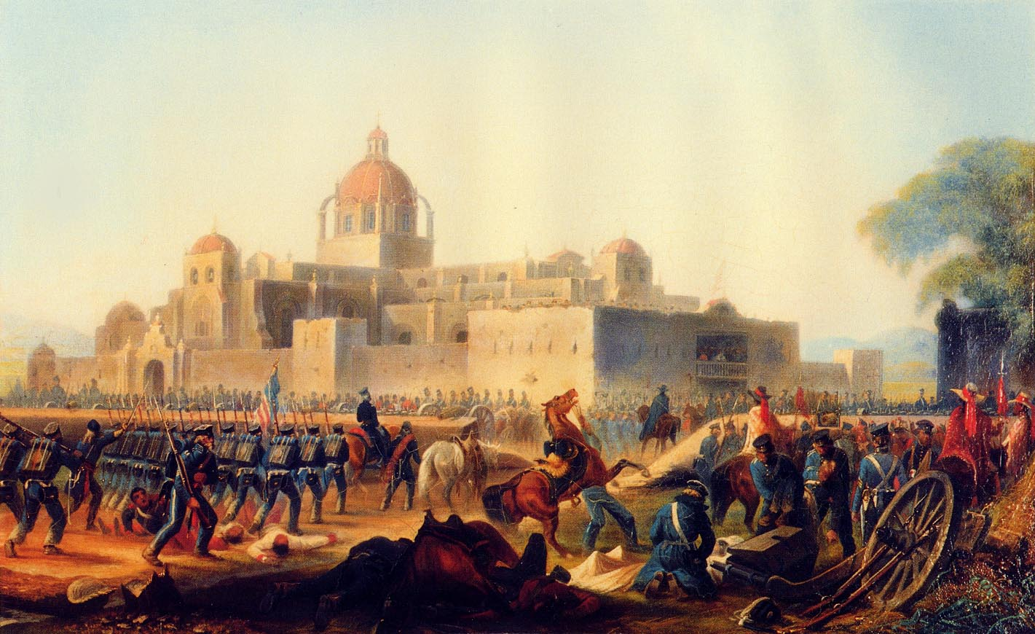
The Mexican War
1846-1847
Notes:
Instructor Note:
These slides contain animated objects. This presentation is intended to be viewed in “Slide Show”. Each click of the mouse will move an object, make an object appear/disappear or show an arrow. Each bulleted line in the Notes Pages correspond the sequential order of each “action” and describes that action.
The accompanying Word analysis document contains analysis for slide #2 and a lot of general analysis.

Slide 2

Troop Strength
30,000
20,000
10,000
Mexico
U.S.
Notes:
Disputed Terrain (See Analysis – Slide #2)
Comparison of Army strengths prior to war
American Plan:
Blockade Gulf and California Coasts with Navy
3 Pincers to occupy Northern Mexican Provinces Attempting to force the Mexicans to negotiate a border between the two countries.
Seize Monterrey with the Army of Occupation (Taylor)
Seize Chihuahua with the Center Division (Wool – Originally part of Taylor’s Army)
Seize New Mexico (Santa Fe) and subsequently seize upper California.

Slide 3
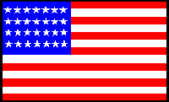
Troop Strength
30,000
20,000
10,000
U.S. Regular
Mexico
U.S.
U.S. Volunteer
Notes:
July – Feb 1846: Taylor moves to Corpus Christi to train his army
Negotiations break down and Taylor is ordered into the disputed territory: March 23 Taylor arrives at Rio Grande to defend against Mexico crossing this river.
4000 man Army under General Arista faces Taylor on the south side of the river, treating Taylor’s Army as an invading force in their territory.
25 April – initial contact between Mexican Cavalry and US Dragoons is followed by the Mexican Army crossing the Rio East of Taylor. Taylor falls back to his supplies at Point Isabel. Taylor then moves fwd to the Rio and clashes with Arista at Palo Alto on May 8 and again at Resaca de la Palma (5 miles south) on May 9. The Mexican army breaks and crosses the river. Taylor cannot pursue due to lack of river crossing equipment.
29 July - San Diego Falls to the Navy
18 - August Kearny takes Santa Fe without a shot
Taylor establishes base at Camargo – Army grows to 15,000, but Militia fiasco and illness drop Taylor’s Army to 3,080 Regulars and 3150 Volunteers
Sept 20-24 – Taylor attacks and Monterrey falls. Taylor allows the Mexicans to withdraw and establishes an Armistice – Polk immediately rescinds it

Slide 4
Troop Strength
30,000
20,000
10,000
U.S. Regular
Mexico
U.S.
U.S. Volunteer
Notes:
25 Sept-12 Dec: Kearney moves on San Diego
2 Oct – Wool leaves San Antonio – Arrives at Monclova on 29 Oct
Nov 13 – Taylor occupies Saltillo (important road juncture btwn Northern and Southern Mexico)
Nov 14 – Navy occupies Tampico
Dec 21 – Intelligence reports that Chihuahua is no longer defended, so Wool joins Taylor
Dec 25 - Doniphan (originally with Kearney’s force, who promised to support Wool if extra troops were available) defeats Mexican force at Brazito and occupies El Paso on Dec 27.
Mid Dec-Jan 23: Troops taken from Taylor (4,000 Regulars, 4,000 Volunteers) and moved to Tampico for ship transport to Veracruz.
Santa Anna forms an Army at San Luis Potosi and captures a copy of orders stating the movement of troops from Taylor to Scott. He therefore gambles by taking his troops through a seemingly impassible dessert, and attacking Taylor’s remaining volunteers.
Feb 23 – Taylor defeats Santa Anna at Buena Vista
Feb 28 – Doniphan defeats Mexican Force at Sacramento and Chihuahua falls on Mar 2
Mar 9 - Scott lands at Veracruz which falls on Mar 27
Santa Anna builds another army and establishes defensive positions to try to keep the Americans in the Yellow Fever belt.
April 18 - Scott, using reconnaissance and maneuver defeats Santa Anna at Cerro Gordo
May 15-Aug 7: Scott loses a majority of his volunteers due to enlistment expirations. He moves to Puebla and builds his force back up to 10,000. With no further troops to defend his lines of communication, he breaks free from his supply line and gambles he can live off the land.
Santa Anna builds a third Army (about 30,000 throughout the city) and occupies fortifications facing East
Aug 7-Sept 14: Scott avoids the Mexican fortifications and attacks Mexico City from the South. In a series of battles, he again defeats Santa Anna and the City falls on Sept 14.

Slide 5
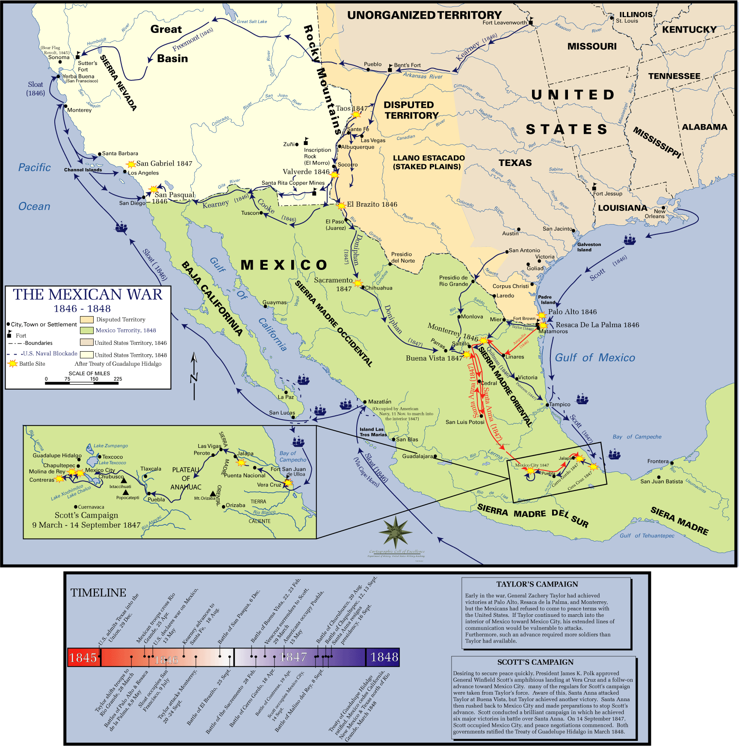
Notes:
Added for possible hand outs.

