Slide 1

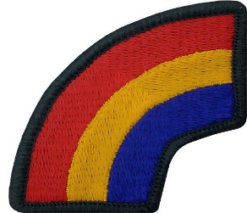
UNCLASSIFIED
Conversational Arabic
Greetings:
Hello
Good Morning
Good Afternoon
Good Evening
Introductions:
My name is _________
How are you doing?
I am doing well
Conversational (Staff Ride/SLE Centric):
How would you approach/solve this problem?
What enduring insights can be gained from the battle/campaign can still be of use today?
Please
Thank you
You’re welcome
Farewells:
Be well
Be blessed
Good bye
Go with god
Tahiaat:
Marhaban
Sabah Alkhyr
Masa’a Alkhayr
Masa’a Alkhayr
Muqadamat :
Aismi……….
Kayf Halk ?
Ana bikhayr
Muhadatha (Jawlet Althubat/ Aijtimae kibar alqada Almarkazi):
Kayf satata’amal / Tahalu Hadhih Almushkila ?
Ma Hia Alruwaa Almustamira Alty Ymkn Aiktisabuha Min Almaeraka /Hal Alhamlah La Tazal Mufida Alyawm ?
Raja’ an
Shukraan
Ahlaan Wasahlaan
Altawdie :
Atamanaa Lak Alafia
Atamanaa Lak Albaraka
Ma’a Alsalama
Tawakal Ala Allah
UNCLASSIFIED

