Slide 1


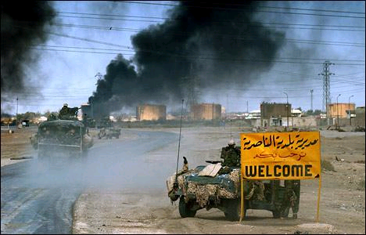
AMBUSH
AT
AN NASIRIYAH
507TH MAINTENANCE COMPANY
UNCLASSIFIED

Slide 2
Agenda
1. The Plan and Preparation
2. Convoy Movement to Attack Position Lizard
3. Movement from Attack Position Lizard to the outskirts of Nasiriyah
4. Movement through Nasiriyah and the Decision to Turn Around
5. Final Movement Through Nasiriyah
UNCLASSIFIED

Slide 3
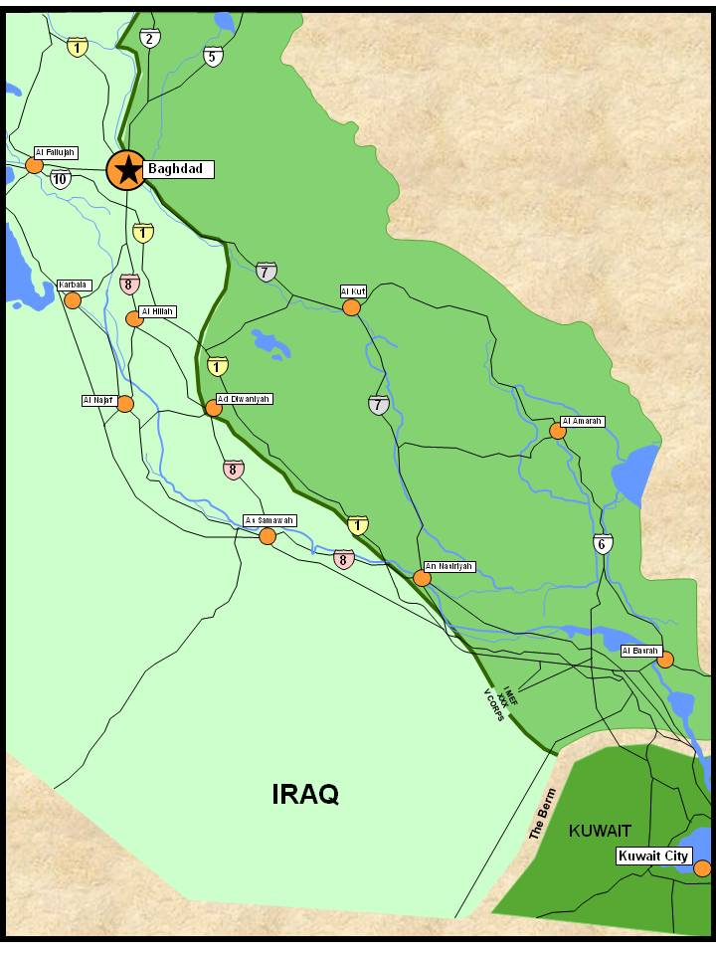




2
Operation IRAQI FREEDOM
Concept of the Operation
OBJ Rams
507th background
Maintenance Culture / pre-deployment training
Arrive Kuwait 20 Feb
Prep for combat 22 Feb - 20 Mar
ROE and expectations in Shia areas
507
Camp Virginia

Slide 4


3
Movement Concept to OBJ Rams
OBJ Rams
Rte Jackson, Hwy 1
350km from Camp Virginia to OBJ Rams
Route Blue to Route Jackson back on to Route Blue
V Corps 600 vehicles
Limited communications
No established logistics/recovery points
TACON 3 FSB (1st BDE/3ID)
Last in order of march
Rte Blue, Hwy 8
LIZARD
507
BULL
DAWSON

Slide 5






4
OIF TIMELINE
19 Mar
(D-Day)
Wed
20 Mar
(D+1)
Thur
21 Mar
(D+2)
Fri
22 Mar
(D+3)
Sat
23 Mar
(D+4)
Sun
UNITS
Prep for Combat
Seize Oil Fields
1st Mar Div
Prep for Combat
Move to Secure Al Basrah
1st UK Div
I MEF
Prep for Combat
Battle: Nasiriyah
TF Tarawa
Ground Attack Begins
507th Ambush
507th MVMT
Prep for Combat
Battle:Talill AB
Battle: Samawah
3 ID
Prep for Combat
101 ABN
V Corps
Prep for Combat
82 ABN(-)
Deploy/Build Cbt Power
4 ID
2 ACR
3 ACR

Slide 6
5
Hwy 8 Intersection to
Objective RAMS
~220 Km
Convoy Movement
Dawson rest/refuel
CPT King receives OPORD on CD
Breakdowns and recovery = separation
No comms with 3 FSB
AN NASIRIYAH
18
1
Liz.
22nd
12
Liz.
6
2
1
18
Bull
Lizard
Vehicles bog down Convoy splits
21st
12
BULL to LIZARD
81 Km
6
Cdrs Coordinate
DAWSON
Link up w/ 3rd FSB
18
20th
12
Virginia
6
Bull
Camp Virginia
Dawson
SP: 211800
SP: 210700
SP: 201400

Slide 7
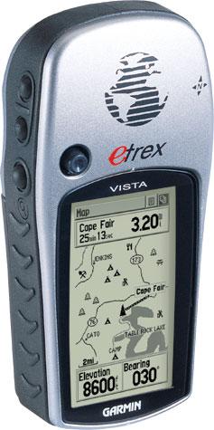

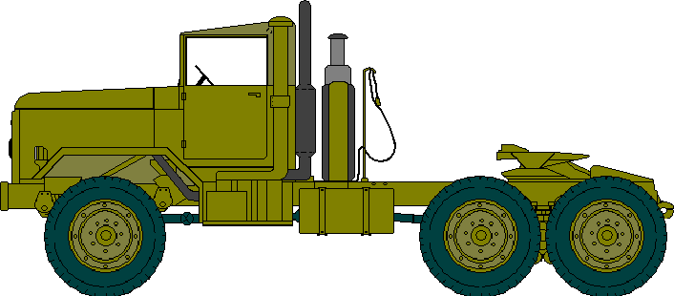
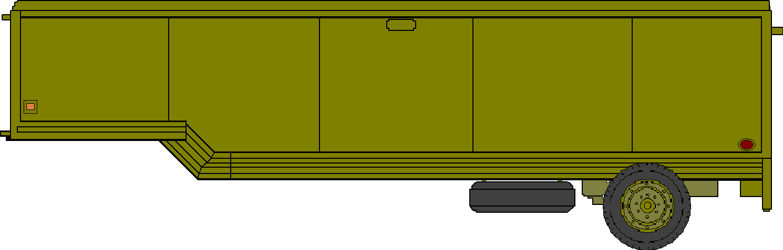
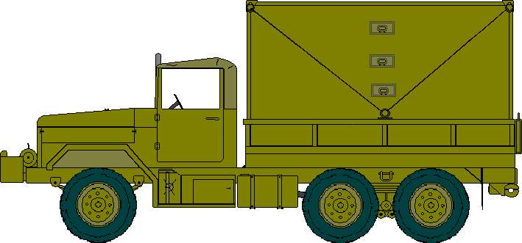
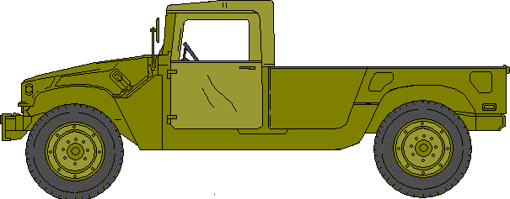
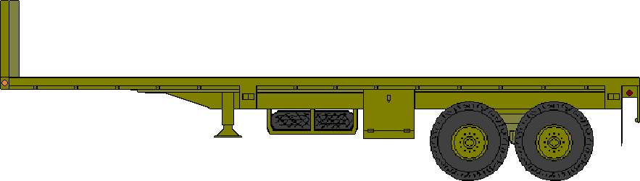
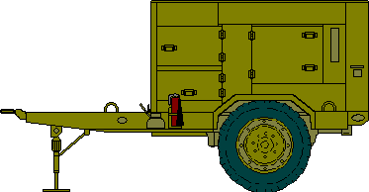
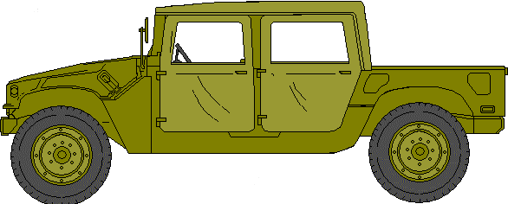
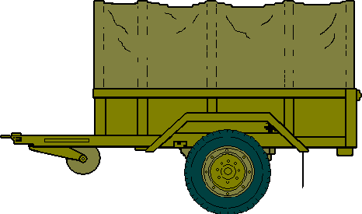
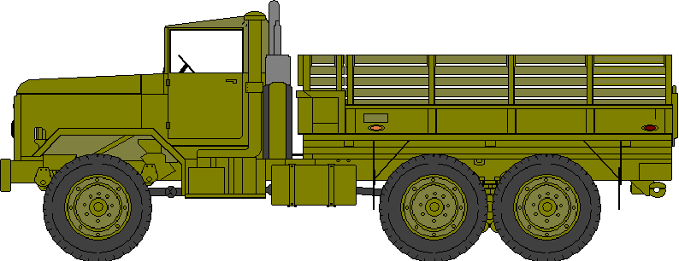
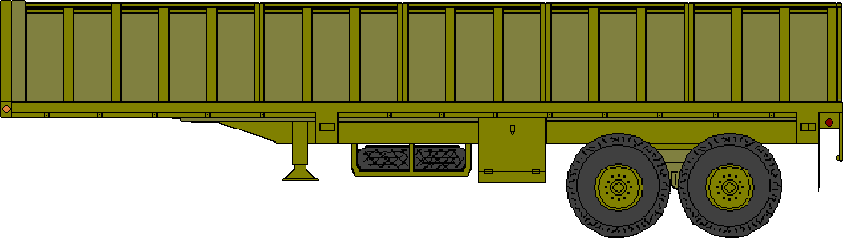
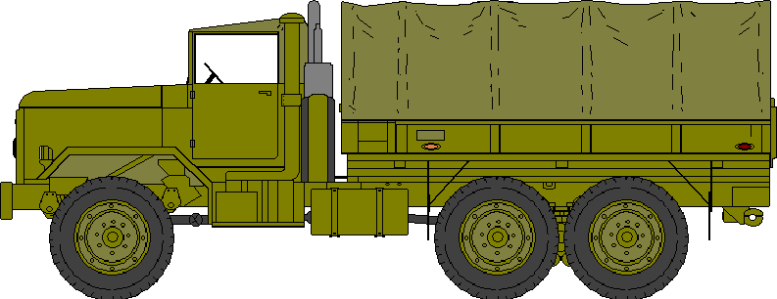
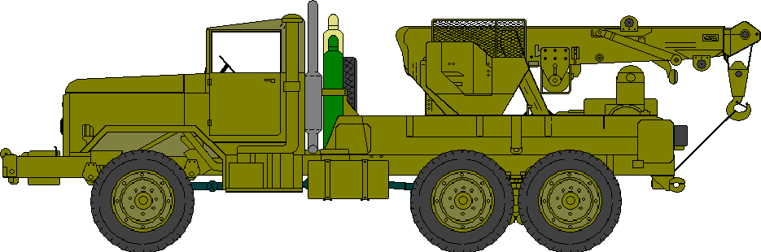
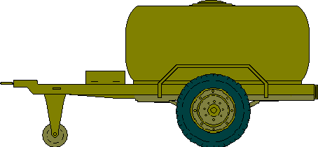
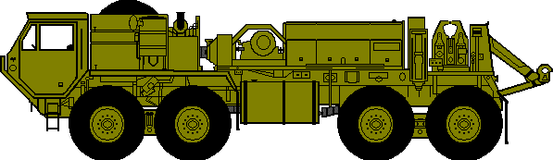
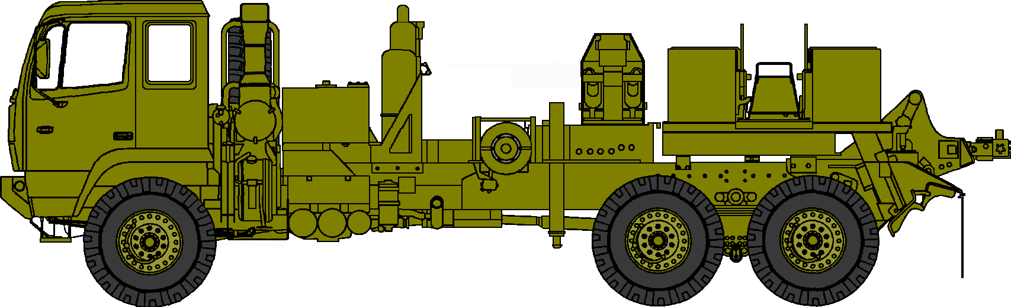
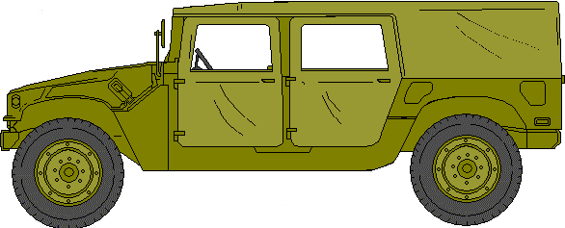
6
507th Maintenance Convoy Serial 2
Radios
GPS
Crew-Served Weapon
ISU90
ISU90
ISU90
ISU90
ISU90
ISU90
CPT KING
PV2 NACE
SPC ZHANG
SGT CAMPBELL
SPC PETERSON
SGT PETRIK
SPC JOHNSON
SFC PIERCE
ISU90
ISU90
ISU90
PFC DUBOIS
CPL LUTEN
CW3 NASH
SSG JACKSON
SPC GRUBB
PFC ELLIOT
PFC JOHNSON H
PV2 ESTRELLA
SPC KIEHL
SPC ADDISON
SGT ROSE
CPL CARISTA
PV2 SLOAN
SGT WALTERS
PFC MILLER
SGT RILEY
SPC HUDSON
CW2 MATA
SGT BUGGS
SPC ANGUIANO
(3d FSB)
PFC PIESTEWA
PFC LYNCH
1SG DOWDY
SPC HERNANDEZ
SPC JOHNSON, S.

Slide 8
7
The Missed Turns: TCP 1
AN NASIRIYAH
GPS
Waypoint
8
8
12
23rd
6
TCP
5.5
18
L
22nd
12
ROUTE BLUE
6
22
18
ROUTE JACKSON
TCP #1
Convoy passes through
23 Mar ~0100L
21st
B
12
5
6
D
18
7
LIZARD
Convoy Departs
22 Mar 1930L
GPS
Waypoint
20th
12
6
1

Slide 9
8
The Missed Turns: Nasiriyah
Serial 2 Awake 47 Hrs After Dawson
AN NASIRIYAH
GPS
Waypoint
Convoy Misses Turn Continues Straight
23 Mar ~0600L
8
8
12
23rd
6
5
Convoy Stops
Cdr & 1SG Confer
23 Mar ~0530L
5
18
L
22nd
12
ROUTE BLUE
6
22
18
ROUTE JACKSON
TCP #1
Convoy passes through
23 Mar ~0100L
21st
B
12
5
6
D
18
7
LIZARD
Convoy Departs
22 Mar 1930L
GPS
Waypoint
20th
12
6
1

Slide 10
9
Movement Through Nasiriyah
16
7
Saddam Canal
An Nasiriyah
7/8
Euphrates River
N
8
7

Slide 11

Situation when realized off route
Radios
GPS
Crew-Served Weapon
ISU90
ISU90
ISU90
ISU90
ISU90
ISU90
CPT KING
PV2 NACE
SPC ZHANG
SGT CAMPBELL
SPC PETERSON
SGT PETRIK
SPC JOHNSON
SFC PIERCE
ISU90
ISU90
ISU90
PFC DUBOIS
CPL LUTEN
CW3 NASH
SSG JACKSON
SPC GRUBB
PFC ELLIOT
PFC JOHNSON H
PV2 ESTRELLA
SPC KIEHL
SPC ADDISON
SGT ROSE
CPL CARISTA
PV2 SLOAN
SGT WALTERS
PFC MILLER
SGT RILEY
SPC HUDSON
CW2 MATA
SGT BUGGS
SPC ANGUIANO
(3d FSB)
SPC HERNANDEZ
SPC JOHNSON, S.
PFC PIESTEWA
PFC LYNCH
1SG DOWDY
Reposition to rear

Slide 12
10
8
507th Maintenance Company
An Nasiriyah
23 March 2003

Slide 13

11
Disabled
11
14
17
Stuck
8
507th Maintenance Company
An Nasiriyah
23 March 2003

Slide 14
12
Disabled
11
14
17
3
Stuck
3
3
1SG Dowdy
1SG Dowdy
15
8
12
9
2
16
12
8
9
15
2
CW3 Nash
2
CW3 Nash
8
16
10
ISU90
ISU90
ISU90
2
13
13
18
18
7
ISU90
ISU90
ISU90
5
6
1
1
6
1
CPT King
7
ISU90
ISU90
ISU90
5
4
ISU90
ISU90
ISU90
ISU90
ISU90
10
ISU90
3
2

Slide 15
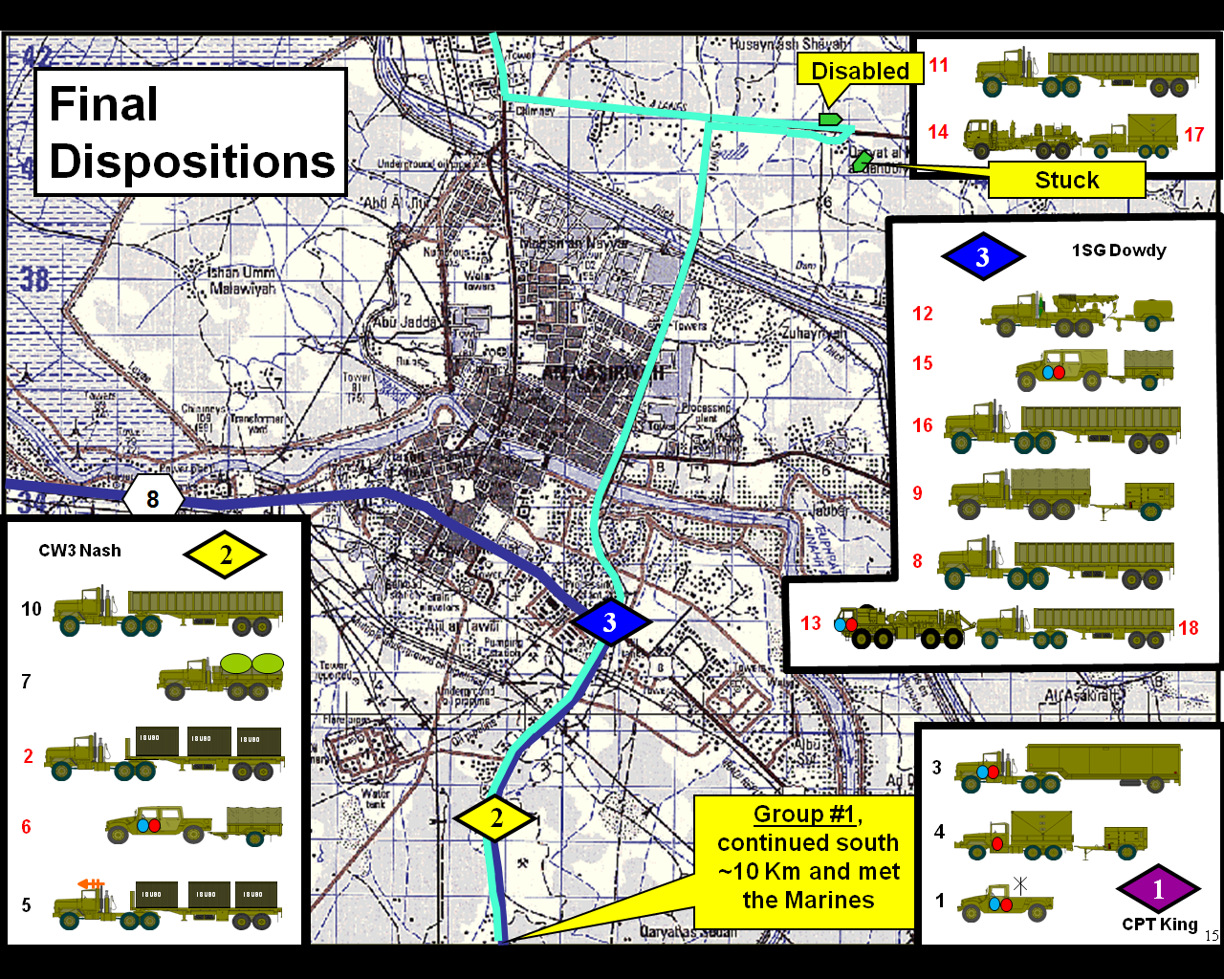
13
8
CW3 Nash
2
10
7
6
5
ISU90
ISU90
ISU90
ISU90
ISU90
ISU90
ISU90
ISU90
2
ISU90

