Slide 1


Ap Bac
2 January 1963

Slide 2
Stand 1: Strategic/Operational Environment
Stand 2: Operational and Tactical Situation
Stand 3: Ap Bac – Fighting the Plan
Stand 4: Ap Bac – Fighting the Enemy
Stand 5: Aftermath, Misconceptions, and Significance

Slide 3

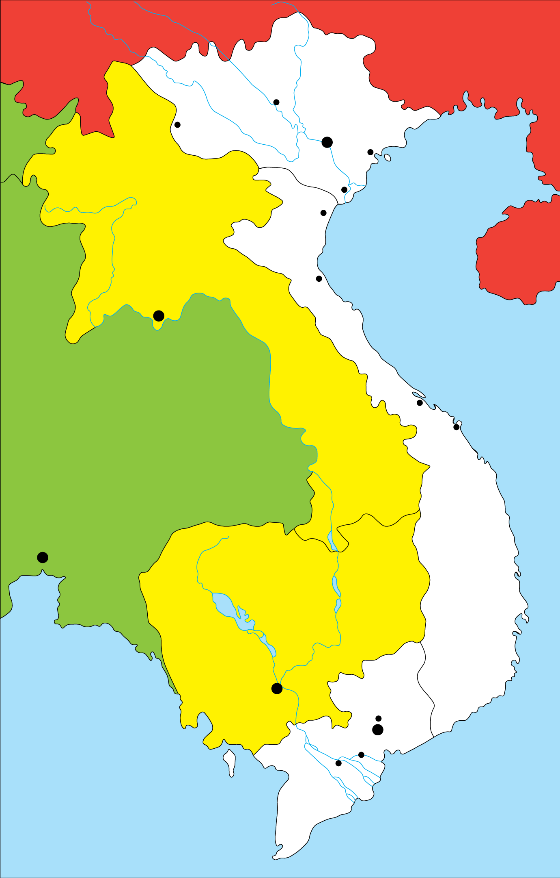


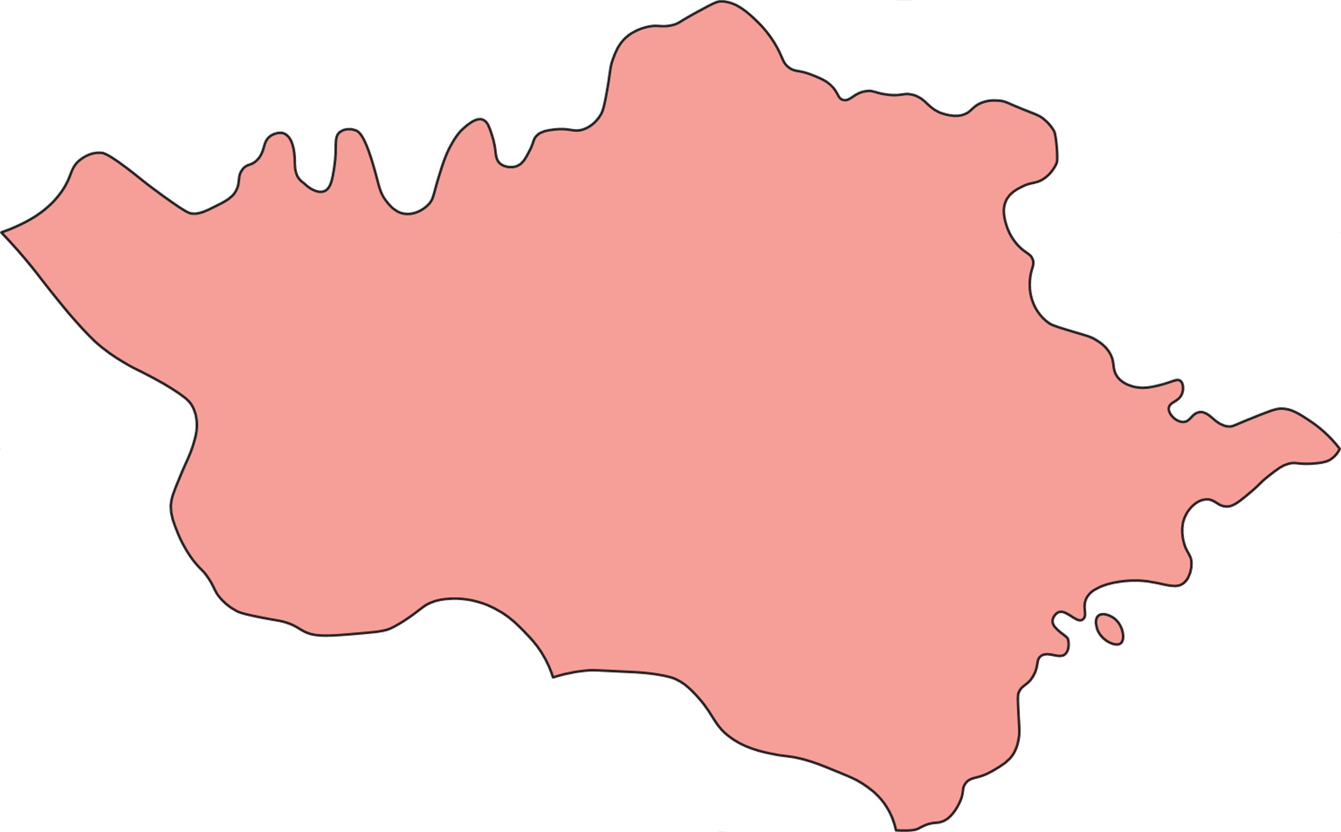

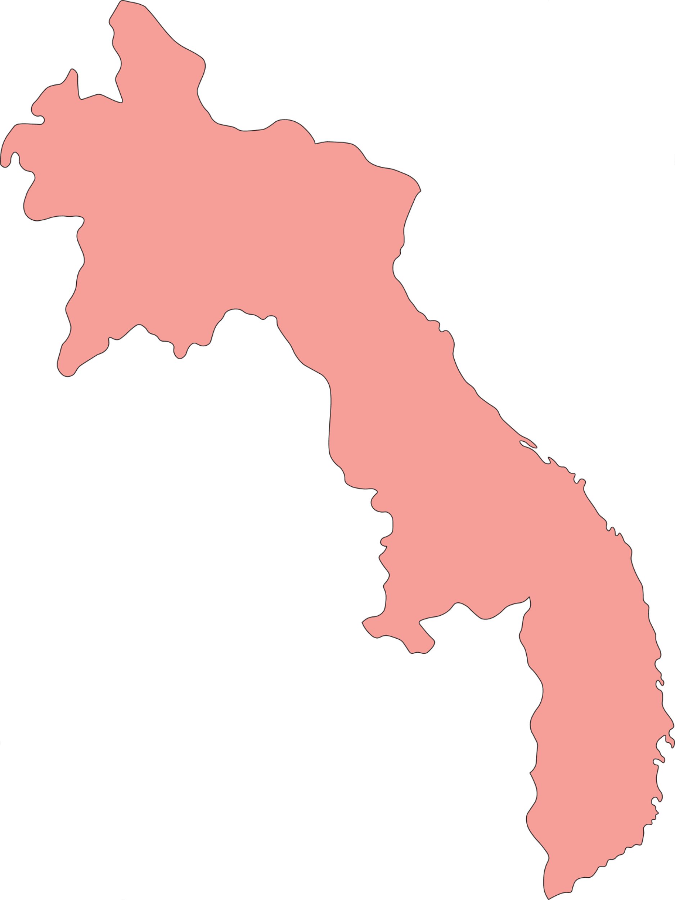
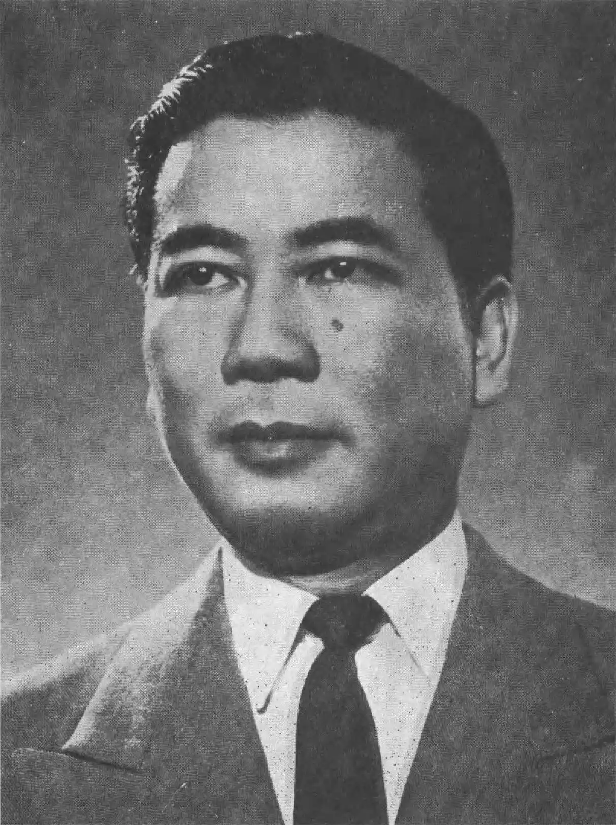
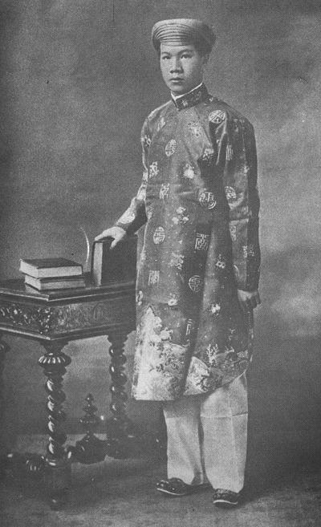
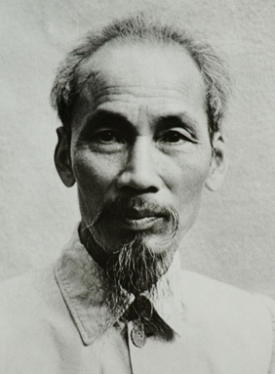
CHINA
TONKIN
Yen Bay
BURMA
Dien Bien Phu
HANOI
Haiphong
Co Am
GULF
OF
TONKIN
LAOS
Thanh Hoa
Republic of Vietnam
Democratic Republic of Vietnam
Vinh
VIENTIANE
ANNAM
THAILAND
Hue
Da Nang
BANGKOK
CAMBODIA
CAMBODIA
GULF OF
THAILAND
PHNOM PENH
Bien Hoa
SAIGON
My Tho
COCHINCHINA
Vinh Long
SOUTH
CHINA
SEA
1955: Ngo Dinh Diem
1946: Ho Chi Minh
1949: Emperor Bao Dai

Slide 4




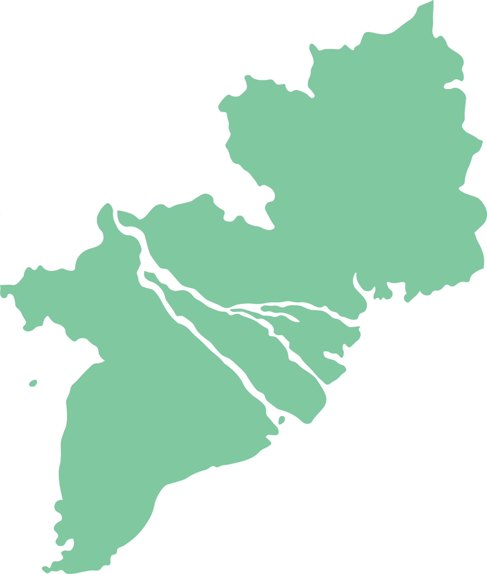

Personnel Strength:
1950: 128
1953: 300+
1959: 685
DEMOCRATIC REPUBLIC OF VIETNAM
ARVN Strength:
1959: 150,000
LAOS
Hue
THAILAND
Da Nang
Personnel Strength:
1961: 746
1962: 3400
1961 ARVN Requested Strength: 250,000
CAMBODIA
REPUBLIC OF VIETNAM
Da Lat
Cam Ranh
Saigon
Vung Tao
1B. Republic of Vietnam
N
miles
0
50
200
km
0
50
200

Slide 5
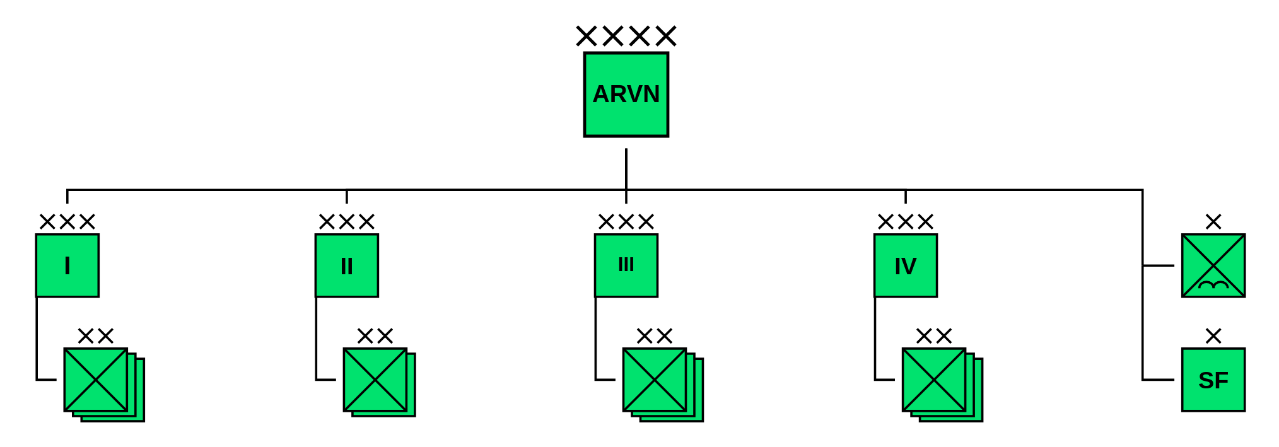

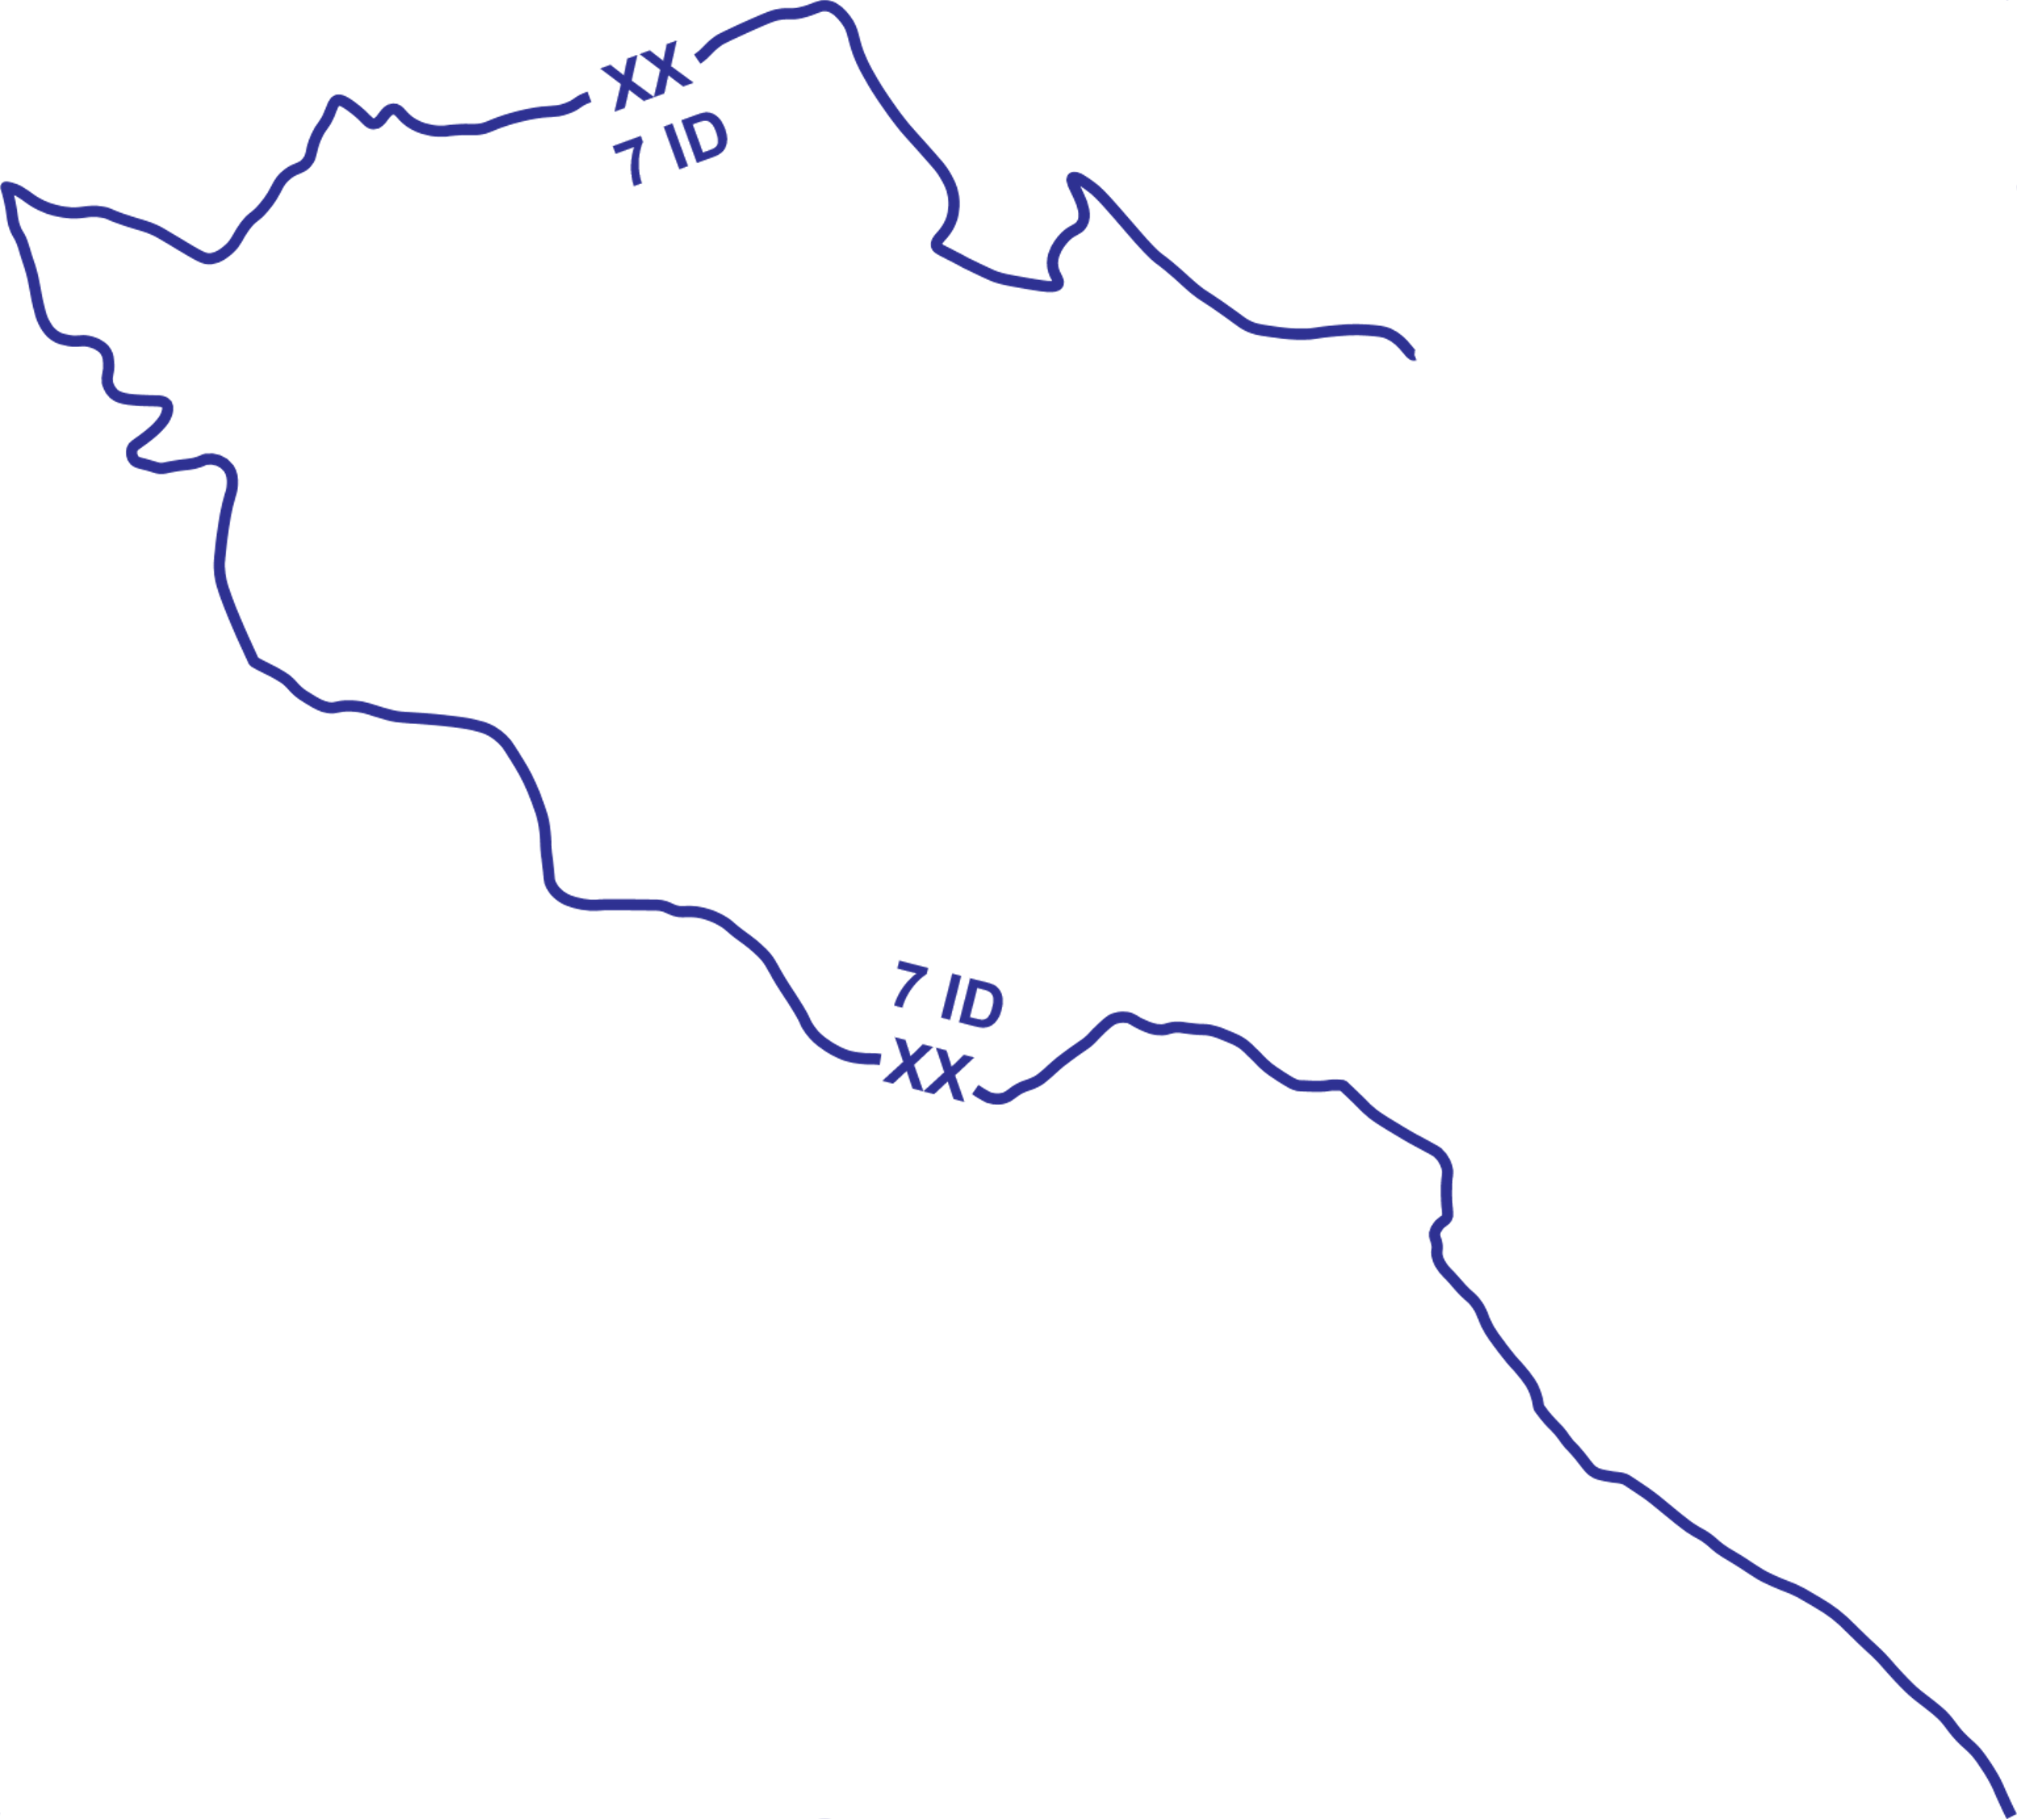



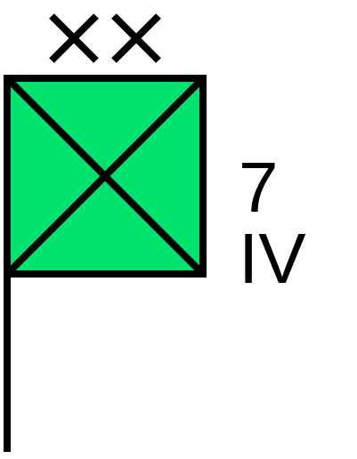


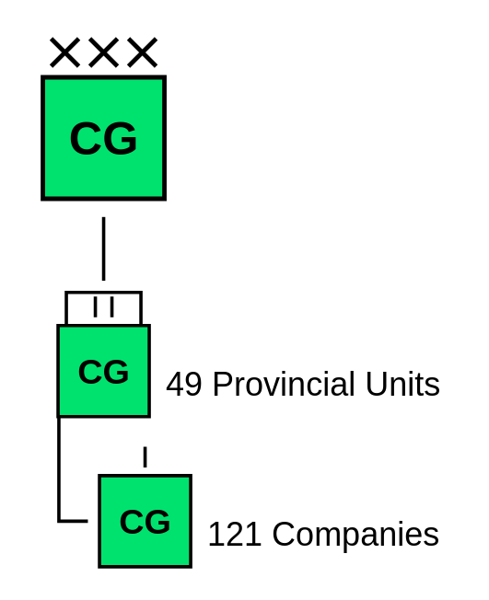
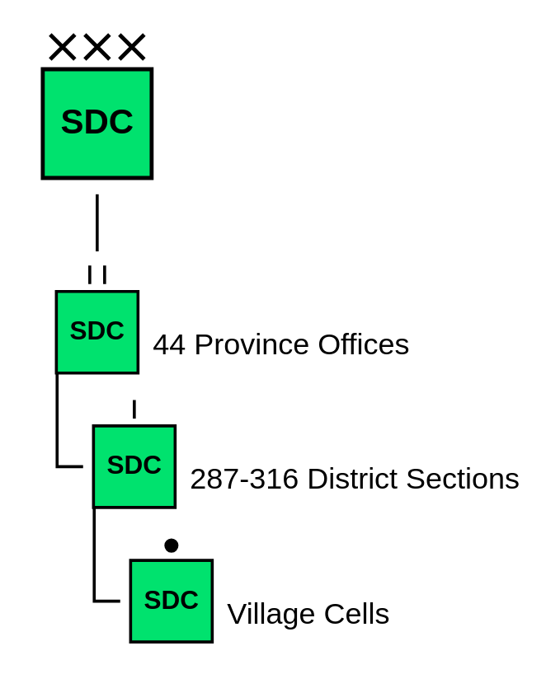
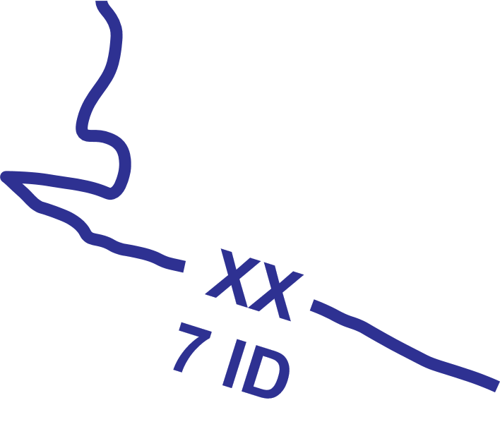

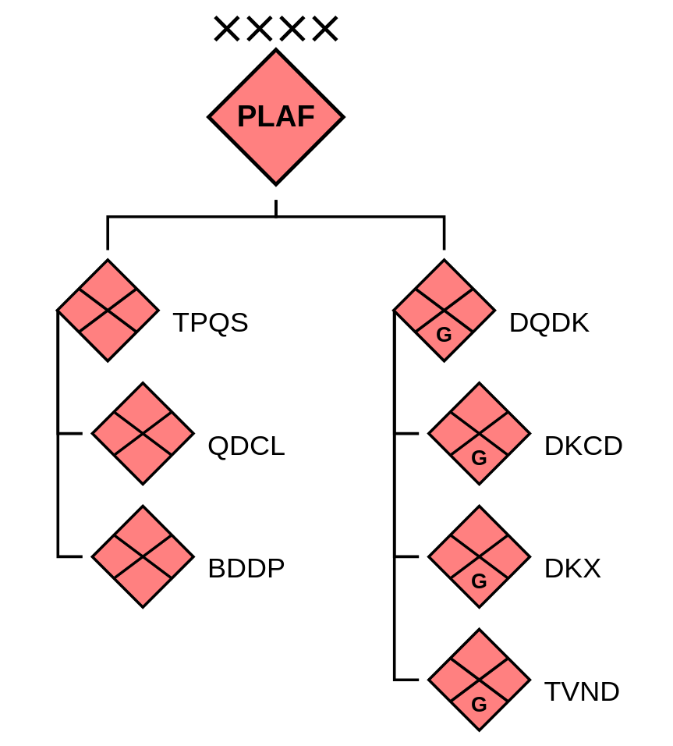

CAMBODIA
KIEN TUONG
Chau Phu
KIEN PHUONG
That Son
Ap Bac
Tri Ton
Cai Lay
Long Xuyen
DT(P)
MoI
My Tho
Ha Tien
DINH TUONG
Sa Dec
Vinh Long
Truc Giang
KIEN HOA
Rach Gia
Can Tho
Phu Vinh
Vi Thanh
CHUONG THIEN
Khanh Hung
Bac Lieu
Quan Long
1C. Mekong Delta
N
miles
10
0
10
20
30
km
10
0
20

Slide 6
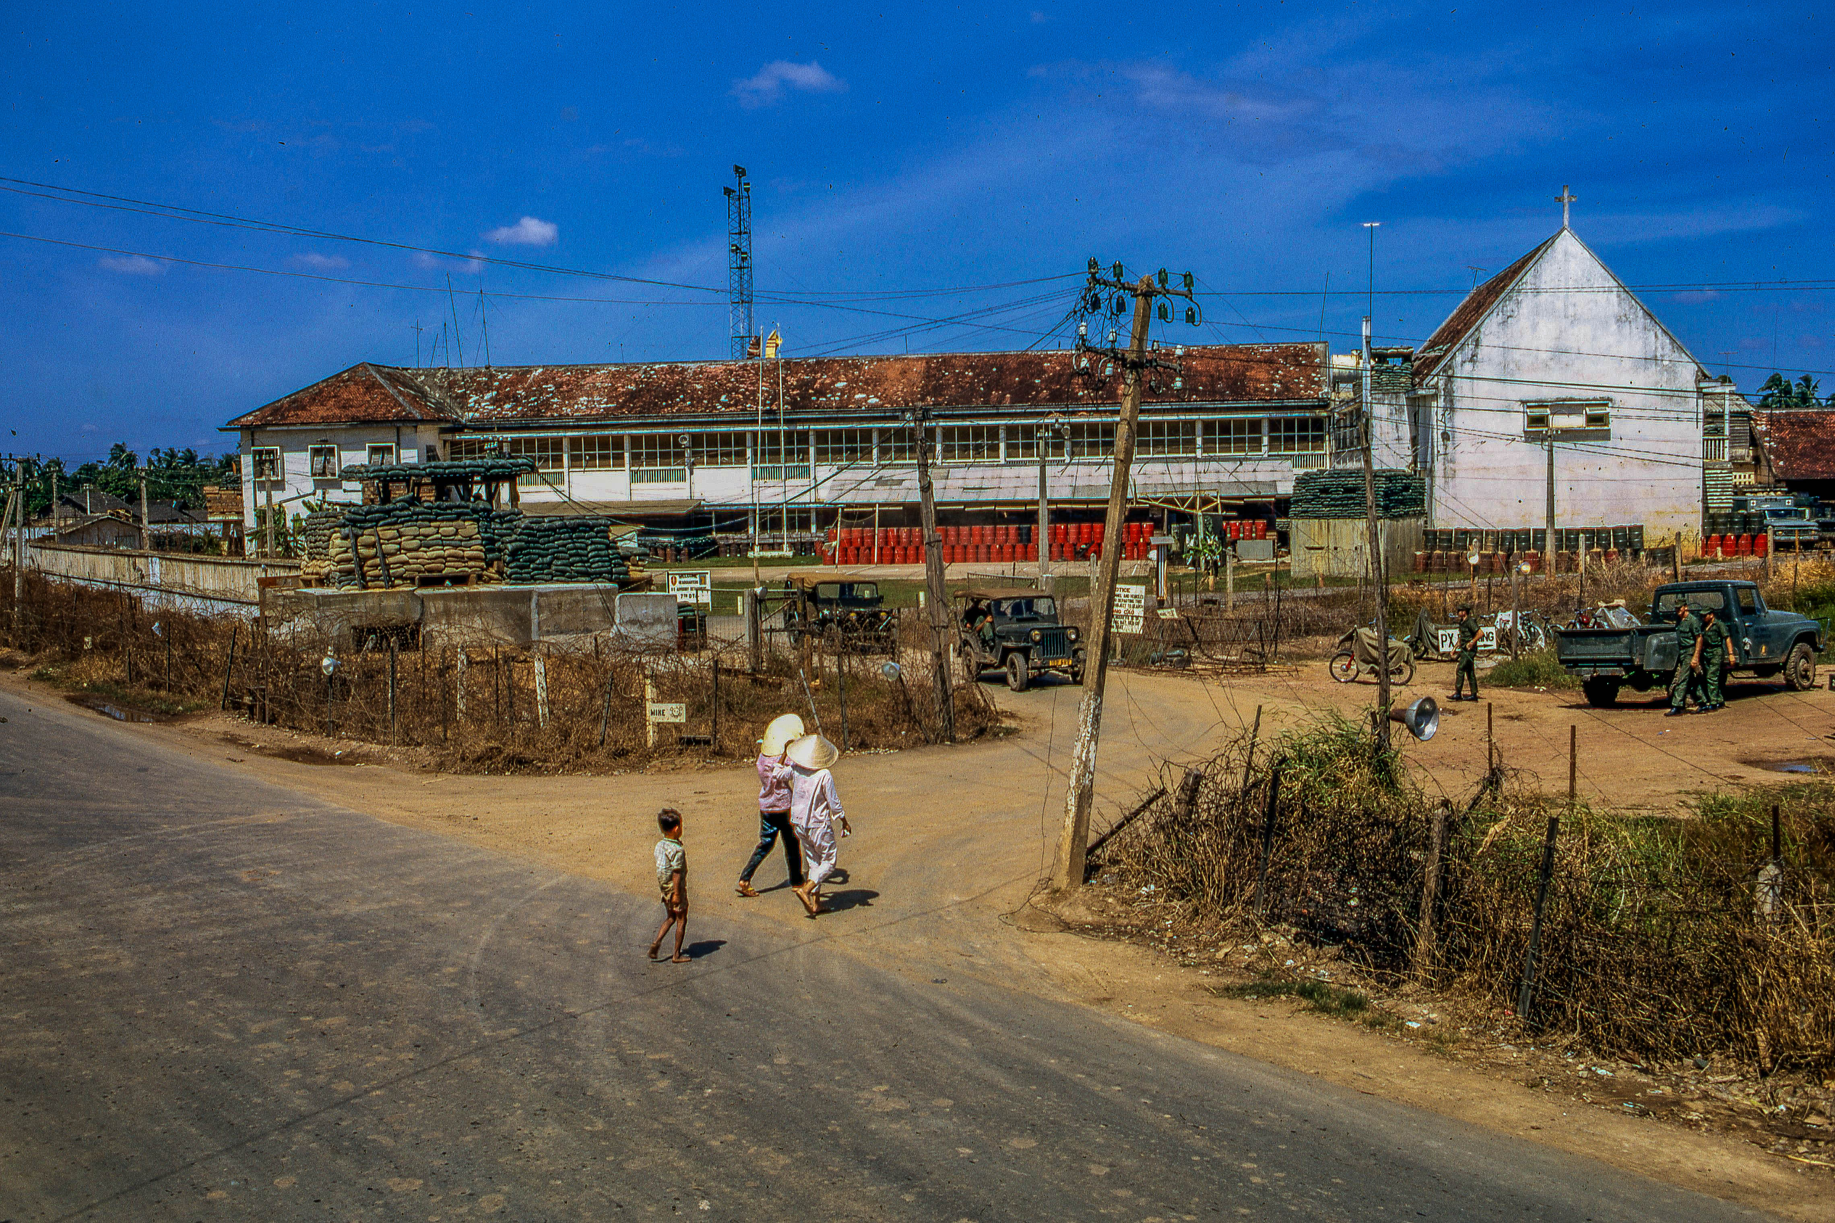
STAND 2: OPERATIONAL AND TACTICAL ENVIRONMENT

Slide 7















MTOE Strength: 10,450
Image: MrPenguin20
2A. ARVN Infantry Division, 1962

Slide 8



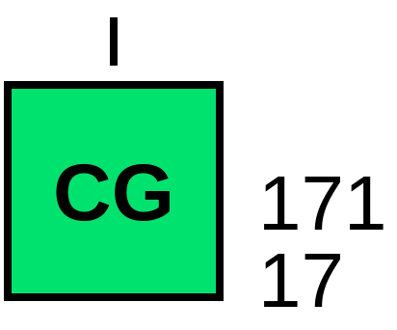








2B. “Dinh Tuong Regiment” (P), 1962

Slide 9
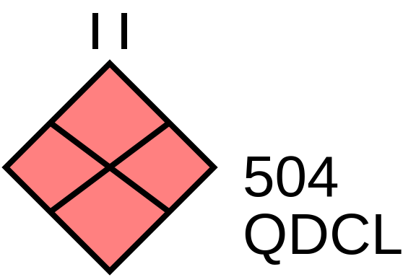



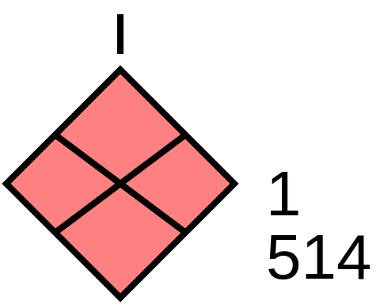
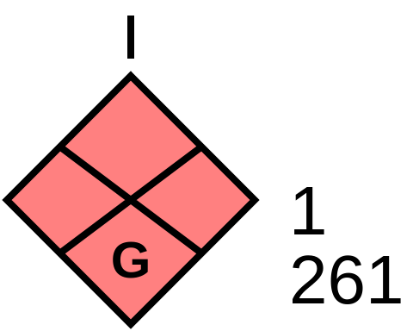


?
2C. Known PLAF Units in 7th DTZ, 1962

Slide 10

2D. Advisor Team 75, MAY 1962
Senior Advisor
LTC John P. Vann
Chief of Staff
MAJ Elmer Faust
INTEL
CPT James Drummond
OPS/PLANS
CPT Richard Zeigler
ALO
Maj Herbert Prevost
10th IN RGT Advisor
11th IN RGT Advisor
MAJ Harold Dill
12th IN RGT Advisor

Slide 11
20 JUL 1962
First night air assault by ARVN units
Attack and destroy a VC company in Kien Tuong Province
Tactically inconclusive
Operational loss
CAMBODIA
KIEN TUONG
Chau Phu
KIEN PHUONG
That Son
Ap Bac
Tri Ton
Cai Lay
Long Xuyen
DT(P)
MoI
My Tho
Ha Tien
DINH TUONG
Sa Dec
Vinh Long
Truc Giang
KIEN HOA
18 SEP 1962
Used recently fielded M113 APCs
Attack and destroy a VC battalion in Dinh Tuong Province
Tactical victory
Operationally inconclusive
Rach Gia
Can Tho
Phu Vinh
Vi Thanh
CHUONG THIEN
Khanh Hung
Bac Lieu
Quan Long
5 OCT 1962
ARVN Ranger Company air assault
Find and destroy VC battalion in Dinh Tuong Province
Tactical loss
Operational loss
2E. Major OPS Prior to Ap Bac
N
miles
10
0
10
20
30
km
10
0
20

Slide 12
Kinh Ba Beo
2F. Major Terrain Features
N
3
“Plain of Reeds”
Xom Chua
1
m
1000
0
500
2000
Kinh Song My Tho
Xom Lang Bien
Xom Lang Bien
km
1
0
1
2
Xom Kinh Ba Beo
Ap Tay
2
Xom Choi
Xom Hue
Xom Ca Ciam
4
Ap Tan Tho
8
Cong Ba Ky
Cong Luong
Tan Hoi
Ap Bac
8
8
Rach Xom Hue
Ap Tan Hoa
5
Ap Can Loi
Ap Tan Hiep
Ap Bung
Ap Ca Mao
Ap Hoa
Ap Hung
Ap Binh Hoa
6
Ap Tay
Rach Sau
Ap Thoi
Ap Hoa
Ap My Dinh
Ap My Loi
Ap Tan Thanh
Ap My An
Ap Tan Phong
Ap My Thuan
Ap My Can
Ap Qui Thanh
7
Ap Trung
Ap Dong
Ap Thuan
Ap Giua
Ap My Kiem
Ap Qui Trinh
Ap Binh
Ap Tay
Ap Trung
Ap Trung

Slide 13
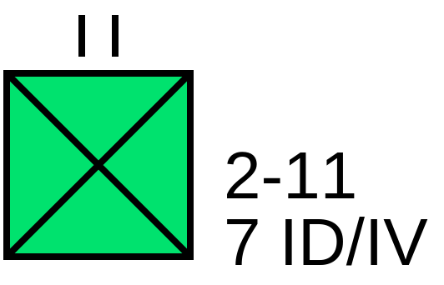




2G. Concept of the Operation
Kinh Ba Beo
N
Xom Chua
“Plain of Reeds”
Supporting Effort 2
T: Block the Kinh Ba Beo Canal
P: Deny VC movement to the north
352
IV
Main Effort
T: Attack Ap Than Tho
P: Destroy VC company and radio transmitter
m
1000
0
500
2000
Kinh Song My Tho
Xom Lang Bien
Xom Lang Bien
B
km
1
0
1
2
Xom Kinh Ba Beo
T: Defend Ap Than Tho
P: Deny avenue of approach from the west
Ap Tay
Xom Choi
Xom Hue
D
Xom Ca Ciam
Ap Tan Tho
Cong Ba Ky
Cong Luong
Ap Bac
T: Defend Ap Bac
P: Deny avenues of approach from the west and south
TF C
17/CG
Tan Hoi
Supporting Effort 1
T: Attack Ap Than Tho
P: Deny VC movement to the south or west
Rach Xom Hue
Ap Can Loi
Ap Tan Hoa
Ap Tan Hiep
Ap Bung
Ap Ca Mao
Ap Hoa
Ap Hung
Ap Binh Hoa
Rach Sau
Ap Tay
Ap Thoi
Ap Hoa
Ap My Dinh
Ap My Loi
Ap Tan Thanh
Ap My An
Ap Tan Phong
Ap My Thuan
TF A
17/CG
Ap My Can
Ap Qui Thanh
4-2
IV
TF B
17/CG
Ap Thuan
Ap Giua
Ap Trung
Ap Dong
Ap My Kiem
Ap Qui Trinh
Ap Binh
Ap Tay
Ap Trung
Ap Trung

Slide 14
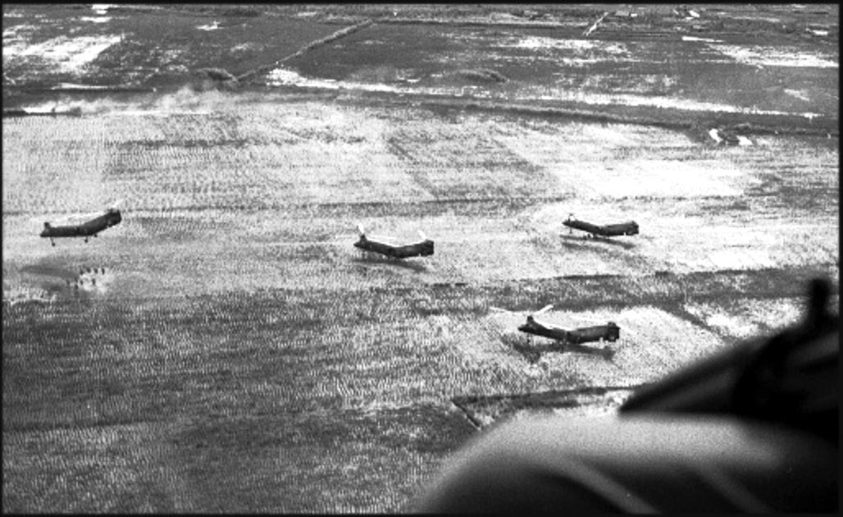
STAND 3: FIGHTING THE PLAN

Slide 15





3A. 2 JAN 63
0630-0900
Kinh Ba Beo
N
Xom Chua
“Plain of Reeds”
352
IV
m
1000
0
500
2000
93
MACV
Kinh Song My Tho
Xom Lang Bien
2/2-11
7 ID/IV
352
IV
km
1
0
1
2
Xom Kinh Ba Beo
Ap Tay
Xom Choi
Xom Hue
1
514
Xom Ca Ciam
Ap Tan Tho
SXN
1/261
Cong Ba Ky
Ap Bac
Cong Luong
4-2
IV
TF C
17/CG
Tan Hoi
PLT
1/261
Rach Xom Hue
PLT
1/261
Ap Tan Hoa
SXN
1/261
Ap Can Loi
TF A
17/CG
Ap Tan Hiep
TF B
17/CG
Ap Bung
Ap Ca Mao
Ap Hoa
Ap Hung
Ap Binh Hoa
Rach Sau
Ap Tay
4-2
IV
Ap Thoi
Ap Hoa
21
NRVN
Ap My Dinh
Ap My Loi
Ap Tan Thanh
Ap My An
Ap Tan Phong
Ap My Thuan
TF A
17/CG
Ap My Can
Ap Qui Thanh
TF B
17/CG
Ap Trung
Ap Dong
Ap Thuan
Ap Giua
Ap My Kiem
Ap Qui Trinh
Ap Binh
Ap Tay
Ap Trung
Ap Trung

Slide 16
3B. 2 JAN 63
0900-1000
Kinh Ba Beo
N
Xom Chua
“Plain of Reeds”
m
1000
0
500
2000
352
IV
Kinh Song My Tho
Xom Lang Bien
km
1
0
1
2
HLZ
Xom Kinh Ba Beo
93
MACV
1/2-11
7 ID/IV
93
MACV
2/2-11
7 ID/IV
3/2-11
7 ID/IV
Ap Tay
Xom Choi
Xom Hue
1
514
Xom Ca Ciam
Ap Tan Tho
HLZ 1
(Dam)
SXN
1/261
HLZ 2
(Dam)
Cong Ba Ky
Cong Luong
TF C
17/CG
Tan Hoi
4-2
IV
HLZ 3
(Vann)
Ap Bac
PLT
1/261
Rach Xom Hue
PLT
1/261
Ap Tan Hoa
F
F
SXN
1/261
Ap Can Loi
TF A
17/CG
Ap Tan Hiep
TF B
17/CG
Ap Bung
Ap Ca Mao
Ap Hoa
Ap Hung
Ap Binh Hoa
Rach Sau
Ap Tay
Ap Thoi
Ap Hoa
Ap My Dinh
Ap My Loi
Ap Tan Thanh
Ap My An
Ap Tan Phong
Ap My Thuan
Ap My Can
Ap Qui Thanh
Ap Trung
Ap Dong
Ap Thuan
Ap Giua
Ap My Kiem
Ap Qui Trinh
Ap Binh
Ap Tay
Ap Trung
Ap Trung

Slide 17





UTTHC
MACV
93
MACV
4-2
IV
SXN
1/261
PLT
1/261
HLZ 3
(Vann)
1/1-11
7 ID/IV
PLT
1/261
SXN
1/261
172
TF A/17
842
TF A/17
892
TF A/17
839
TF B/17
172
TF B/17
171
TF B/17
3C. Reserve LZ
2 JAN 1000-1100
N
0
500
1000
Xom Lang Bien
meters

Slide 18

3D. 2 JAN 63
1100-1200
Kinh Ba Beo
N
Xom Chua
“Plain of Reeds”
m
1000
0
500
2000
352
IV
Kinh Song My Tho
Xom Lang Bien
km
1
0
1
2
Xom Kinh Ba Beo
2/2-11
7 ID/IV
Ap Tay
Xom Choi
3/2-11
7 ID/IV
Xom Hue
1/2-11
7 ID/IV
1
514
Xom Ca Ciam
Ap Tan Tho
4-2
IV
SXN
1/261
Cong Ba Ky
Cong Luong
TF C
17/CG
Tan Hoi
Ap Bac
PLT
1/261
1/1-11
7 ID/IV
Rach Xom Hue
PLT
1/261
Ap Can Loi
Ap Tan Hoa
TF B
17/CG
TF A
17/CG
Ap Tan Hiep
Ap Bung
Ap Ca Mao
Ap Hoa
Ap Hung
Ap Binh Hoa
Rach Sau
Ap Tay
Ap Thoi
Ap Hoa
Ap My Dinh
Ap My Loi
Ap Tan Thanh
Ap My An
Ap Tan Phong
Ap My Thuan
Ap My Can
Ap Qui Thanh
Ap Trung
Ap Dong
Ap Thuan
Ap Giua
Ap My Kiem
Ap Qui Trinh
Ap Binh
Ap Tay
Ap Trung
Ap Trung

Slide 19
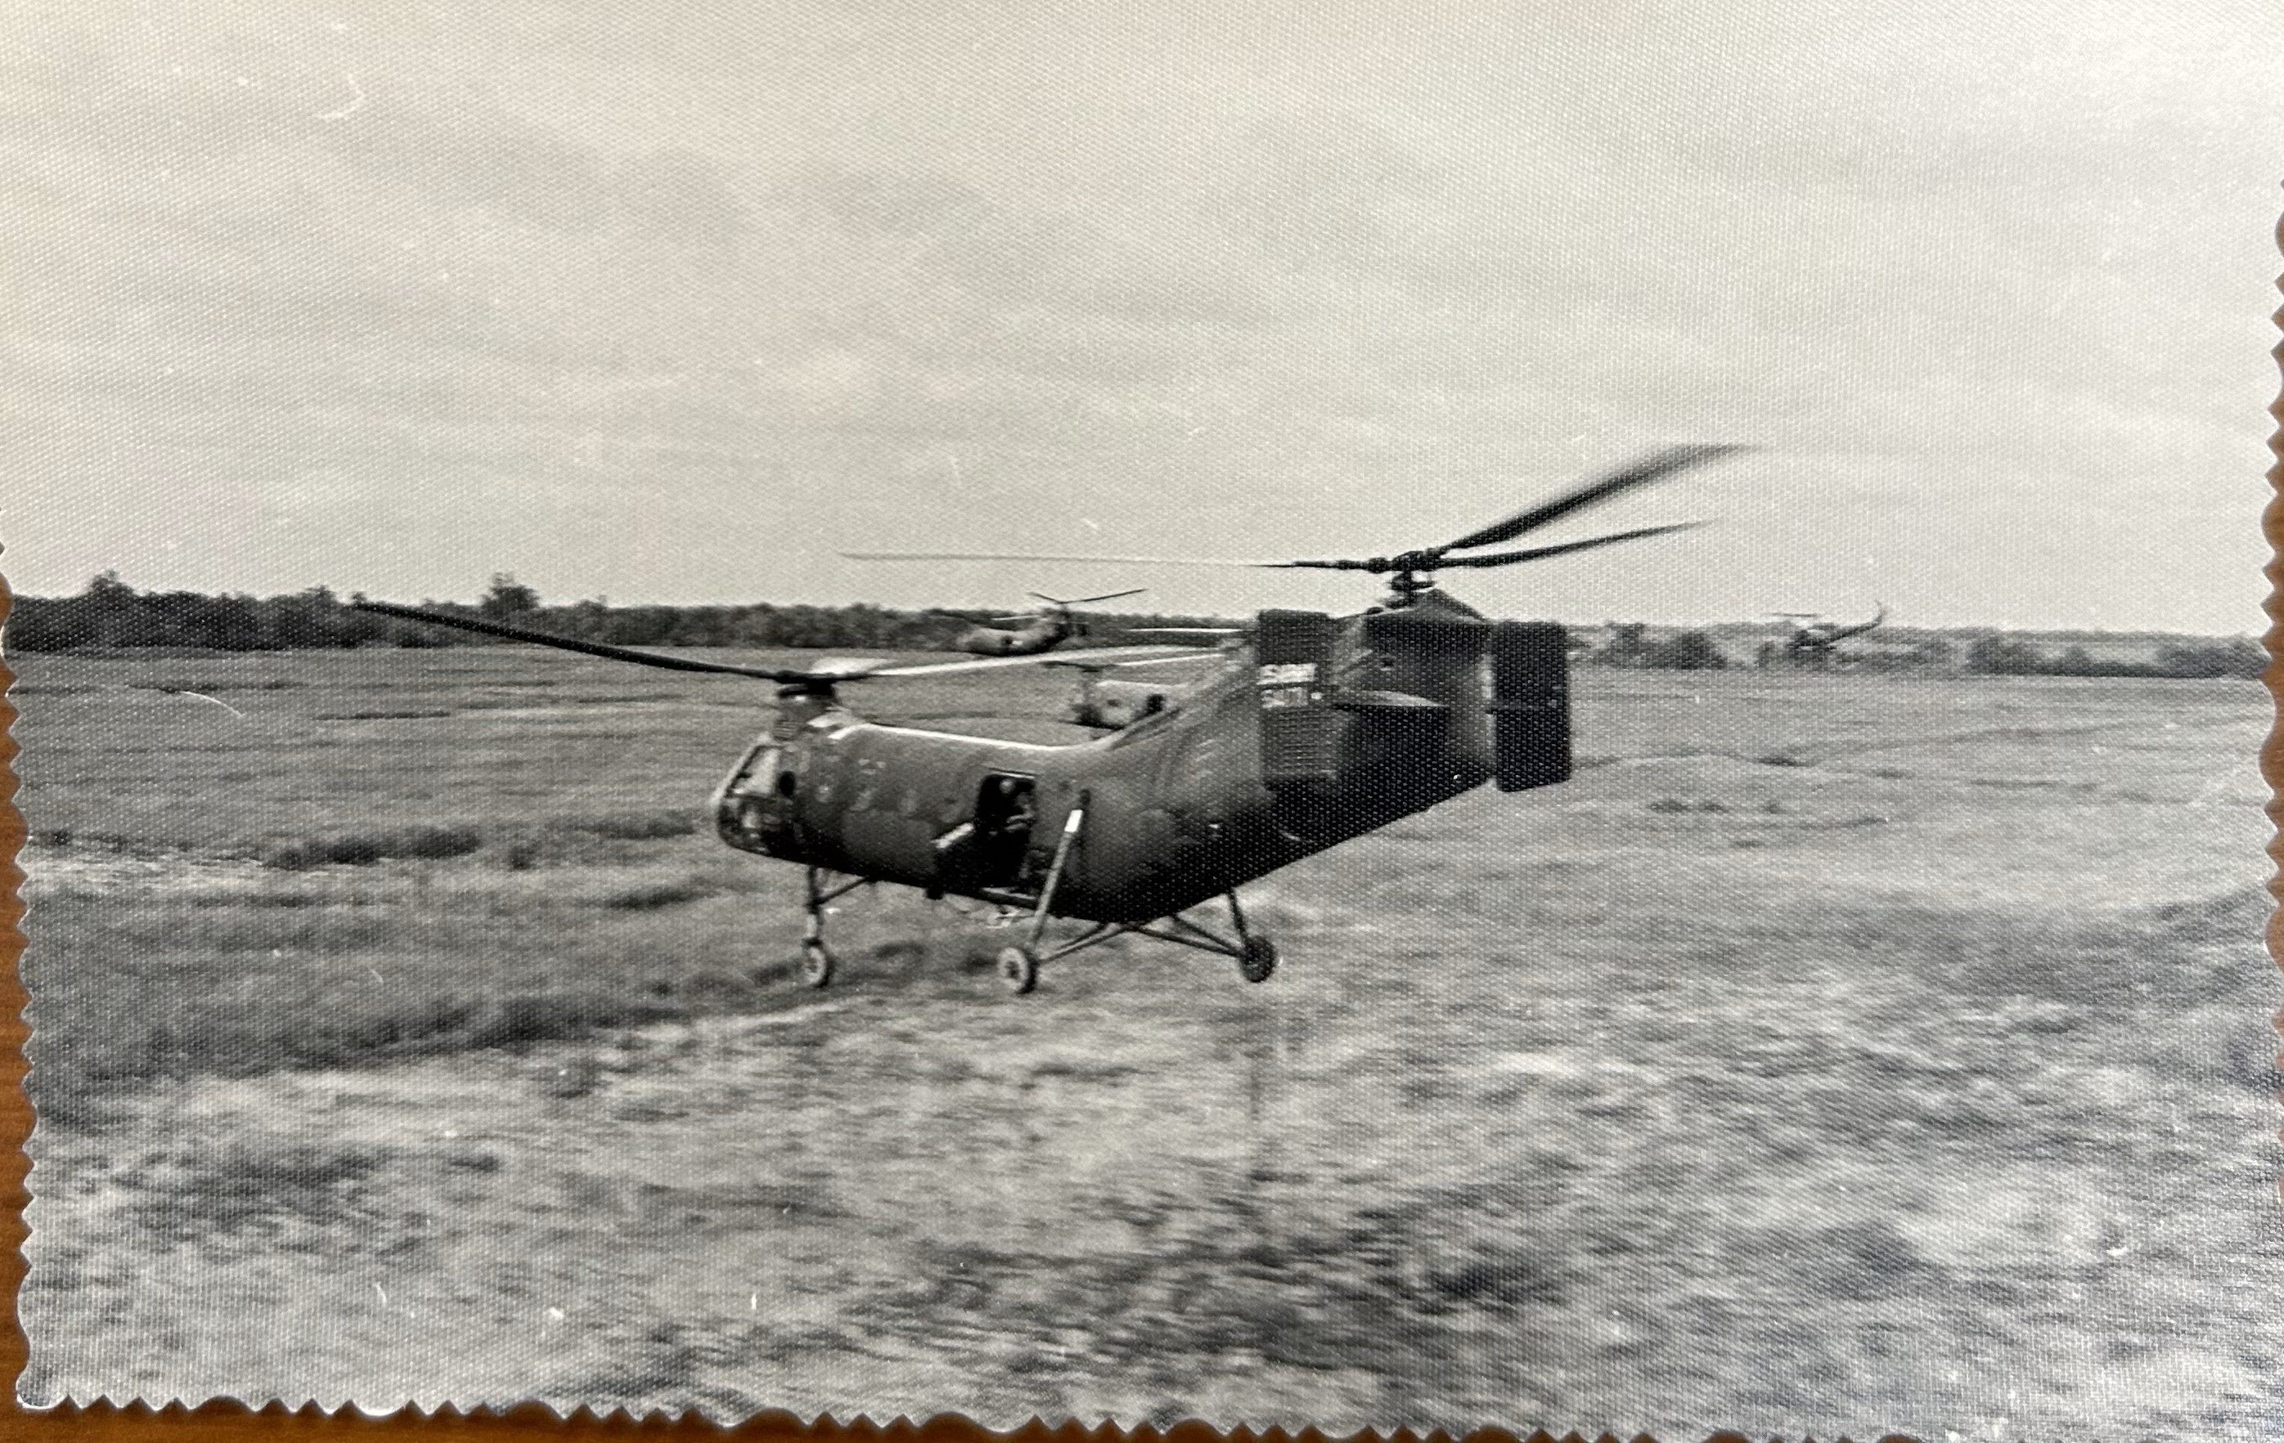
STAND 4: FIGHTING THE ENEMY

Slide 20
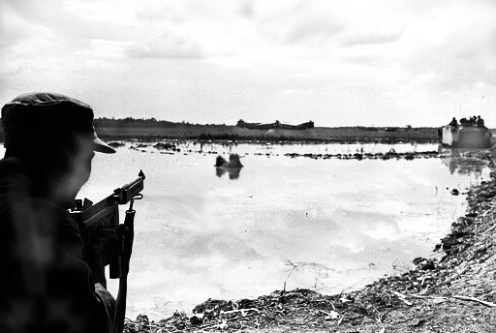
4A. 2 JAN 63
1200-1400
Kinh Ba Beo
N
Xom Chua
“Plain of Reeds”
m
1000
0
500
2000
352
IV
Kinh Song My Tho
Xom Lang Bien
km
1
0
1
2
Xom Kinh Ba Beo
2/2-11
7 ID/IV
Ap Tay
Xom Choi
3/2-11
7 ID/IV
Xom Hue
1/2-11
7 ID/IV
1
514
Xom Ca Ciam
Ap Tan Tho
4-2
IV
SXN
1/261
Cong Ba Ky
Cong Luong
TF C
17/CG
Tan Hoi
Ap Bac
PLT
1/261
1/1-11
7 ID/IV
Rach Xom Hue
PLT
1/261
Ap Can Loi
Ap Tan Hoa
TF B
17/CG
TF A
17/CG
Ap Tan Hiep
Ap Bung
Ap Ca Mao
Ap Hoa
Ap Hung
Ap Binh Hoa
Rach Sau
Ap Tay
Ap Thoi
Ap Hoa
Ap My Dinh
Ap My Loi
Ap Tan Thanh
Ap My An
Ap Tan Phong
Ap My Thuan
Ap My Can
Ap Qui Thanh
Ap Trung
Ap Dong
Ap Thuan
Ap Giua
Ap My Kiem
Ap Qui Trinh
Ap Binh
Ap Tay
Ap Trung
Ap Trung

Slide 21
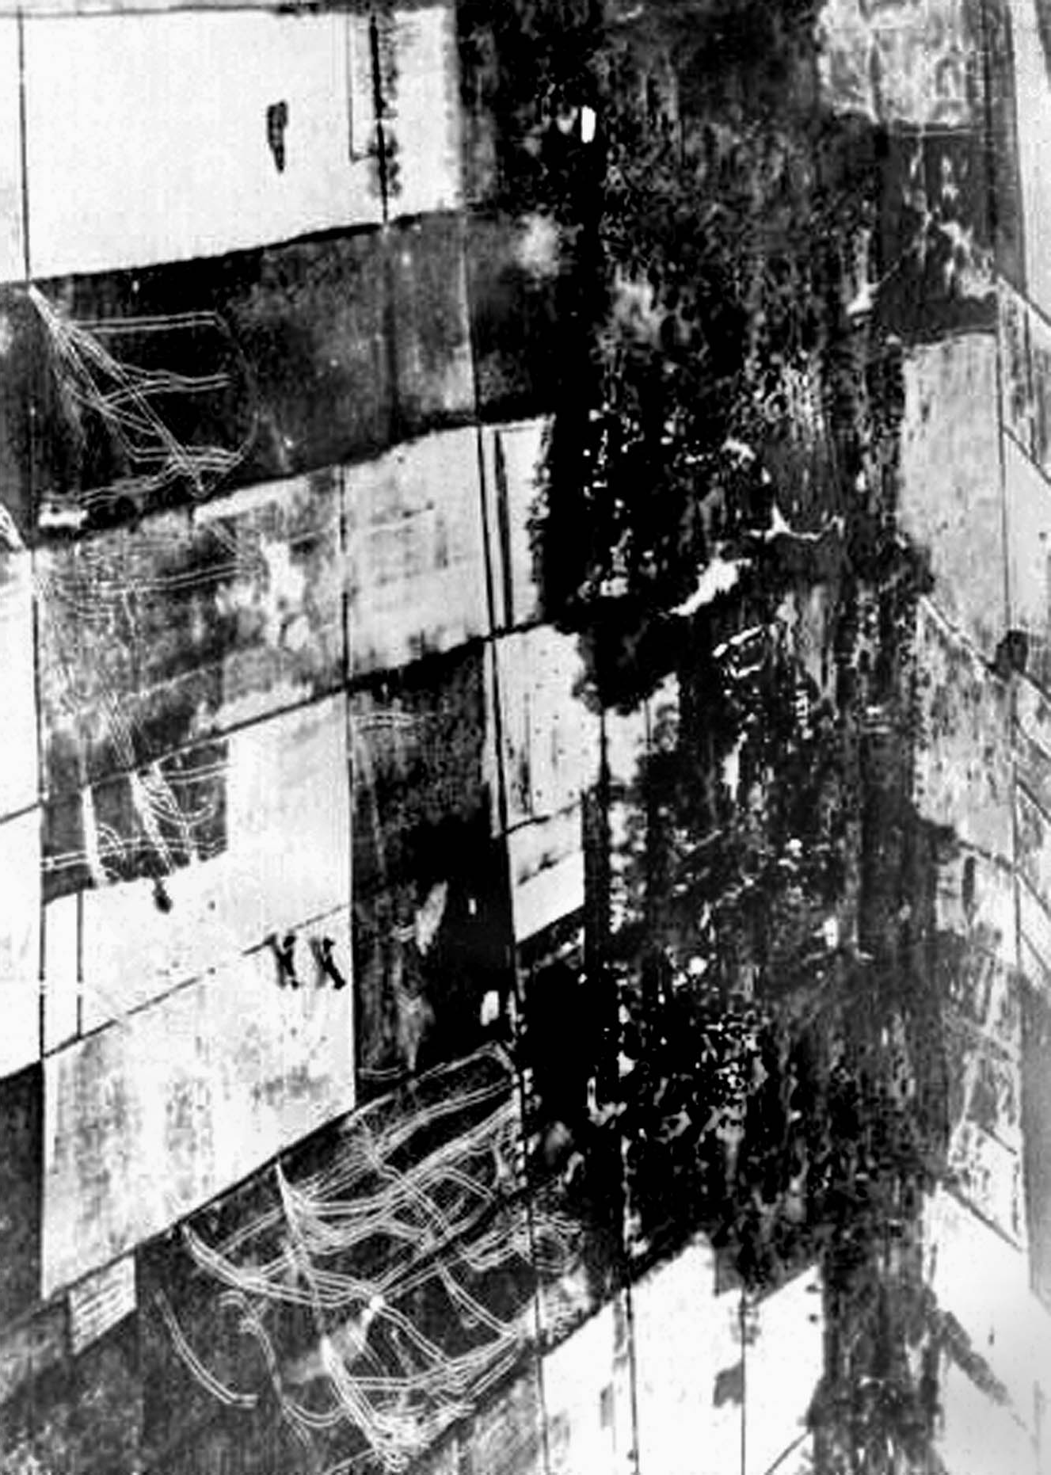

SXN
1/261
4-2
IV
PLT
1/261
1/1-11
7 ID/IV
PLT
1/261
172
TF A/17
842
TF A/17
TF B
17/CG
892
TF A/17
4B. Reserve LZ
1400-1600
N
0
500
1000
Xom Lang Bien
meters

Slide 22

4C. Ap Than Tho
1400-2400
N
352
IV
0
500
1000
Xom Lang Bien
meters
8 ABNE BN
DZ
(Cao)
8 ABNE BN
DZ
(Cao)
8 ABNE BN
DZ
(Vann)
1/2-11
7 ID/IV
2/2-11
7 ID/IV
3/2-11
7 ID/IV
1
514
8
2-VNAB
SXN
1/261
PLT
1/261
1/1-11
7 ID/IV

Slide 23
4D. 2 JAN 63
1800-2400
Kinh Ba Beo
N
Xom Chua
“Plain of Reeds”
m
1000
0
500
2000
Kinh Song My Tho
Xom Lang Bien
km
1
0
1
2
Xom Kinh Ba Beo
2/2-11
7 ID/IV
Ap Tay
Xom Choi
1/2-11
7 ID/IV
Xom Hue
3/2-11
7 ID/IV
1
514
Xom Ca Ciam
Ap Tan Tho
8
2-VNAB
SXN
1/261
Cong Ba Ky
Cong Luong
4-2
IV
TF C
17/CG
Tan Hoi
Ap Bac
PLT
1/261
1/1-11
7 ID/IV
Rach Xom Hue
PLT
1/261
Ap Can Loi
Ap Tan Hoa
TF B
17/CG
TF A
17/CG
Ap Tan Hiep
Ap Bung
352
IV
Ap Ca Mao
Ap Hoa
Ap Hung
Ap Binh Hoa
Rach Sau
Ap Tay
Ap Thoi
Ap Hoa
Ap My Dinh
Ap My Loi
Ap Tan Thanh
Ap My An
Ap Tan Phong
Ap My Thuan
Ap My Can
Ap Qui Thanh
Ap Trung
Ap Dong
Ap Thuan
Ap Giua
Ap My Kiem
Ap Qui Trinh
Ap Binh
Ap Tay
Ap Trung
Ap Trung

Slide 24

4E. Consolidation
3 JAN 63
Kinh Ba Beo
N
Xom Chua
“Plain of Reeds”
m
1000
0
500
2000
Kinh Song My Tho
Xom Lang Bien
km
1
0
1
2
Xom Kinh Ba Beo
Ap Tay
Xom Choi
Xom Hue
2-11
7 ID/IV
Xom Ca Ciam
Ap Tan Tho
8
2-VNAB
8
2-VNAB
Cong Ba Ky
Cong Luong
4-2
IV
2-11
7 ID/IV
TF C
17/CG
Tan Hoi
Ap Bac
1-10
7 ID/IV
1/1-11
7 ID/IV
Rach Xom Hue
Ap Can Loi
Ap Tan Hoa
1-10
7 ID/IV
TF B
17/CG
TF A
17/CG
Ap Tan Hiep
Ap Bung
349
IV
Ap Ca Mao
Ap Hoa
Ap Hung
Ap Binh Hoa
Rach Sau
Ap Tay
352
IV
Ap Thoi
Ap Hoa
Ap My Dinh
Ap My Loi
Ap Tan Thanh
5-1
IV
Ap My An
Ap Tan Phong
Ap My Thuan
Ap My Can
Ap Qui Thanh
Ap Trung
Ap Dong
Ap Thuan
Ap Giua
Ap My Kiem
Ap Qui Trinh
Ap Binh
Ap Tay
Ap Trung
Ap Trung

Slide 25
4F. Consolidation
4-6 JAN 63
Kinh Ba Beo
N
Xom Chua
“Plain of Reeds”
m
1000
0
500
2000
Kinh Song My Tho
Xom Lang Bien
km
1
0
1
2
Xom Kinh Ba Beo
Ap Tay
Xom Choi
Xom Hue
Xom Ca Ciam
Ap Tan Tho
Cong Ba Ky
Cong Luong
Tan Hoi
Ap Bac
1-10
7 ID/IV
4-2
IV
Rach Xom Hue
Ap Can Loi
Ap Tan Hoa
Ap Tan Hiep
2-11
7 ID/IV
Ap Bung
349
IV
Ap Ca Mao
Ap Hoa
Ap Hung
Ap Binh Hoa
8
2-VNAB
Rach Sau
Ap Tay
352
IV
Ap Thoi
Ap Hoa
Ap My Dinh
Ap My Loi
Ap Tan Thanh
5-1
IV
Ap My An
Ap Tan Phong
Ap My Thuan
Ap My Can
Ap Qui Thanh
Ap Trung
Ap Dong
Ap Thuan
Ap Giua
Ap My Kiem
Ap Qui Trinh
Ap Binh
Ap Tay
Ap Trung
Ap Trung

Slide 26
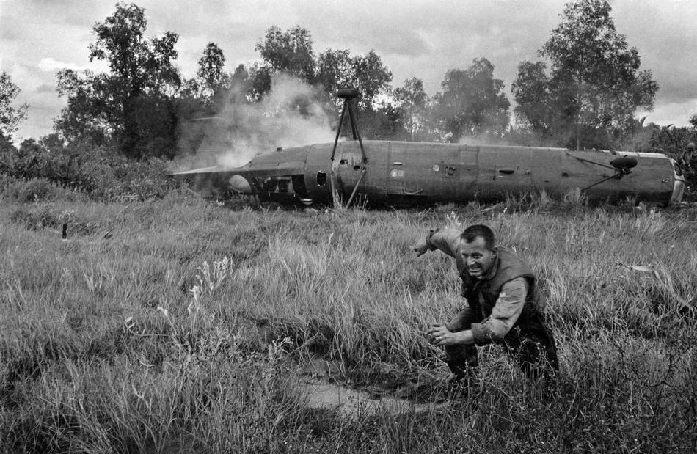
STAND 5: AP BAC – AFTERMATH, MISCONCEPTIONS AND SIGNIFICANCE

Slide 27
5A. Vietnam and the Continuum of Conflict, 1954-65
1965
National Strategic: Competition with global communist expansion
Theater Strategic: Competition communist expansion in East Asia and crisis in Vietnam
Operational: Limited contingency and large-scale ground combat, MACV – Offense, Defense, and Security Assistance
Tactical: Large scale ground combat, Advisor Team 75 – Assess, Advise, Support, Liaise
US military conventional forces start deploying to Southeast Asia
1961
National Strategic: Competition with global communist expansion
Theater Strategic: Competition communist expansion in East Asia
Operational: Crisis response, MACV – Security Force Assistance
Tactical: Advisor Team 75 – OTERA-A
1954
1962-64
National Strategic: Competition with global communist expansion
Theater Strategic: Competition communist expansion in East Asia
Operational: MAAG Vietnam - Security Force Assistance with RVN
Tactical: OTERA-A
National Strategic: Competition with global communist expansion
Theater Strategic: Competition communist expansion in East Asia
Operational: Crisis response and limited contingency, MACV – Security Assistance
Tactical: Limited contingency and large-scale ground combat, Advisor Team 75 – Assess, Advise, Support, Liaise
Special Forces established and deployed
1950
National Strategic: Competition with global communist expansion
Theater Strategic: Competition and crisis with communist expansion in East Asia
Operational: MAAG Indochina - Security Cooperation with French in Indochina
Tactical: NA

Slide 30


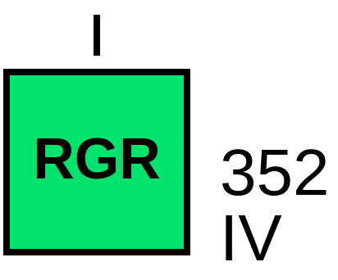

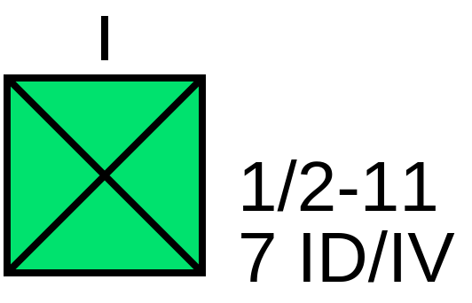







2G. Operation DUC THANG 1 – Task Organization
ASSIGNED
ATTACHED
OPCON
TACON

Slide 31


COL Hai Hoang, Senior Party Committee
CPT San Bich
CPT Nguyen Bay
2H. PLAF Task Organization
PLAF (People’s Liberation Armed Forces) Echelons:
DQDK: Dan Quan Du Kich (Guerilla Popular Army)
BDDP: Bo Doi Dia Phuong (Regional Force)

