Slide 1
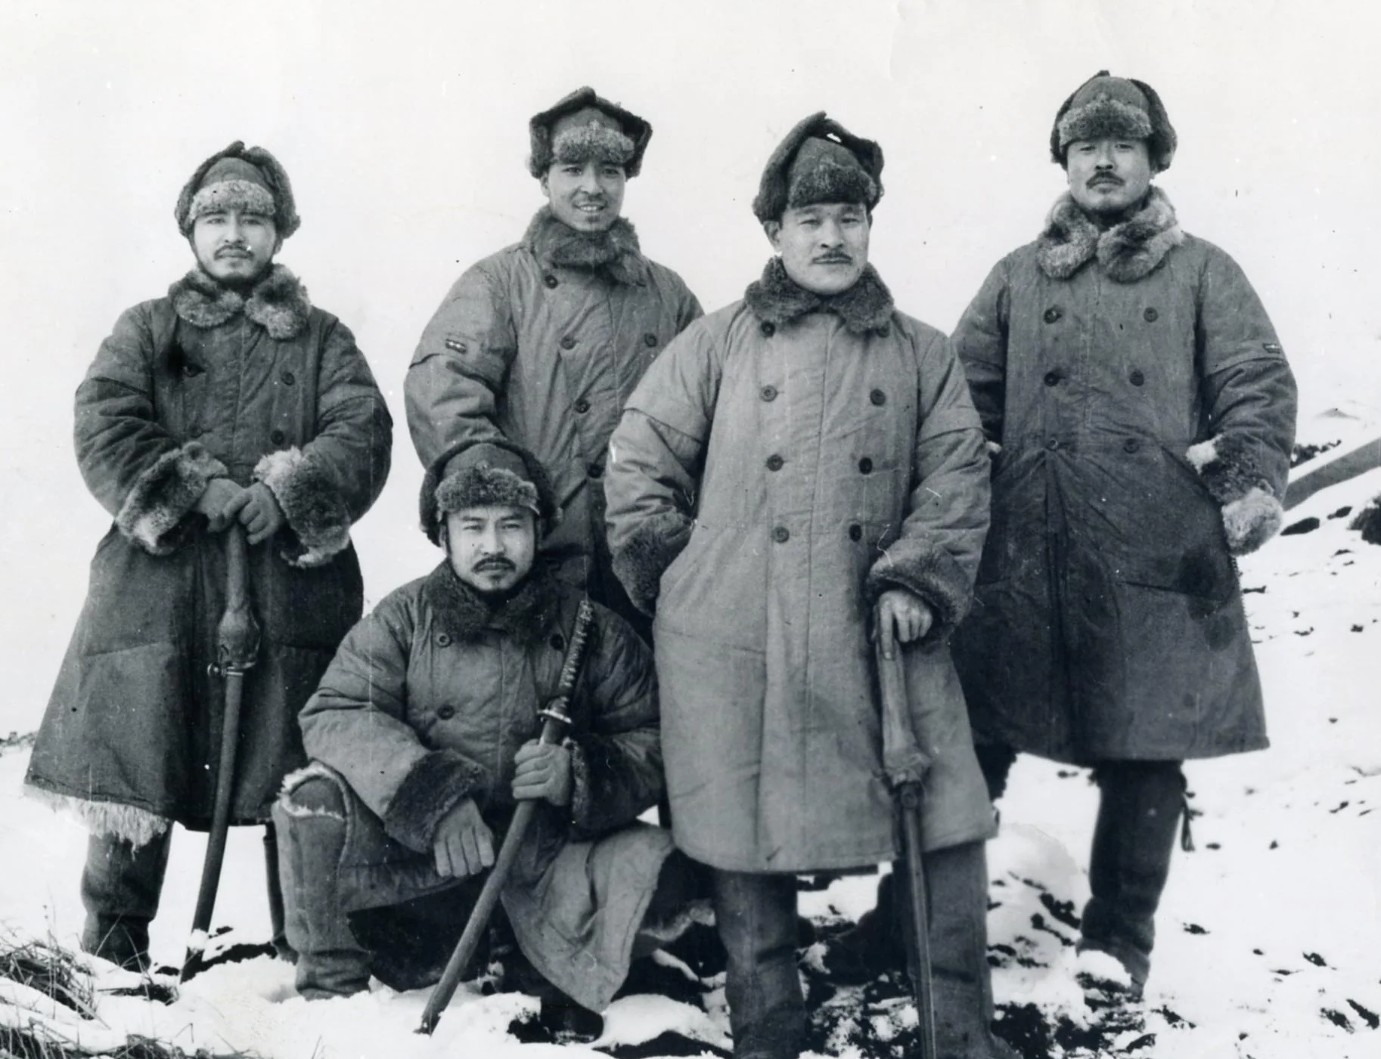
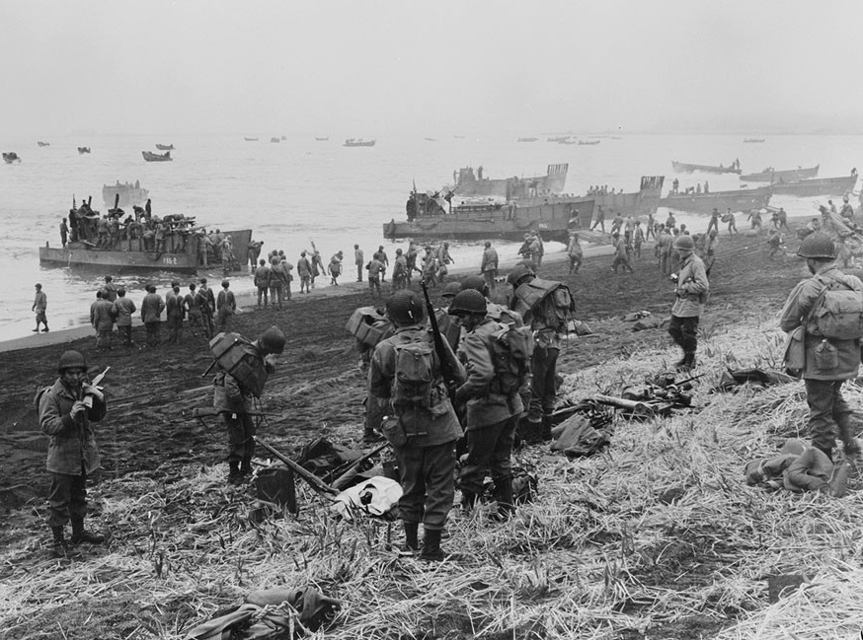
The Battle for Attu (Part 1)
Japanese Officers on Attu
US Landing at Massacre Bay

Slide 2
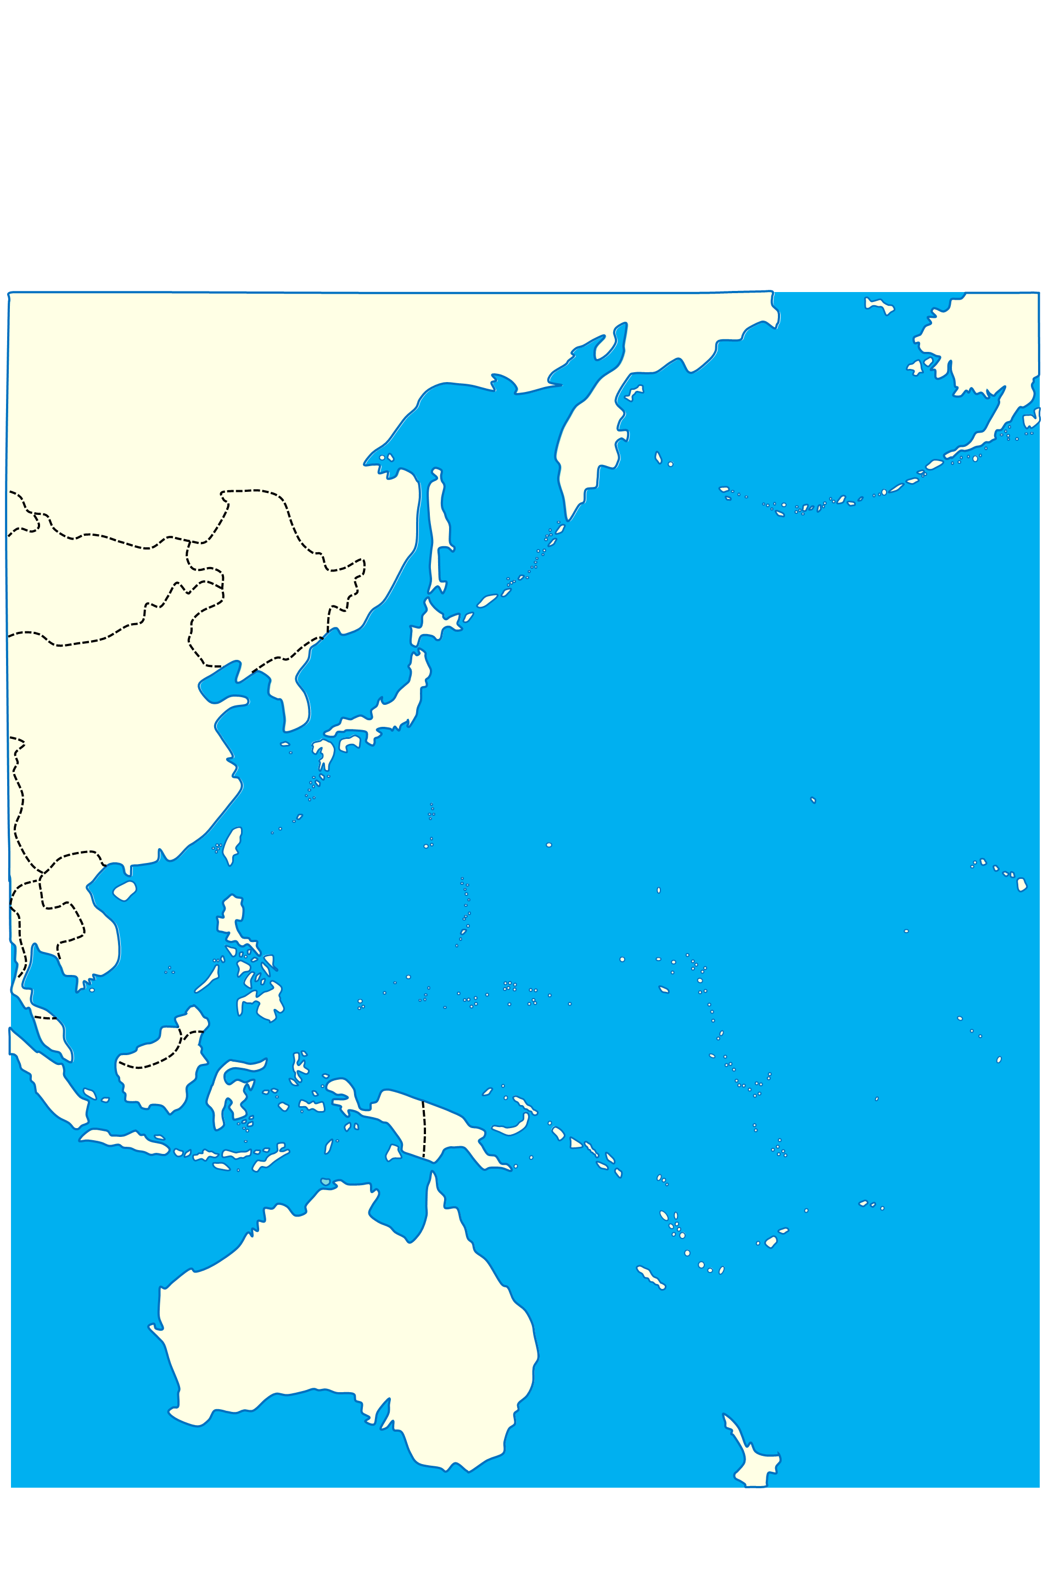
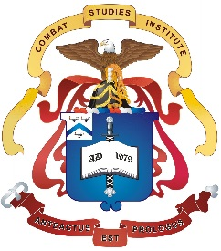
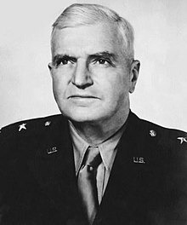
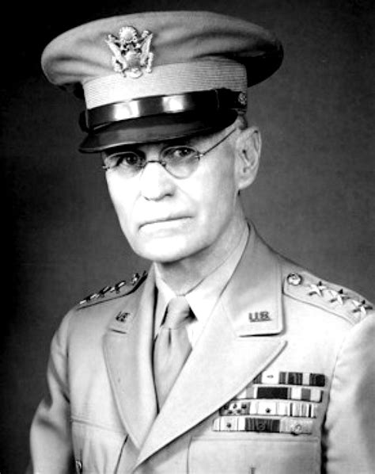
Japanese
Strategic Plan
December 1941
Alaska
1-1
USSR
0 400 800 1200 1600
Miles
N
Aleutian Islands
Mongolia
Manchuria
Kuril Islands
Conduct Raid on Pearl Harbor to Remove Threat of US Fleet
Continue War in China
Korea
Japan
China
Pacific
Ocean
Midway
Okinawa
Iwo Jima
Formosa
BG Simon Bolivar Buckner
Hong Kong
Seize Philippines to Free LOC from East Indies
Wake
Hawaiian
Islands
Marianas
Islands
French
Indochina
Philippines
Caroline Islands
Marshall
Islands
Seize Islands to Form Defensive Perimeter
Malaya
Singapore
New
Guinea
Gilbert
Islands
Borneo
Celebres
Bismarck
Islands
Sumatra
Java
Timor
Islands
Solomon
Islands
Samoa
Seize Resources of Netherlands East Indies
New
Hebrides
Australia
New Caldonia
LTG John L. DeWitt

Slide 3
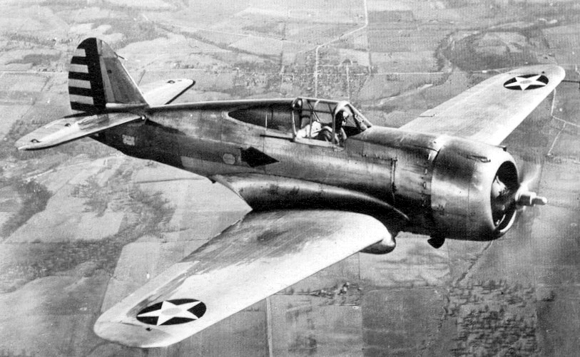
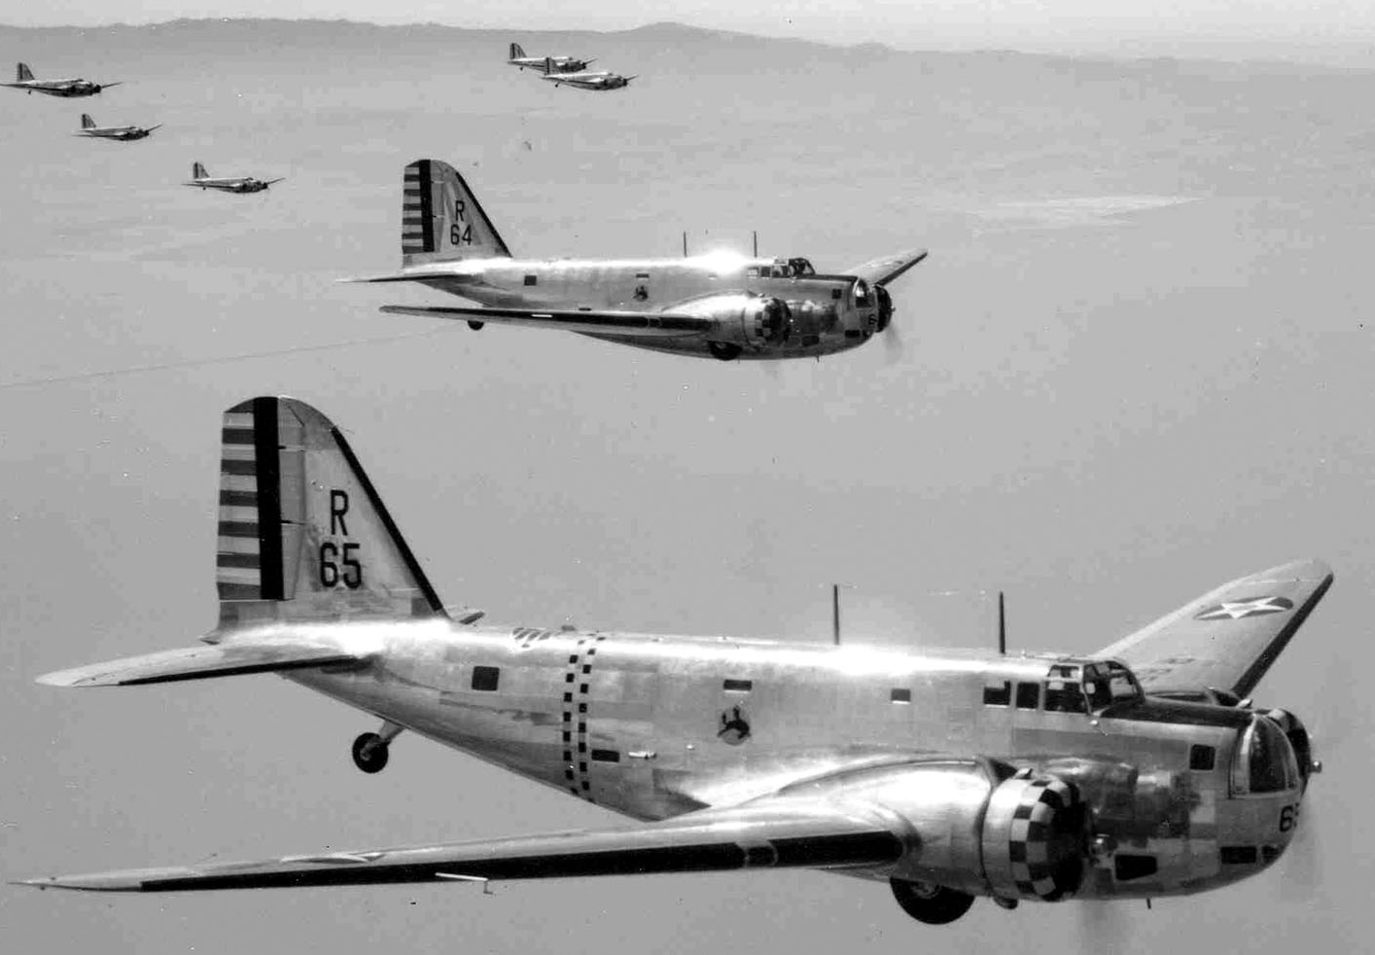
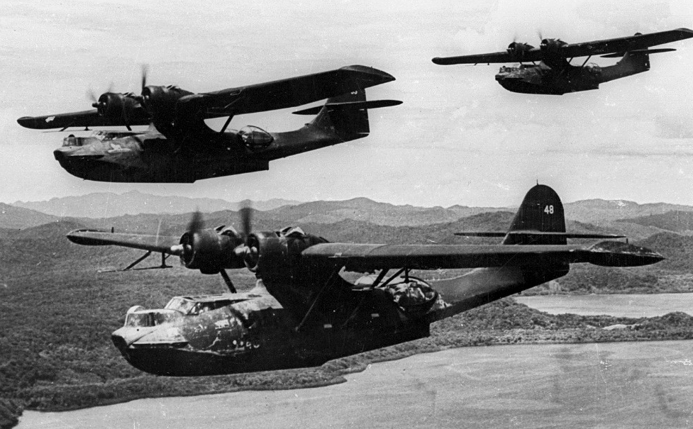
P-36 Hawk Fighter
Initial US Aircraft
in Alaska
1-2
B-18 Bolo Bomber
PBY Catalina

Slide 4
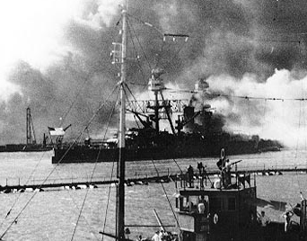
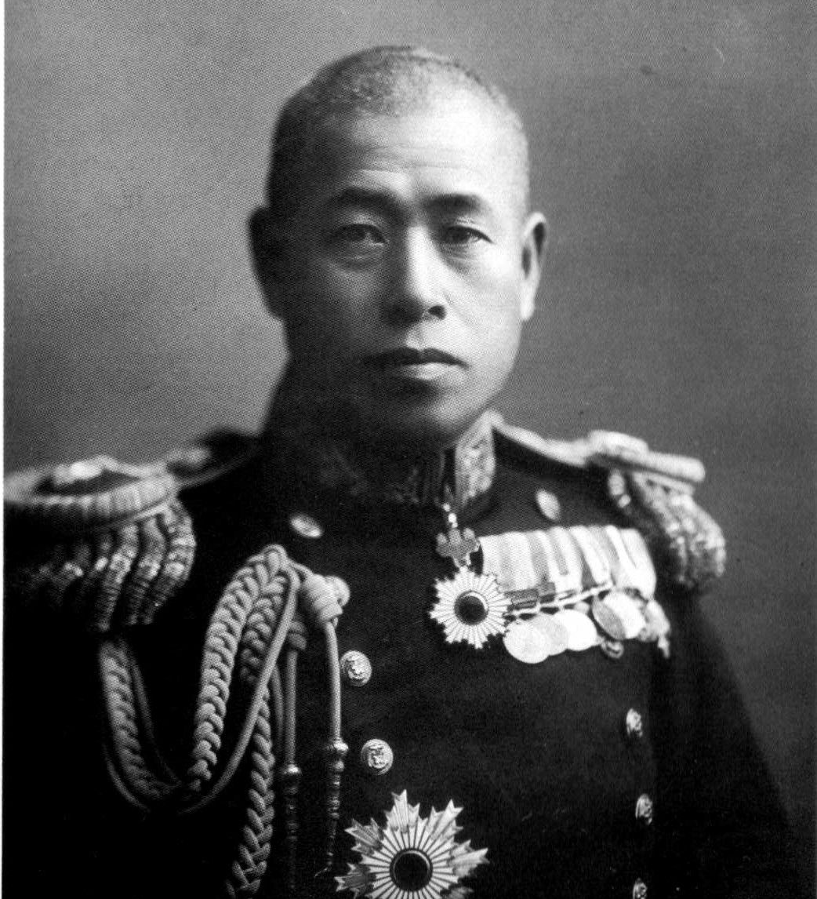
Japanese
Attack
December 1941
Alaska
1-3
USSR
0 400 800 1200 1600
Miles
N
Aleutian Islands
Mongolia
Manchuria
Kuril Islands
Conduct Raid on Pearl Harbor to Remove Threat of US Fleet
Korea
Japan
Hong Kong Seized
China
Pacific
Ocean
Midway
USS Nevada at Pearl Harbor
Later Part of the Attu Campaign
Okinawa
Iwo Jima
Formosa
Hong Kong
Philippines Seized
Marianas
Islands
Wake
Hawaiian
Islands
Tarawa Seized
Wake Seized
French
Indochina
Philippines
Caroline Islands
Marshall
Islands
Malaya
Singapore Seized
Kwajalein Seized
Singapore
New
Guinea
Tarawa Seized
Gilbert
Islands
Borneo
Celebres
Sumatra
Bismarck
Islands
Java
Timor
Islands
Solomon
Islands
Samoa
New
Hebrides
Australia
New Caldonia
Admiral Isoroku Yamamoto

Slide 5
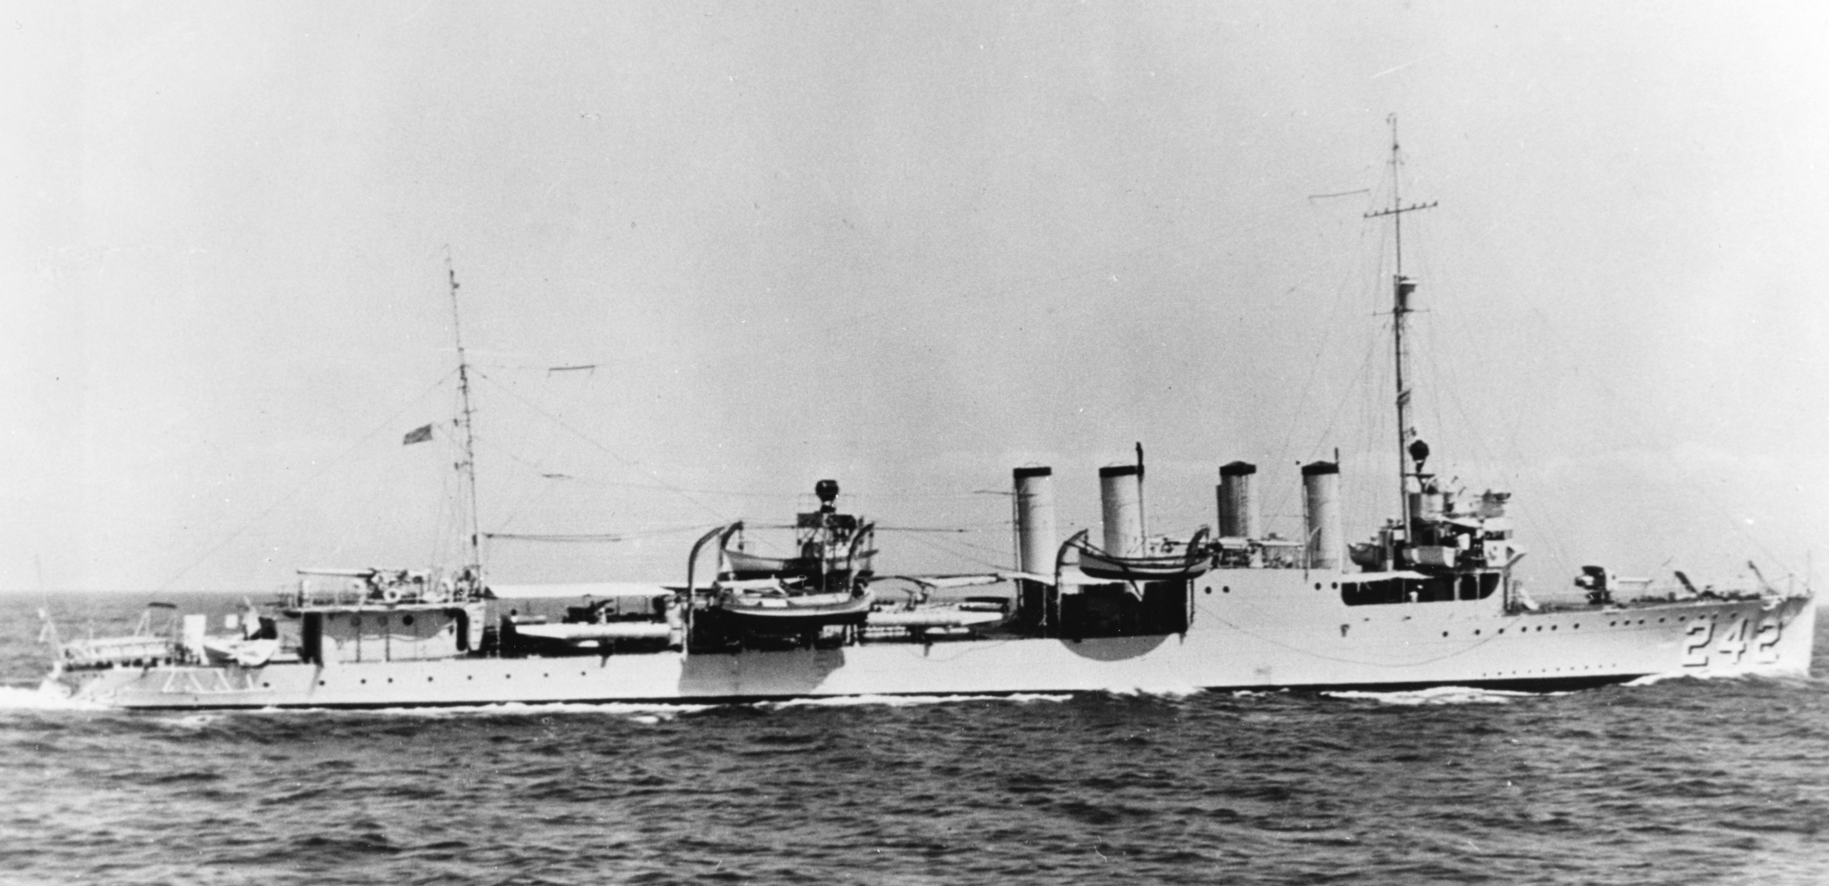
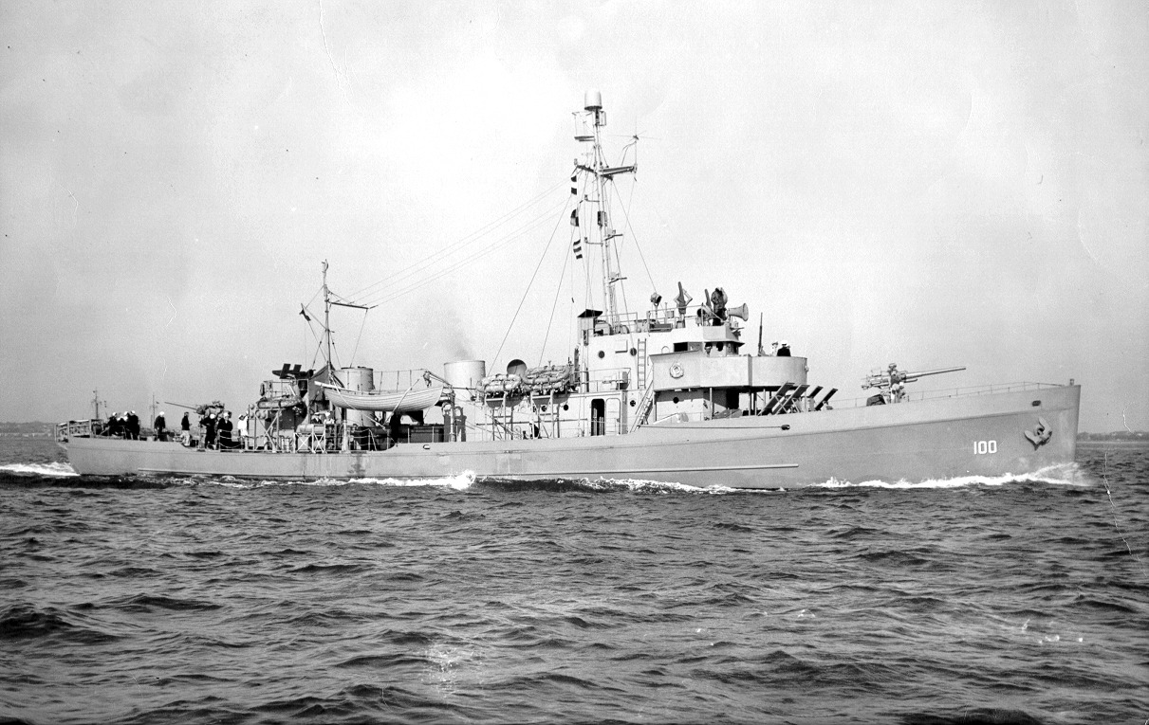
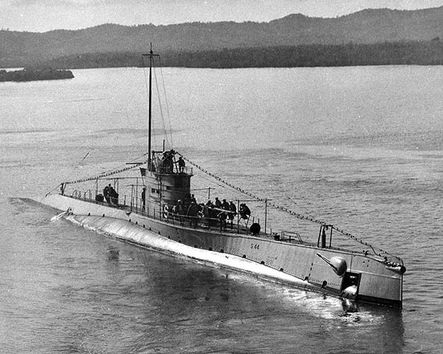
1-4
USS King—WWI Era Destroyer
US Alaskan Navy
Reinforcements
After Pearl Harbor
S Class Submarine
USCGC Argo (Coast Guard Cutter)

Slide 6
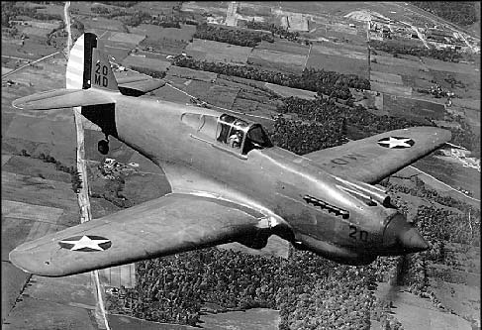
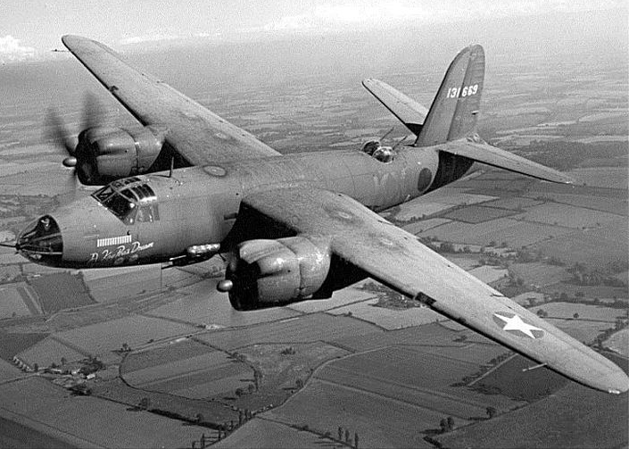
Reinforcing Aircraft to Alaska
After Pearl Harbor
1-5
P-40 Warhawk Fighter
B-26 Marauder Bomber

Slide 7
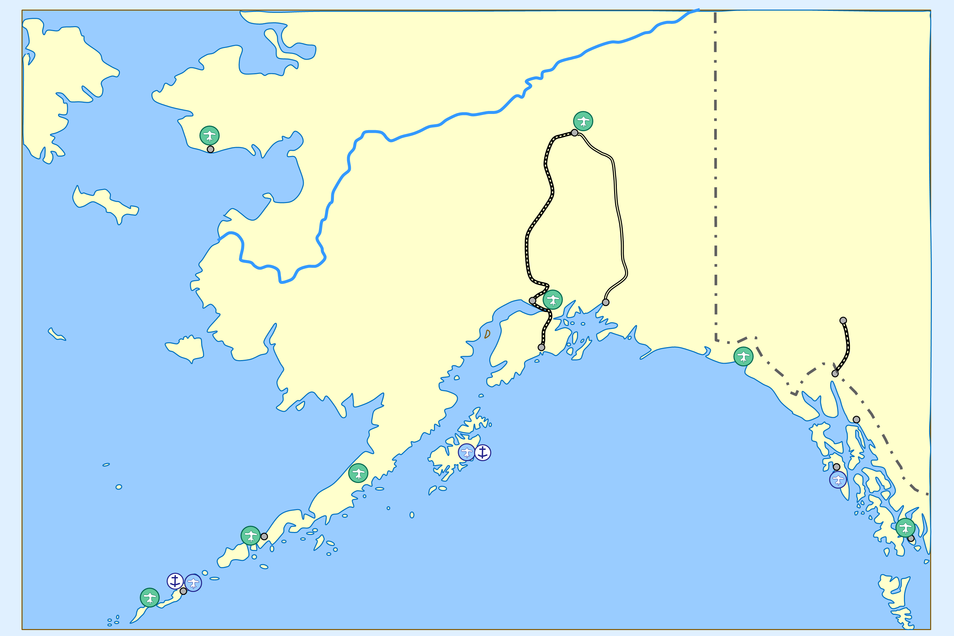
Alaska
Alaska Defenses
December 1941
1-6
USSR
XXX
0 50 100 150 200
Miles
N
Marks
ADC
Ladd Field
Fairbanks
XXX
Nome
11
Yukon River
III
Richardson
75
Railroad
Canada
III
4
Alaska
Highway
X
Alaska
Valdez
Whitehorse
III
Anchorage
215
Seward
III
Elmendorf Field/
Fort Richardson
Yakutat
Skagway
201
Bering Sea
Juneau
Fort Greely
III
Fort Morrow
Sitka
Kodiak Island
Fort Ray
206
III
US Army Airfields
Annette Island
37
Fort Randall/
Cold Bay Airfield
US Navy Air Stations
Metlakatla
Fort Mears
US Navy Sea Bases
Fort Glenn
Dutch Harbor

Slide 8
Japanese
Midway Plan
June 1942
1-7
USSR
Alaska
0 400 800 1200 1600
Miles
N
Japanese Forces and
Commanders
1. Guard Force-
Takasu
2. Midway
Occupation Force-
Tanaka
3. Midway Support
Force- Kurita
4. Carrier Strike
Force-Nagumo
5. Main Body-
Yamamoto
6. Second Fleet-
Kondo
7. Northern Force
Main Body-
Hosogaya
8. Attu Invasion
Force-Omori
9. Kiska Invasion
Force-Ono
10. Dutch Harbor
Raid Force-
Kakuta
Aleutian Islands
Attu
Dutch Harbor
8
Kiska
9
Kurile Islands
Manchuria
7
10
Pacific
Ocean
Korea
1
Japan
4
5
China
Midway
6
Okinawa
Iwo Jima
2
Hawaiian
Islands
Formosa
3
Marianas
Islands
Wake
Philippines

Slide 9
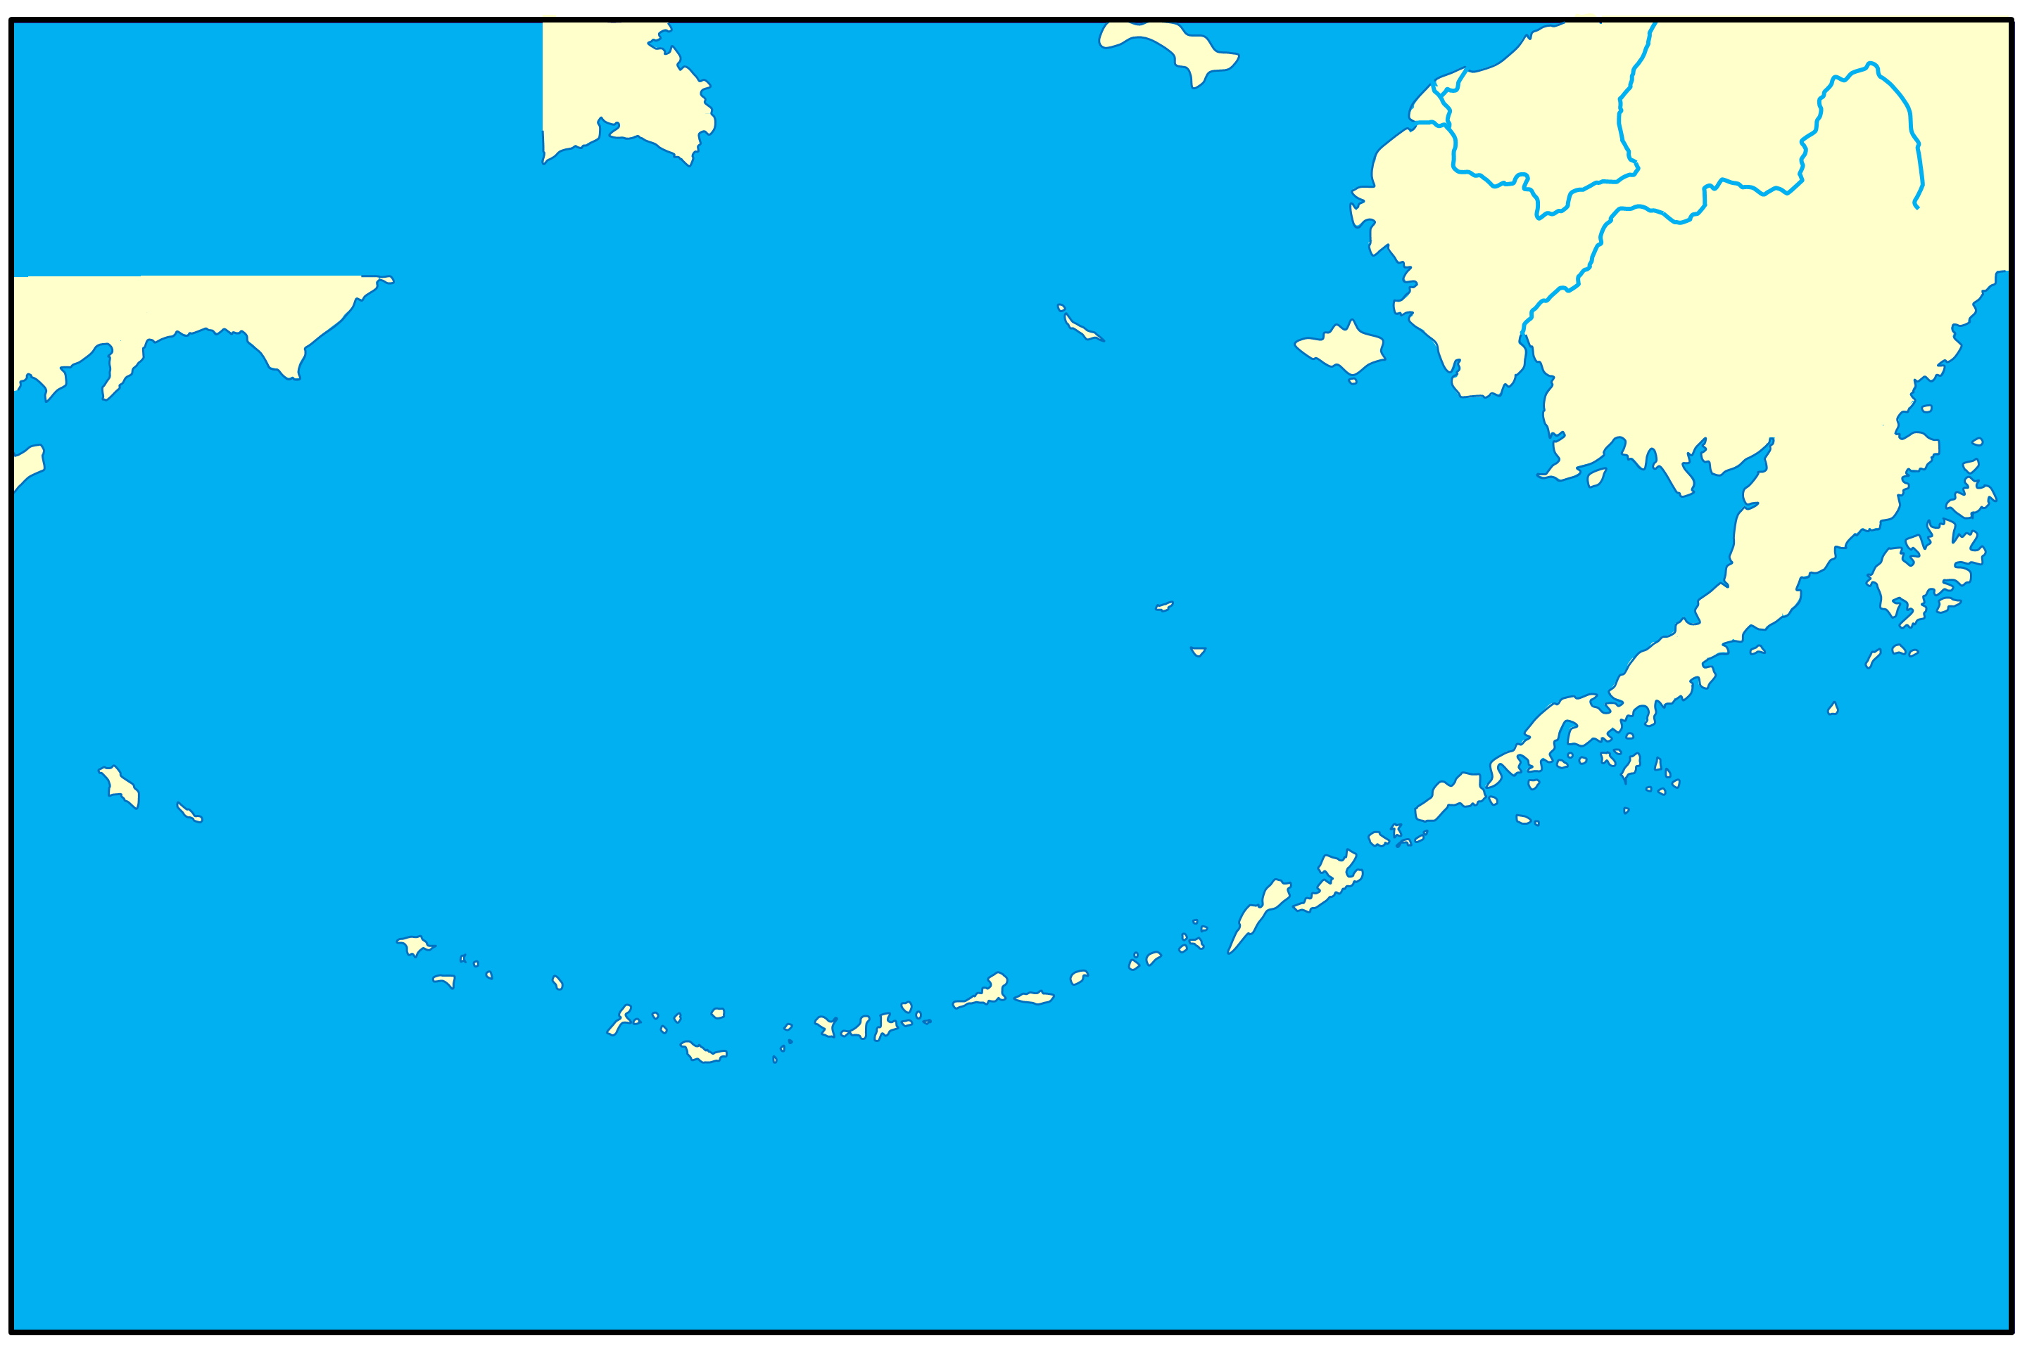
The Aleutians
Orientation
1942-1943
1-8
St. Lawrence
N
0 Mile 100 200 300
Alaska
USSR
Bering Sea
Alaska Peninsula
Pribilof Islands
Kodiak Island
Komandorski Islands (USSR)
Unimak
Cold Bay
1200 Miles
Unalaska
250 Miles
Dutch Harbor
Attu
Umnak
Fox Islands
Shemya
Kiska
Adak
Amchitka
Aleutian Islands

Slide 10
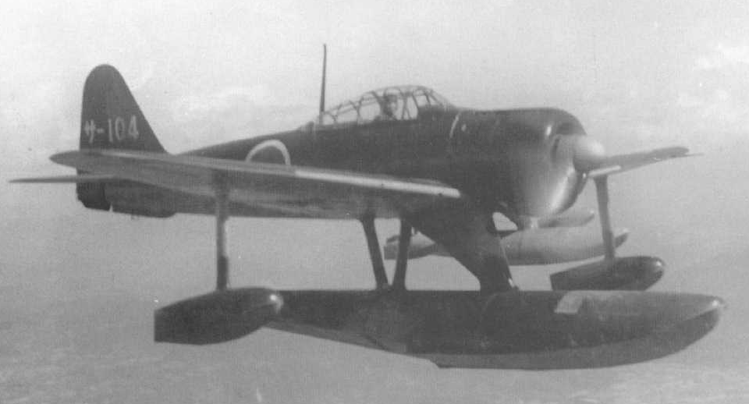
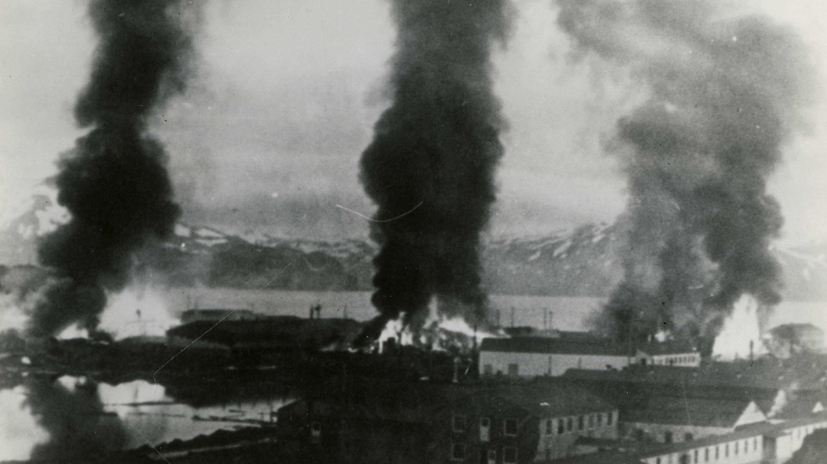
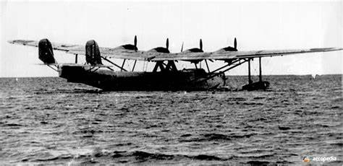
The Aleutians
Japanese Strike
June 1942
1-9
A6M2-N “Rufe” Fighter Floatplane
St. Lawrence
0 Mile 100 200 300
N
Three Buildings on Fire After Japanese Bombardment on Dutch Harbor
Alaska
USSR
Bering Sea
Alaska Peninsula
Pribilof Islands
Kodiak Island
Komandorski Islands (USSR)
H6K “Mavis” Bomber Floatplane
Unimak
Cold Bay
Aleutian Islands
Unalaska
Dutch Harbor
Attu
Umnak
Fox Islands
Shemya
Kiska
Adak
Japamese Raid on Dutch Harbor
3-4 June 1942
Amchitka
Japanese Seize Attu and Kiska
7 June 1942

Slide 11
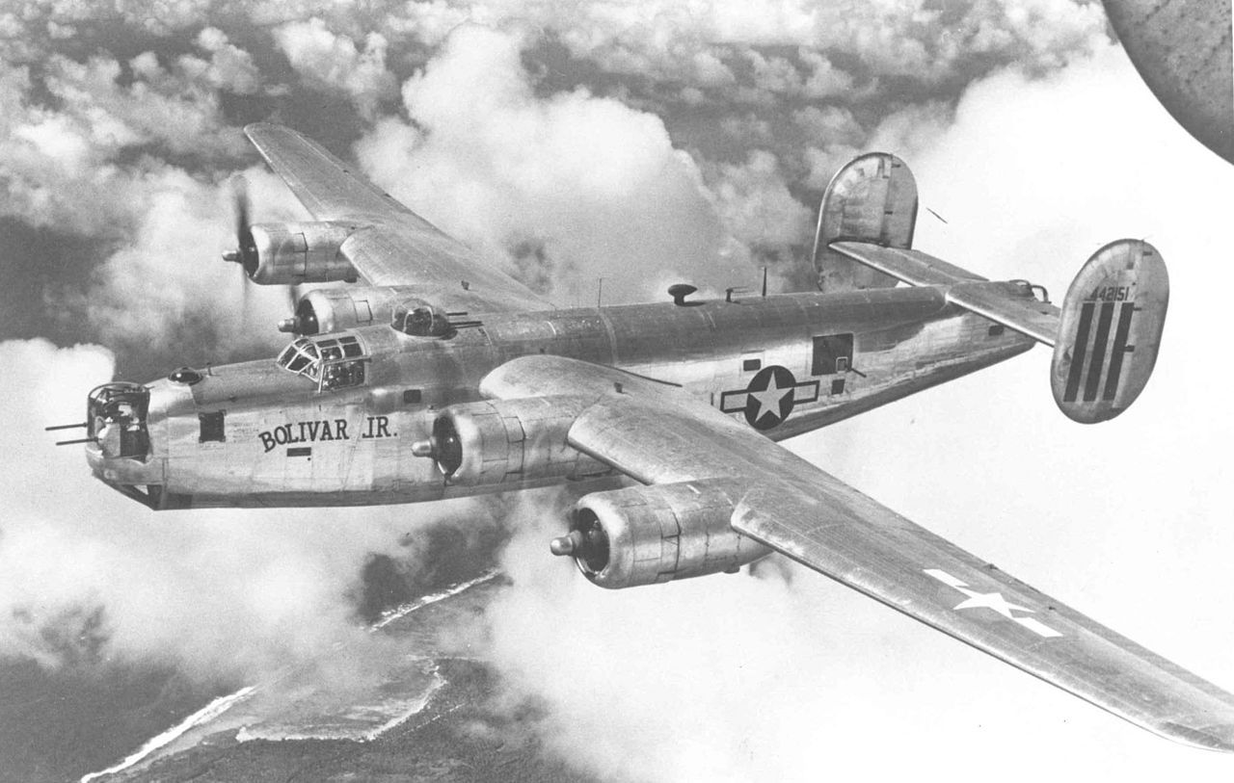
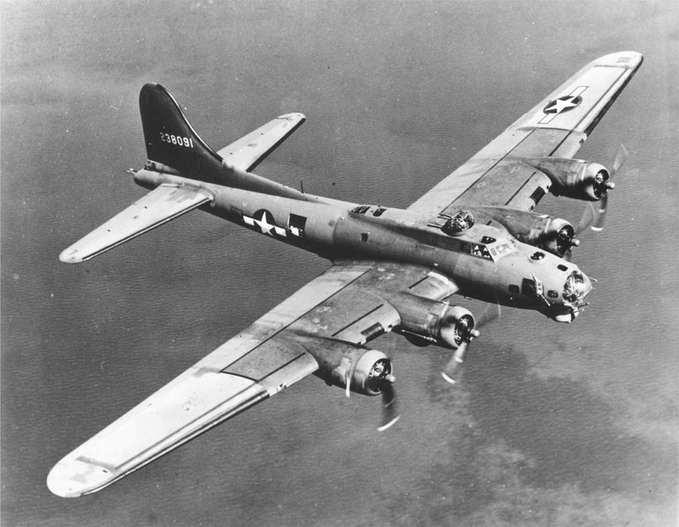
The Aleutians
US Preliminary
Operations 1942--Air
1-10
St. Lawrence
N
0 Mile 100 200 300
Alaska
USSR
B-24 “Liberator” Bomber
Bering Sea
Alaska Peninsula
B-17 “Flying Fortress” Bomber
Pribilof Islands
Kodiak Island
Komandorski Islands (USSR)
Unimak
Cold Bay
Unalaska
Dutch Harbor
Attu
Umnak
Fox Islands
Shemya
Kiska
Adak
Aleutian Islands
Kiska Blitz
11 June 1942
Amchitka

Slide 12
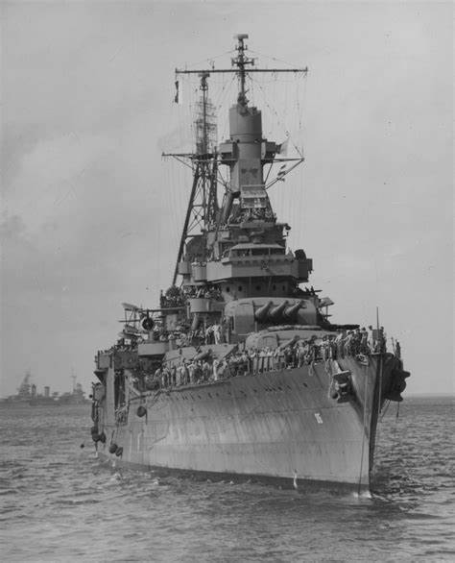
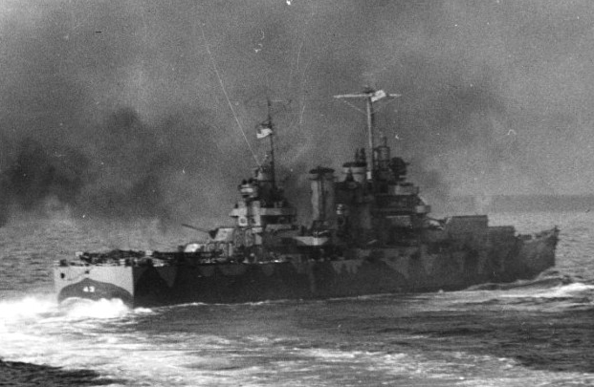
The Aleutians
US Preliminary
Operations 1942--Navy
1-11
St. Lawrence
N
0 Mile 100 200 300
Alaska
USSR
Bering Sea
Alaska Peninsula
USS Nashville Light Cruiser
Pribilof Islands
Kodiak Island
Komandorski Islands (USSR)
Unimak
Cold Bay
Naval Bombardment 7 Aug 1942
“Spring Plowing”
Unalaska
Dutch Harbor
Attu
Umnak
Fox Islands
Shemya
Kiska
USS Indianapolis Heavy Cruiser
Adak
Aleutian Islands
Amchitka

Slide 13
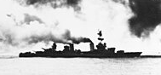
The Aleutians
US Preliminary
Operations 1942-43
Getting Closer
1-12
St. Lawrence
USS Salt Lake City at the Battle of the Komandorski Islands
N
0 Mile 100 200 300
Alaska
USSR
Bering Sea
Alaska Peninsula
Pribilof Islands
Kodiak Island
Komandorski Islands (USSR)
III
Unimak
Landrum
AK Def
Unalaska
Cold Bay
III
Dutch Harbor
Attu
Jones
AK Def
Umnak
Fox Islands
Shemya
Kiska
Battle of the
Komandorski Islands
26 March 1943
Aleutian Islands
Adak
U.S Forces Seize
Amchitka
12 January 1943
Amchitka
U.S Forces Seize Adak
30 August 1942

Slide 14
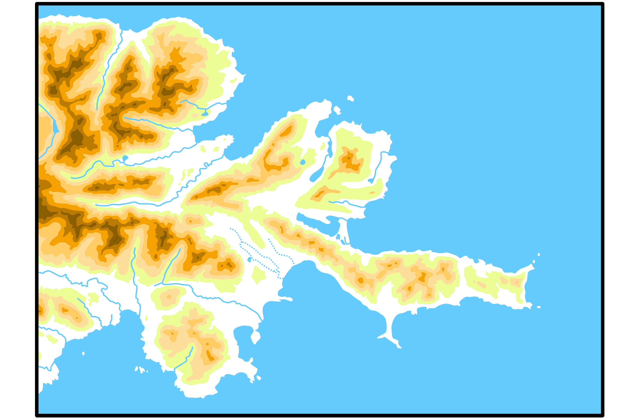

2-1
Attu
Orientation
Overall
Northern Force Area
N
0 Mile 1 2
Japanese Counter-attack Area
Southern Force Area

Slide 15
Austin Cove
Scarlet Beach
2-2
Attu
Northern Force
Area
N
0 Mile 1 2
Ballentine Creek
Red Beach
Vieth Ridge
Cupp’s
Hill
Brannon Ridge
Holtz Bay
Hill
X
Scout Creek
West Arm
Young
Hill
Buchanan Ridge
East Arm
Addison Creek
O’Donnell Creek
Moore Ridge
Prendergat Ridge

Slide 16
Robinson
Ridge
2-3
Attu
Southern Force
Area
Cold
Mtn
N
Jarmin Pass
Clevesy Pass
Engr
Hill
0 Mile ½ 1
Black Mtn
Point
Able
Zwinge Pass
Hogback
Gilbert Ridge
Henderson Ridge
Terrible Mtn
Blue Beach
Arty
Mtn
Yellow Beach
Massacre Bay
Peaceful River
Navy Cove

Slide 17
2-4
Attu
Japanese
Counterattack
Area
N
Holtz Bay
Chichagof Harbor
0 Mile ½ 1
Fishook Ridge
Attu Village
East Arm
Middle Peak
Lake Cories
Prendergat Ridge
Sarana Nose
Cold
Mtn
Clevesy Pass
Sarana Valley
Engr
Hill
Point
Able
Lake Nicholas
Gilbert Ridge

Slide 18
Attu
Japanese Defenses
May 1943
N
Austin Cove
Elmnts 83rd IN BN
Yamasaki’s HQs
2-5
0 Mile 1 Mile 2 Miles
303rd IN BN HQs
Holtz Bay
Anti-aircraft Btry
Hill
X
Chichagof Harbor
West Arm
Anti-aircraft Btry
Buchanan Ridge
Fishook Ridge
East Arm
Attu Village
Mountain Gun Btry
Addison Creek
O’Donnell Creek
Prendergat Ridge
Moore Ridge
Sarana Nose
Mountain Gun Btry
Cold
Mtn
Engr
Hill
2nd CO 303rd IN BN
Jarmin Pass
Black Mtn
Point
Able
Lake Nicholas
1st CO 303rd IN BN (-)
Henderson Ridge
Gilbert Ridge
Sarana Bay
One Plt, 1st CO 303rd IN BN
Terrible
Mtn
4th CO 303rd IN BN
Arty
Mtn
Massacre
Beach
Massacre Bay
Mathew’s
Mtn
Navy Cove
Possible IN Force
Peaceful River
Anti-aircraft Btry
Weston
Mtns
Alexai
Point
Temnac Bay

Slide 19
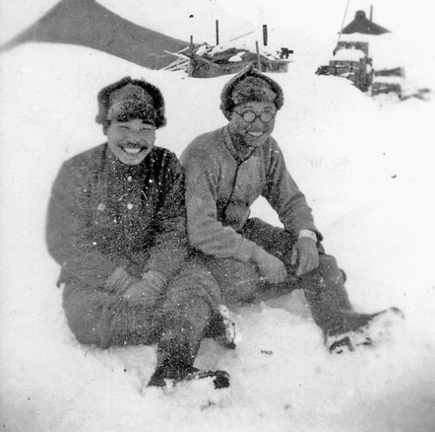
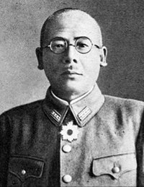
Attu
Japanese Order of Battle
May 1943
IJA 2nd District, North Seas Garrison:
Colonel Yasuyo Yamasaki
83rd Independent Infantry BN: Lieutenant Colonel Isamu Yonegawa
303rd Independent Infantry BN: Major Jokuji Watanabe
Aoto Anti-aircraft BN: Major Seiji Aoto
Northern Kurile Fortress Infantry BN: Lieutenant Colonel Hiroshi Yonekawa
6th Independent Mountain Artillery BN (-): Second Lieutenant Taira Endo
302nd Independent Engineer Company: Captain Chinzo Ono
6th Ship Engineer Regiment, 2nd Company: Captain Kobayashi
2-6
Japanese Soldiers on Attu Prior to Invasion
Colonel Yasuyo Yamasaki

Slide 20
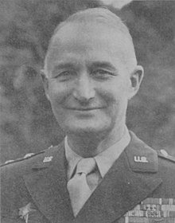
Attu
7th Division Preparation
Order of Battle
May 1943:
2-7
Landing Force Attu (7th Infantry Division):
Major General Albert Brown
Provisional Scout BN: Captain William H. Willoughby
7th Scout Company
7th Cavalry Reconnaissance Troop
Northern Force: Colonel Frank L. Culin
1st BN, 17th Regimental Combat Team (RCT): LTC Albert V. Hartl
Southern Force: Colonel Edward Palmer Earle
2nd BN, 17th Regimental Combat Team (RCT): MAJ Edward P. Smith
3rd BN, 17th Regimental Combat Team (RCT): MAJ James R. Montague
2nd BN, 32nd RCT: MAJ Charles G. Fredericks
Reinforcing forces
1st BN, 32nd Regimental Combat Team (RCT): LTC Earnest H. Bearss
3rd BN, 32nd Regimental Combat Team (RCT): LTC John M. Finn
1st BN, 4th RCT (at Adak): MAJ John D. O'Reilly
78th Coast Artillery (Anti-aircraft) Regiment
50th Combat Engineer BN
MG Albert E. Brown

Slide 21
2-8
Attu
Invasion Options
N
a
Austin Cove
0 Mile 1 Mile 2 Miles
b
Holtz Bay
Hill
X
Chichagof Harbor
West Arm
Buchanan Ridge
c
East Arm
d
Fishook Ridge
Attu Village
Addison Creek
c
Moore Ridge
O’Donnell Creek
Prendergat Ridge
Sarana Nose
Robinson
Ridge
Cold
Mtn
Engr
Hill
e
Black
Mtn
Point
Able
Lake Nicholas
Henderson Ridge
Gilbert Ridge
Sarana Bay
f
Arty
Mtn
Mathew’s
Mtn
g
Navy Cove
Peaceful River
f
g
Massacre
Bay
f
Weston
Mtns
Alexai
Point
Temnac Bay

Slide 22
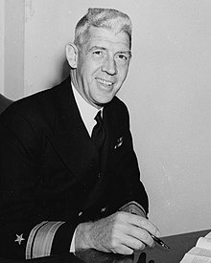
II
2-9
Attu
Final Invasion Plan
N
Austin Cove
Prov
III
Northern
Force
0 Mile 1 Mile 2 Miles
Holtz Bay
Hill
X
Chichagof Harbor
West Arm
Buchanan Ridge
East Arm
Fishook Ridge
Attu Village
Addison Creek
Moore Ridge
O’Donnell Creek
Prendergat Ridge
Sarana Nose
Robinson
Ridge
Cold
Mtn
Engr
Hill
Black
Mtn
Point
Able
Lake Nicholas
Sarana Bay
Vice Admiral
Francis W. Rockwell
Henderson Ridge
Gilbert Ridge
Arty
Mtn
III
Mathew’s
Mtn
Peaceful River
Navy Cove
Sothern
Force
Weston
Mtns
Massacre
Bay
Alexai
Point
Temnac Bay
7 Rec

