Slide 1


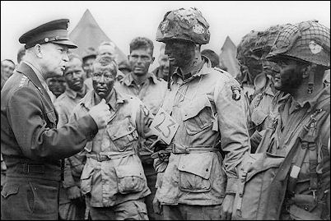
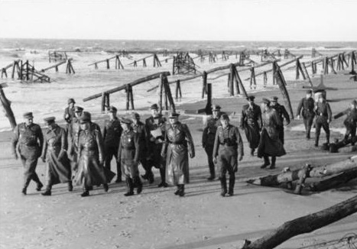
The Normandy Landings:
Operations Neptune and Overlord
Introduction
Eisenhower Talks to 101st Airborne Paratroopers
Rommel and his Staff Inspect the Atlantic Wall Defenses

Slide 2
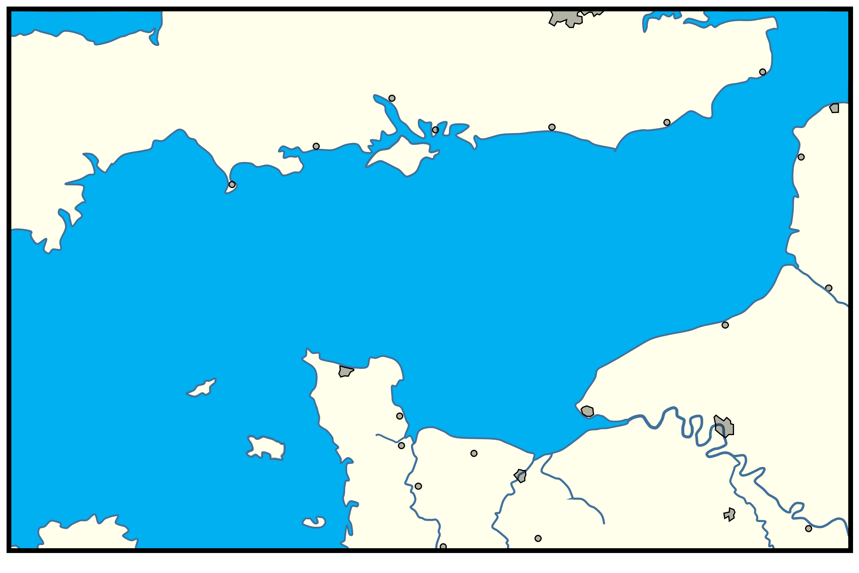
Northwest France
Invasion Areas
1944
1-1
London
Dover
0 10 20 30 40
Miles
N
Southampton
Strait of
Dover
Portsmouth
Hastings
Calais
Poole
Shoreham
Isle of
Wight
Portland
Boulogne
Plymouth
Pas de Calais Area
Dartmouth
Abbeville
Somme River
Alderney
Dieppe
English
Channel
Cherbourg
Normandy Area
Guernsey
Varreville
Le Havre
Douve
River
Rouen
Carentan
Bayeux
Jersey
St. Lo
Caen
Seine
River
Vire River
Dives River
Orne River
Eureux
Falaise
Eure River
Vire
Mantes
Vire

Slide 3
COSSAC
Original Invasion Plan
1-2
London
Dover
0 10 20 30 40
Miles
N
Southampton
Strait of
Dover
Portsmouth
Hastings
Calais
Poole
Shoreham
Isle of
Wight
Boulogne
Plymouth
Portland
Dartmouth
Abbeville
Somme River
Alderney
Dieppe
English
Channel
Cherbourg
Guernsey
Varreville
Le Havre
XX
XX
XX
Rouen
Douve
River
Carentan
US
Br
Br
XX(-)
Jersey
Bayeux
Caen
Seine
River
St. Lo
Br
Dives River
Vire River
Orne River
Eureux
Falaise
Eure River
Vire
Mantes
Vire

Slide 4
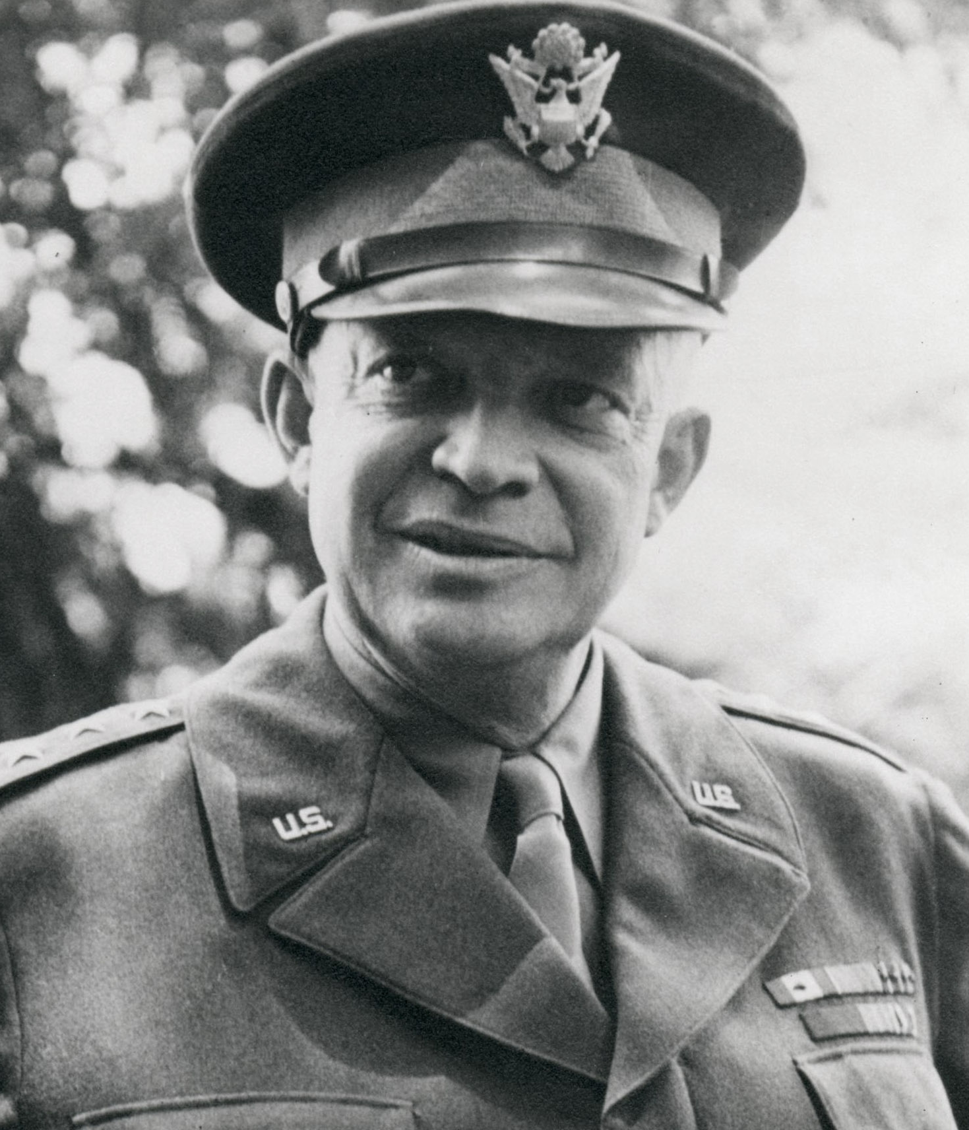
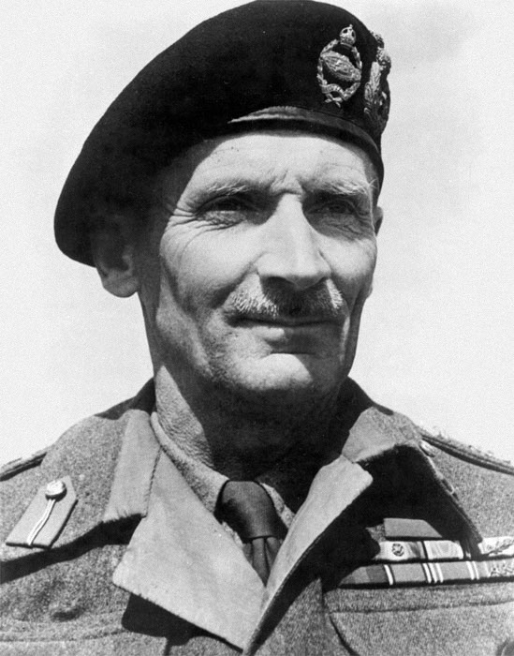
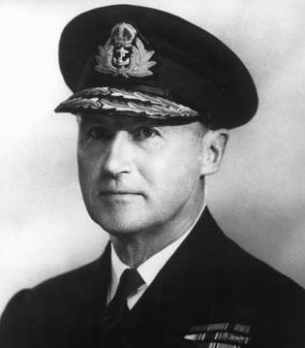
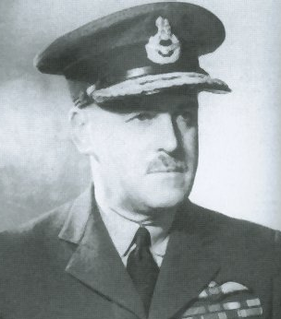
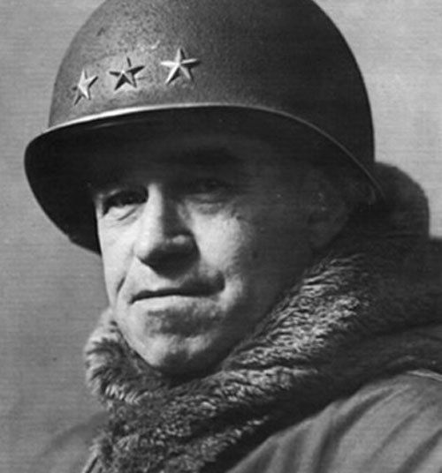
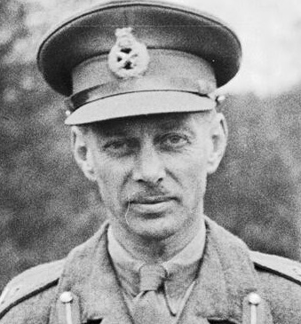
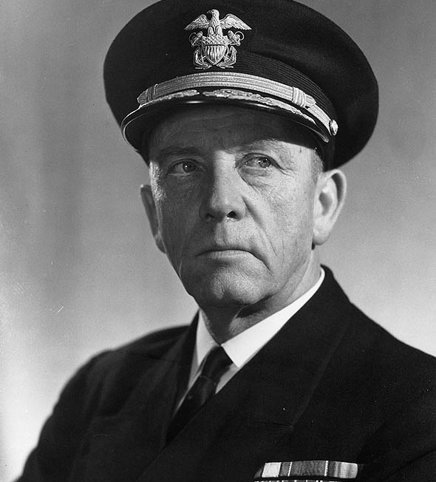
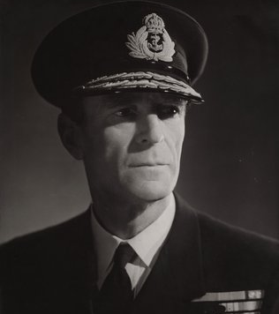
Supreme Commander
Allied Expeditionary Force
Senior Commanders
Allied Expeditionary Force
D-Day, 6 June 1944
2-1
General Dwight
D. Eisenhower
Commander
21st Army Group
Commander-in-Chief
Allied Naval Expeditionary Force
Commander Allied
Expeditionary Air Force
General Sir Bernard
L. Montgomery
Admiral Sir
Bertram Ramsey
Air Chief Marshal
Sir Trafford
Leigh-Mallory
Commander
US 1st Army
Commander
British 2nd Army
Commander
Western Naval TF
Commander
Eastern Naval TF
Elements of:
US Strategic Air Forces Cmd, Europe
RAF Bomber Command
2nd Tactical Air Force
RAF Transport Command
US Army 8th Air Force
US Army 9th Air Force
Lieutenant General
Omar N. Bradley
Lieutenant General
Miles Dempsey
Rear Admiral
Alan G. Kirk
Rear Admiral
Sir Philip L. Vian

Slide 5
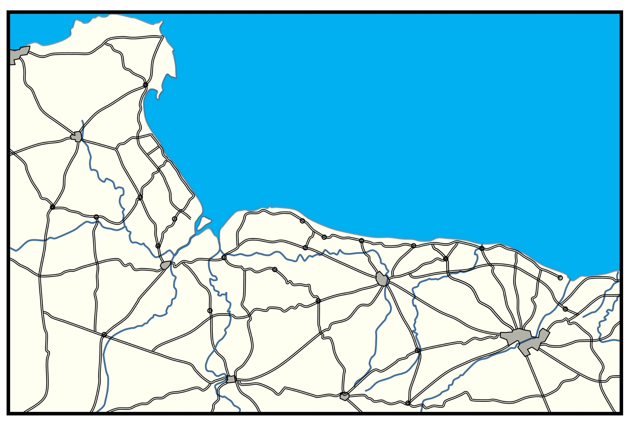

Neptune Plan
Allied Landing Beaches and
Airborne Landings
6 June 1944
Cherbourg
2-2
N
0 5 10
Miles
Valognes
XX
4
VII
II
XX-
XX-
Merderet River
UTAH
RGR
2
V
1
V
29
V
XX
St. Mére Egilse
Pointe du Hoc
OMAHA
50(Br)
XXX
XX
XX
3(Can)
I
St. Sauveir
Pont L’ Abbe
XX
101
VII
GOLD
XX
82
VII
JUNO
3(Br)
I
St. Marie du Mont
Vierville
SWORD
St. Côme du Mont
Douve
River
Formigny
Colleville
Port-en-Bessin
Arromanche
Crepon
Courseulles
Carentan
Bayeux
Ouistreham
Vire River
Colombiéres
XX
6(Br)
I
Littry
Ranville
St Jean de Daye
Orne River
Douve River
Seulles River
Periers
L’Aure Inferieure
Caen
St. Lo
Villers

Slide 6
Allied Objectives:
Overlord
June 1944
2-3
N
0 10 20 30
Miles
English
Channel
Dieppe
Cherbourg
D-Day Objective Line
Seize Port at Cherbourg
Le Havre
Varreville
Seine
River
Rouen
D-Day Objective Line
Douve
River
Bayeux
Carentan
Caen
Cut Cotentin Peninsula
St. Lo
Eure River
Orne River
Dives River
Vire River
Advance Into Heart of France
Seize Falaise Expand Lodgment
Eureux
Vire
Falaise

Slide 7
Neptune Plan
Naval Operations
June 1944
3-1
London
XXX
XXX
Dover
XXX(Br)
2nd
I(Br)
2nd
0 10 20 30 40
Miles
N
XXX
Southampton
V
1st
XX
XX
Strait of
Dover
XX
3(Can)
XXX
3(Br)
I
Hastings
Calais
Poole
50(Br)
XXX
XXX
Portsmouth
Shoreham
VII
1st
XX
Isle of
Wight
1
V
Boulogne
Plymouth
Portland
Eastern Naval
Task Force
XX
Western Naval
Task Force
4
VII
Dartmouth
German Anti-Ship Minefield
Abbeville
Somme River
Alderney
Dieppe
English
Channel
Cherbourg
Guernsey
UTAH
Le Havre
Varreville
OMAHA
GOLD
JUNO
SWORD
Rouen
Douve
River
Jersey
Carentan
Bayeux
St. Lo
Caen
Dives River
Seine
River
Vire River
Orne River
Eureux
Falaise
Eure River
Vire
Mantes
Vire

Slide 8
XXX
XXX
XXX
V
1st
Southampton
XXX(Br)
2nd
I(Br)
2nd
Portsmouth
Hastings
XXX
Shoreham
VII
1st
Poole
Isle of
Wight
Portland
Dartmouth
US Gliders
Bombardment by US Army 9th Air Force
XX
Alderney
6(Br)
I
Dieppe
English
Channel
Cherbourg
Bombardment by US Army 8th Air Force
XX
82
VII
Guernsey
XX
Varreville
Le Havre
Seine
River
101
VII
UTAH
OMAHA
Rouen
GOLD
JUNO
Douve
River
SWORD
Carentan
Bayeux
Neptune Plan
Air Operations
June 1944
3-2
Jersey
St. Lo
Caen
Eure River
Vire River
Orne River
Dives River
0 10 20 30 40
Miles
N
Eureux

Slide 9
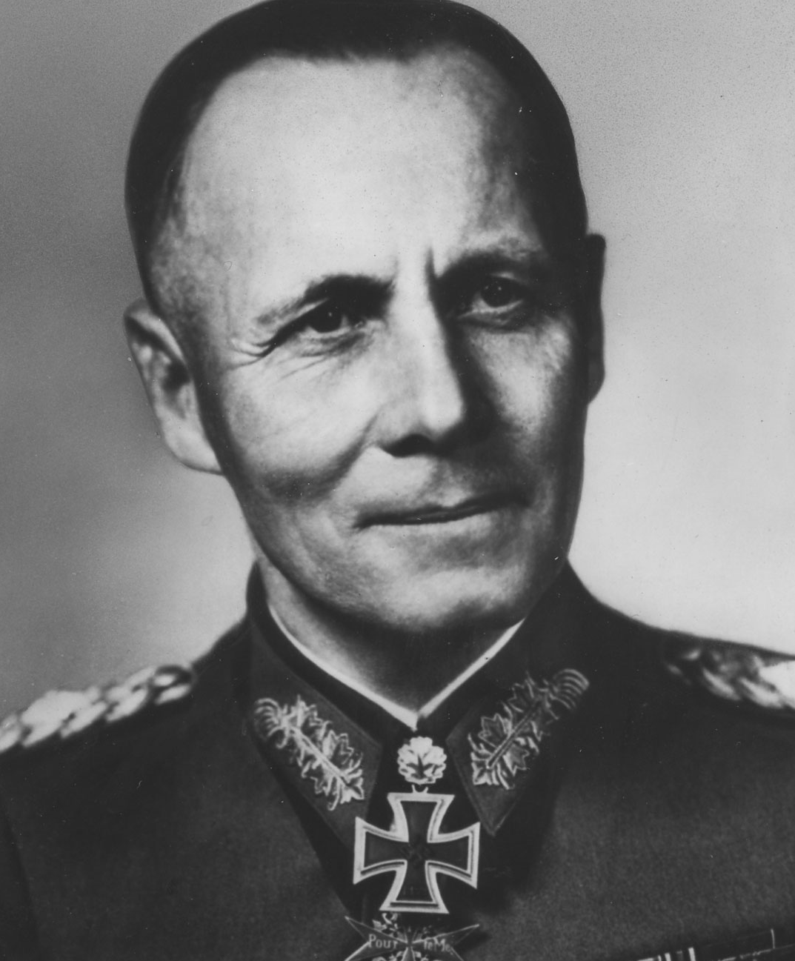
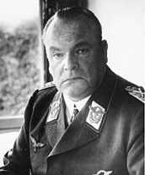
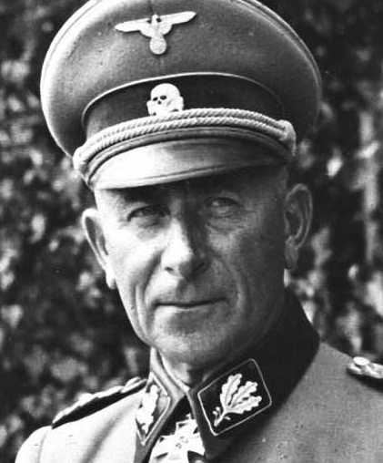
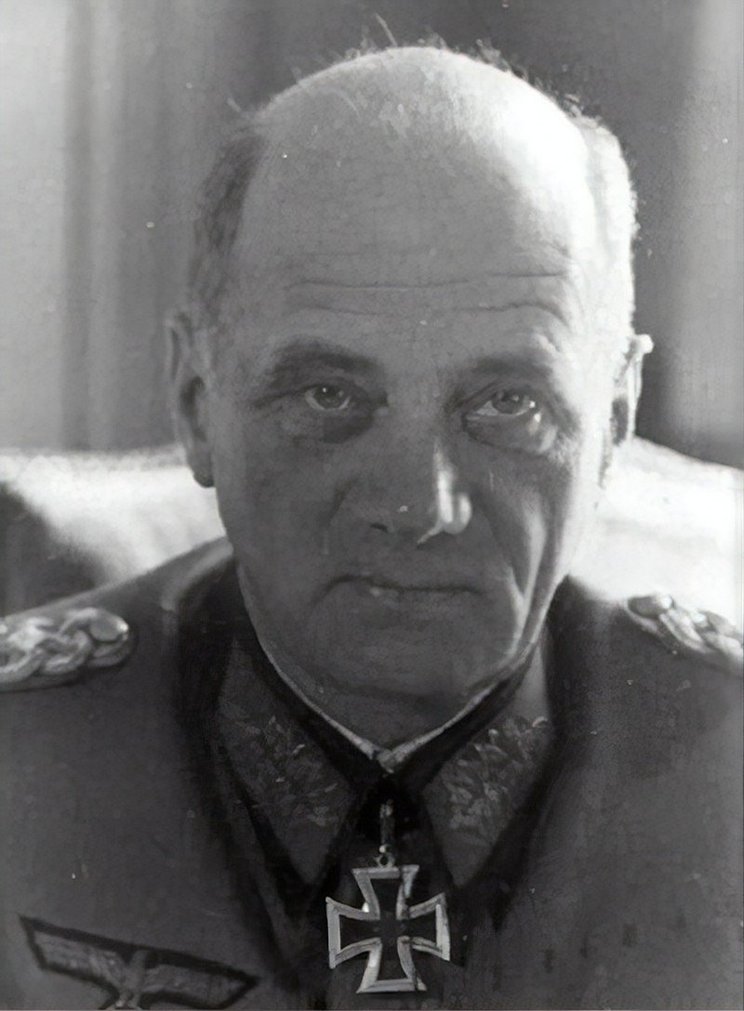
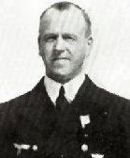
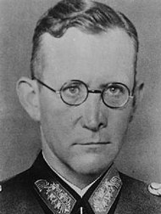
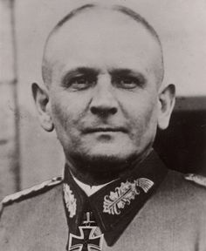
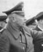
Commander
Army Group B
Senior German
Commanders
D-Day, 6 June 1944
4-1
Field Marshal
Erwin Rommel
Commander
3rd Luftflotte
Commander
7th Army (Normandy and Brittany)
Commander
15th Army (Pas de Calais)
Field Marshal
Hugo Sperrle
Colonel General
Friedrich Dollmann
Colonel General
Hans von Salmuth
Commander
English Channel District
Commander
LXXXIV Corps (Normandy)
Commander
LXXIV Corps (North Brittany)
Commander
XXV Corps (South Brittany)
Admiral Friedrich Rieve
General of the Artillery
Erich Marcks
General of the Infantry
Erich Straube
General of the Artillery
Wilhelm Fahrmbacher

Slide 10
Northwest France
German Defenses
June 1944
Calais
4-2
Portsmouth
Shoreham
XX
Hastings
Strait of
Dover
0 10 20 30 40
Miles
Isle of
Wight
N
Boulogne
-- German Fortress Cities
XX
XX
Portland
-- German Static Division
XX
English
Channel
XX
XX
Abbeville
Somme
River
Dieppe
XX
Alderney
XX
Cherbourg
XXX
XX
LXXXI
15
709
LXXXIV
XX
Guernsey
XX
Seine
River
243
LXXXIV
Varreville
UTAH
OMAHA
Le Havre
Rouen
XX
GOLD
JUNO
XX
91
LXXXIV
XX
SWORD
116
LXXXI
Douve
River
352
LXXXIV
XX
XX
Carentan
716
LXXXIV
711
LXXXI
XXX
Jersey
Bayeux
XLVII
AGB
XXX
Caen
St. Lo
LXXXIV
7
XX
Dives River
XX
Vire River
Orne
River
21
XLVII
15
12 SS
XLVII
XXXX
Eure River
7
Eureux
Vire
Falaise
Mantes

Slide 11
German Dispositions:
Marcks’ LXXXIV Corps
June 1944
Cherbourg
4-3
N
0 5 10
XX
St. Vaast-la-Hougue
Miles
709
XX
709
LXXXIV
243
Valognes
709
XX
91
XX
91
LXXXIV
UTAH
243
St. Mére Egilse
XX
St. Sauveir
OMAHA
91
Merderet
River
GOLD
JUNO
Pont L’ Abbe
St. Marie du Mont
709
Vierville
SWORD
XX
II
St. Côme du Mont
II
XX
Arromanche
100
91
352
Formigny
Colleville
243
LXXXIV
Port-en-Bessin
Crepon
Courseulles
Carentan
Colombiéres
Bayeux
Ouistreham
III
Vire River
XX
XX
III
Littry
352
LXXXIV
716
LXXXIV
Ranville
243
6
91
St Jean de Daye
Orne River
XX
Douve River
Seulles River
Caen
Periers
L’Aure Inferieure
352
XX
716
XX
XX
15
XXXX
21
XLVII
7
St. Lo
Caumont
Villers

