Slide 1
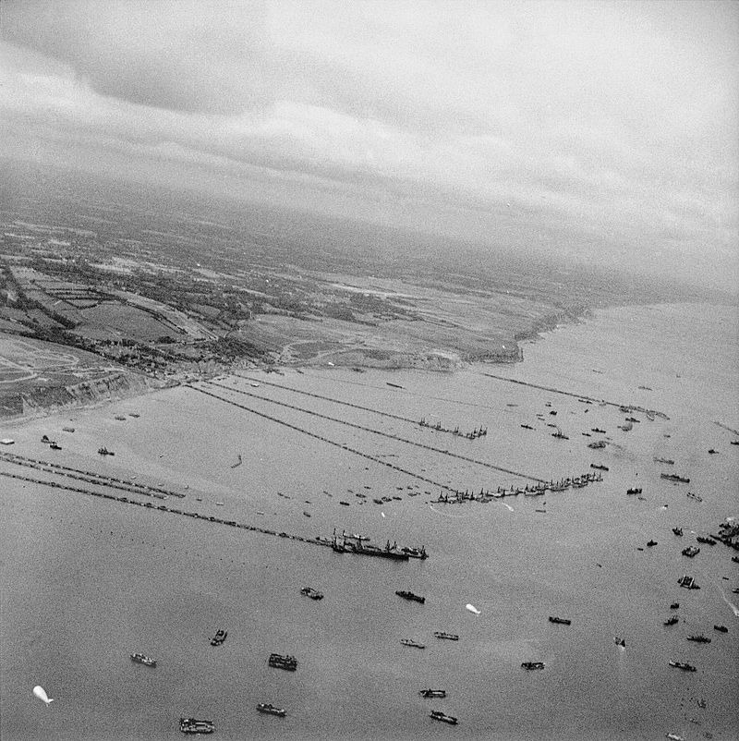


Sustaining Normandy
The Mulberry Harbour
GOLD Beach

Slide 2
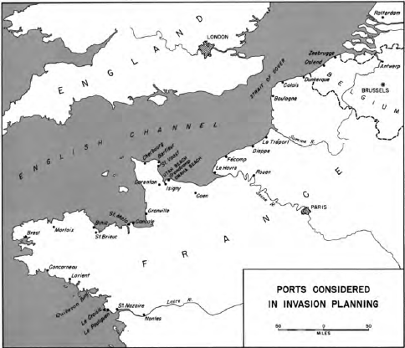

Allied planning
Ports would be limited until D+90
18 divisions over-the-beach first month
12 divisions over-the-beach second month
Major port group still must be captured early
Bombing strengths and weaknesses
SOS would transition to COMZ (ESC)
Rotterdam
London
Thames R
Zeebrugge
Ostend
Antwerp
Calais
Dunkerque
Brussels
Boulogne
Le Treport
Somme R
Cherbourg
Barfleur
Dieppe
St. Vaast
Fecamp
Grandcamp
Le Havre
Carentan
Rouen
Isigny
Caen
Seine R
St. Malo
Paris
Granville
Binic
Brest
Morlaix
St Brieuc
German planning
Demands of the Eastern Front
Internal Lines of Communication
Do not have the capacity for fortify the entire Coast
Concarneau
Lorient
Battle of the Buildup
1a
Mulberry Harbor planning
D+8 Gooseberries in place
D+15 Cherbourg captured
D+15 Mulberries complete
D+120 Mulberries close
Le Pouliguen
Loire R
Logistics Planning
St Nazaire
Le Croisic
Nantes
N
0
25
50
75
Miles

Slide 3
Gooseberries
Bombardons are 200’ long by 25’ wide
Phoenix Caissons range from 25-60’ high and 175-200’ long
Blockships (Corncobs) were outdated naval vessels
1b
Mulberry A
Omaha Beach
N
0
250
500
750
Yards
Airfield A2C 10 June
Sunken Blockship
Phoenix Caisson
Floating Quay
Pontoon Railway
LST Quay
Coastal Protection vessel mooring
Liberty Ship Mooring
Floating Docks
Floating Cranes
Munitions Quay
Floating, fabric Roadway
Small craft mooring
Rhino Ferries
Reinforced Pontoon Roadway
Bombardons

Slide 4
Took 65-80 minutes to unload a LST at a quay
LST beaching took ~12 hours
Phoenix Caissons range from 25-60’ high and 175-200’ long
Blockships (Corncobs) were outdated naval vessels
1c
Mulberry B
Arromanches
Gold Beach
N
Northern Entrance
0
250
500
750
Yards
Western Entrance
Eastern Entrance
Tracy
St-Come-de-Fresne
Mulberry Harbor execution
D+5 Gooseberries in place
D+10 Omaha Mulberry operational
D+12 Arromanches Mulberry operational
Arromanches
Item Green
Item Red
Sunken Blockship
Phoenix Caisson
Floating Quay
Pontoon Railway
LST Quay
Coastal Protection vessel mooring
Liberty Ship Mooring
Floating Docks
Floating Cranes
Munitions Quay
Floating, fabric Roadway
Small craft mooring
Rhino Ferries
Reinforced Pontoon Roadway
Bombardons

Slide 5
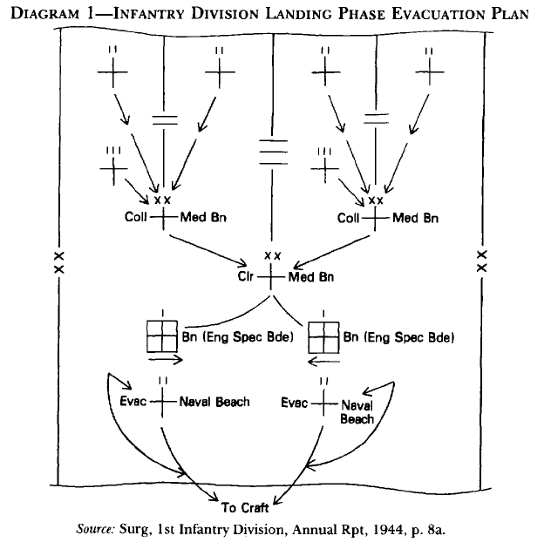
Point of Injury
Pre-invasion medical care (malaria/STDs), medical training, medical supplies
Development of expeditionary hospitals
Early stage casualties – most casualties/fewest medical personnel
Planned for 15,000 casualties from D to D+2
97% would require evacuation to UK
Planned 75 litter/75 ambulatory per LST
Evacuation hospitals D+%, evacuation hospitals o/a D+15
Through D+18 transport to UK
As hospitals begin operations, change to 7/15/30 days of treatment
No dedicated air evacuation
1d
ALLIED ARMY D-DAY
Invasion beach
Medical Planning

Slide 6
CHARLIE
DOG GREEN
DOG WHITE
DOG RED
EASY GREEN
EASY RED
FOX GREEN
N
116
III
16
2
500 60
(-)
SPT
2
391 61
(+)
60
6 ESB
ooo
1
6 ESB
ooo
2
634 60
ooo
VIERVILLE
SPT
2
393 61
61
5 ESB
Coast Highway
ooo
ST LAURENT
ooo
Coast Highway
LE GRAND HAMEAU
`
2
1
DIV
COLLEVILLE
SPT
LOUVIERES
Omaha Beach
Invasion medical
support locations
7 June 1944
2a
0 0.5 1 miles

Slide 7
2b
Mulberry B
Arromanches
Gold Beach
N
Northern Entrance
0
250
500
750
Yards
Western Entrance
Eastern Entrance
Tracy
Arromanches
St-Come-de-Fresne
Item Green
Item Red
Sunken Blockship
Phoenix Caisson
Floating Quay
Pontoon Railway
LST Quay
Coastal Protection vessel mooring
Liberty Ship Mooring
Floating Docks
Floating Cranes
Munitions Quay
Floating, fabric Roadway
Small craft mooring
Rhino Ferries
Reinforced Pontoon Roadway
Bombardons

Slide 8
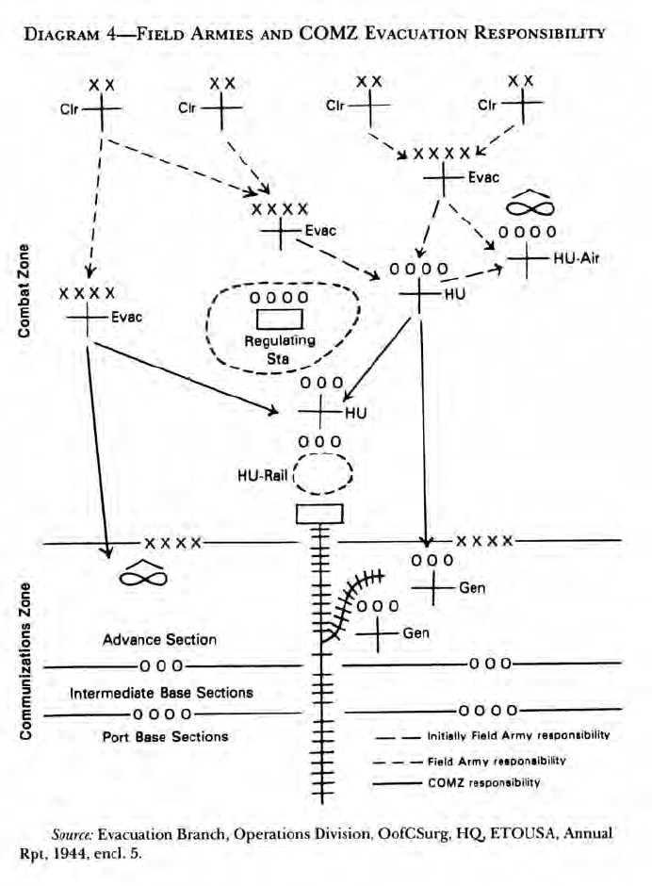
3a
ALLIED ARMY D-DAY
CHERBOURG
N
Expanded Medical
Operations Example
North Sea
0 5 10
Scale in Miles
Valognes
Point of Injury
Utah
Omaha
Gold
Juno
Sword
St. Mére Egilse
St. Sauveir
Pont L’ Abbe
St. Marie du Mont
Vierville
Port-en-Bessin
St. Côme du Mont
Arromanches
Courseulles
Formigny
Colleville
Isigny
Anselles
Crepon
Colombiéres
Ouistreham
Carentan
Bayeux
St Jean de Daye
Littry
VII US
Ranville
XXX
V US
Cerisy
Forest
First US
XXXX
Periers
Second UK
Juvigny
St. Lo
CAEN
Caumont
Villers

Slide 9
4a
ALLIED ARMY D-DAY
12 Sep
Antwerp
Red Ball Express
and
other routes
Mechelen
N
Ghent
Brussels
St Truiden
Miles
Tienen
0
25
50
Tourcoing
Lille
Liege
Mons
Charleroi
Arras
Hirson
Cherbourg
St Saens
16 Jul
Yvetot
Valognes
Le Havre
Rouen
Beauvais
Compiegne
Laon
Carentan
Soissons
Bayeux
Caen
Reims
24 Jul
Periers
St Lo
Lisieux
Gisors
Coutances
Pontoise
Chateau-Thierry
Vire
Evreux
Mantes-la-Jolie
St. Denis
La Ferte
Granville
Paris
Coulommiers
Sommesous
Avranches
Argentan
L’Aigle
Dreux
Versailles
Ghennevieres
Dromfront
Rozay-en-brie
Esternay
Dol
Alencon
Ablis
Red Ball Express (29 Aug – 10 Sep)
Red Ball Express (10-20 Sep)
Red Ball Express (20 Sep addition)
Red Lion (16 Sep – 12 Oct)
White Ball Route (6 Oct – 10 Jan)
Green Diamond (10 Oct – 1 Nov)
Chartres
Fontainebleau
Nogent
26 Aug
13 Aug

Slide 10
4b
ALLIED ARMY D-DAY
COMZ Boundaries
November 1944
London
N
28 Nov
CBS
Antwerp
0
25
50
75
Miles
Aachen
Lille
CBS
XXXX
Liege
Namur
Frankfurt
ADSEC
NBS
Mainz
16 Jul
Channel
Base
Section
DS
Luxembourg
13 Oct
Dise
Section
Cherbourg
Le Havre
Rouen
Normandy
Base
Section
16 Oct
COMZ
Reims
XXXX
Karisruhe
Verdun
Metz
St. Malo
Paris
SS
Nancy
Brest
Brittany
Base
Section
Chartres
Seine
Section
XXXX
XXXX
SOLOC
Nantes
Month | Omaha Beach | % | Utah Beach | % | Mulberry B | % | Cherbourg | % | Normandy minor ports | % | Brittany Ports | % | Le Havre | % | Rouen | % | Antwerp | % | Southern France | %
Jun | 182,199 | 62.53 | 109,134 | 30.36 | 68,134 | 18.95 | 0 | 0.00 | 0 | 0.00 | 0 | 0.00 | 0 | 0.00 | 0 | 0.00 | 0 | 0.00 | 0 | 0.00
Jul | 356,219 | 57.33 | 193,154 | 24.28 | 205,857 | 26.16 | 31,658 | 3.83 | 40,291 | 4.87 | 0 | 0.00 | 0 | 0.00 | 0 | 0.00 | 0 | 0.00 | 0 | 0.00
Aug | 348,820 | 31.35 | 187,955 | 17.72 | 214,712 | 17.86 | 266,644 | 20.23 | 125,353 | 9.44 | 9,499 | 0.72 | 0 | 0.00 | 0 | 0.00 | 0 | 0.00 | 174,500 | 13.15
Sep | 243,564 | 20.12 | 150,158 | 15.09 | 99,106 | 8.20 | 314,431 | 25.48 | 100,126 | 7.65 | 75,198 | 5.74 | 0 | 0.00 | 0 | 0.00 | 0 | 0.00 | 326,813 | 24.96
Oct | 120,786 | 9.23 | 72,728 | 7.39 | 39,910 | 3.09 | 365,603 | 28.76 | 58,816 | 4.57 | 77,735 | 5.88 | 61,731 | 4.58 | 26,891 | 1.99 | 0 | 0.00 | 524,894 | 38.91
Nov | 13,411 | 0.96 | 12,885 | 1.33 | 0 | 0.00 | 433,301 | 32.38 | 48,707 | 3.89 | 64,078 | 5.03 | 148,654 | 10.65 | 127,569 | 9.10 | 5,873 | 0.42 | 547,602 | 39.06
Dijon
Continental
Advance
Section
Gas
British area where NBS supports US Troops
British area where CBS supports US Troops
Inter-Allied administrative boundary
Advance Section

Slide 11
4c
ALLIED ARMY D-DAY
Antwerp
General Hospitals
And Depots
November 1944
N
Gen. Hospital (3)
Ambulance Co.
Brussels
0
25
50
Miles
Liege
Mons
Gen. Hospital (2)
Ambulance Co.
Gen. Hospital (3)
Gen. Hospital (2)
Cherbourg
Gen. Hospital (3)
Ambulance Co.
Gen. Hospital
Ambulance Co. (2)
Valognes
Le Havre
Soissons
La Have-du-Puits
Carentan
Lison
L’Etard
Gen. Hospital (6)
Ambulance Co.
Reims
Caen
Coutances
St Lo
Chateau-Thierry
Gen. Hospital (3)
Granville
Vire
Mantes-la-Jolie
L’Aigle
Paris
Sommesous
Bar-le-Duc
Avranches
Versailles
Gen. Hospital
Ambulance Co.
Gen. Hospital
Ambulance Co.
Fontainebleau
Rennes
Le Mans

